Slide 1
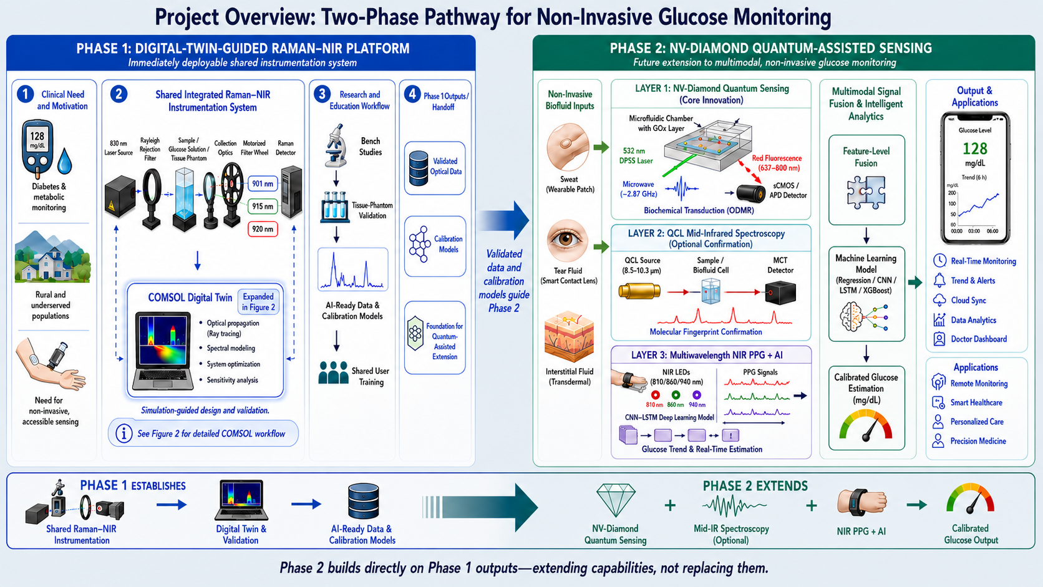
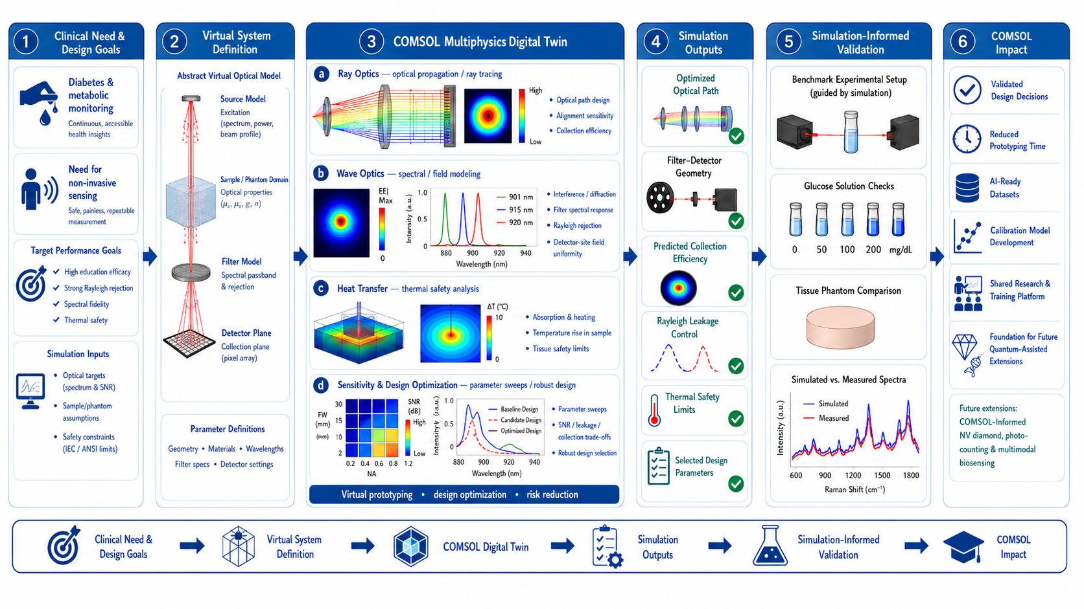
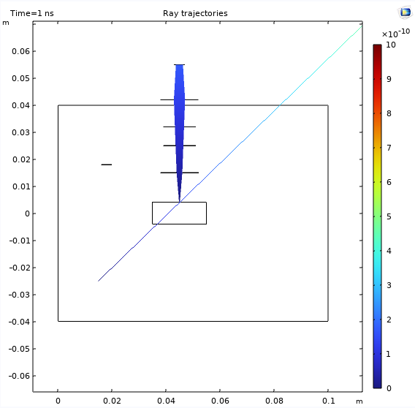
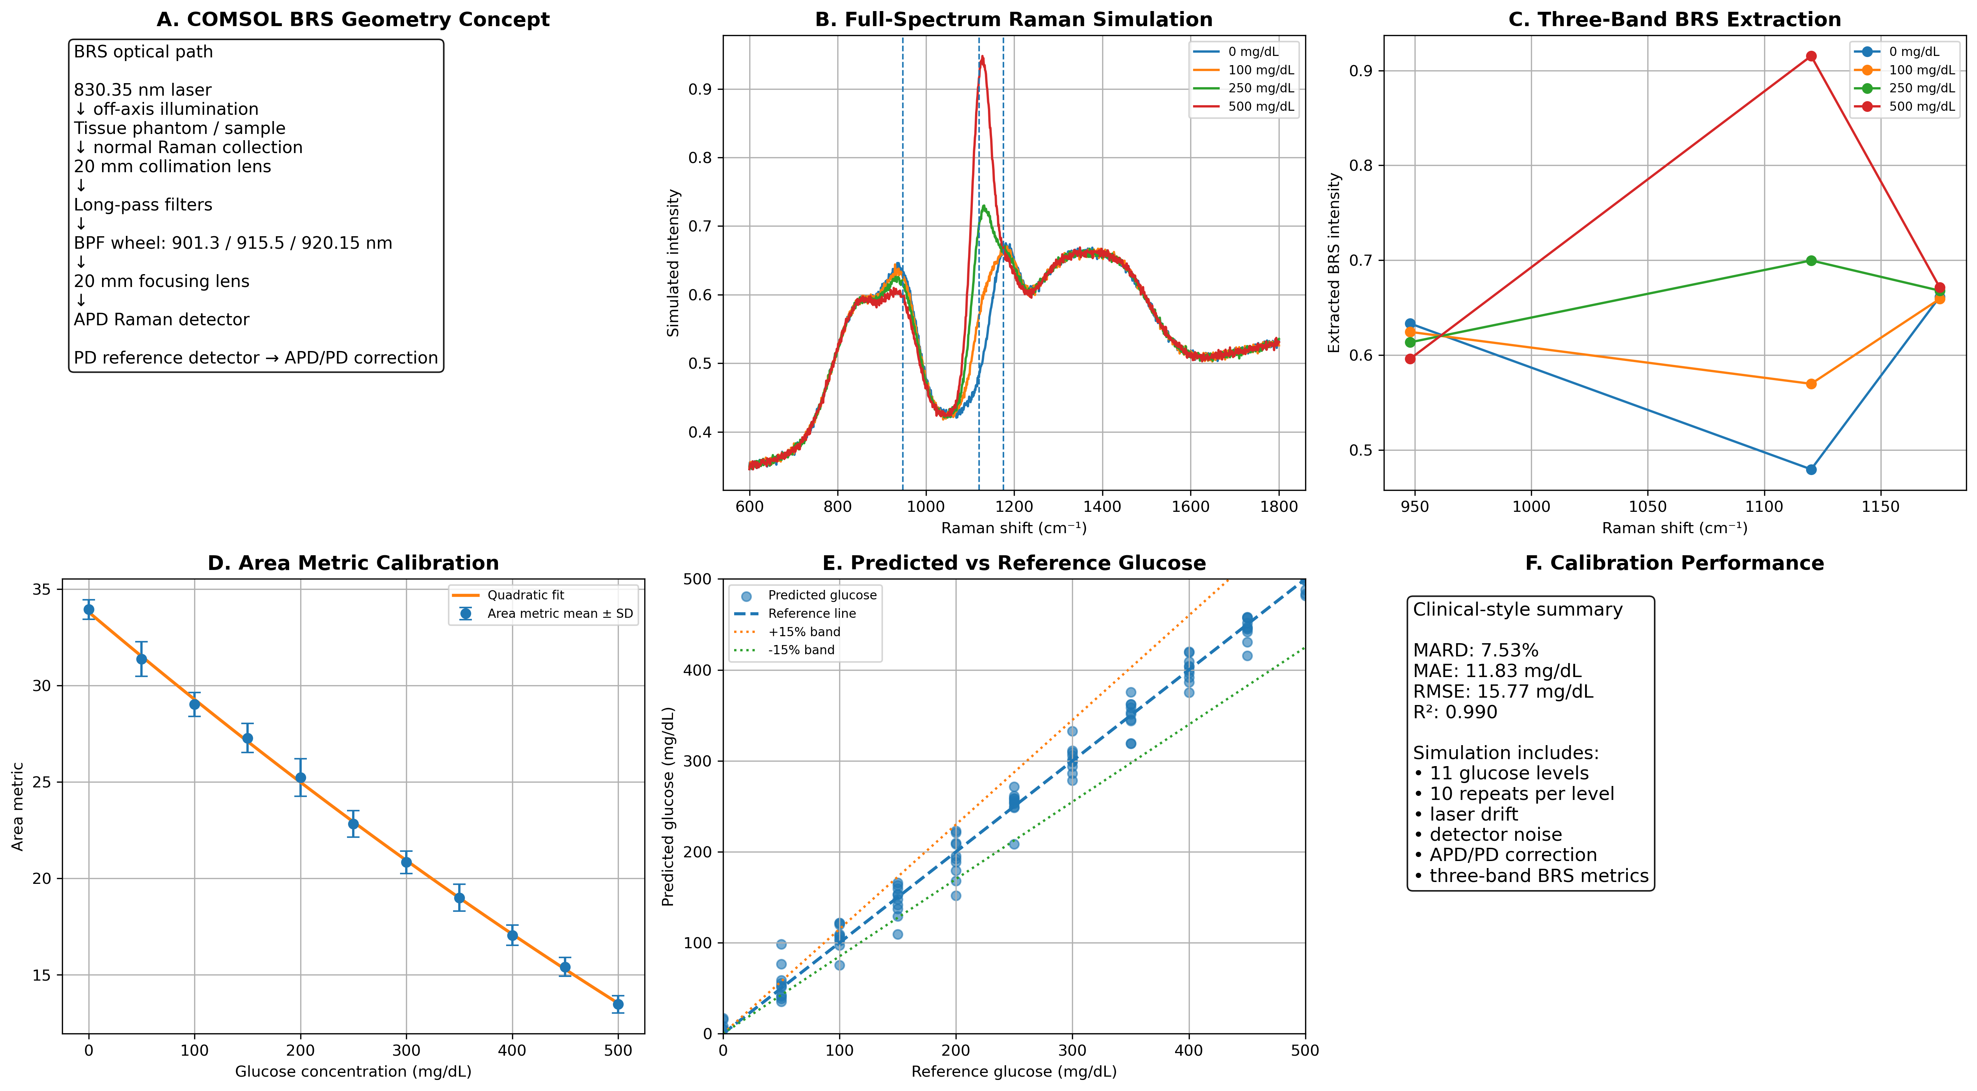
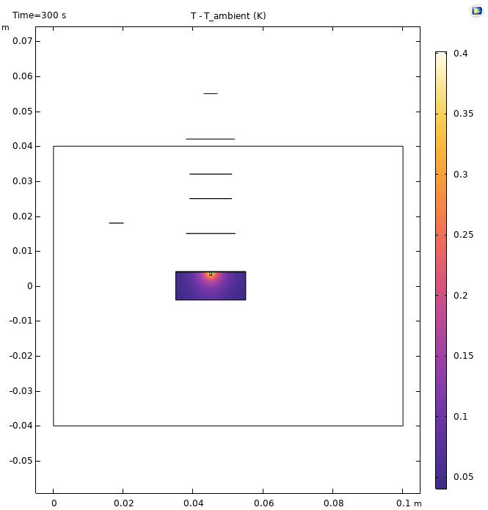
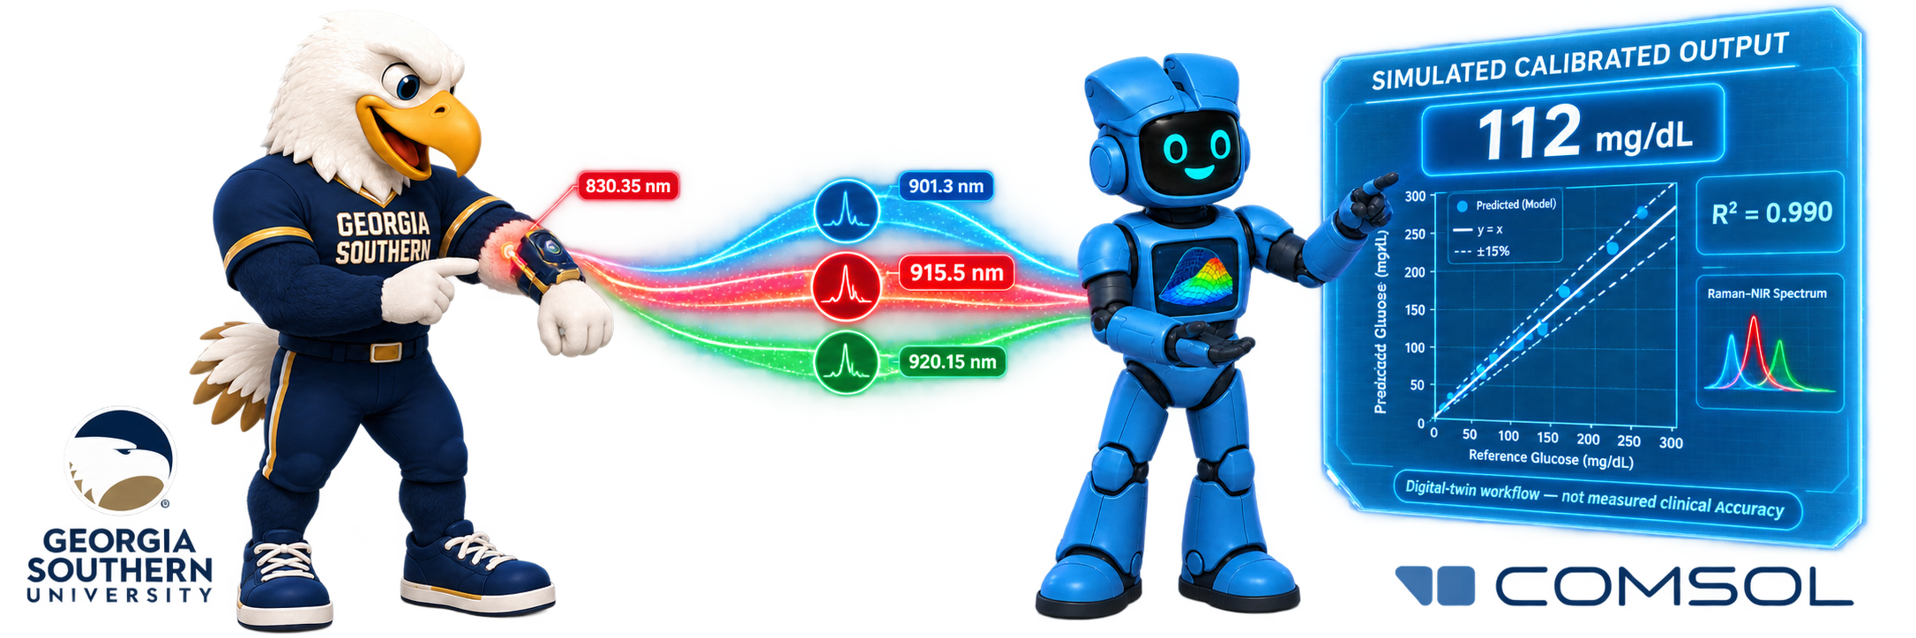
COMSOL Digital Twin for Raman–NIR Non-Invasive Glucose Sensing: From Prototype to Validation
Optical • Spectral • Thermal • Calibration
Simulation-guided optical–thermal design for three-band calibration and bench validation.
Md Shohel Rana¹, Md Mehedi Hasan¹, Andrew H. Sung²
¹ Georgia Southern University, Statesboro, GA, USA
² The University of Southern Mississippi, Hattiesburg, MS, USA
Why a Digital Twin First?
THE NEED — Current continuous glucose monitoring systems require transcutaneous sensor insertion and periodic replacement. Raman sensing offers molecular specificity, but weak glucose-related signals are obscured by scattering, fluorescence, and Rayleigh light; small changes in alignment or detector response can also reduce repeatability.
PHASE 1 GOAL — The Phase 1 objective is to develop a COMSOL digital twin for an 830.35 nm Raman–NIR platform that jointly evaluates optical geometry, Rayleigh rejection, three BRS channels, reference normalization, and sample heating before glucose-solution and tissue-phantom validation. Calibration results shown here are simulation-defined—not measured device or clinical performance.
Digital Twin Methodology
GEOMETRY — Ray Optics: off-axis excitation and near-normal Raman collection; detector offsets of −2, 0, and +2 mm.
SELECTIVITY — Three-band BRS: 901.3 nm sideband, 915.5 nm glucose-sensitive band, and 920.15 nm sideband with long-pass Rayleigh rejection.
HEATING — 91.5 mW, 2% assumed absorption, 0.5 × 1.0 mm spot, 1 mm depth, and 300 s exposure.
CALIBRATION — 11 glucose levels × 10 simulated repeats with drift and detector noise.
FIGURE 1. Phase 1 digital twin: optical geometry → spectral filtering → thermal response → sensitivity → validation.
Results
OPTICS & FILTERING — Separate excitation/collection paths; attenuate 830.35 nm Rayleigh light; transmit the 901.3, 915.5, and 920.15 nm bands.
THERMAL — Preliminary ΔTmax ≈ 0.4 K at 300 s under assumed conditions; direct temperature monitoring is planned.
CALIBRATION (Simulation Consistency) — 11 levels × 10 simulated repeats:
7.53% MARD 0.990 R²
11.83 mg/dL MAE | 15.77 mg/dL RMSE
Simulation-defined workflow consistency only—not measured device or clinical accuracy.
NEXT → solutions • tissue phantoms • separate-session validation
FIGURE 2. Separated optical paths, three transmitted Raman bands, localized ΔTmax ≈ 0.4 K, and predicted values compared with ±15% reference bands.
J. Shi et al., “Sensor technologies for non-invasive blood glucose monitoring,” Sensors, 2025.
J. Wu et al., “A new generation of sensors for non-invasive blood glucose monitoring,” American Journal of Translational Research, 2023.
C.-W. Peng et al., “Noninvasive blood glucose monitoring system based on deep learning and multiwavelength near-infrared technology,” IEEE THMS, 2025.
A. Bresci et al., “Band-pass Raman spectroscopy unlocks compact point-of-care noninvasive continuous glucose monitoring,” Analytical Chemistry, 2025.
N. Aslam et al., “Quantum sensors for biomedical applications,” Nature Reviews Physics, 2023.
C. L. Degen et al., “Quantum sensing,” Reviews of Modern Physics, 2017.
M. Kaluza et al., “Clinical validation of noninvasive blood glucose measurements by midinfrared spectroscopy,” Communications Medicine, 2025.
T. Debnath et al., “Wearable intelligent system for non-invasive glucose monitoring using quantum sensing,” ACM BCB, 2026.
M. S. Rana et al., “QSen-FMoE: A federated mixture-of-experts framework for quantum-driven next-generation wearable sensing,” ICBCB, 2026.
Notes:
[Sources]
- COMSOL_Digital_Twin.pdf, supplied by the user: scientific claims, numerical results, authorship, affiliations, and figures.
- Poster-Template-COMSOL-Conference-2026-Boston (5).pptx, supplied by the user: poster dimensions, branding, typography, layout, footer, and COMSOL logo.
[/Sources]

