Slide 1
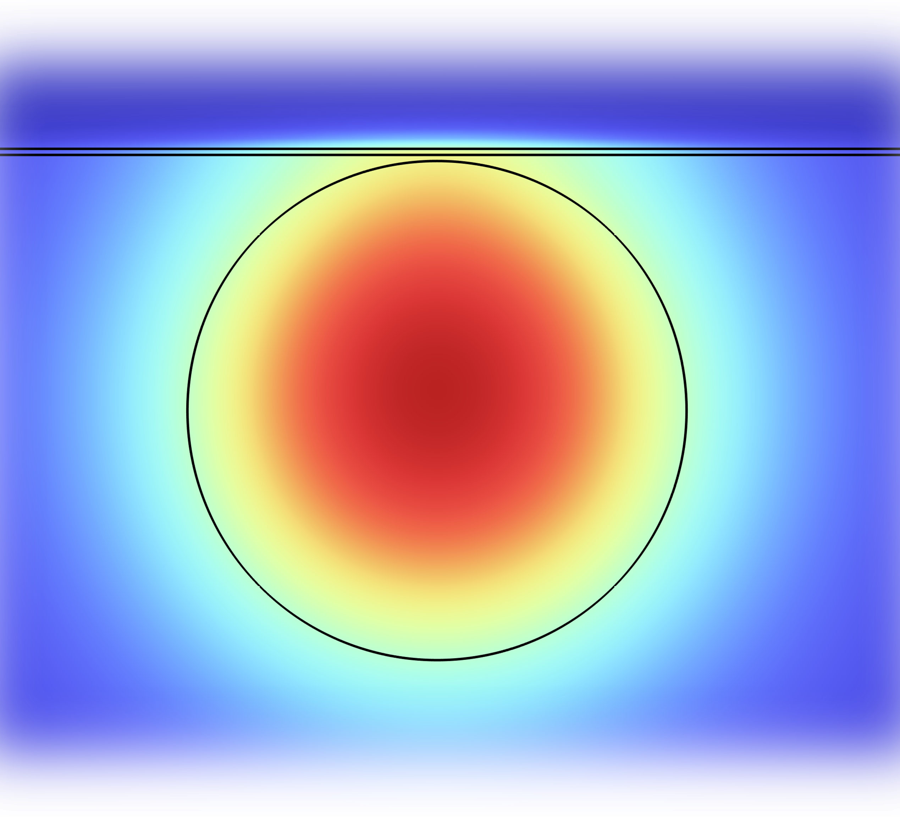
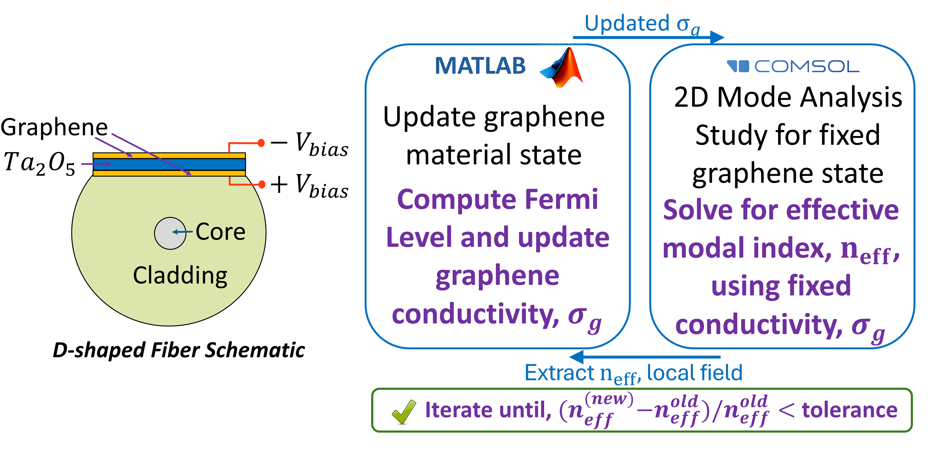

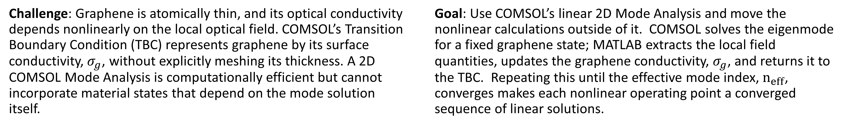
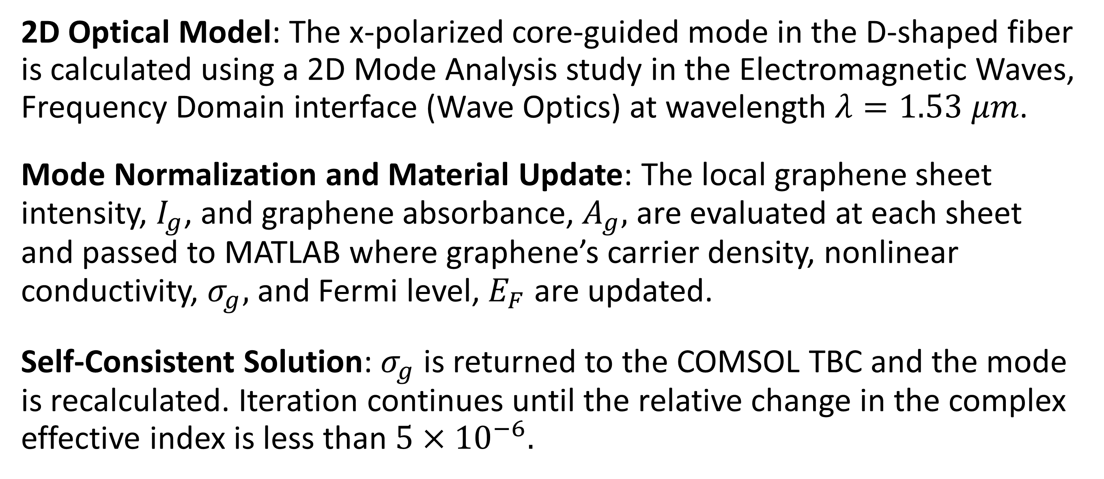
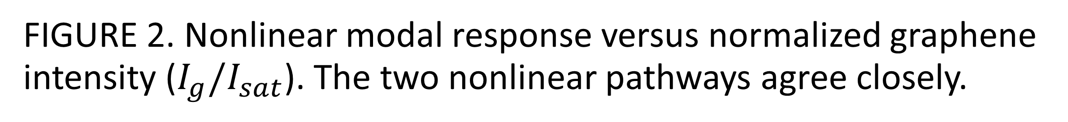
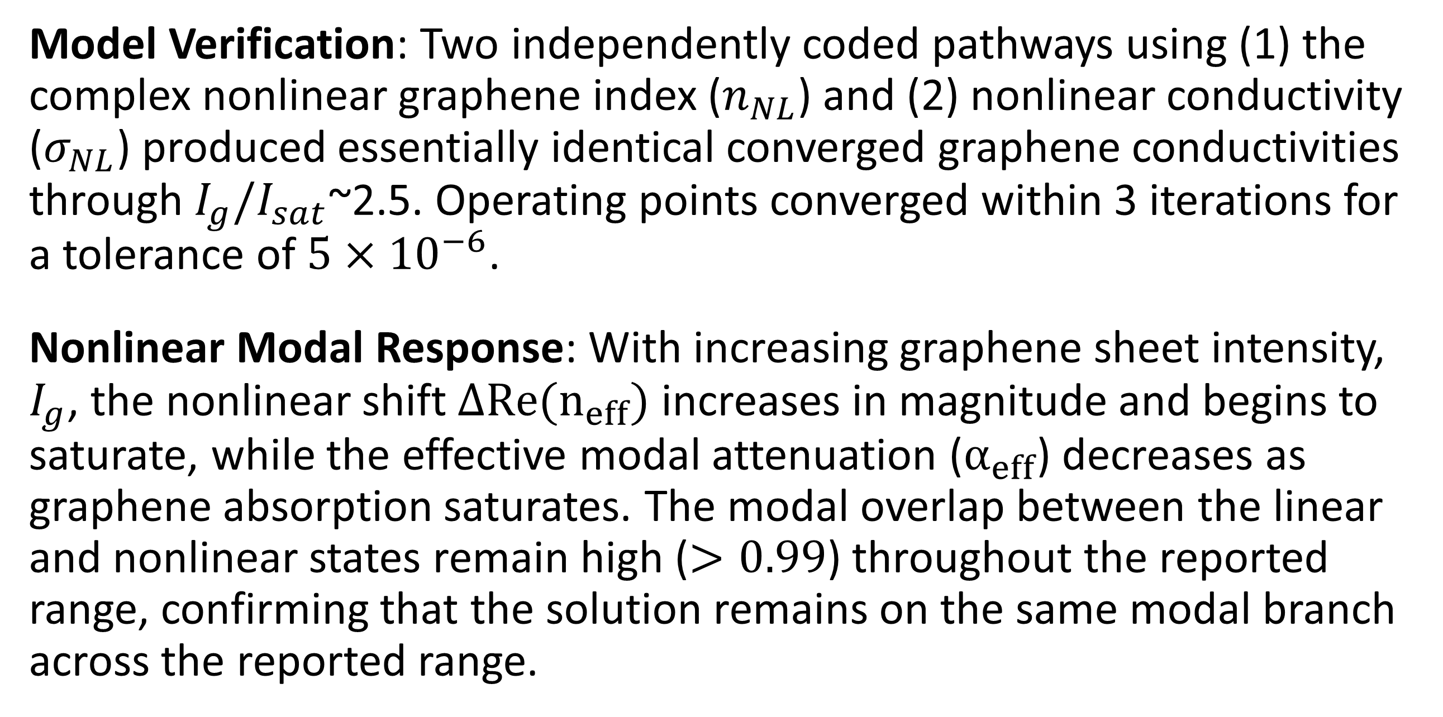
Modeling Graphene Nonlinearity with 2D Eigenmode Analysis
A linear 2D COMSOL mode analysis is coupled to iterative MATLAB updates of graphene surface conductivity via LiveLink to capture nonlinear modal response efficiently.
A. D. McCoy, M. Ibsen
Optoelectronics Research Centre, University of Southampton, Southampton, United Kingdom
Introduction & Goal
Challenge: Graphene is atomically thin, and its optical conductivity depends nonlinearly on the local optical field. COMSOL’s Transition Boundary Condition (TBC) represents graphene by its surface conductivity,${ σ}_{g}$, without explicitly meshing its thickness. A 2D COMSOL Mode Analysis is computationally efficient but cannot incorporate material states that depend on the mode solution itself.
Goal: Use COMSOL’s linear 2D Mode Analysis and move the nonlinear calculations outside of it. COMSOL solves the eigenmode for a fixed graphene state; MATLAB extracts the local field quantities, updates the graphene conductivity, $σ_{g}$, and returns it to the TBC. Repeating this until the effective mode index, $n_{eff}$, converges makes each nonlinear operating point a converged sequence of linear solutions.
Methodology
2D Optical Model: The x-polarized core-guided mode in the D-shaped fiber is calculated using a 2D Mode Analysis study in the Electromagnetic Waves, Frequency Domain interface (Wave Optics) at wavelength $λ=1.53 μm$.
Mode Normalization and Material Update: The local graphene sheet intensity, $I_{g}$, and graphene absorbance, $A_{g},$ are evaluated at each sheet and passed to MATLAB where graphene’s carrier density, nonlinear conductivity, $σ_{g},$ and Fermi level, $E_{F}$ are updated.
Self-Consistent Solution: $σ_{g}$ is returned to the COMSOL TBC and the mode is recalculated. Iteration continues until the relative change in the complex effective index is less than$5×{10}^{−6}.$
FIGURE 1. D-shaped fiber geometry and simplified COMSOL-MATLAB LiveLink workflow.
Results
Model Verification: Two independently coded pathways using (1) the complex nonlinear graphene index ($n_{NL}$) and (2) nonlinear conductivity ($σ_{NL}$) produced essentially identical converged graphene conductivities through $I_{g}/I_{sat}$~2.5. Operating points converged within 3 iterations for a tolerance of $5×{10}^{−6}$.
Nonlinear Modal Response: With increasing graphene sheet intensity, $I_{g}$, the nonlinear shift $ΔRe(n_{eff})$ increases in magnitude and begins to saturate, while the effective modal attenuation ($α_{eff}$) decreases as graphene absorption saturates. The modal overlap between the linear and nonlinear states remain high ($>0.99$) throughout the reported range, confirming that the solution remains on the same modal branch across the reported range.
FIGURE 2. Nonlinear modal response versus normalized graphene intensity ($I_{g}/I_{sat}$). The two nonlinear pathways agree closely.
[1] J. D. Zapata et al., “Efficient graphene saturable absorbers on D-shaped optical fiber for ultrashort pulse generation,” Sci. Rep. 6, 20644 (2016).
[2] K. J. A. Ooi and D. T. H. Tan, “Nonlinear graphene plasmonics,” Proc. R. Soc. A 473, 20170433 (2017).
[3] A. Pitilakis and E. E. Kriezis, J. Opt. Soc. Am. B 39, 2723–2734 (2022).

