Slide 1


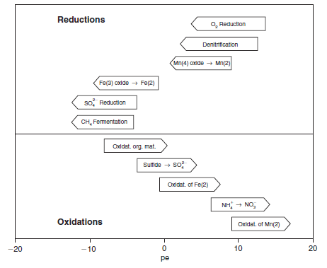
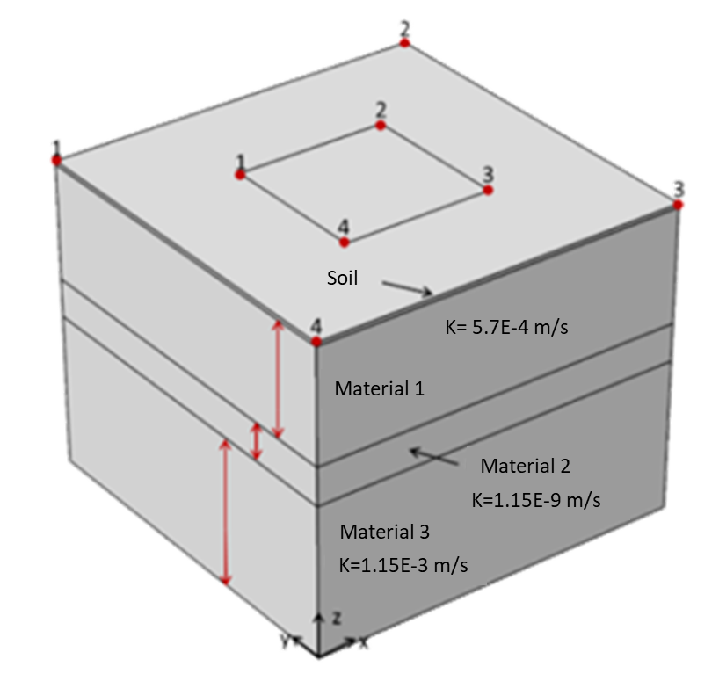
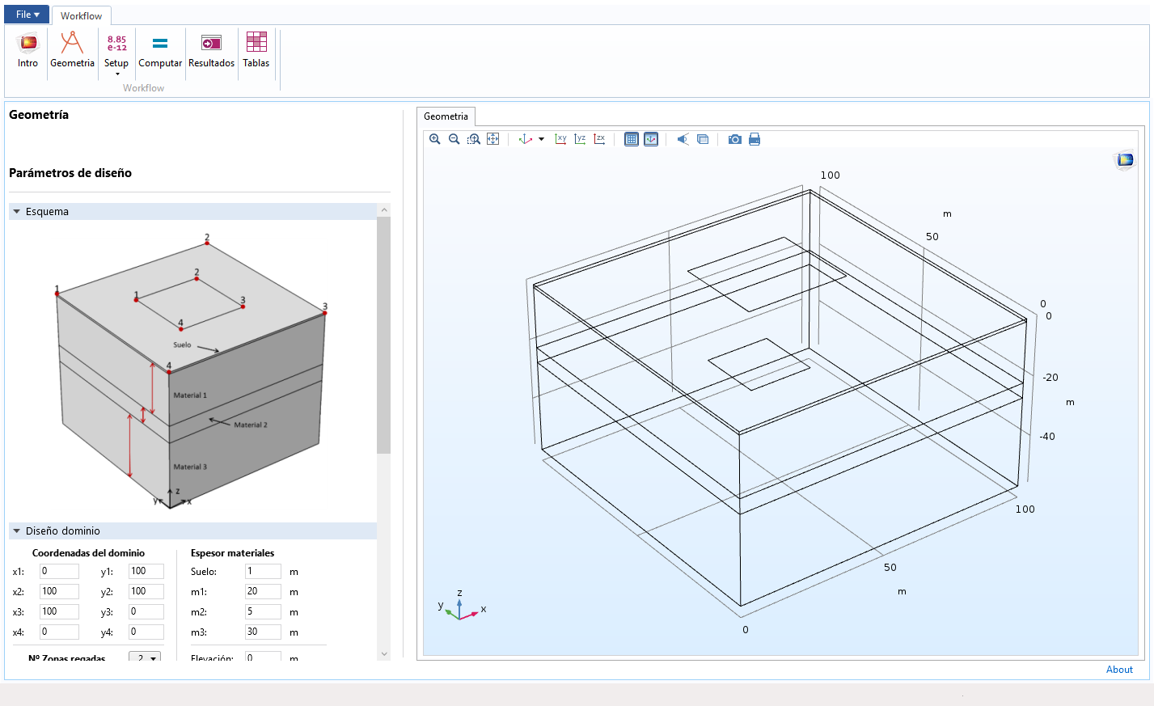
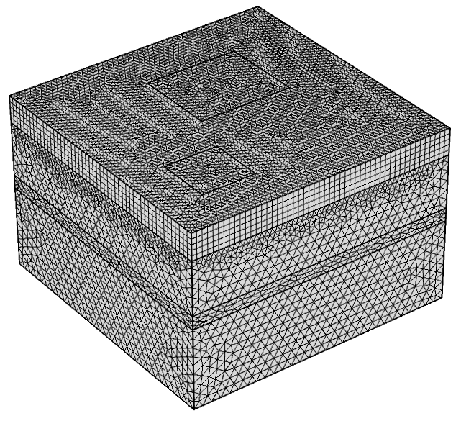
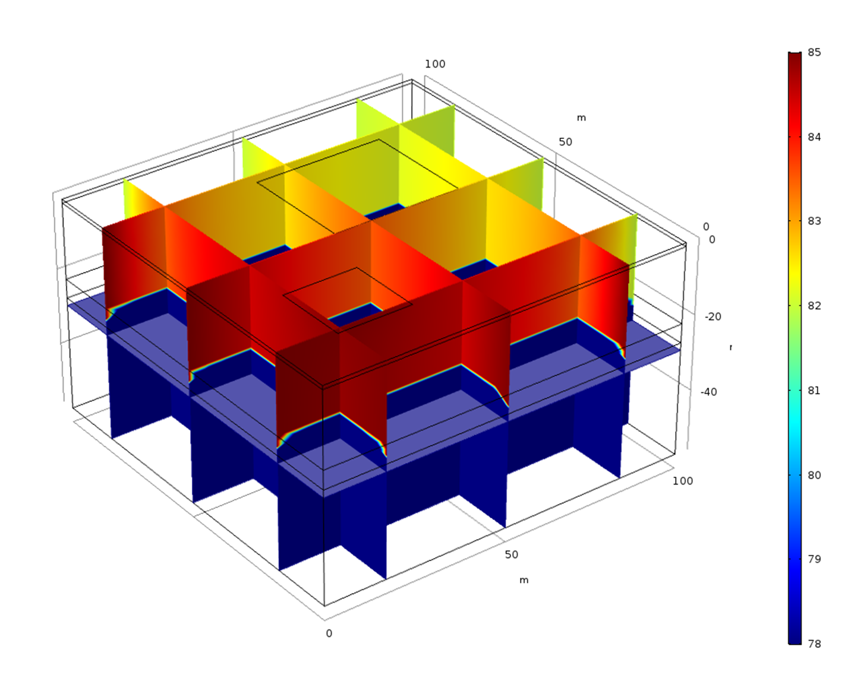
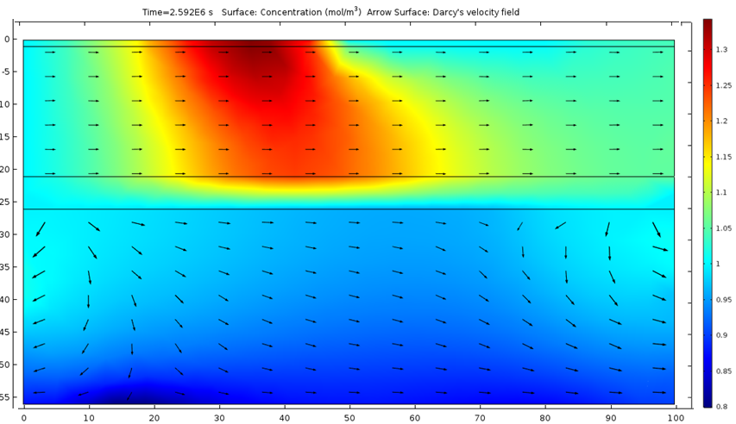
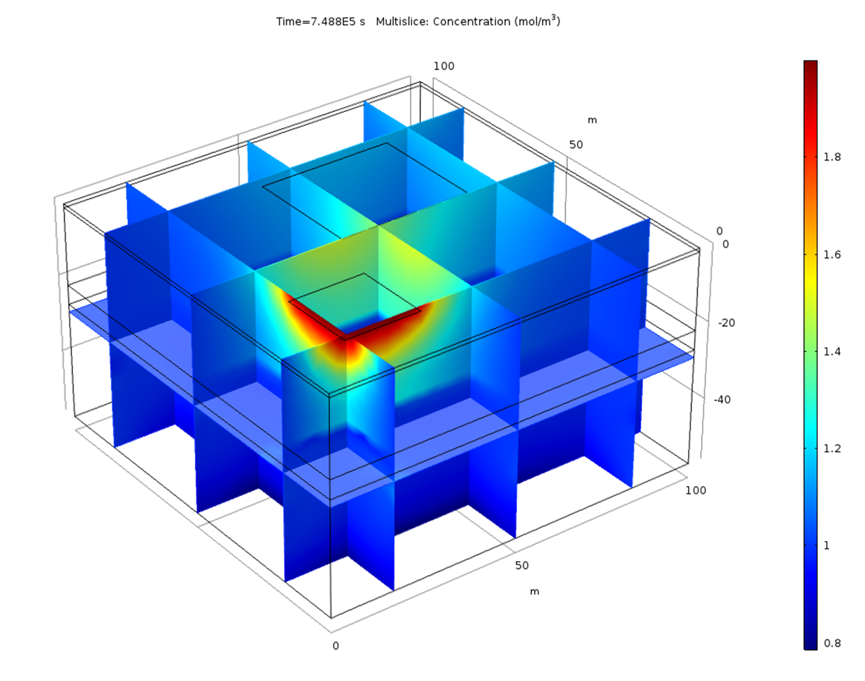
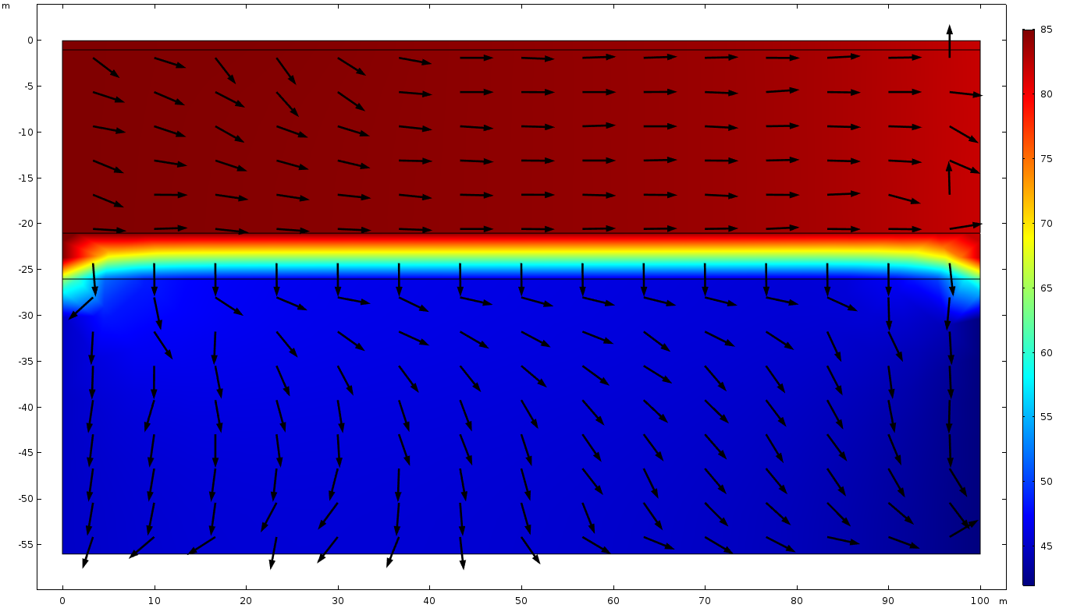
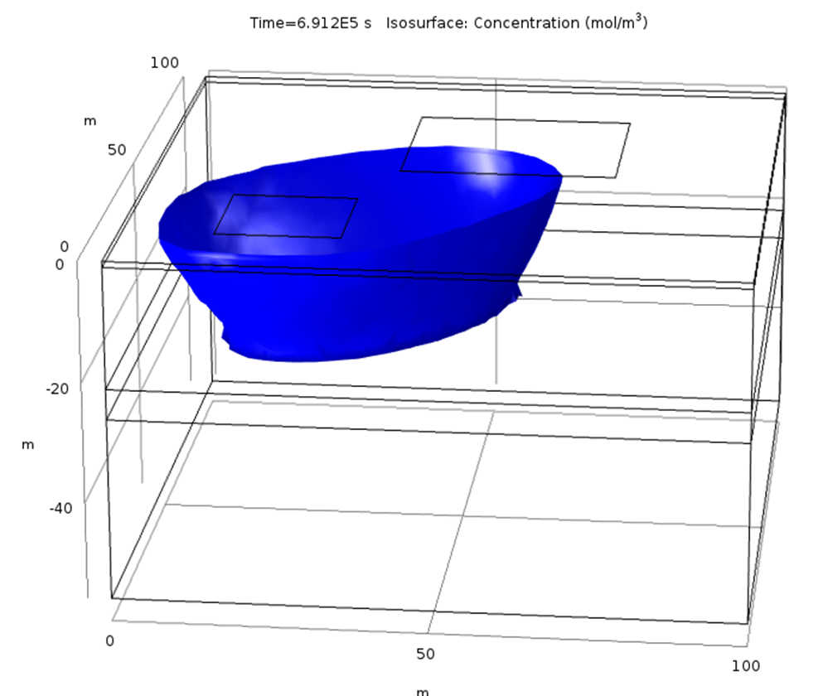
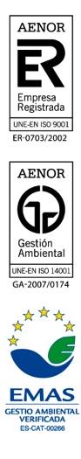
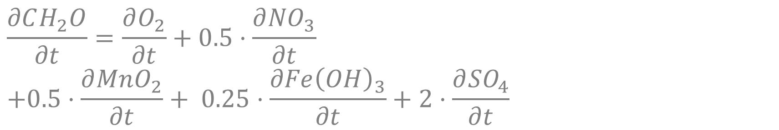
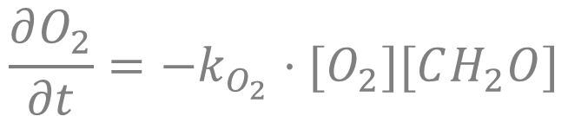
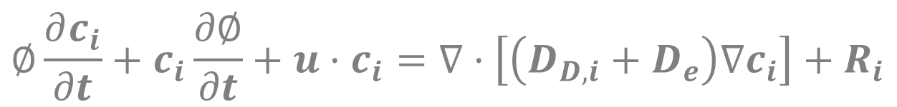
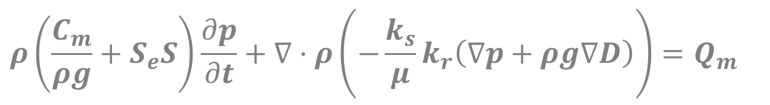
A computational app for a proper evaluation of the irrigation effect over the aquifers
⁽¹⁾ Amphos 21 Consulting S.L. ⁽²⁾ Grupo Tragsa - SEPI, Spain.
Diego Sampietro⁽¹⁾, Alvaro Sáinz-García⁽¹⁾,Jorge Molinero⁽¹⁾, Enrique Fernández⁽²⁾
Motivation
A correct design and control of the irrigation cycles is very important for the correct and efficient grow of the crops. It is well known that a correct design of the irrigation cycles increases its efficiency and reduces the amount of water required. The irrigation cycles have effect over the quality and quantity of water. It becomes more relevant in these areas of the world where the amount of water is limited. Nowadays, several scientists are involved in different research whose objectives are focus on find alternative sources of water that can be used to the irrigation. One idea is to reuse human waste water [1]. This concept is based on the pollutant removal effect of the sun, the soil and the plants itself. However, it requires an important control of the polluted water evolution in the subsurface.
Numerical modelling is an important tool to help engineers and scientists to design structures, simulate experiments, etc. In the present context, it can be used as a proper design of irrigation structures. It serves also to evaluate the propagation of the pollutants or nutrients not absorbed by plants in the irrigation water through the subsurface.
We present an useful app designed in Comsol that simulates the effects of different irrigation cycles over the soil saturation. It also can simulate the evolution of certain pollutants dissolved or suspended in the water through the subsurface attending to its degradation. The application reproduces the groundwater flow field, the saturation and the movement of the pollutants or nutrients. The model is designed to evaluate the evolution of the dissolved elements involved in the organic matter degradation chain.
Chemical model
Source: [2]
App Workflow
Inputs
Computation
Post-process
Geometry
Boundary conditions
Variable saturated groundwater Flow:
Richard’s equation
Transport of diluted species:
Advection-dispersion-diffusion equation
Organic matter oxidation:
2nd order kinetic.
E.g.
Plots
Nº of irrigation zones
Nº of materials
Size of the domain
Thickness of each materials
Location of sampling points
Hydraulic:
    Hydraulic heads.
    Irrigation function
    Recharge function
Transport: Inlet concentrations
$$ρ\left(\frac{C_{m}}{ρg}+S_{e}S\right)\frac{∂p}{∂t}+∇·ρ\left(−\frac{k_{s}}{μ}k_{r}\left(∇p+ρg∇D\right)\right)=Q_{m}$$
Hydraulic:
    2D & 3D plots showing the saturation, the hydraulic head, flow velocity and the flow direction for the different times.
Transport:
  2D&3D plots showing the spatial distribution of each species for the different times.
Parameters
Model settings
$$∅\frac{∂c_{i}}{∂t}+c_{i}\frac{∂∅}{∂t}+u·c_{i}=∇·\left[\left(D_{D,i}+D_{e}\right)∇c_{i}\right]+R_{i}$$
Hydraulic parameters:
  Permeability
  Porosity
  Van-Genuchten model
Transport parameters:
  Dispersivity
  Effective diffusion
Kinetic reaction constants
Spatial discretization:
  3 resolutions of the FEM
Temporal discretization:
  Time-step
  Total time
Solver settings:
  Direct/sequential
  relative tolerance
$$\frac{∂CH_{2}O}{∂t}=\frac{∂O_{2}}{∂t}+0.5·\frac{∂{NO}_{3}}{∂t}$$
$$+0.5·\frac{∂{MnO}_{2}}{∂t}+ 0.25·\frac{∂Fe{\left(OH\right)}_{3}}{∂t}+2·\frac{∂{SO}_{4}}{∂t}$$
Tables
Results at the observation points
  Hydraulic head and effective saturation
  Concentration of chemical species
$$\frac{∂O_{2}}{∂t}=−k_{O_{2}}·[O_{2}][CH_{2}O]$$
Application example
Geometry
Mesh
Boundary conditions
Intro
Geometry
Compute
Results
Table
Regional flow streams from north (85 m) to south (82 m).
Aquifer is characterized by a bicarbonated water with a low mineralization whereas one of the irrigation waters is characterized by a high content in DOM, SO4 and Cl.
Groundwater flow is solved first in a transient simulation for a total time of 10 days with 100 linear time-steps.
Second, the computed flow field is used for a transport simulation with the same time discretization and the same duration.
Geometry
Geometry
Design inputs
Scheme
Computation settings
This example consider two permeable materials separated by an small aquitard. Two irrigation zones
Domain design
Domain coordinates
Material thickness
Soil:
Nº Irrigation zones:
Elevation:
Finite element grid formed by tetrahedra and prisms
The irrigation is imposed over the small crop. It modifies locally the groundwater flow that now flow from SE to NW.
The reclaimed water used to irrigate the crop infiltrates in the upper aquifer although they don’t reach the depth aquifer due the presence of an aquitard that isolate both aquifers. Regarding to the DOM it is degraded in the aquifer thanks to anoxic conditions.
Outputs
Cl mol/m³
Isosurface Cl 1.2 mol/m³
Hydraulic head (m)
Cl mol/m³
Concluding remarks
The possibility of generated custom apps with Comsol allow the user to generate general models such as the one presented here that can be applied for different cases.
References
[1] Hussain I.; L. Raschid; M. A. Hanjra; F. Marikar; W. van der Hoek. 2002. Wastewater use in agriculture: Review of impacts and methodological issues in valuing impacts. Working Paper 37. Colombo, Sri Lanka: International Water Management Institute.
[2] Appelo, C.A.J y Postma.D, 2014. Geochemistry, groundwater and pollution. 2nd edition.

