Slide 1
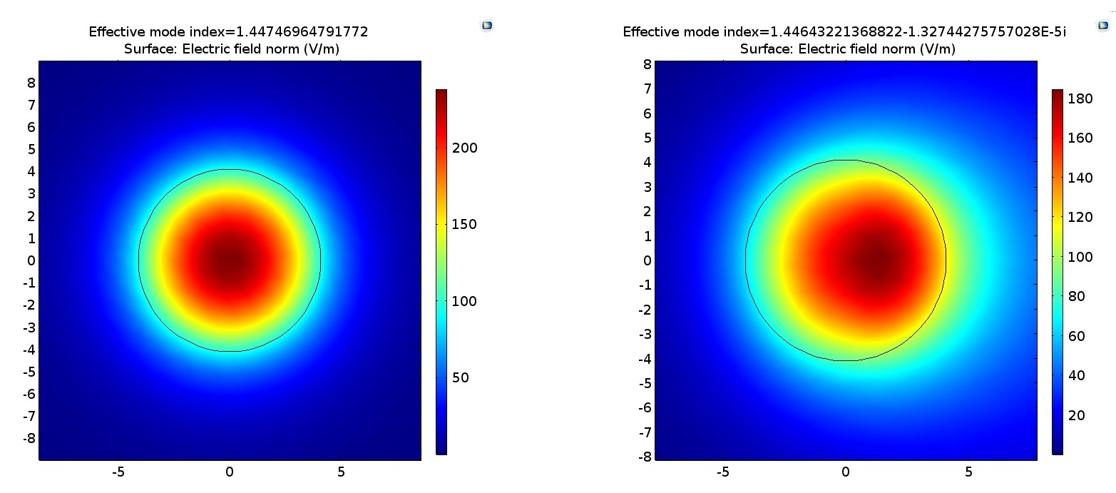
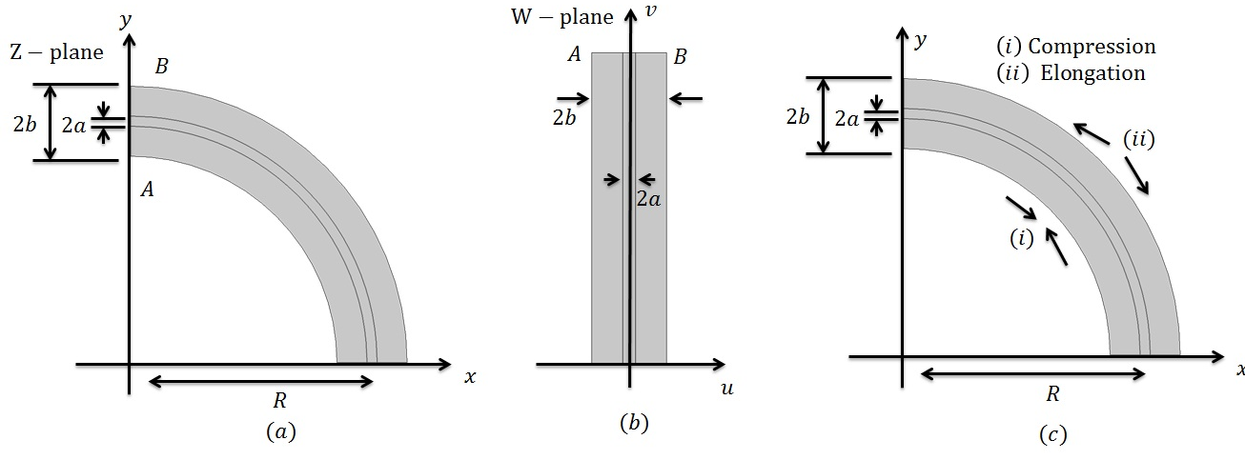
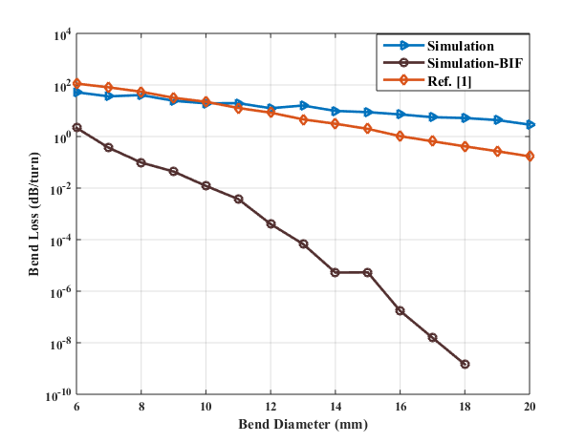
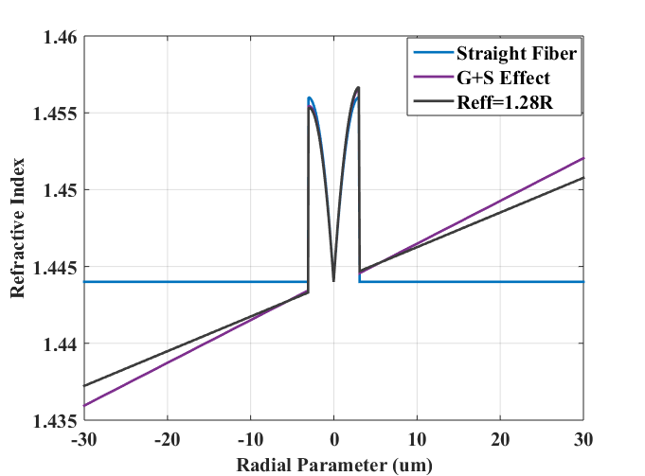
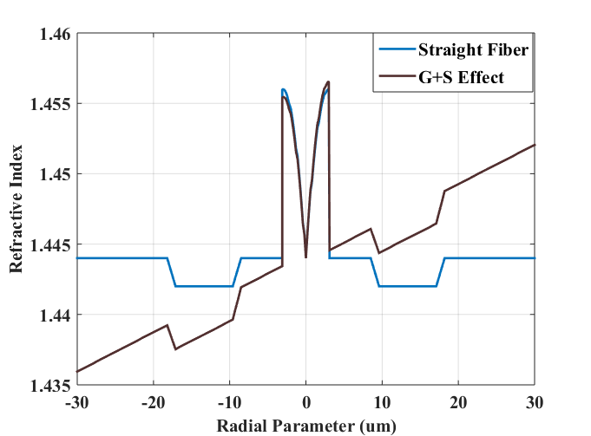
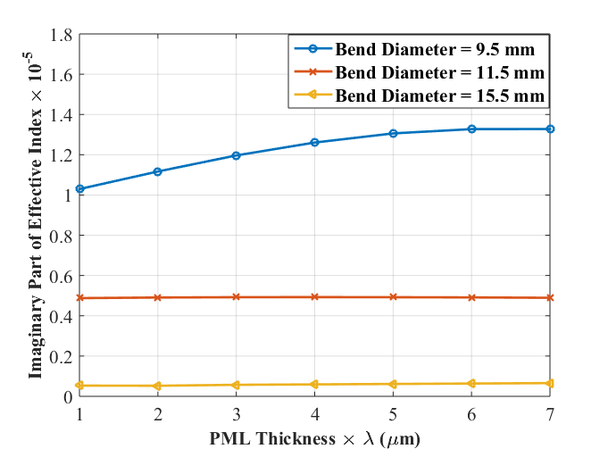
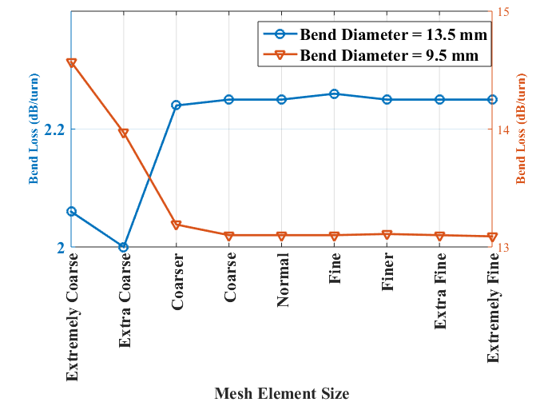
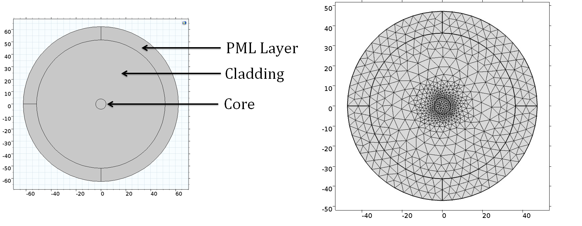
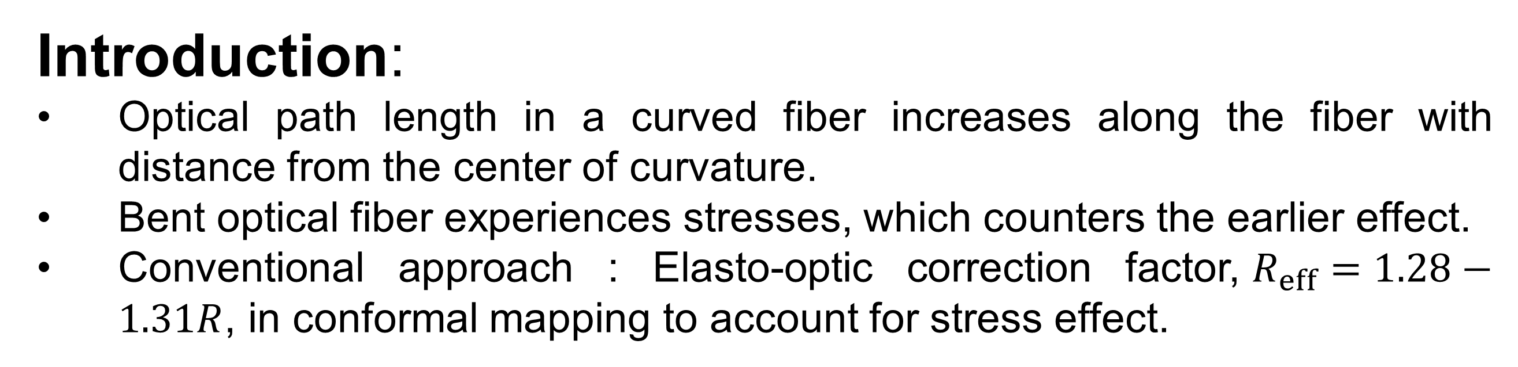
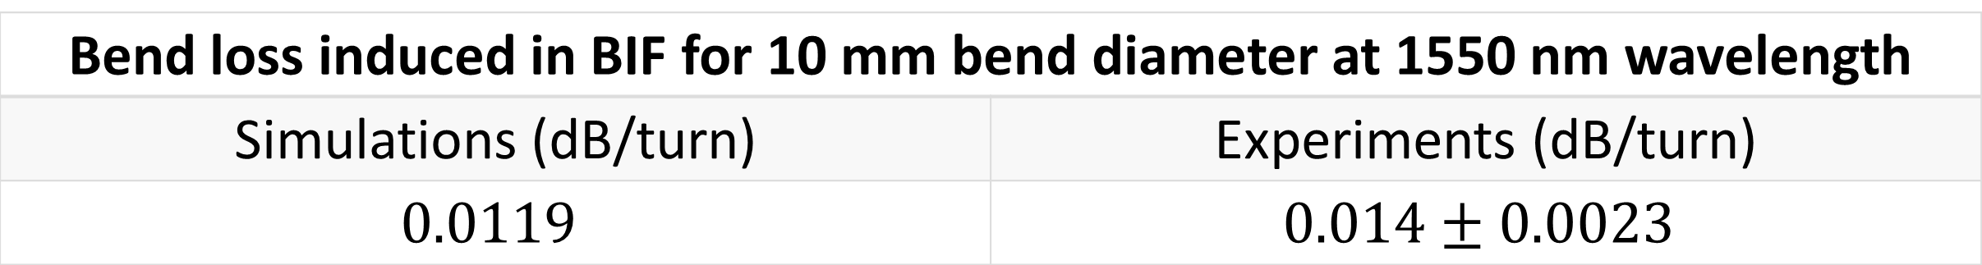

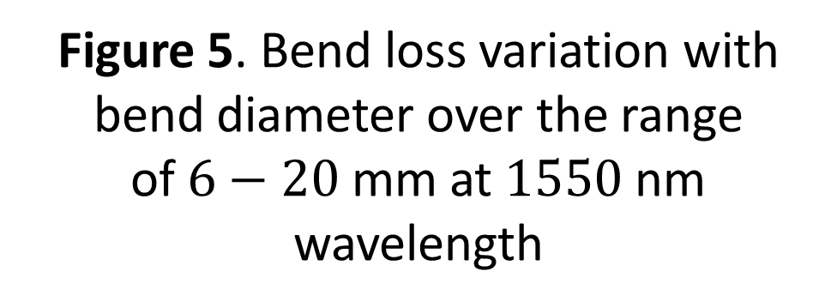
Study of Bending Losses in Optical Fiber using COMSOL
Ashitosh Velamuri¹, Krupal Patel², Ishan Sharma², Shakti Gupta², Pradeep Kumar K¹
1. Center for Lasers and Photonics, Indian Institute of Technology Kanpur, Kanpur, U.P, India
2. Department of Mechanical Engineering, Indian Institute of Technology Kanpur, Kanpur, U.P, India
Introduction:
Optical path length in a curved fiber increases along the fiber with distance from the center of curvature.
Bent optical fiber experiences stresses, which counters the earlier effect.
Conventional approach : Elasto-optic correction factor,$R_{eff}=1.28−1.31R$, in conformal mapping to account for stress effect.
Results:
Figure 3. Geometry used, meshing applied and results obtained in simulations
Figure 4. LP01 mode propagating through the fiber when it is
straight and bent at a diameter of 10 mm
Figure 1. (a) Schematic of bent fiber, (b) Mapping of curved fiber to equivalent straight fiber by conformal mapping, (c) Stresses experienced by fiber under bending conditions
Computational Methods:
GEBT + Conformal mapping to obtain modified refractive index
$$n_{G+S}\left(x,y\right)=n\left(x,y\right)\left[1−\frac{n^{2}}{2}\left(P_{11}ε_{1}+P_{12}\left(ε_{2}+ε_{3}\right)\right)\right]\left(1+\frac{x}{R}\right)$$
Where $P_{11}=0.113$ and $P_{12}=0.252$ are the stress optic coefficients,${ ε}_{1}, ε_{2}, ε_{3}$ are the principle strains obtained from GEBT and$n(x,y)$ is the index profile of unbent fiber.
Geometry: A 2D cross section with core and cladding surrounded by perfectly matched layer.
PML thickness: $7λ (λ is the operating wavelength)$.
Meshing: Physics controlled mesh with fine element size.
Physics: Electromagnetic wave, frequency domain (ewfd) physics in wave optics module, to solve the wave equation.
$$∇×∇×\vec{E}−k_{0}^{2}ε_{r}\vec{E}=0$$
Boundary Conditions: Perfect electric conductor with zero initial conditions.
Study: Mode Analysis, to solve for the effective index of the propagating mode, which becomes complex for bent fiber.
Figure 5. Bend loss variation with bend diameter over the range of$6−20$ mm at $1550$nm wavelength
Bend loss induced in BIF for 10 mm bend diameter at 1550 nm wavelength
Simulations (dB/turn) | Experiments (dB/turn)
$$0.0119$$ | $$0.014±0.0023$$
Parameters Optimization:
Figure 2. Refractive Index profile of standard G652 fiber with a dip in middle and bend-insensitive fiber with a trench in cladding for bend and unbent case
Figure 6. Sensitivity of simulation results with
(a) PML thickness, (b) Mesh element size
Conclusions:
Proposed a new method to estimate bend losses in optical fiber,
Applied GEBT and conformal mapping to obtain modified refractive index.
Wave optics module, ewfd physics and mode analysis study of COMSOL were used in solving the wave equation.
PML thickness and mesh element size are optimized to minimize any variations in simulation results.
Simulation results for standard G652 fiber along with bend insensitive fiber are presented.
Figure 3. Geometry of the model and physics controlled mesh
with fine element size applied
References:
Marcuse, Dietrich. ”Curvature loss formula for optical fibers.” JOSA 66.3 (1976): 216-220
Schermer, Ross T., and James H. Cole. ”Improved bend loss formula verified for optical fiber by simulation and experiment.” IEEE Journal of Quantum Electronics 43.10 (2007): 899-909
Watekar, Pramod R., Seongmin Ju, and Won-Taek Han. "Design and development of a trenched optical fiber with ultra-low bending loss." Optics Express 17.12 (2009): 10350-10363
$$Bend Loss: 2α\left[dB/turn\right]=\frac{20}{\ln\left(10\right)}\frac{2π}{λ} Im\left\{n_{eff}\right\}×πd$$

