Slide 1
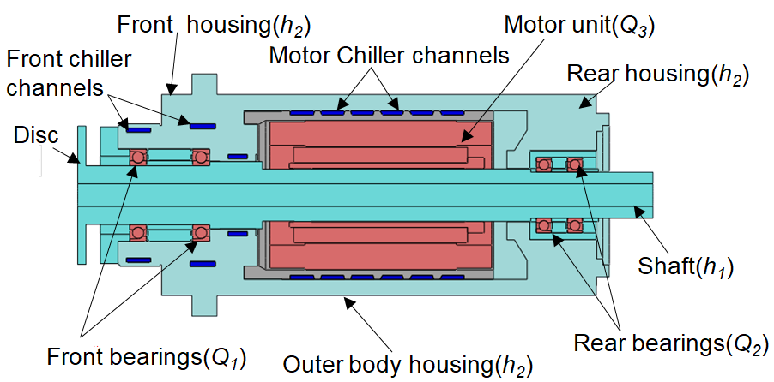
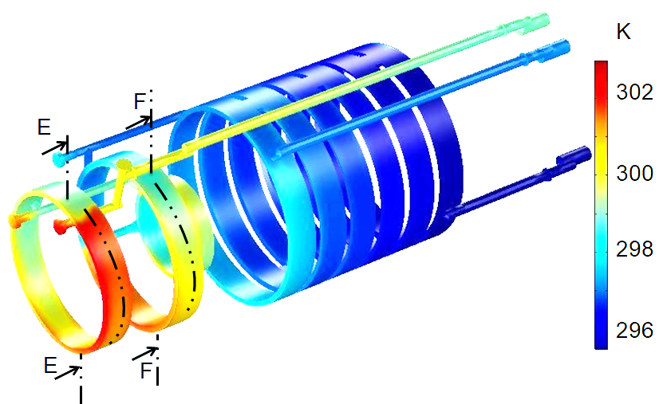
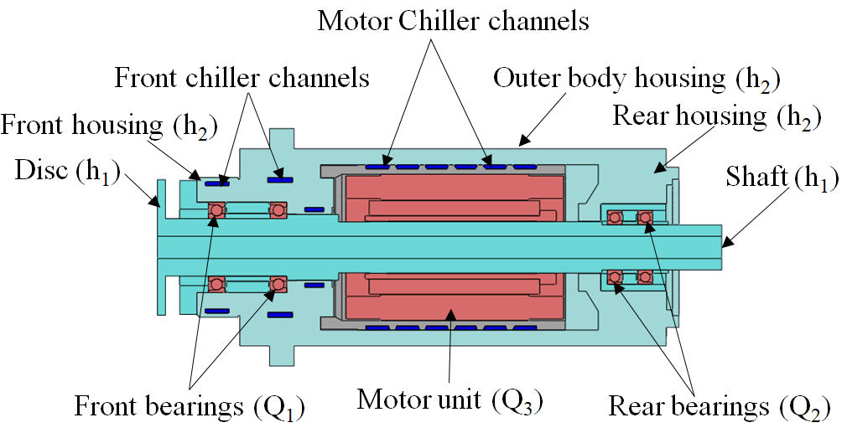
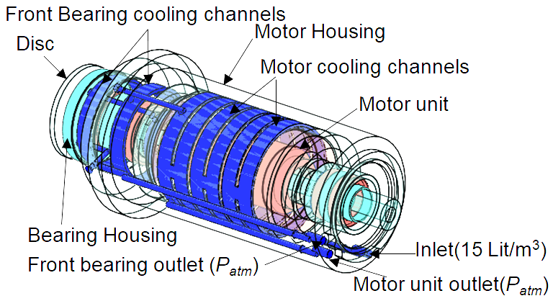
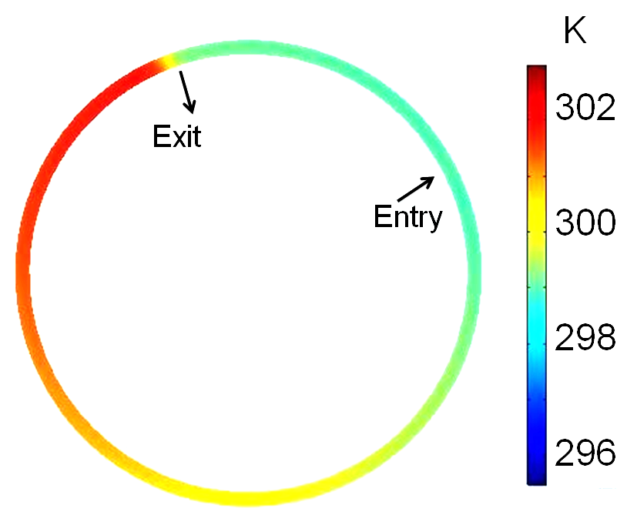
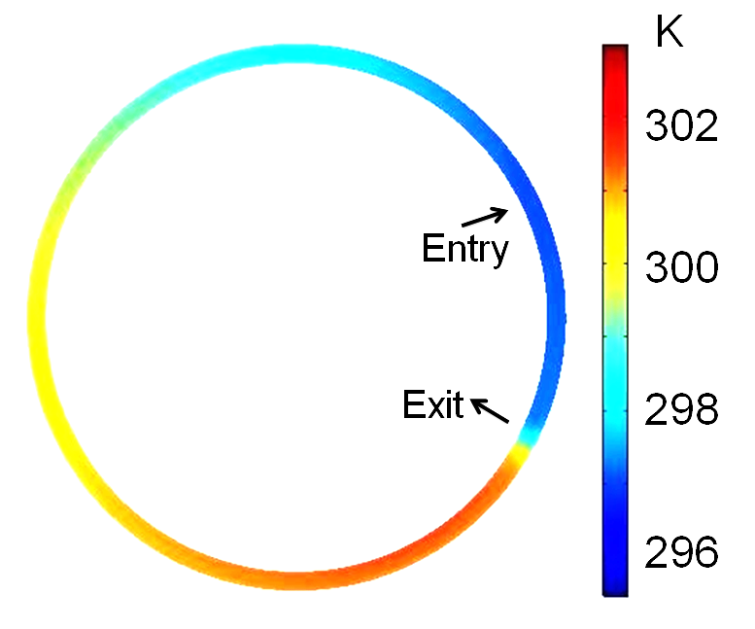
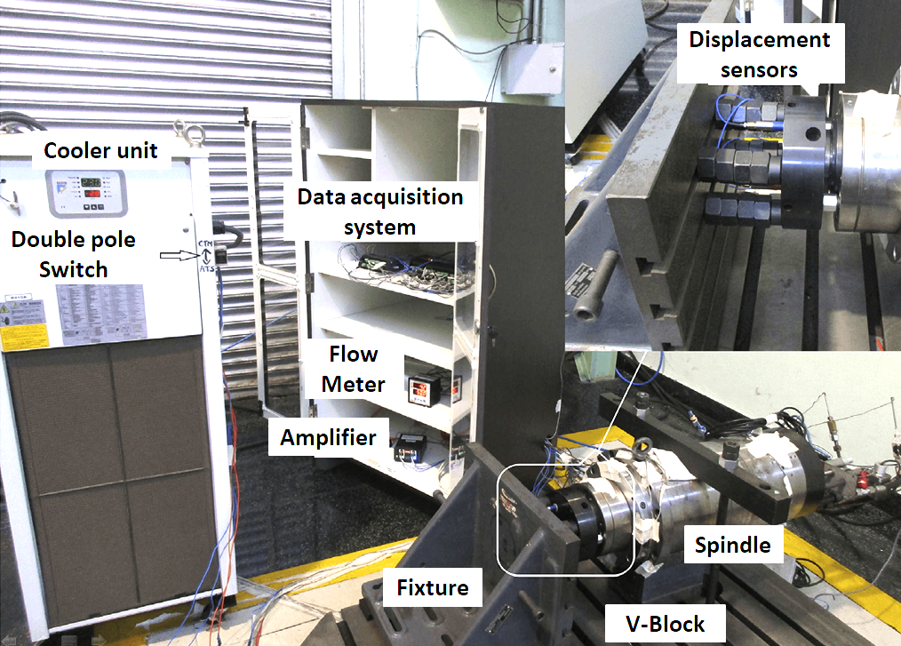
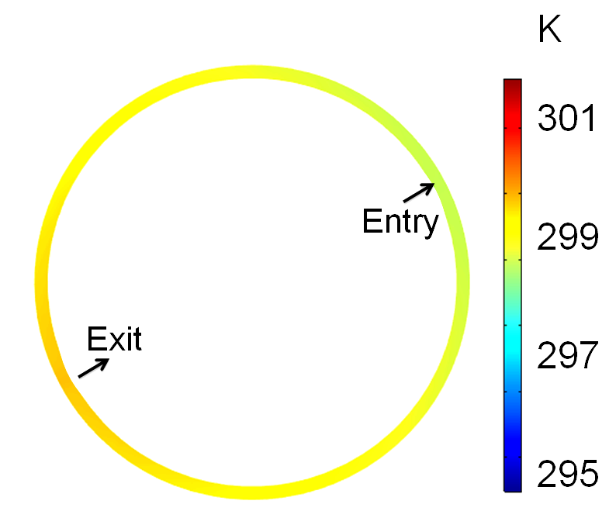
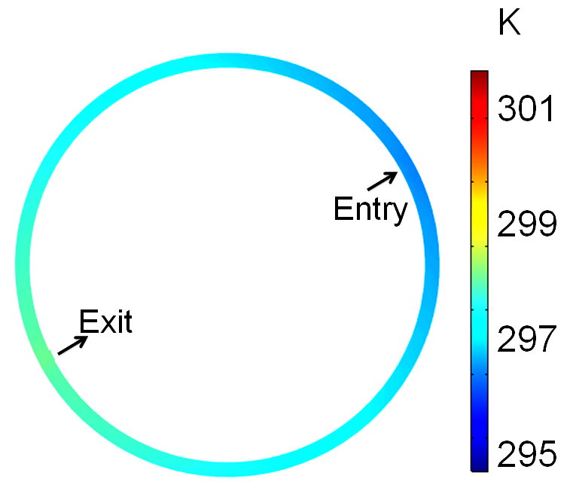
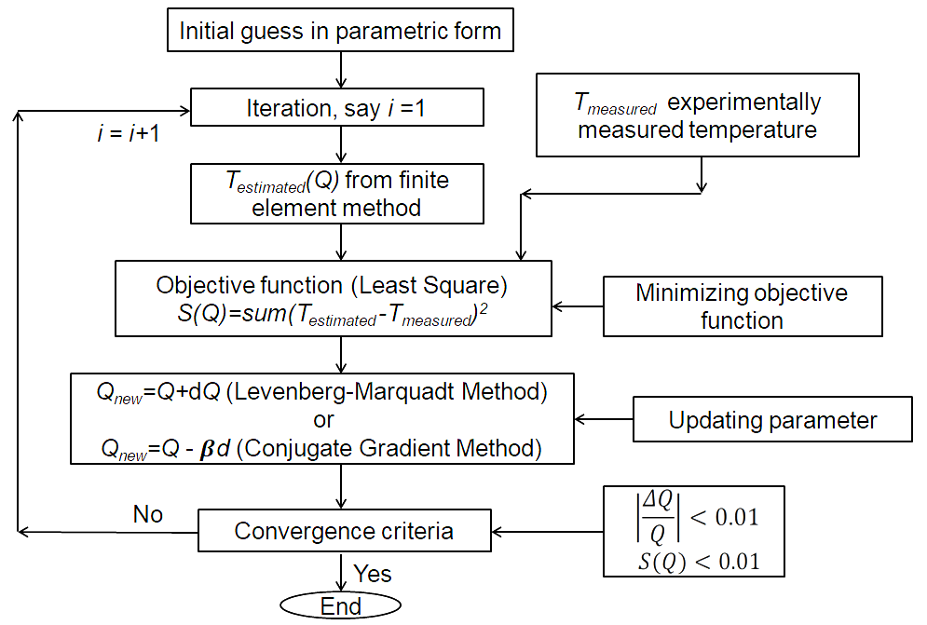
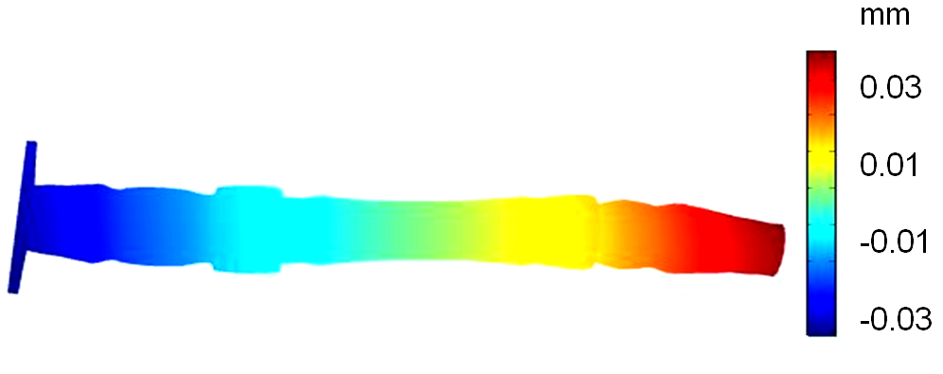
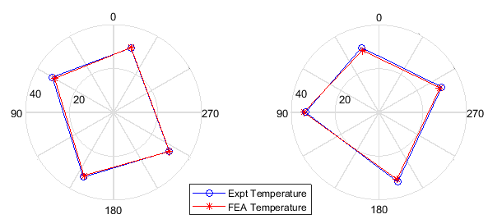
Coupled Fluid-Thermal-Structural Modeling of Motorized Spindle to Reduce Thermal Distortion
Mallinath N. Kaulagi¹, Srinivas N. Grama², Ashok N. Badhe³, J. Sharana Basavaraja⁴
^{1,4} B. M. S. College of Engineering, Bengaluru, KA, India
^{2,3} Dr. Kalam center for innovation, Bharat Fritz Werner Ltd., Bengaluru, KA, India
Problem definition and objectives:
Heat generation characterization of motorized spindle using inverse techniques.
Coolant channel optimization to reduce thermal distortion.
Optimization of coolant channel using COMSOL multiphysics:
The objective is to reduce the disparity in temperature near front bearings and in turn angular deformation of spindle shaft.
The coolant entry and exit angles near the front bearings are made diametrically opposite leading to lower disparity in temperature distribution (around 1 degree from 2.5 degrees).
Boundary conditions:
Figure 1: a) Sectional view and b) isometric view of motorized milling spindle.
4-noded tetrahedron linear element; spindle Material – Alloy steel
Coolant type: VG-32 oil, inlet flow rate: Q_{in}=15 L/min, outlet pressure = 1 bar (atm)
Flow type: laminar flow (based on R_{e} number) ; 3-D numerical analysis
Bearing radial stiffness is twice that of axial stiffness [1]
Figure 5. Temperature distribution of coolant in the existing spindle model
Figure 6. Temperature across section E-E and F-F for existing spindle design
Figure 2: Actual experimental setup [2].
Figure 7. Temperature variation across sections E-E and F-F for optimized spindle design.
Inverse method for steady state heat generation estimation:
Temperature variation (ºC) | Current spindle | Optimized spindle
Section E-E | 2.98 | 0.87
Section F-F | 4.26 | 1.4
Unknown heat sources: front bearing (Q₁), rear bearing (Q₂), motor (Q₃) are estimated using inverse techniques [3].
Non-uniform temperature distribution is observed near front bearings.
Table 2. Maximum temperature variation near front bearings for current and optimized spindles.
Coupled structural-thermal-fluid multi-physics analysis is performed in COMSOL to obtain thermal distortion at the tool-end of the spindle shaft.
Figure 8. Thermal distortion of spindle shaft
Significant reduction in angular distortion of spindle is observed because of optimization – leads to improved machining accuracy and precision.
Figure 3: Flowchart of the iterative inverse algorithm.
Thermal Distortion | Current spindle | Optimized spindle
Axial (µm) | 26.49 | 25.44
Angular (µrad) | 12.8 | 3.23
Spindle speed (rpm) |  | 15,000 | 4,500
Heat Generation rate (W) | Front Bearing (Q₁) | 238.4 | 111.2
 | Rear Bearing (Q₂) | 125.9 | 37.1
 | Motor (Q₃) | 132.7 | 66.7
Table 3. Axial and angular thermal distortion of spindle shaft.
Table 1: Estimated heat generation rate for spindle speeds of 15,000 and 4,500 rpm.
Conclusions:
Steady-state heat characterization of motorized spindle for various spindle speeds is performed using Levenberg-Marquardt and conjugate gradient inverse methods.
Non-uniform temperature distribution near front bearings has been reduced from 2.5 degrees to around 1 degree by coolant channel optimization.
Further, spindle angular deformation is reduced from 12.8 to 3.2 µ radian in the optimized design.
Figure 4: Polar plot of temperature on the outer race of front bearings illustrating numerically obtained temperatures with respect to experimental measurements for Section E-E and F-F respectively (Refer Fig. 5).
References:
FAG manual, Axial angular contact ball bearings,SchaeﬄerTechnologies GmbHCo. KG (2010)
Grama et al, A model-based cooling strategy for motorized spindle to reduce thermal errors, IJMTM, 132, 3–16 (2018)
M Necat Ozisik, Inverse heat transfer: fundamentals and applications, CRC Press (2000)

