Slide 1
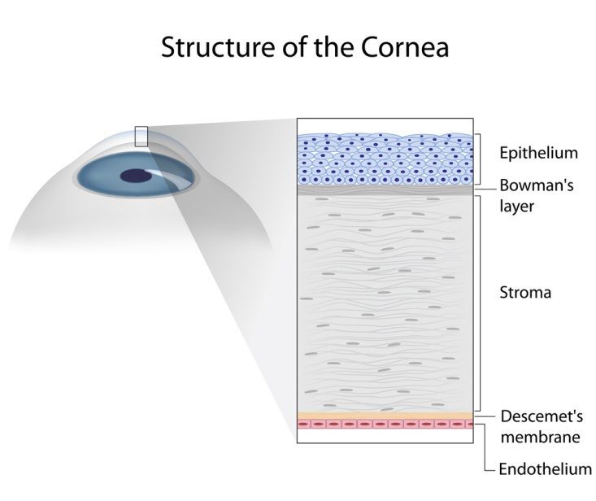
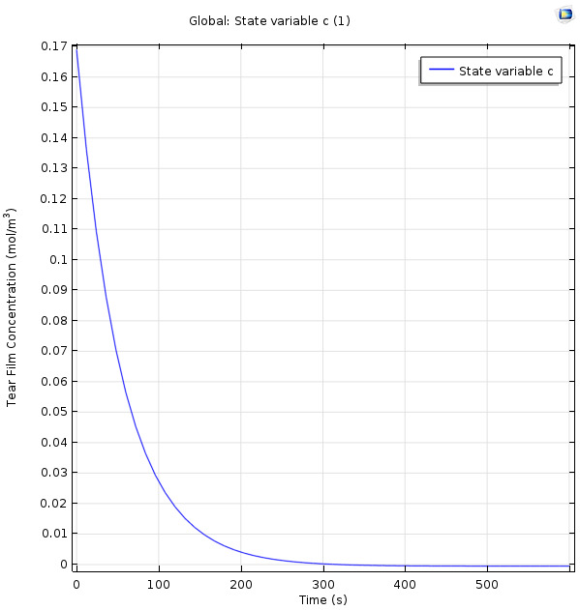
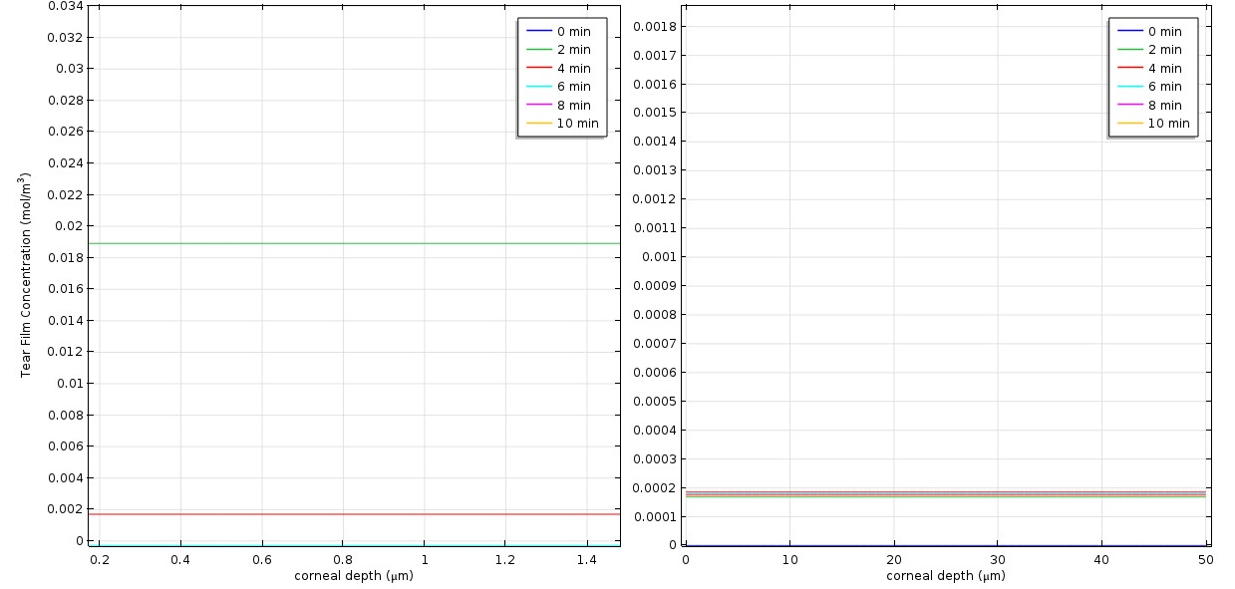
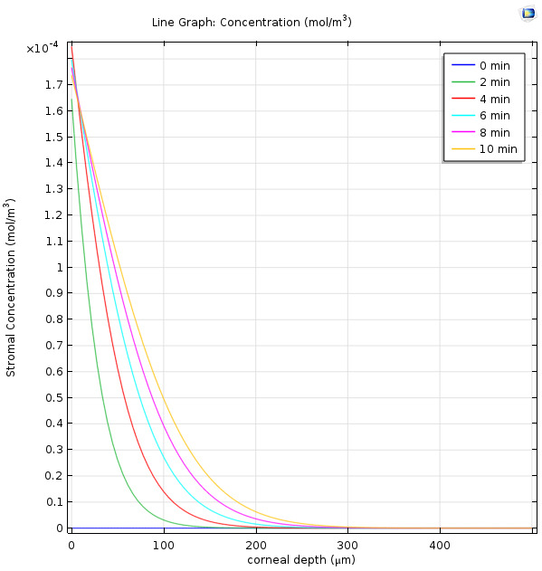
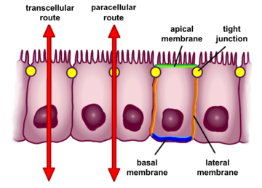
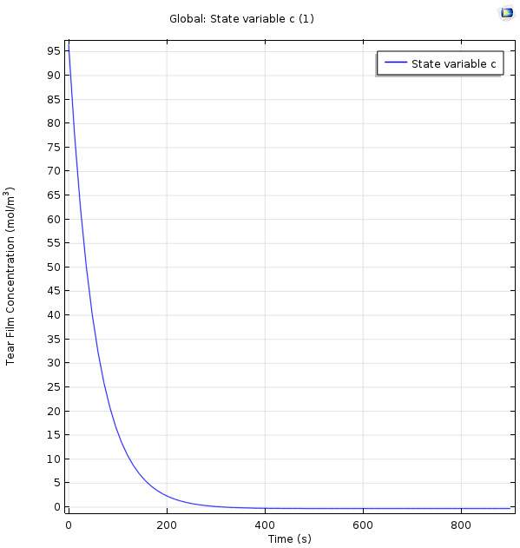
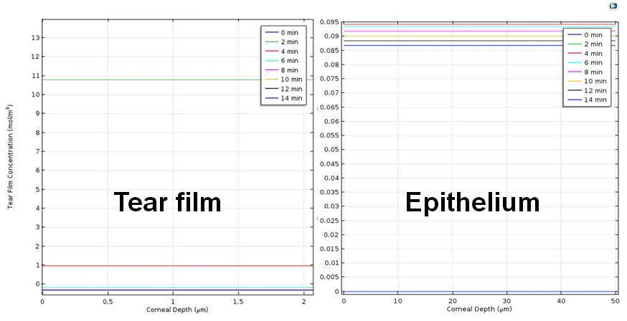
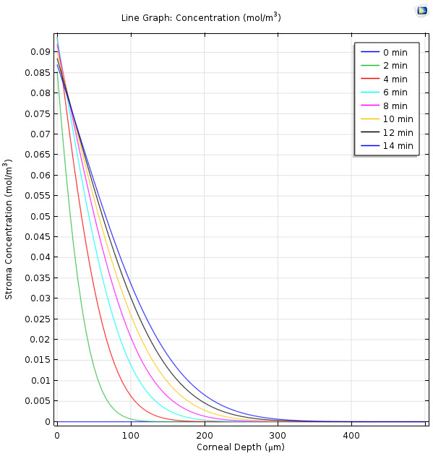
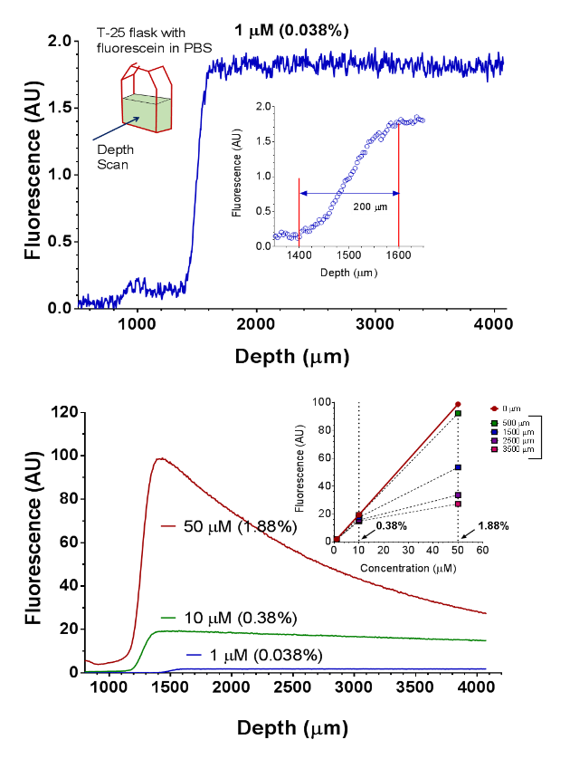
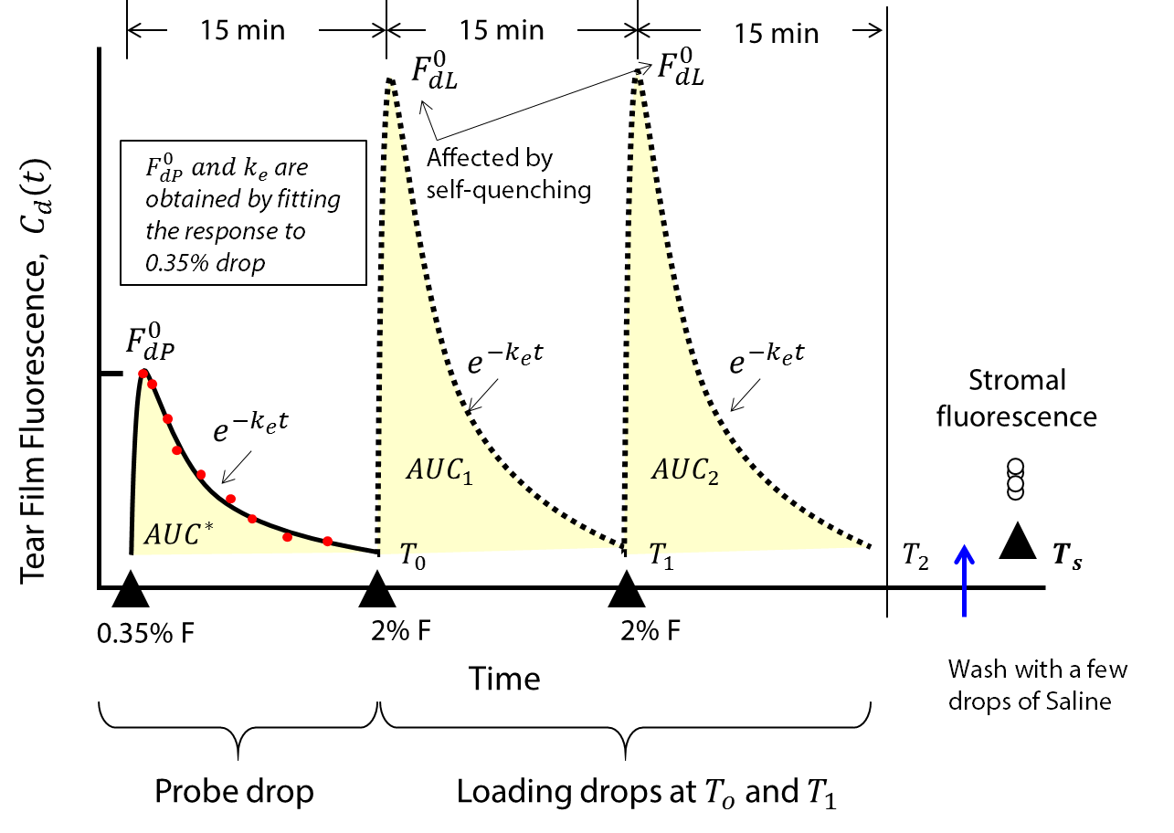
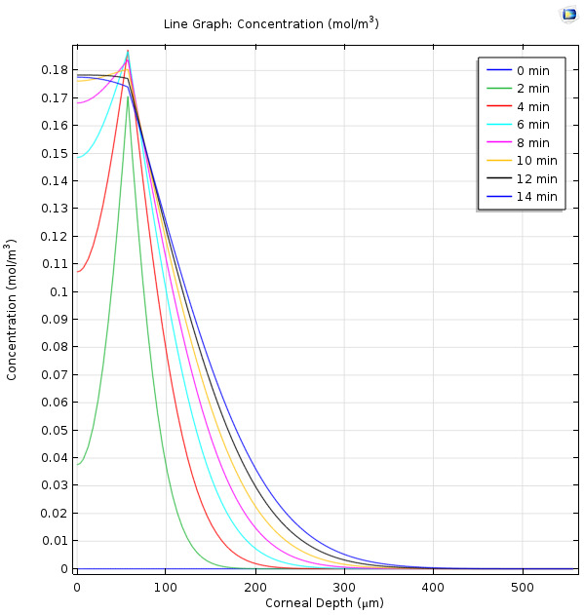
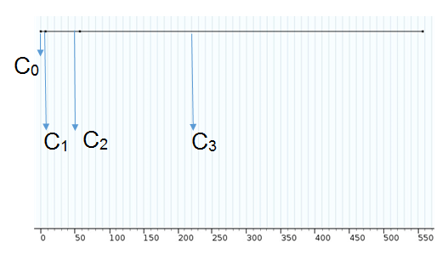
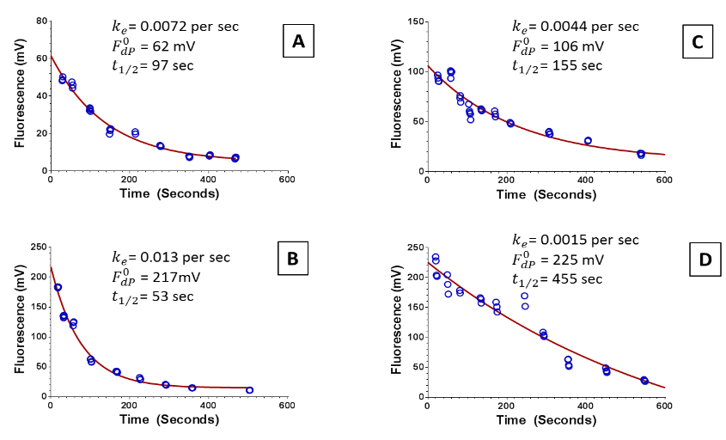


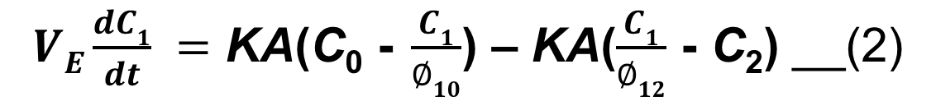
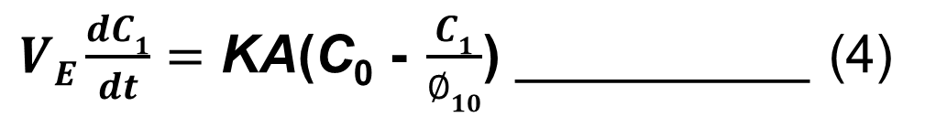


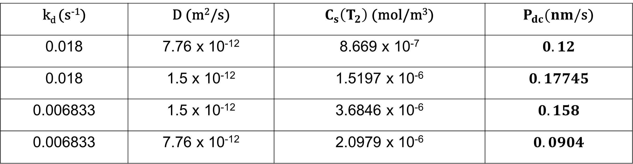



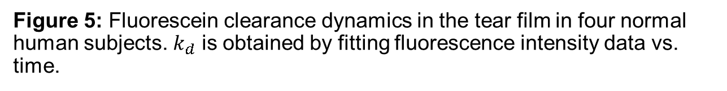
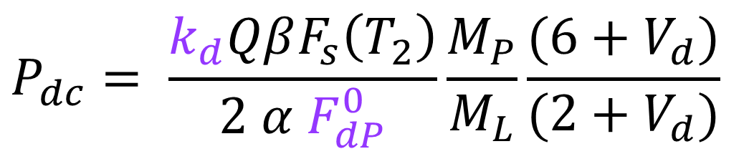
Simulation of Measurement of Corneal Permeability by Multi-Drop Method using COMSOL Multiphysics
Shashank Bharadhwaj¹, Mohd. Danish Ahmed¹, CSN Harshavardhan¹, S P Srinivas², Sudhir H Ranganath¹
¹Department of Chemical Engineering, Siddaganga Institute of Technology, Tumkur, India, ²Indiana University, Bloomington, IN, USA
Corneal Epithelial Permeability and Permeability Measurement
Results and Discussion
Cornea: Barrier to pathogenic agents
Barrier integrity of epithelium determines the corneal health
Barrier integrity expressed in terms of permeability to Fluorescein
Permeability affected in dry eye disease, aging and diabetes
Conventional methods for measuring epithelial permeability
Single drop method
Bath technique
Estimated permeability < 100 times the expected values
After the instillation of the probe drop
Tear film
Tear film
Epithelium
Stroma
Figure 1: Anatomy of the human cornea. The cornea is a three cellular layered tissue consisting of the outermost epithelium, middle stroma and the innermost endothelium. Courtesy: https://dreamstime.com
After the instillation of the loading drop
Figure 2: Routes for fluid and drug transport across the corneal epithelium. Courtesy: https://upload.wikimedia.org
Limitations of Measuring Permeability and Multi-drop method
Concentration quenching
Inner filter effects
Low spatial resolution
Tear film
Stroma
Probe Drop
Loading Drop
Tear Film
Epithelium
Figure 2: Concentration quenching and inner filter effects seen in the measurement of Fluorescein concentration using a custom-made spot fluorometer.
Figure 3: Multi-drop method for measuring corneal epithelial permeability (P_{dc}) using a custom-made spot fluorometer.
Comparison of stromal accumulation
of fluorescein after the probe drop and
the first loading Drop
Stroma
Objectives
Develop mathematical models of fluorescein transport across the human cornea
Simulate fluorescein transport across the human cornea in a novel multi-drop permeability measurement method
Compute corneal epithelial permeability using the parameters estimated via modeling
Stromal accumulation after second loading Drop
Computation of Permeability after Simulation
Mathematical Modeling of Fluorescein Transport across the Cornea
$$P_{dc}= \frac{Q C_{s}\left(T_{2}\right)}{2 \left[{AUC}_{dL}\right]}$$
Tear film (~ 7 μm)
$$P_{dc}= \frac{k_{d}QβF_{s}\left(T_{2}\right)}{2 α F_{dP}^{0}}\frac{M_{P}}{M_{L}}\frac{{(6+V}_{d})}{{(2+V}_{d})}$$
Epithelium (~ 50 μm)
Depth of the Cornea (μm)
Stroma (~ 500 μm)
$k_{d}$ is the fluorescein elimination constant in the tear film
$F_{dP}^{0}$ is the initial fluorescein concentration of the probe drop
$Q$ is the stromal thickness
$AUC$ is area under the fluorescence vs. time curve for the loading drops.
$α$ and $β$are proportionality constants for the calibration curve between tear and stromal fluorescence and fluorescein concentration.
$M_{P}$ and $M_{L}$ are mass of fluorescein in the probe drop and loading drop respectively, $V_{d }$is the volume of the tear
$F_{s}\left(T_{2}\right)$ is the average stromal fluorescence measured ~ 15 min after instillation of the second loading drop
$$C_{0}$$
$$C_{1}$$
$$C_{2}$$
$$C_{3}$$
Figure 4: Schematic representation of Fluorescein concentration across the depth of the cornea
Figure 5: Fluorescein clearance dynamics in the tear film in four normal human subjects. $k_{d}$ is obtained by fitting fluorescence intensity data vs. time.
Fluorescein clearance in the tear film at any time is given by: $C\left(t\right)=C_{0}e^{−k_{d}t}$_________ (1)
where, $k_{d}$ is the fluorescein clearance rate constant and $t$ is time.
Fluorescein partitions at the tear film-epithelium interface:
where, $VE$ is the volume of the epithelium, KA is permeability, $∅10$ is the partition coefficient of fluorescein between the tear film and the epithelium, $∅12$ is the partition coefficient of fluorescein between the epithelium and the stroma.
Applying the boundary condition for transfer across the tear film-epithelium interface: $C2=\frac{C1}{Ø10}$
The equation reduces to:
To represent Fluorescein diffusion in the stroma,
Fick’s second law was used: $\frac{∂C_{3}}{∂t}=D\frac{∂^{2}C_{3}}{∂x^{2}}$
Values Obtained from the Simulation
$VE\frac{dC1}{dt} =$ KA(C₀ - $\frac{C1}{∅10}$) – KA($\frac{C1}{∅12}$ - C₂) __(2)
k_{d} (s⁻¹) | D (m²/s) | $C_{s}\left(T_{2}\right)$ (mol/m³) | $P_{dc}(nm/$s)
0.018 | 7.76 x 10⁻¹² | 8.669 x 10⁻⁷ | $$0.12$$
0.018 | 1.5 x 10⁻¹² | 1.5197 x 10⁻⁶ | $$0.17745$$
0.006833 | 1.5 x 10⁻¹² | 3.6846 x 10⁻⁶ | $$0.158$$
0.006833 | 7.76 x 10⁻¹² | 2.0979 x 10⁻⁶ | $$0.0904$$
$VE\frac{dC1}{dt}=$ KA(C₀ - $\frac{C1}{∅10}$) __________ (4)
Experimentally determined value of corneal epithelial permeability: 0.01 to 1.28 nm/s
Conclusions
Fluorescein clearance from the tear film followed mono exponential decay.
Transport in the epithelium is a pseudo-steady state transport, while diffusion in the stroma is seen to be transient.
Results from the simulation yielded permeability value close to experimentally determined values in human subjects.
Parameters used in the simulation
Parameters | Symbol | Value | Unit
Initial Fluorescein concentration in the probe drop | C₀ | 0.17 | mol/m³
Fluorescein clearance rate constant | k_{d} | 0.12 | s⁻¹
Diffusion coefficient of Fluorescein in the stroma | D | 7.76 x 10⁻¹² | m²/s
Partition coefficient of Fluorescein in the tear film-epithelium interface | Ø₁₀ | 0.556 | -
Volume of the corneal epithelium | V_{E} | 7.952 x 10⁻¹³ | m³
Permeability | kA | 1.48 x 10⁻¹⁷ | m³/s
Acknowledgements
Sree Siddaganga Education Society, Tumkur for intramural research funding to Bio-INvENT Lab
Department of Chemical Engineering, SIT, Tumkur
Indiana University School of Optometry, Bloomington, IN, USA
For more details, contact: Dr. Sudhir Ranganath at sudhirh@sit.ac.in, Phone: +91-9901699216

