Slide 1


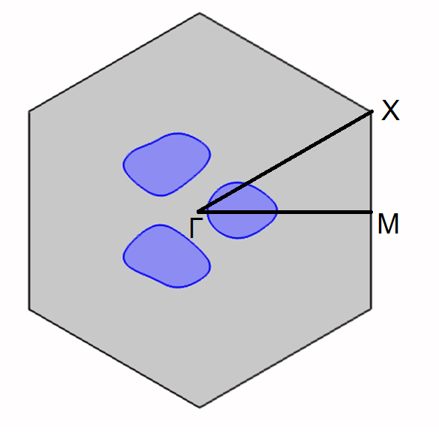
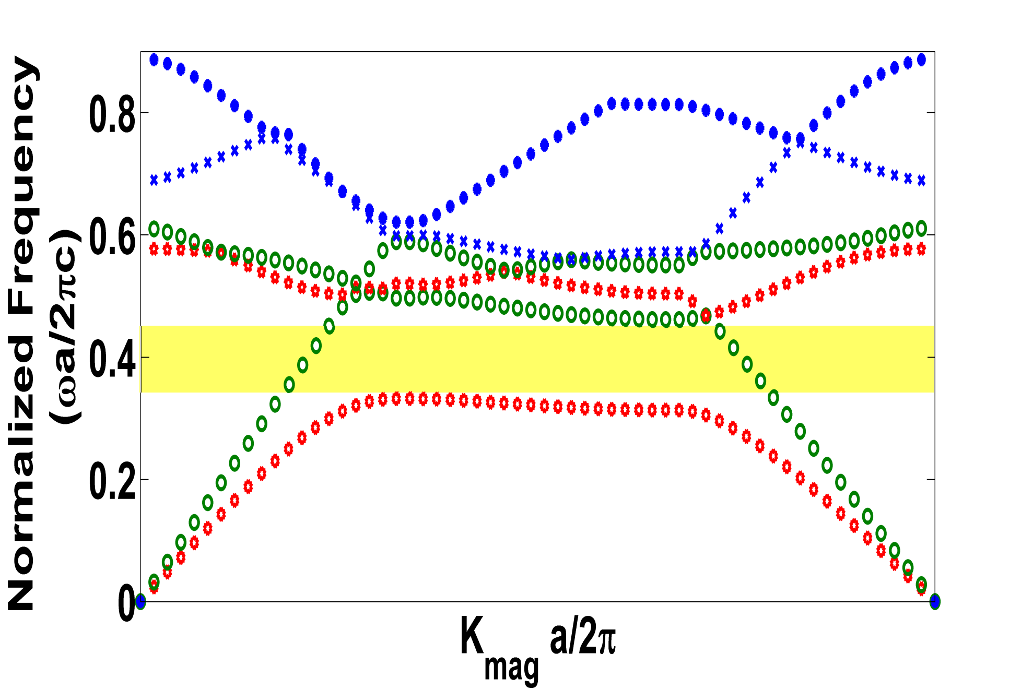
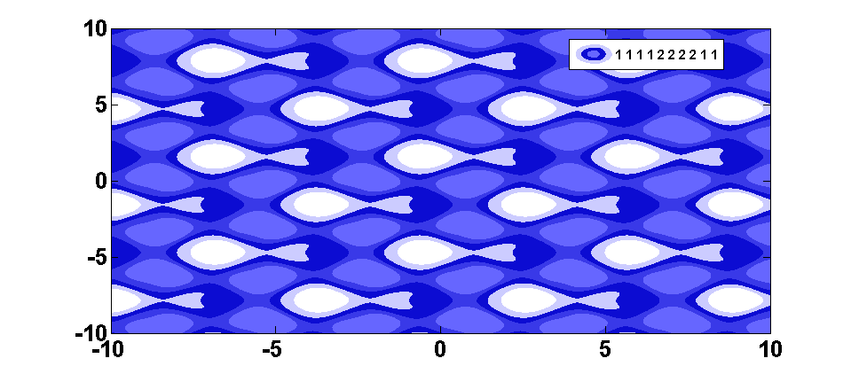
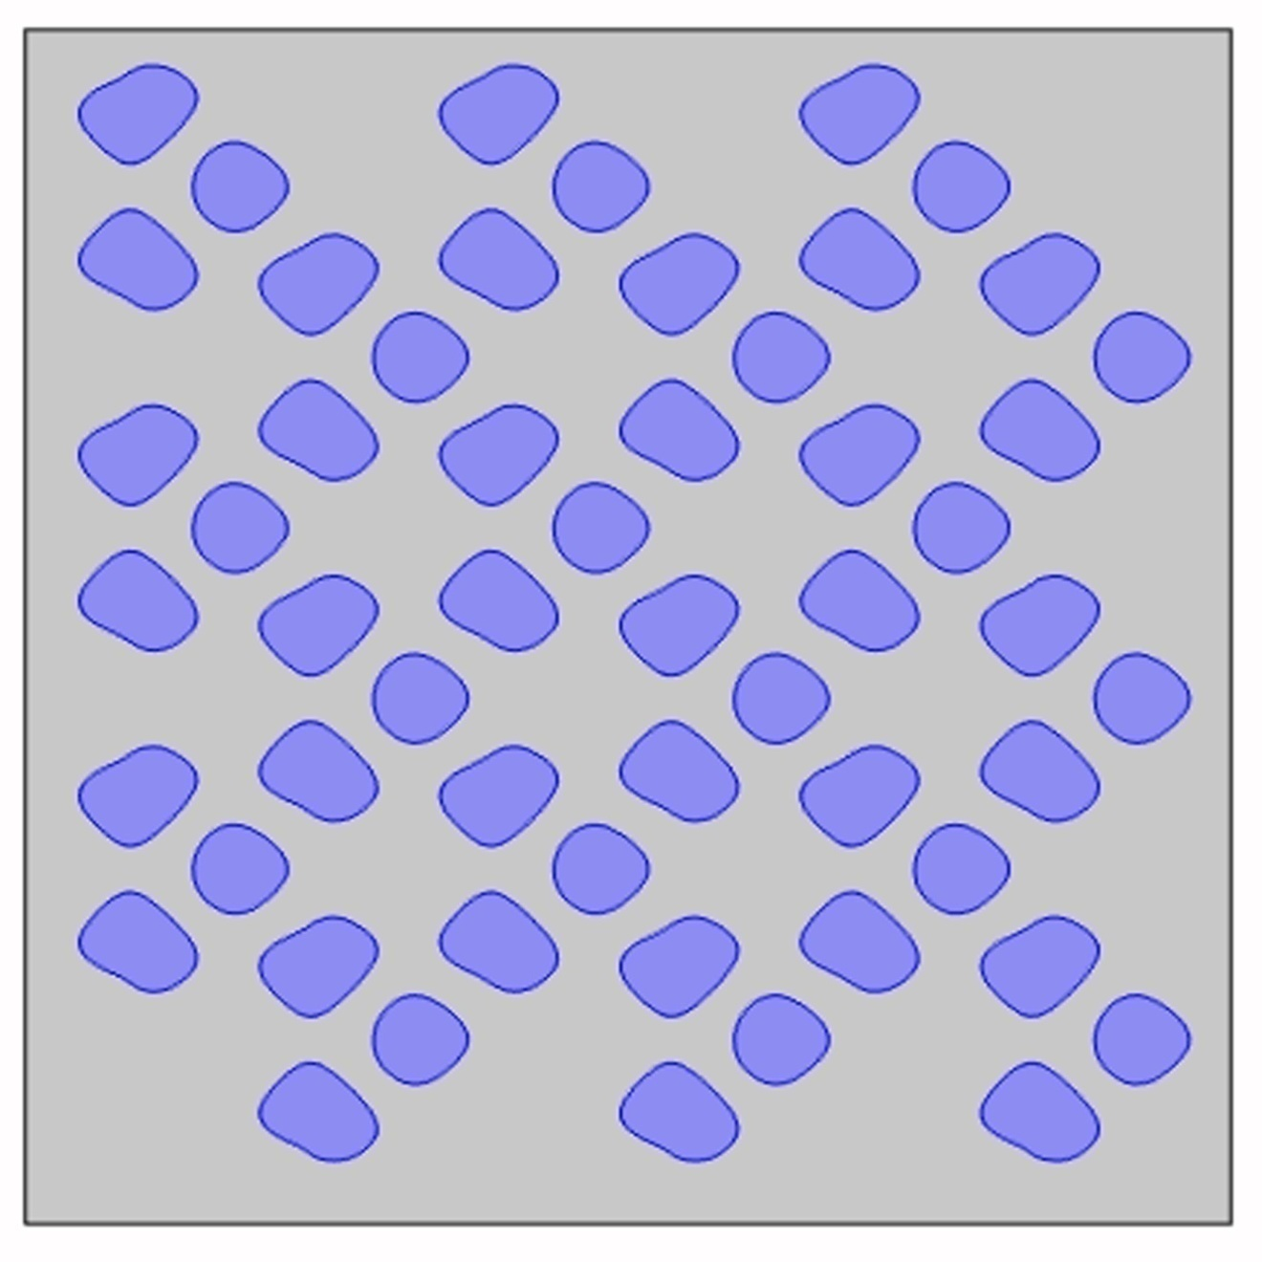
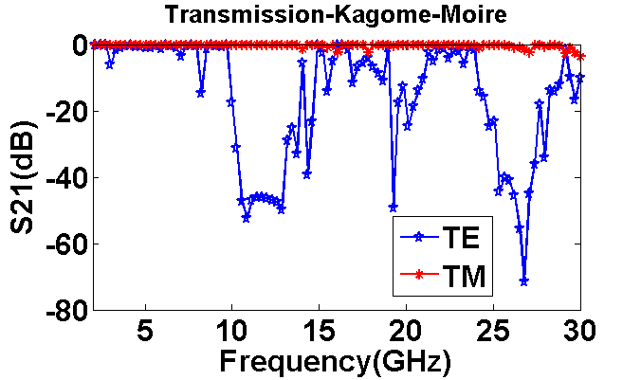
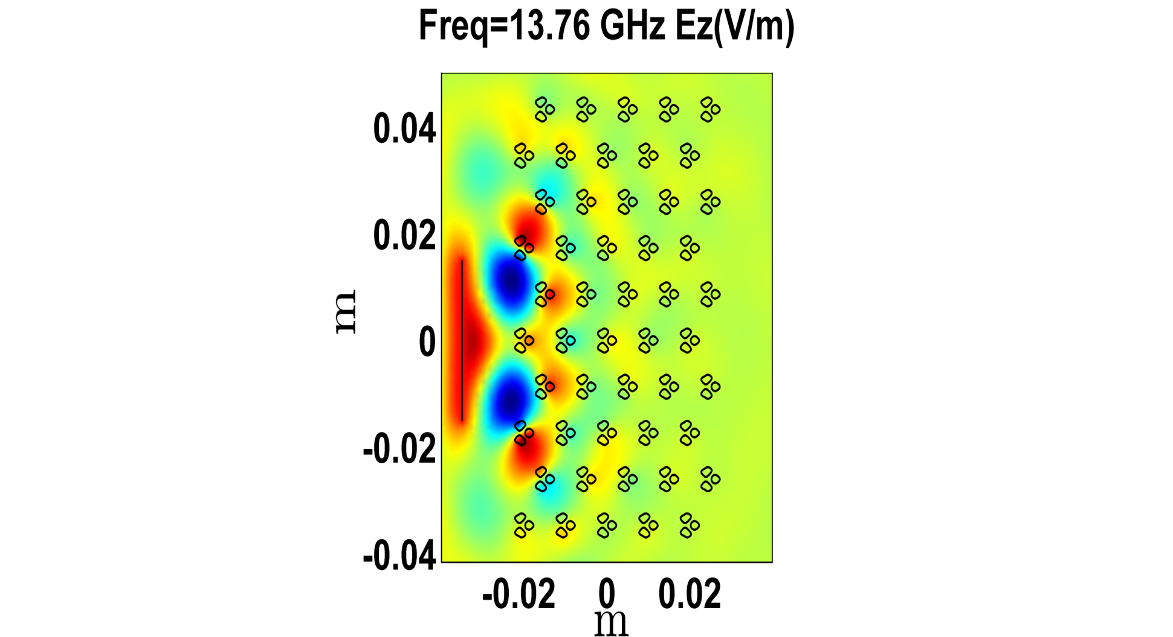
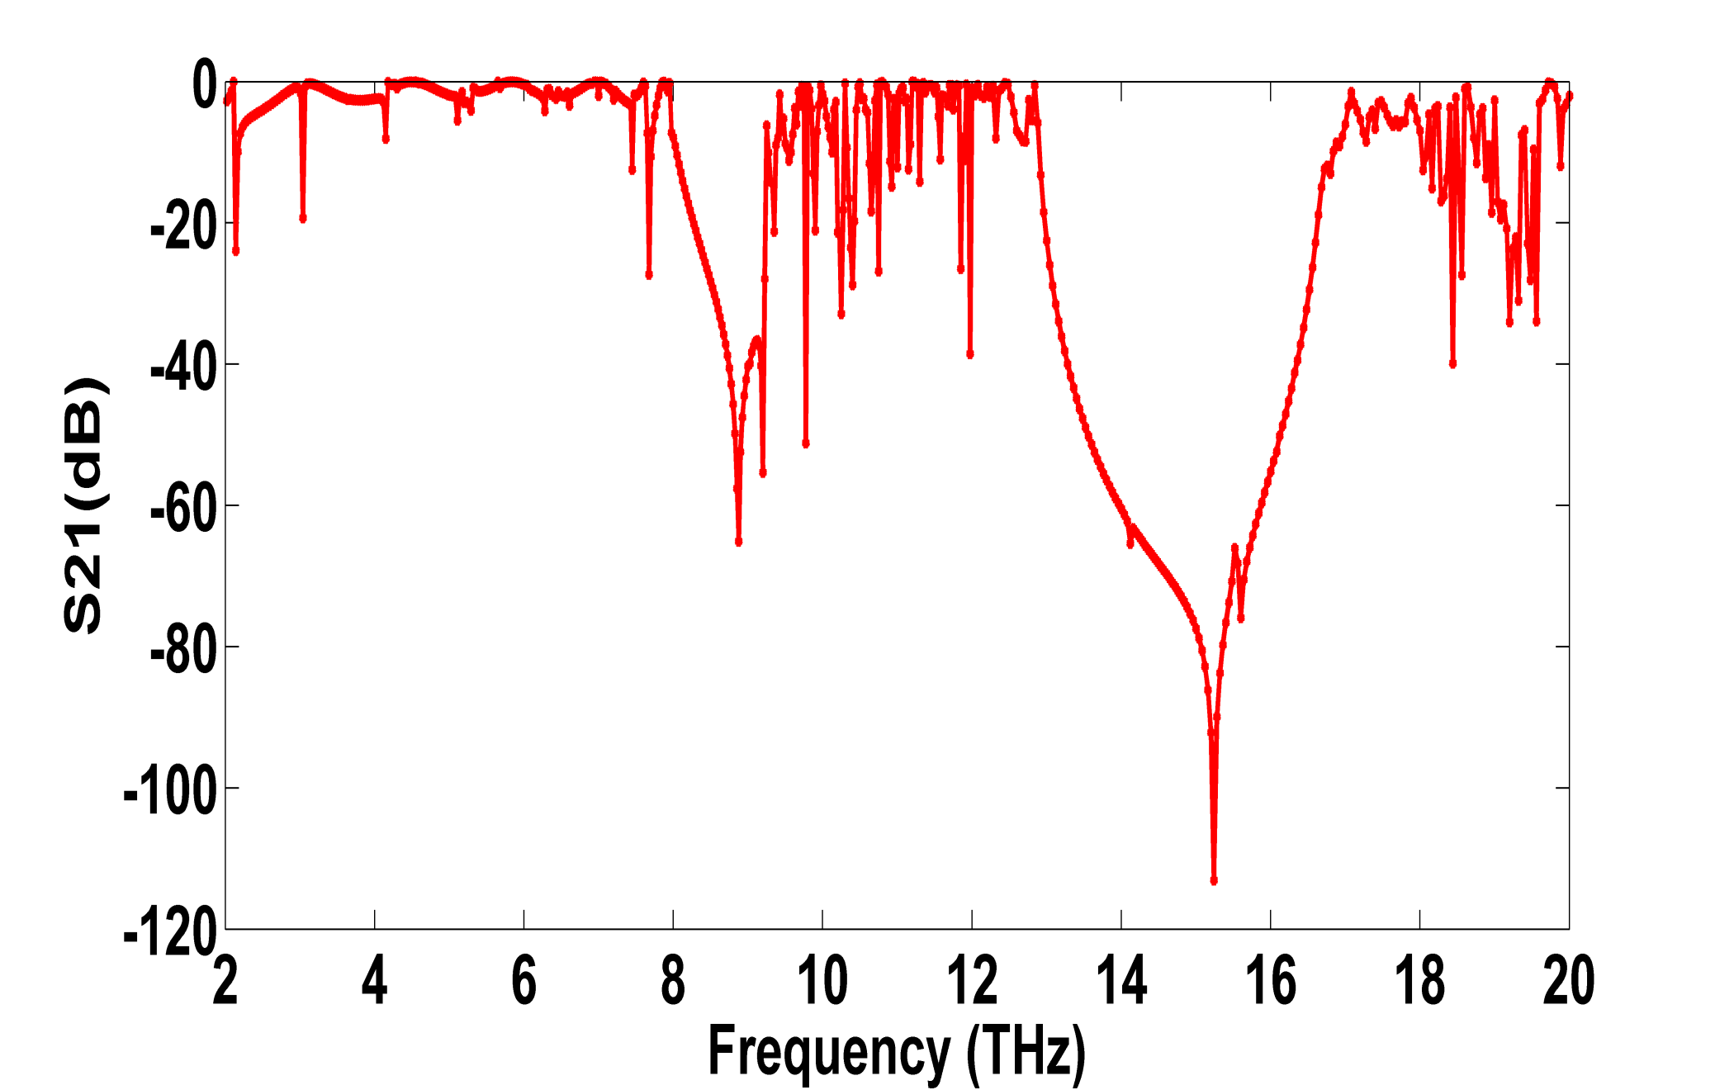
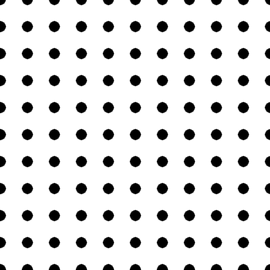
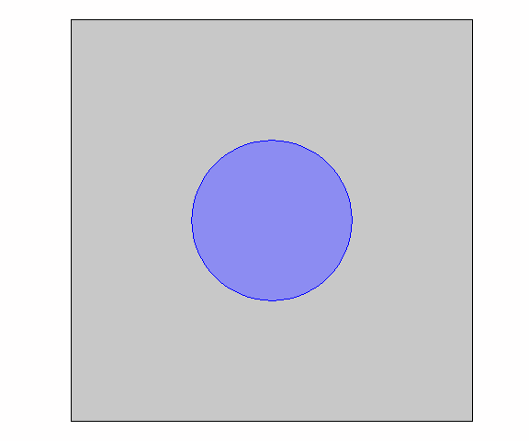
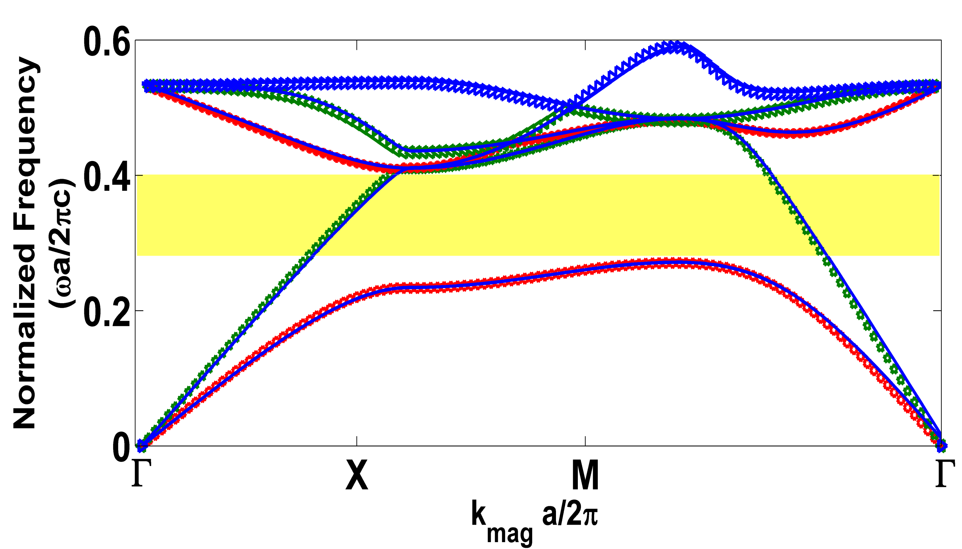
Photonic Band Structure Formed by Moirè Patterns
for Terahertz Applications
R. Rachel Darthy, C. Venkateswaran and N. Yogesh*
Department of Nuclear Physics, University of Madras (Guindy) Chennai-600025, TN, India.
INTRODUCTION: Due to the advent of 3-D printing technique, one can explore variety of geometrical structures for novel control of light. One such geometry is Moiré Pattern .
Moiré Patterns are the contours of trignometric functions, modeled as
RESULTS: Band structure of the proposed PhCs is obtained. First bandgap for TE mode spans from 0.3274 (c/a) to 0.5022 (c/a). For a=1 cm, it corresponds to 9.8 GHz to 15 GHz.
Figure 4. Unit cell of Moire PhC .
Figure 5. Photonic Band structure.
Figure 1. A moiré pattern generated by contours of trigonometric functions.
Figure 2. Photonic Crystal formed by specific contour of the Moiré pattern.
Figure 6. Transmission at normal incidence.
Figure 7. E_{z} field map at 13.76 GHz shows bandgap phenomenon.
METHODOLOGY: Maxwell’s wave equation
EXPLORING THZ BANDGAP:
Bandgap has been obtained for normal incidence in THz range with lattice constant of 10 µm and filling fraction of 74%
Primary bandgap has been obtained from the range of 7.92 THz to 9.25 THz and Secondary bandgap with a narrow steep from 12.88 THz to 17.12 THz.
is treated as an eigenvalue problem for solving photonic bandstructure.
TOOLS: Comsol RF Module has been used and results are verified with open source code MPB.
(a)
(b)
M
Γ
X
Figure 8. Transmission at normal incidence for Transverse Electric mode.
(c)
CONCLUSION: Photonic crystal formed by novel dielectric geometry is proposed and photonic bandstructure is obtained.
FUTURE SCOPE: Wavevector diagram of the proposed PhC are being explored and THz components will be realized.
Acknowledgement: We thank DST-INSPIRE Faculty Fellowship (DST/INSPIRE/04/2015/002420) for the research support.
REFERENCES:
Zhixiang Tang et. al., Optical properties of a square-lattice photonic crystal within the partial bandgap, Opt. Soc. Am. A, Vol.24, No2 (2007)
Johnson, S. G. and J. D. Joannopoulos, Block-iterative frequency-domain methods for Maxwell's equations in a plane wave basis," Opt. Express, Vol. 8, No. 3, 173-190, (2001). http://ab-initio.mit.edu/mpb.
Figure 3. Square lattice PhC of circular rod with radius 0.2cm, lattice constant 1cm and ε_{r}=12.96 (a) PhC with 10x10 Matrices (b) Unit cell (c) Band structure of Square lattice.

