Slide 1
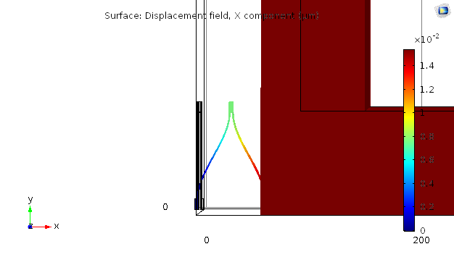
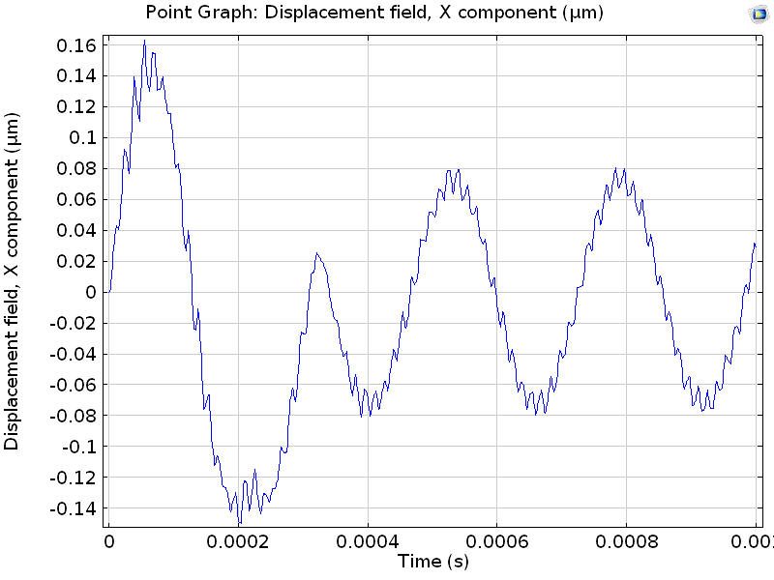
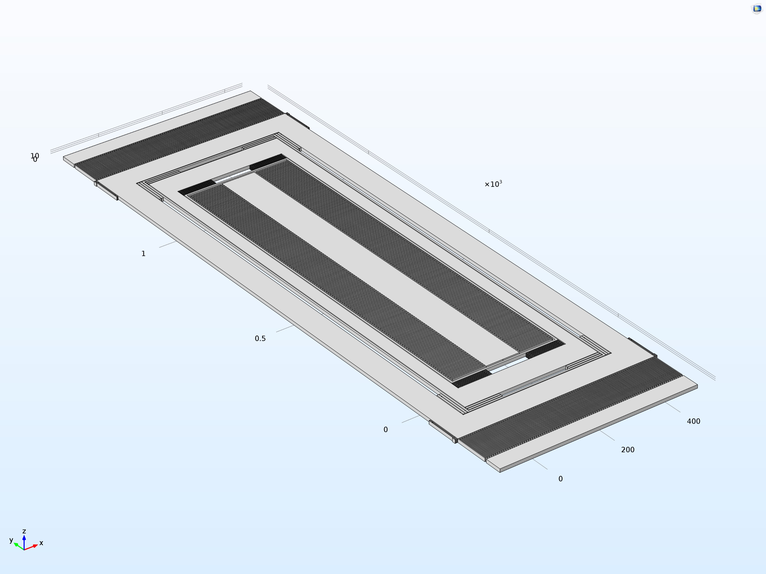
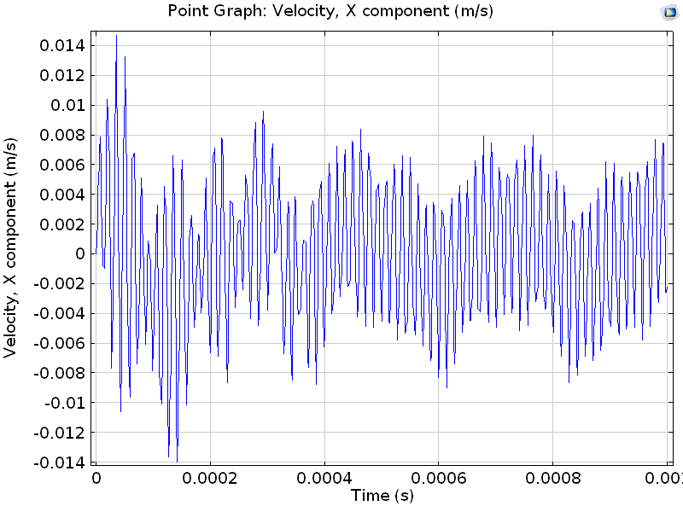
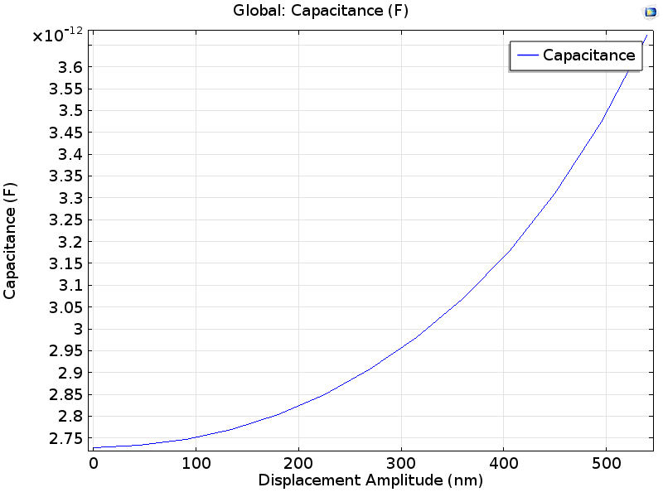
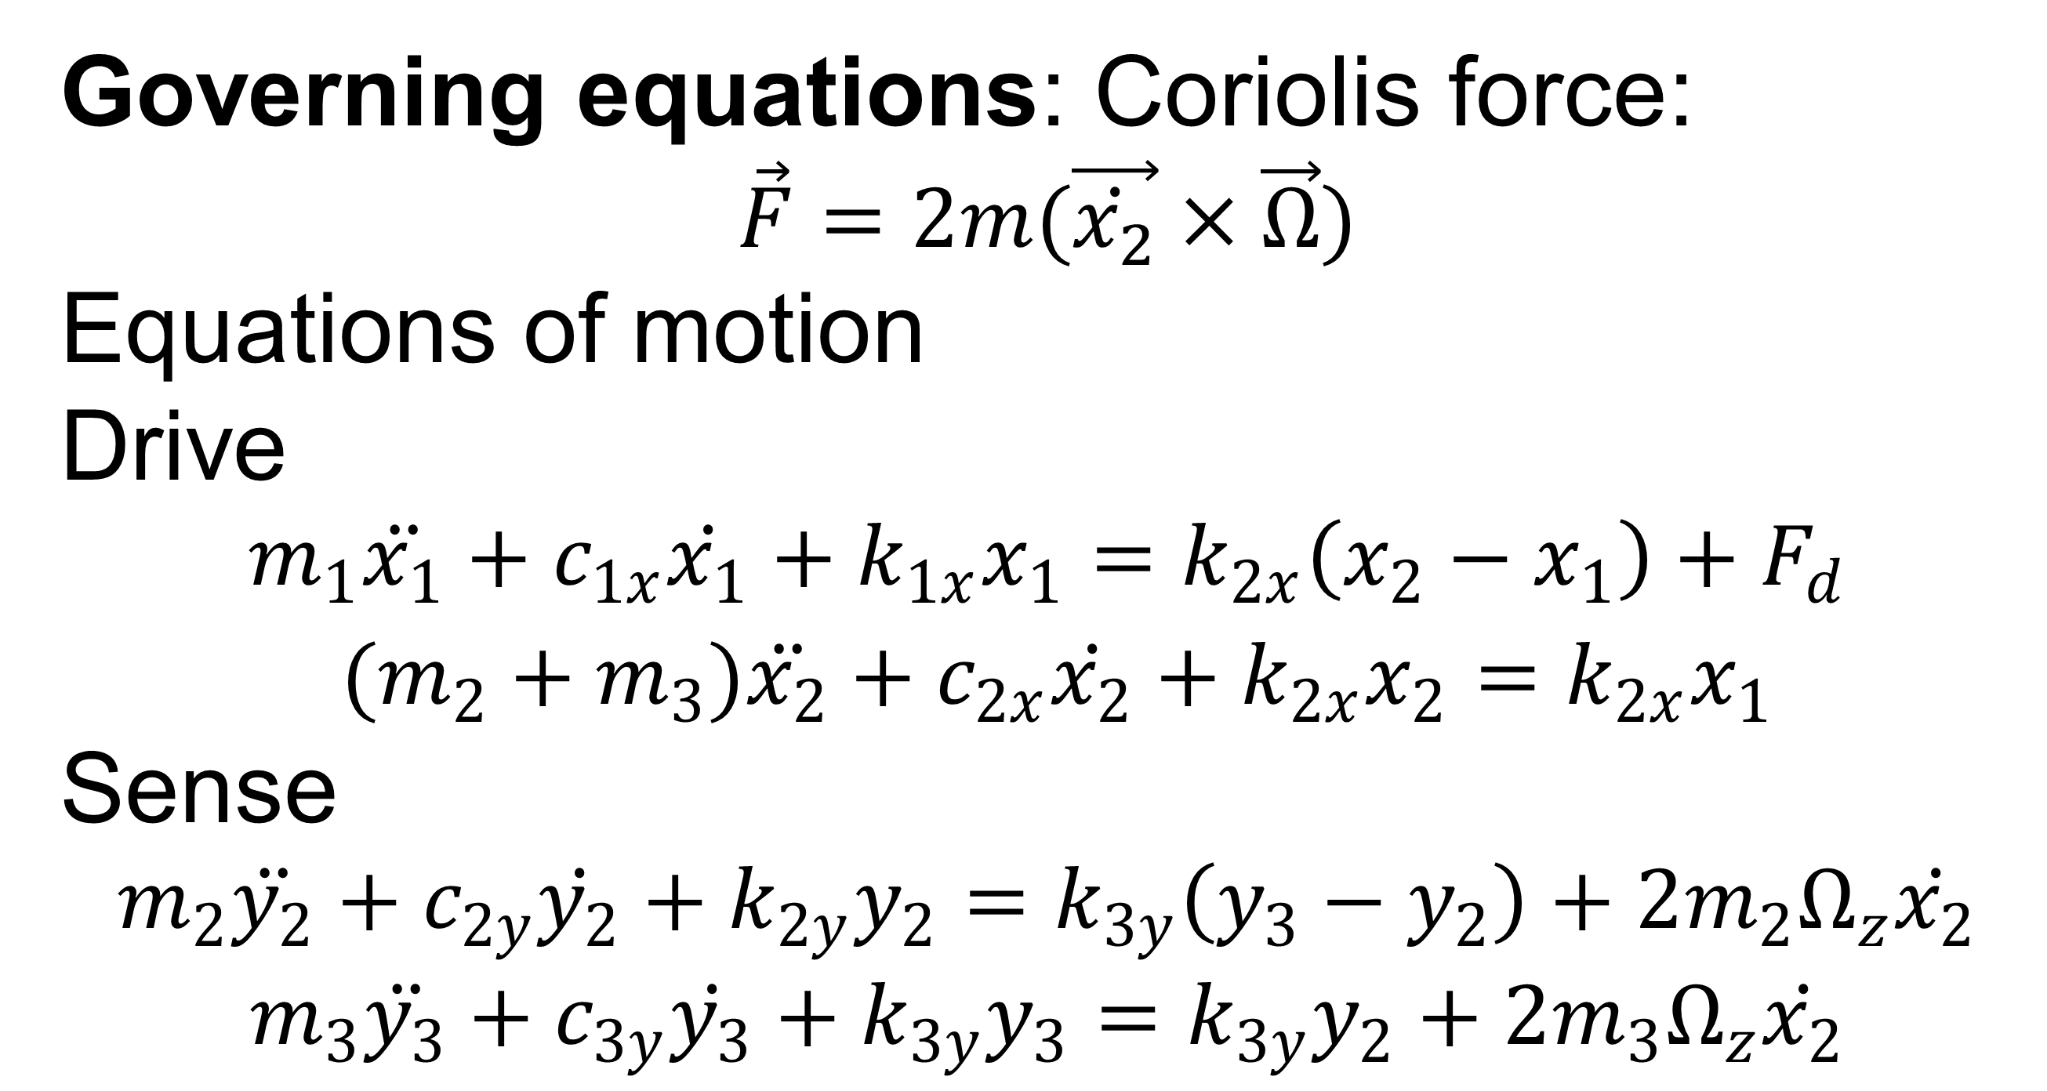
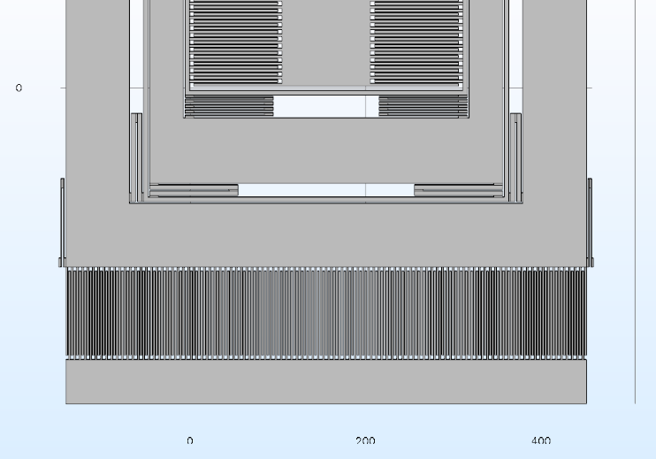
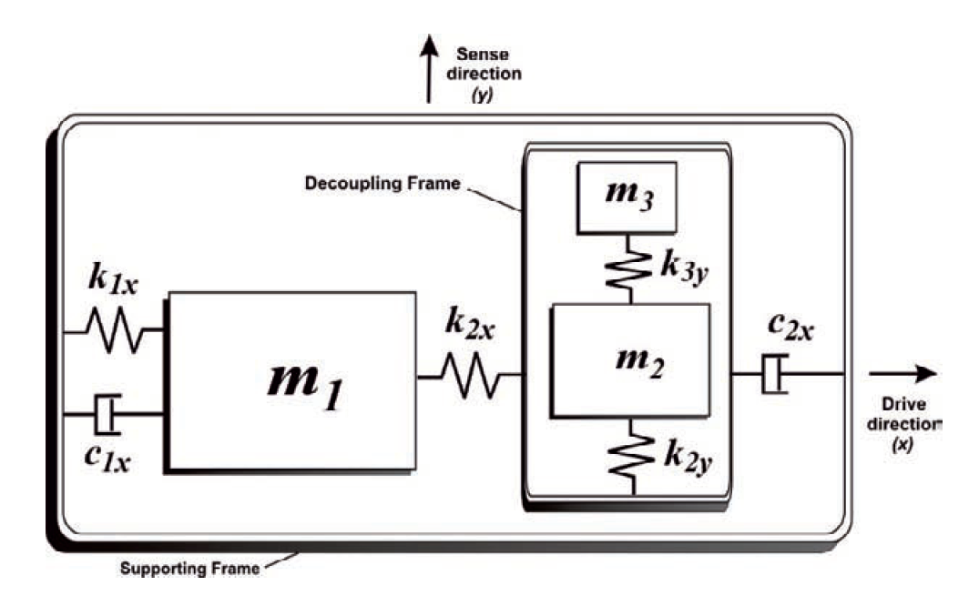
Design and Simulation of Indigenous Roll-over Sensor for Four-Wheeler Automobiles
Piyush Raj, Adarsh G Datta, Vishnu Kumar
Centre for Nano Science and Engineering, Indian Institute of Science, Bangalore, KA, India.
Introduction: Goal of our work is to design and simulate a 4-DOF MEMS vibratory gyroscope. Design has to be mechanically robust, compact, and durable since it is intended to be deployed in a life-threatening scenario.
(a)
(b)
(c)
(d)
Figure 3. (a) Spring constant calculation of serpentine structure
(b) Displacement of m₁ with sinusoidal excitation
(c) Velocity of decoupling frame with sinusoidal excitation
(d) Capacitance variation with displacement amplitude of sense electrode attached to sense mass
Figure 1. COMSOL Multiphysics® design of 4-DOF MEMS Vibrating Gyroscope
Results: Operating frequency = 70 kHz
Applied force = 16.48 µN (amplitude)
Sensitivity = ~10⁻¹⁵ F/(rad/s)
Advantages of this design:
Less sensitive to process variations
Less sensitive to operating conditions
High Bandwidth
Challenges:
On-chip detection needed
Conclusions: 4-DOF system offers superior performance compared to other systems. Careful calculation of operating frequency is crucial to robustness of design.
d
k
i
c
h
f
a = Fixed drive electrodes
b = m₁ (6.4956e-9 kg)
c = m₂ (3.41e-9 kg)
d = Fixed sense electrodes
e = k_{1x} (6.667 N/m)
f = k_{2x} (714 N/m)
g = k_{2y} (714 N/m)
h = k_{3y} (1.66 N/m)
i = m₃ (5.087e-9 kg)
j = Drive electrodes on drive mass
k = Sense electrodes on sense mass
e
b
g
j
References:
C. Acar, A. Shkel, "Structural Approaches to Improve Robustness," in MEMS Vibrating Gyroscopes, Springer, 143-144 (2008)
G. C. Y. G. G.Q. Wu∗, "A dual-mass fully decoupled MEMS gyroscope with wide bandwidth and high linearity," Elsevier, no. Sensors and Actuators A 259 50–56 (2017)
K. M. H. K. Masanori Yachi, "Development of a Roll Over Sensor," Fujitsu Ten Tech Journal, no. Fujitsu Ten Tech Journal, No (13), 1999.
a
Figure 2. Detailed look at the Gyro design

