Slide 1
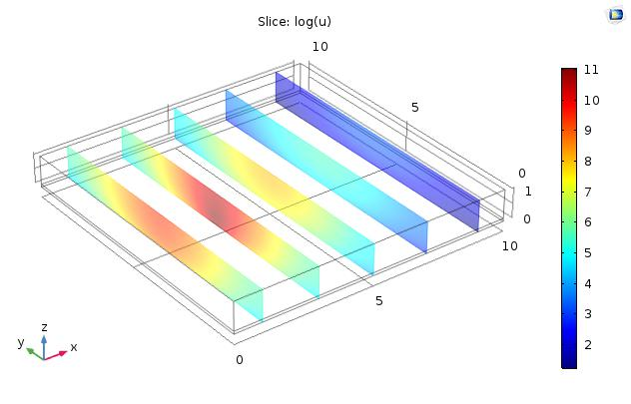
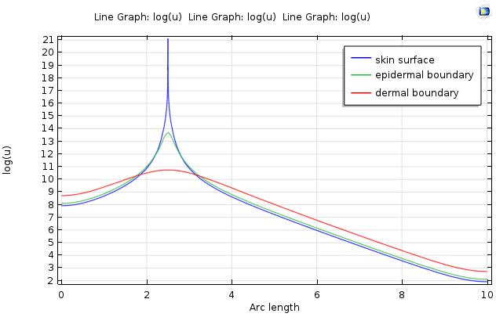
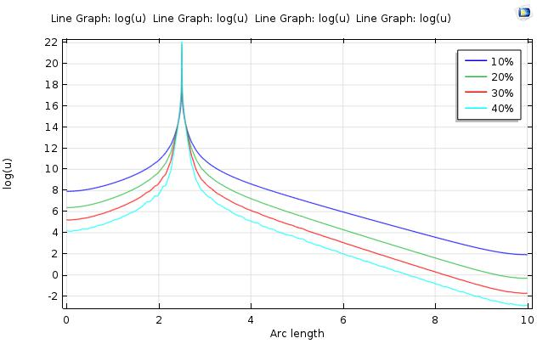
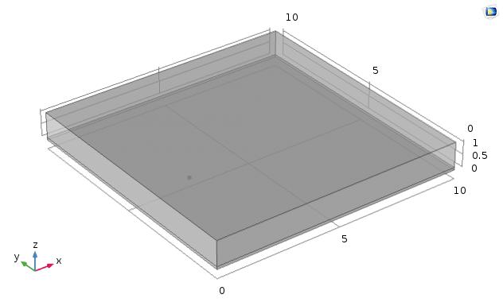
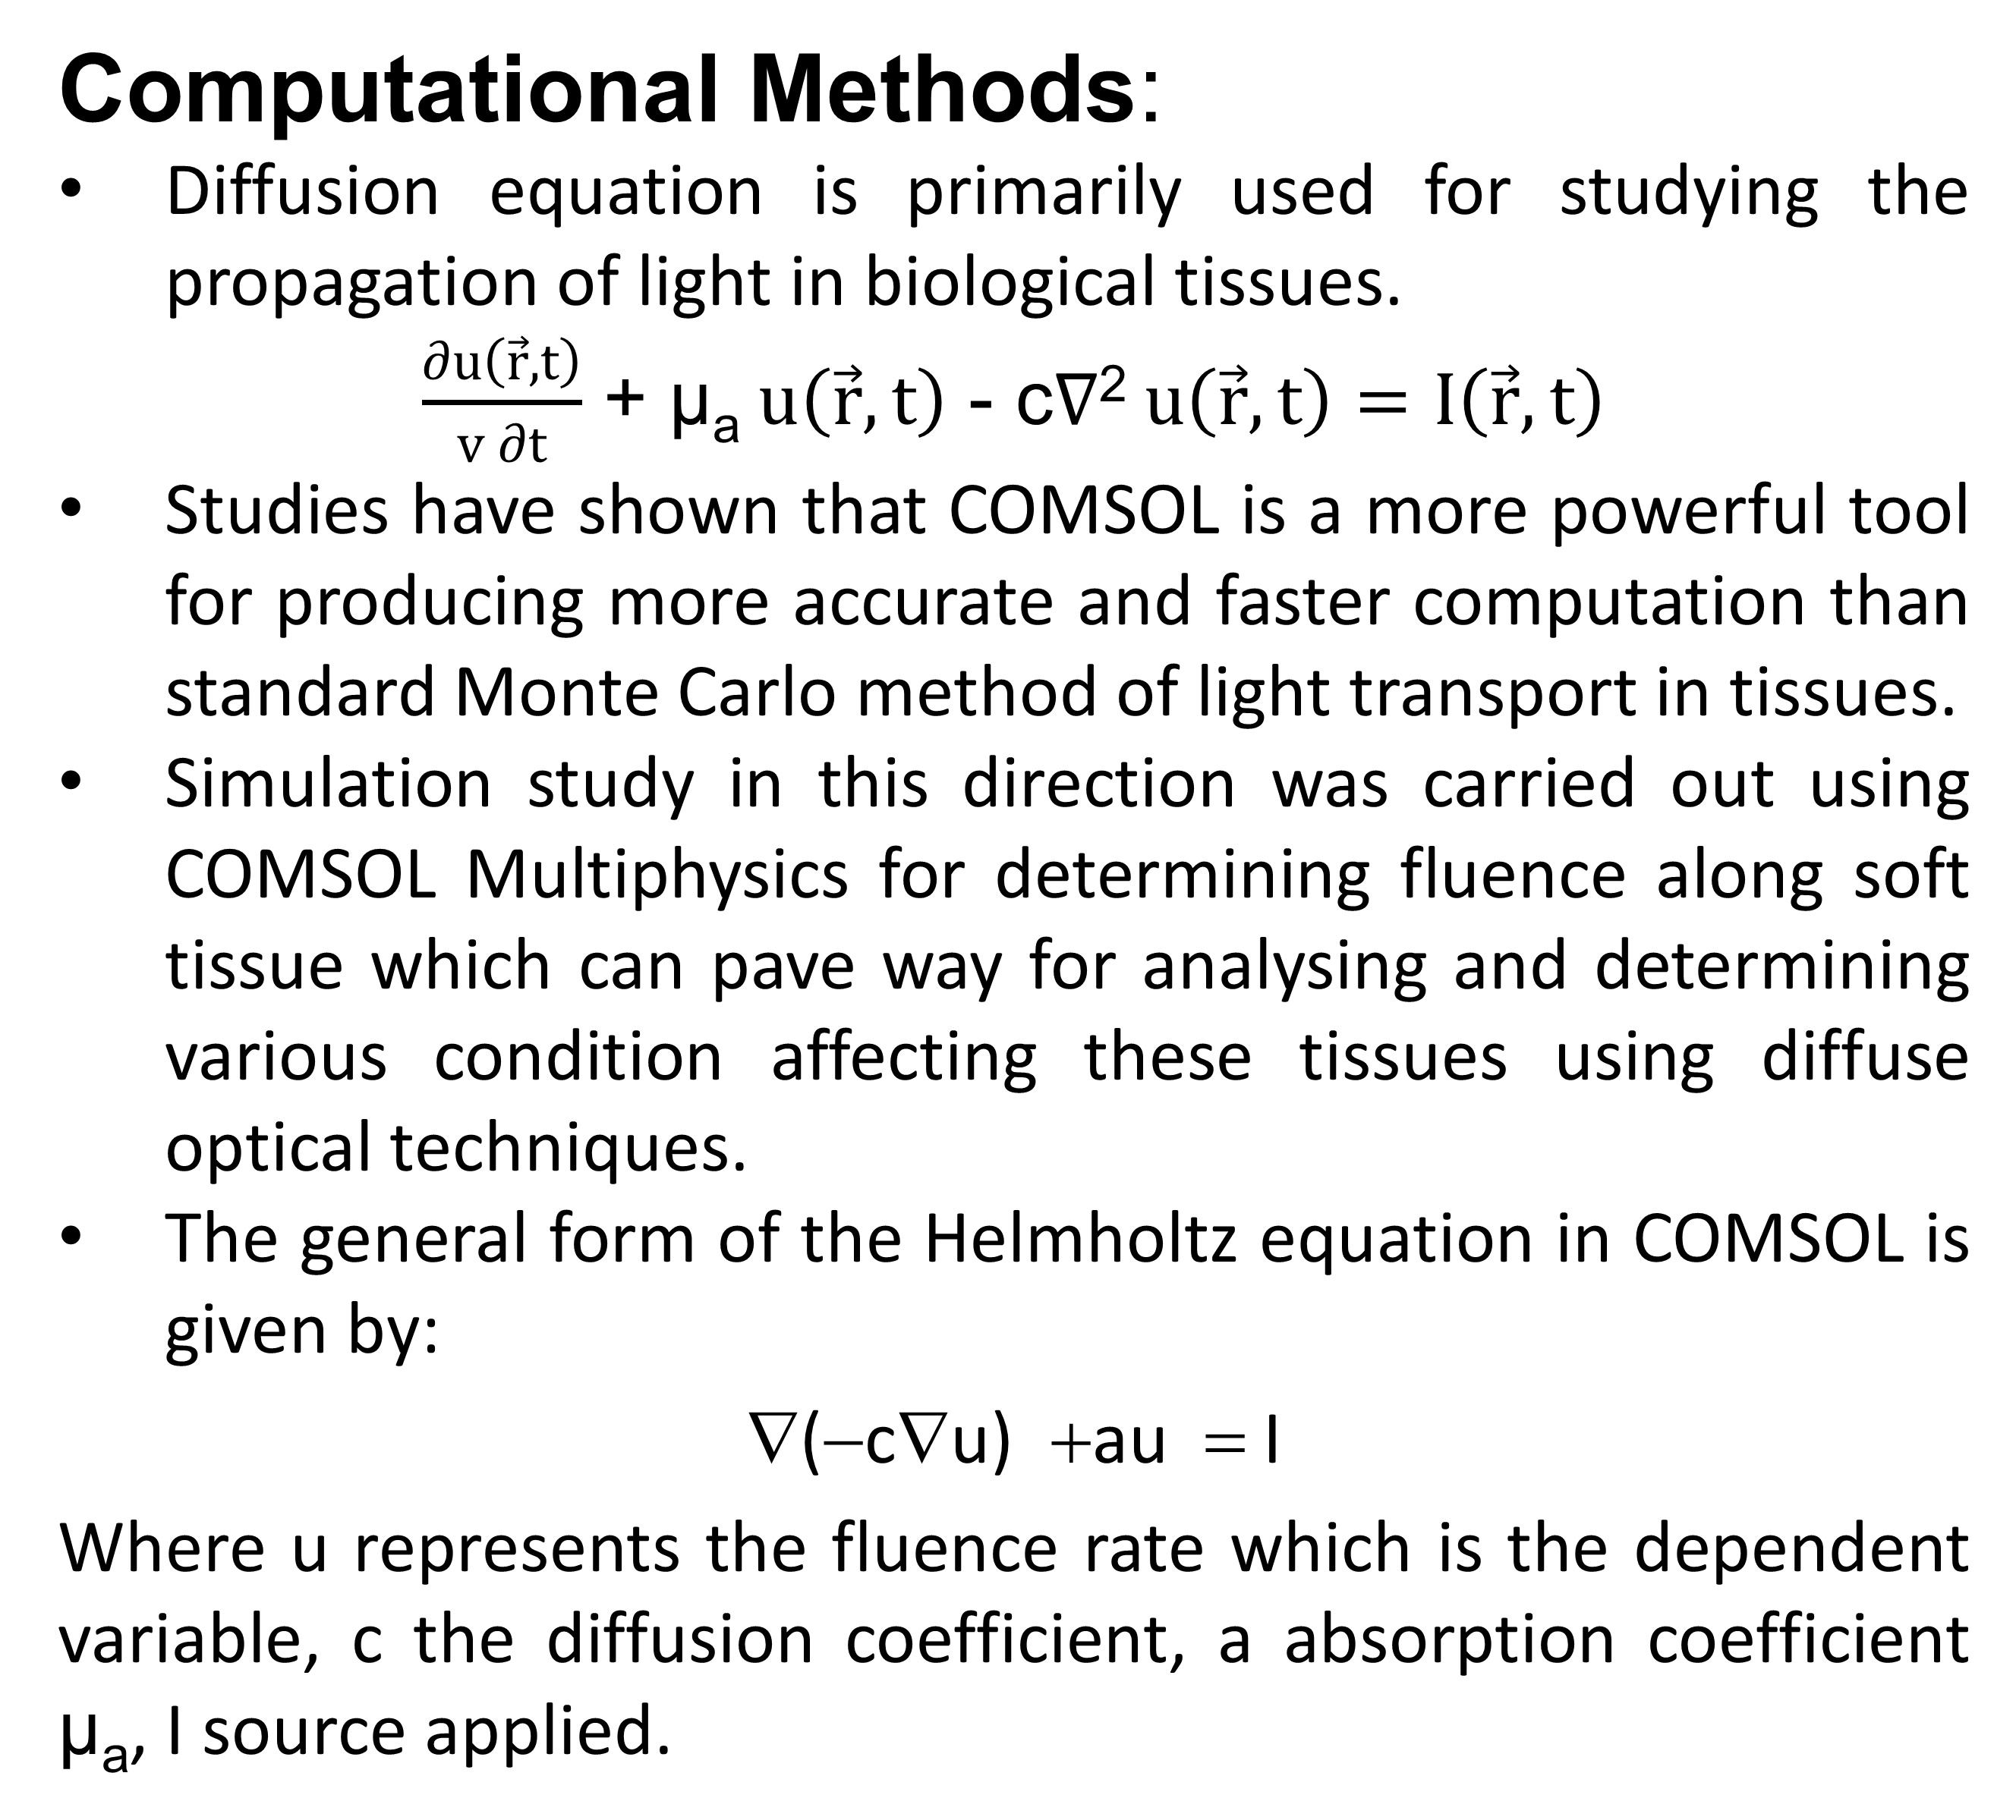
Light-tissue interaction modelling using COMSOL Multiphysics for multi-layered skin tissues
Vysakh Vasudevan*, N. Sujatha
Department of Applied Mechanics, IIT Madras, Chennai, TN, India 600036
Introduction
Diagnosis of soft tissue abnormalities normally follow invasive tissue biopsy or blood analysis
Diffuse optical spectroscopy (DOS) generally employs the reflected or transmitted light between multiple source-detector pairs on the tissue surface to reconstruct the distributions of the optical properties or their variations inside an object, and then relates these physical parameters to a physiological or pathological status in biological tissue.
In this work, we have modelled a multi-layered skin tissue in COMSOL and studied the effect of light-tissue interaction using a near infra-red source.
So this model can be used for analysing the extent of cancerous affected sites from normal skin and also helps in determining the magnitude of progress after treatments.
Results:Fluence distribution within the tissue slab was carried out using stationary study and analysis was carried out using 3D slice plots and 2D line plots. Figure 3 shows the fluence distribution along the block at different layers. Figure 4 shows the variation in fluence at the outer surface on varying the optical properties of the skin. A detector can be placed at a definite distance based on the application from the source position and thus the variation in reflected intensity at detector point can be determined
OPTICAL PARAMETERS | EPIDERMIS | DERMIS
ABSORPTION COEFFECIENT µ_{a} (cm⁻¹) | 27.196 | 0.288
SCATTERING COEFFECIENT µ_{s}ꞌ (cm⁻¹) | 22.452 | 22.335
DIFFUSION COEFFECIENT D (cm) | 0.00671 | 0.0147
Computational Methods:
Diffusion equation is primarily used for studying the propagation of light in biological tissues.
$\frac{∂u\left(\vec{r},t\right)}{v∂t}$ + µ_{a}$u\left(\vec{r},t\right)$ - c$∇$²$u\left(\vec{r},t\right)=I\left(\vec{r},t\right)$
Studies have shown that COMSOL is a more powerful tool for producing more accurate and faster computation than standard Monte Carlo method of light transport in tissues.
Simulation study in this direction was carried out using COMSOL Multiphysics for determining fluence along soft tissue which can pave way for analysing and determining various condition affecting these tissues using diffuse optical techniques.
The general form of the Helmholtz equation in COMSOL is given by:
∇(−c∇u) +au = I
Where u represents the fluence rate which is the dependent variable, c the diffusion coefficient, a absorption coefficient µ_{a}, I source applied.
Figure 2.3D fluence distribution
Table 1. Inputted parameters to COMSOL
SOURCE DETECTOR DISTANCE IN mm
SOURCE DETECTOR DISTANCE IN mm
Figure3. Fluence distribution along epidermal layer for varying optical properties
Figure 4. Fluence distribution along the tissue block in different layers
Conclusions:
Fluence distribution along multiple skin layers was analysed using COMSOL Multiphysics.
With variation in optical properties, the fluence distribution varies and it can be determined using COMSOL with relative ease when compared to previous methods.
Help in carrying out simulation studies related to soft tissue abnormalities using diffuse optical techniques and can contribute to its hardware realization.
Calculations:
Information about optical properties like absorption coefficient and reduced scattering coefficient of different skin layers is required to carry out the analysis.
Values for each of these layers when illuminated with a source at a wavelength of 660nm were determined for a skin tissue having 10 % concentration of melanosomes in epidermal layer and was quantified as shown in table 1.
Source
References:
V. V. Tuchin, “Tissue Optics and Photonics: Biological Tissue Structures,” J. Biomed. Photonics Eng., vol. 1, no. 1, pp. 3–21, 2015.
A. G. Yodh, “Diffuse Optics : Fundamentals & Tissue Applications,” Astronomy, pp. 51–74, 2011.
S. A. M. Kirmani, L. Velmanickam, D. Nawarathna, S. S. Sherif, and I. T. L. Jr, “Simulation Of Diffuse Optical Tomography Using COMSOL Multiphysics ®,” Proc. 2016 COMSOL Conf. Bost., 2016.
O. Medical, N. Jan, and S. L. Jacques, “Skin Optics,” http://Omlc.Ogi.Edu, pp. 1–6, 2011.
Dermis
Epidermis
Figure 1. 3D geometry constructed replicating skin tissue

