Slide 1
The effect of viscosity on dynamics of Electrowetting droplet
Ning Weng
Qian Xuesen Laboratory

Slide 2
Outline
Introduction
Mathematical Models
Results and Discussion
Conclusions

Slide 3
Introduction
Digital microfluidics
Liquid lens
Micro switches
Optical valves and mirrors
Reflective displays

Slide 4
Mathematical Models
Fluid properties and simulation conditions
Parameter | Symbol | Value | Unit
Density of liquid | ρ_{l} | 1000 | Kg/m³
Dynamics viscosity of liquid | μ_{l} | 0.0001,0.001,0.01,0.1,0.8 | Pa·s
Density of air | ρ_{a} | 1.204 | Kg/m³
Dynamics viscosity of air | μ_{a} | 1.814*10⁻⁵ | Pa·s
Surface tension | σ | 0.0712 | N/m
Droplet diameter | D | 1.016 | mm
Voltage | V | 120 | V
Initial contact Angle | θ_{s} | 118 | °
Thickness of dielectric layer | d | 5 | um
Relative permittivity of the insulating dielectric layer | ε_{r} | 3.15
Hydrophobic layer(PTFE) | d | 100 | nm

Slide 5
Mathematical Models
Navier-Stokes equations for fluid flow:
Moving mesh for interface

Slide 6
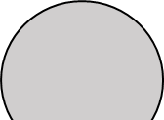
Mathematical Models
θ_{D}
_{h}
_{R}
Fig 1. Schematic of electro-wetting droplet on a surface

Slide 7

Mathematical Models
Open flow boundary
g
Liquid droplet
Open flow
boundary
air
z
r
Wetted wall
Fig 2. Schematic of computational domain

Slide 8
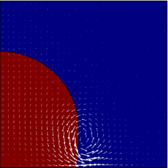
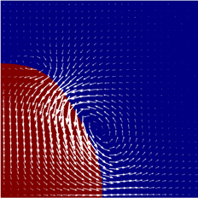
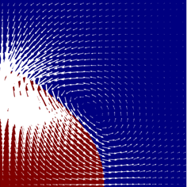
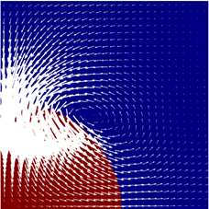
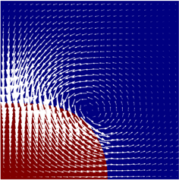
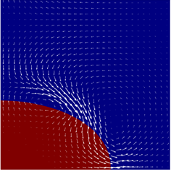
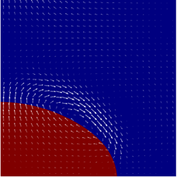
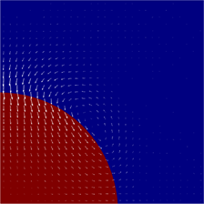

Results and Discussions
Dynamics Process of Electro-wetting droplet(μ_{l}=0.001Pa·s voltage=120v)
1ms
3ms
5ms
6ms
7ms
9ms
10ms
20ms
50ms
Fig 3. Electro-wetting process of droplet on the substrate (V=120V, μ_{l,} =0.001 Pa·s)

Slide 9
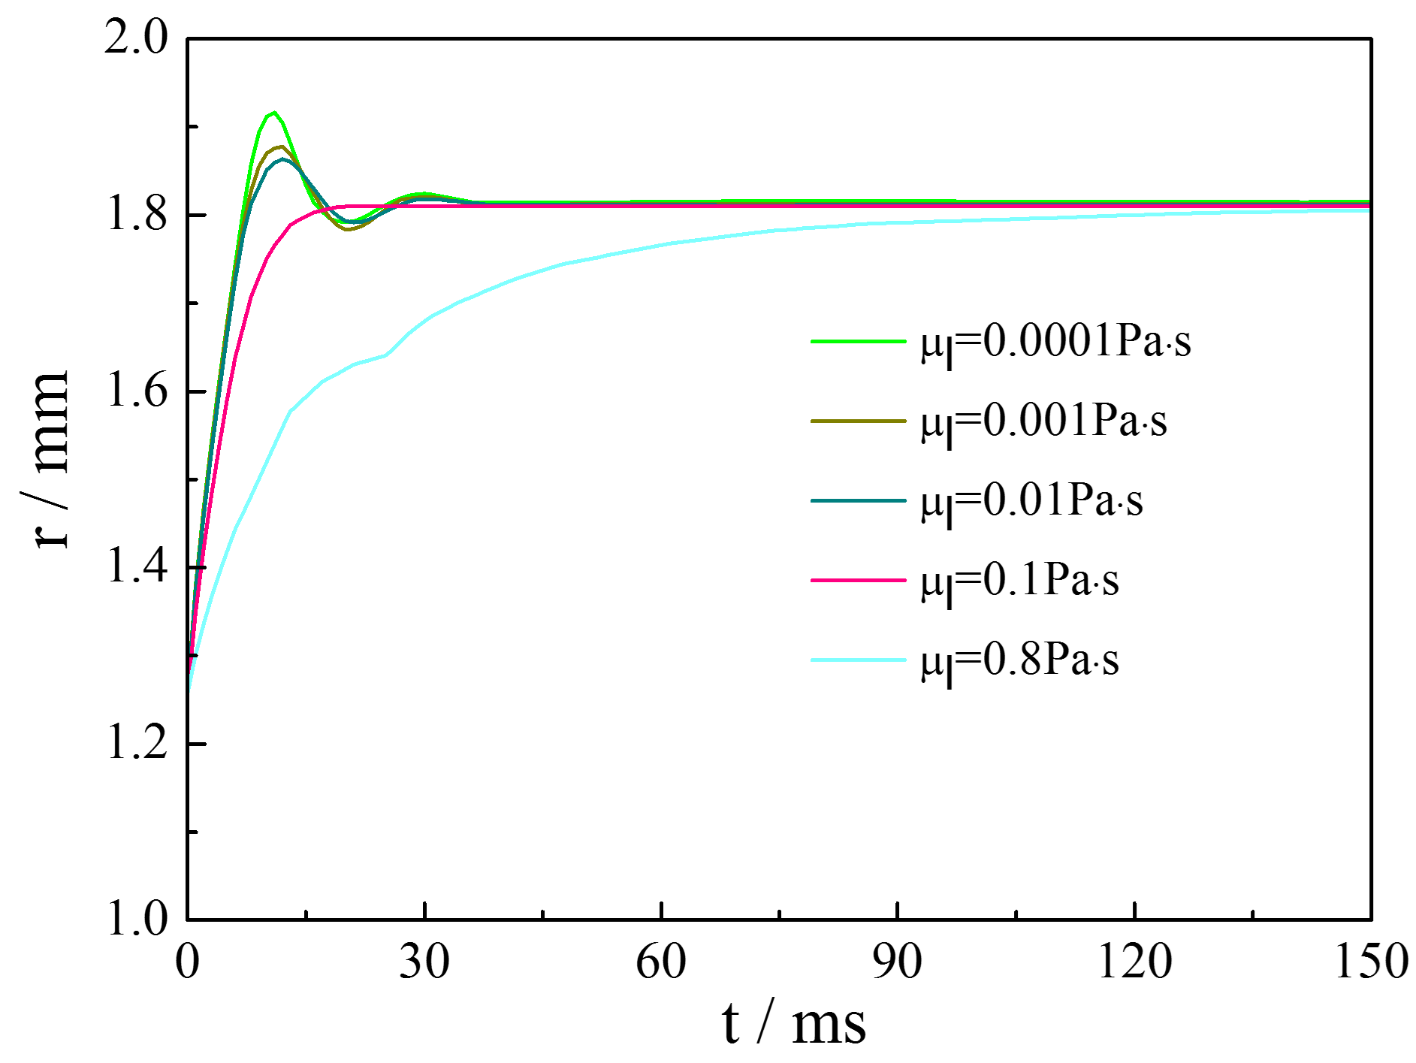
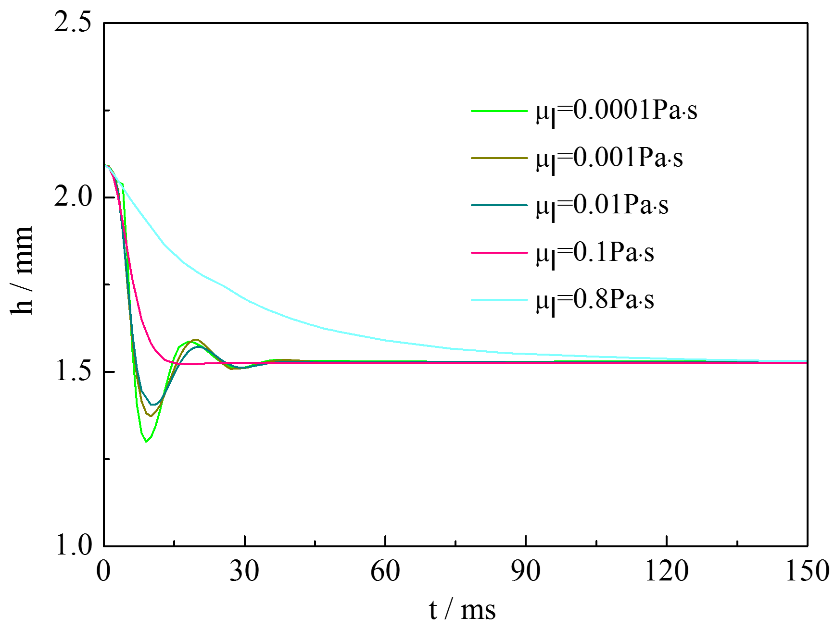
Results and Discussions
Fig 4. Time evolution of contact radius of droplet with different viscosity in DC (V=120V)
Fig 5. Time evolution of height of droplet with different viscosity in DC (V=120V)

Slide 10
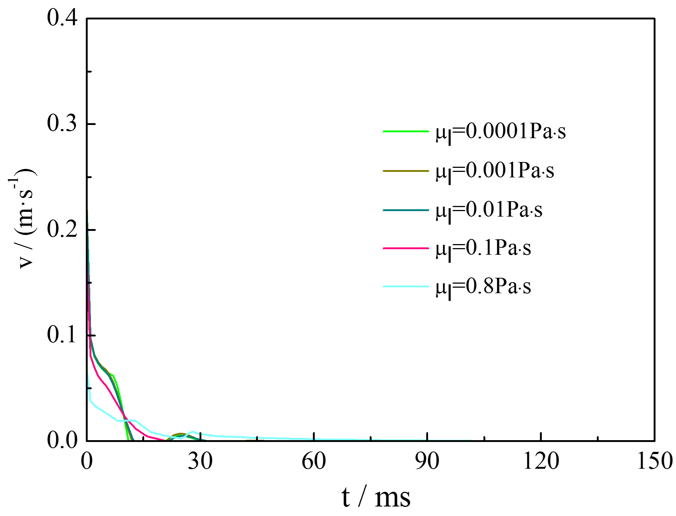
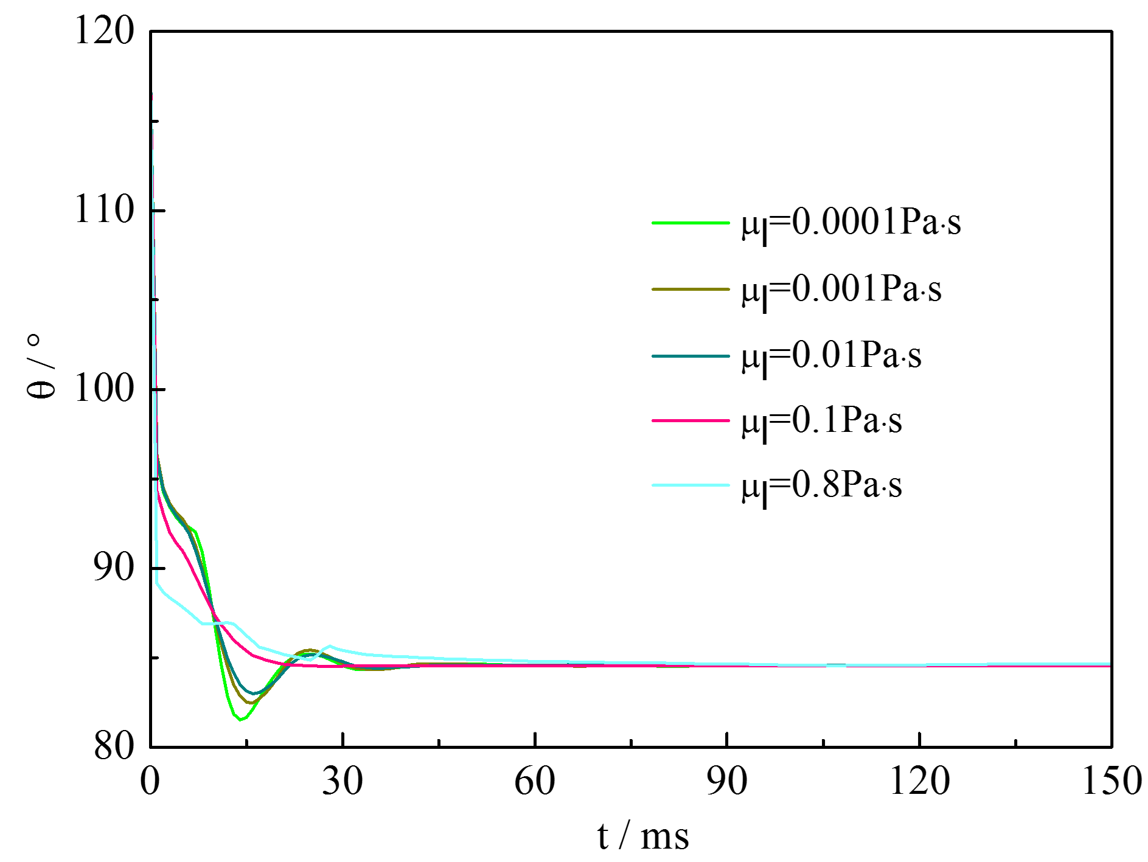
Results and Discussions
Fig 6. Time evolution of contact line velocity of droplet with different viscosity in DC (V=120V)
Fig 7. Time evolution of contact angle of droplet with different viscosity in DC (V=120V)

Slide 11
Conclusions
The dynamic process of electrowetting droplet on solid substrates were simulated using Moving Mesh.
The MKT based dynamic contact angle model can be successfully used to numerical analysis of droplet dynamics.
When droplet’s viscosity is low, it recoils and undergoes damped oscillations under DC Electro-wetting. When droplet’s viscosity is high, oscillations don’t occurs.

Slide 12
Thank you

