Slide 1


Impact of Fluctuations of Core Refractive Index on Large Mode Area Photonic Crystal Fiber Mode Distortion
Qiubai Yang, Fei Yu, Chunlei Yu, Lili Hu
The R&D Center for High Power Laser Components
Shanghai Institute of Optics and Fine Mechanics, Chinese Academy of Science
yangqiubai@siom.ac.cn yufei@siom.ac.cn
10/17/2019

Slide 2
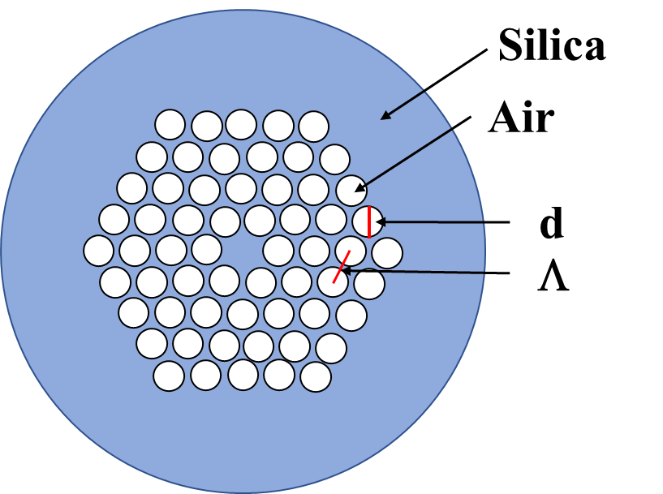
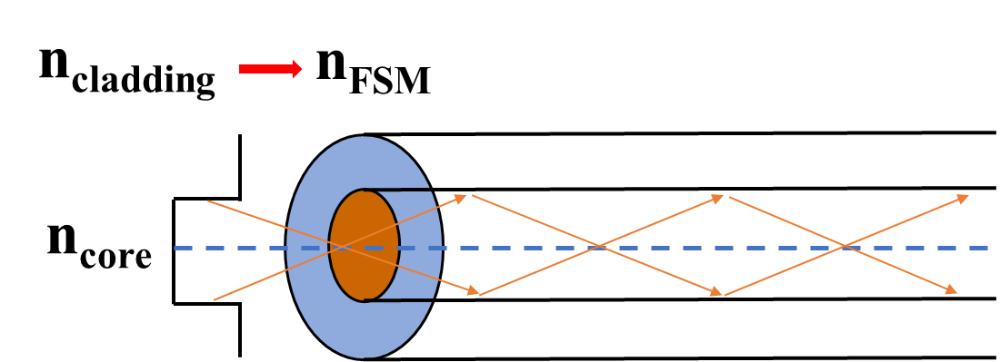
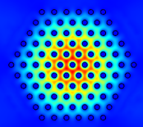
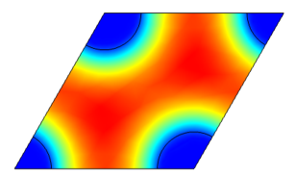
Introduction
Photonic Crystal Fiber
Equivalent step index model
n_{FSM}＜ n_{eff}=β/k₀ ≤ n_{core}
Fundamental space-filling mode (FSM)
2

Slide 3
Introduction
High Power Laser Fiber
Low Nonlinear Effect and High Laser Damage Threshold
Photonic Crystal Fiber
Large Mode Area
Large Core Size
Single Mode
Large Mode Area Photonic Crystal Fiber
3

Slide 4
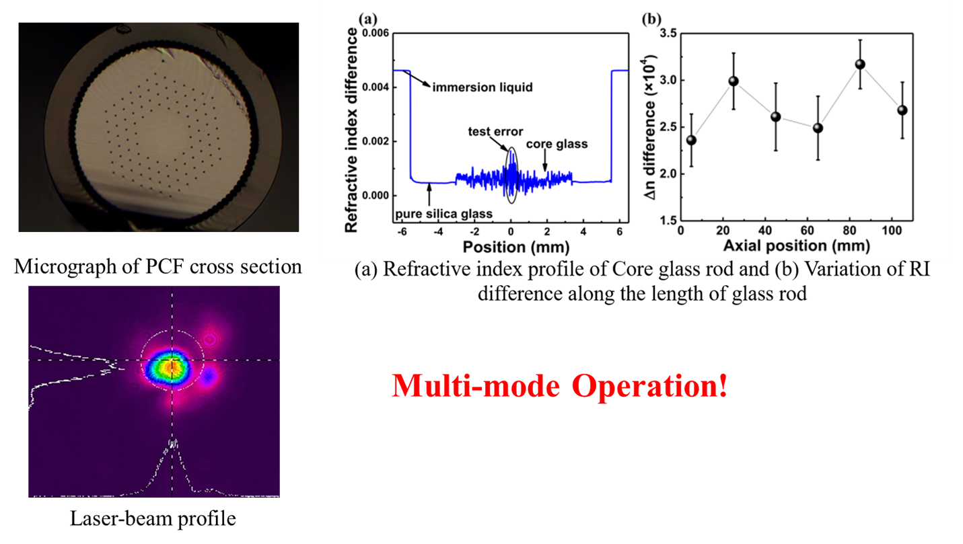
Introduction
4

Slide 5
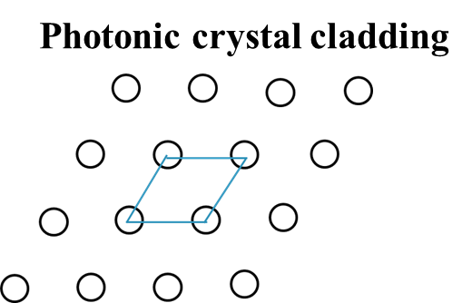
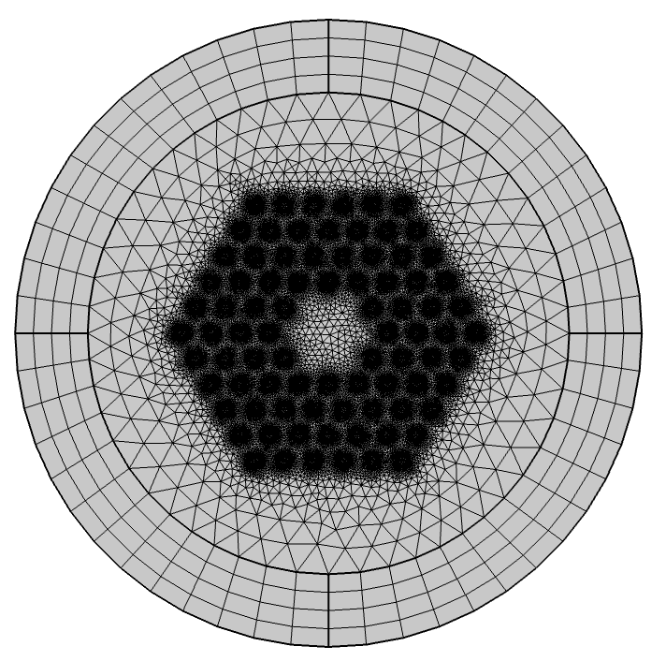
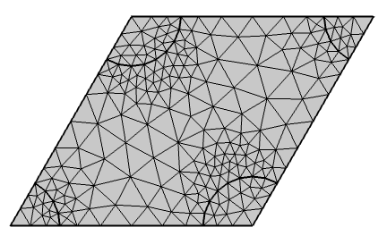
Simulation
    Single-Mode Regime of LMAPCF
    Non-uniform Distribution of n_{core}
Electromagnetic Waves, Frequency Domain
Study—Mode Analysis
LMAPCF
Unit cell
5

Slide 6
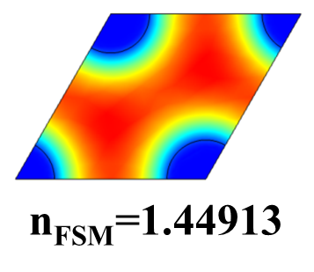
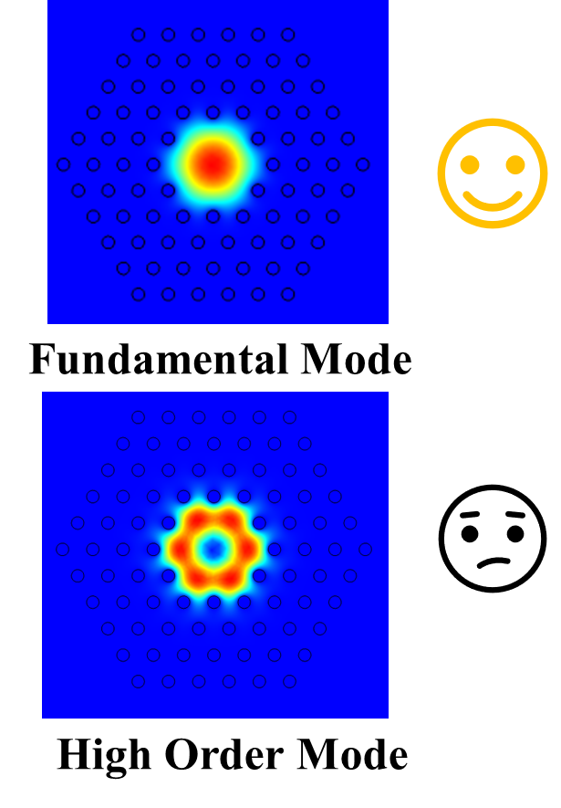
Simulation
Correlation between n_{core} and n_{eff} of FM
6

Slide 7
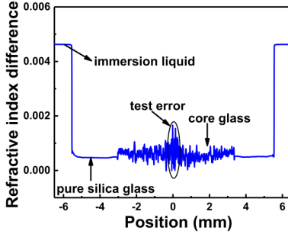
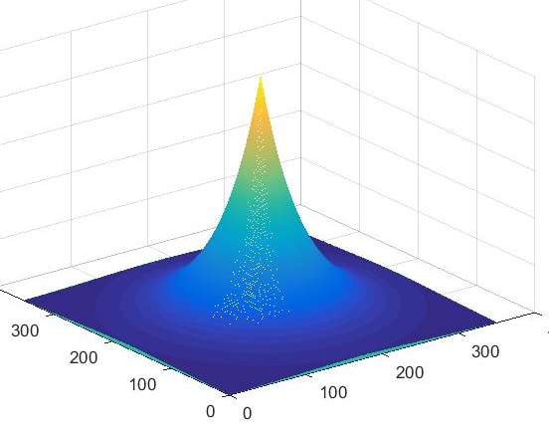
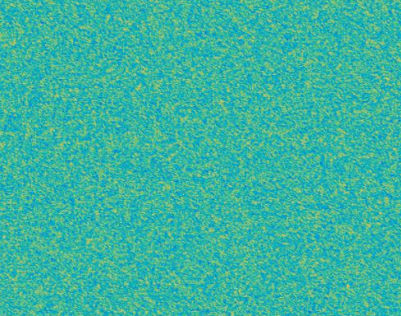
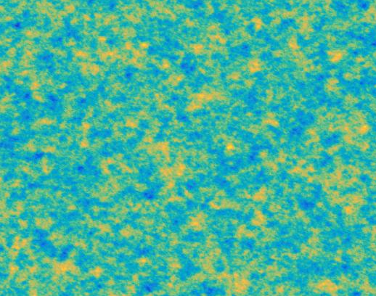
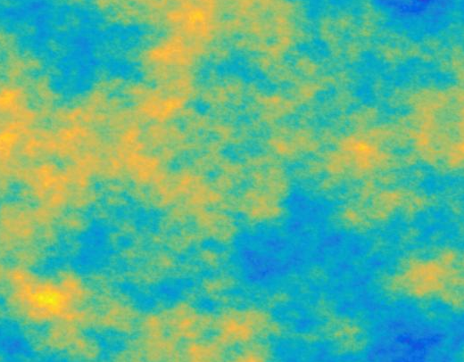

Simulation
$Rz \left(k,l\right)$=$S_{q}^{2}$exp$\left\{−2.3\left[\left(k/βx\right)2+(\left(l/βy\right)2)\right]\right\}$
S_{q}: Root mean square height
β_{x,y}：Autocorrelation length
β_{x,y}=0.1um
β_{x,y}=1um
β_{x,y}=10um
7

Slide 8
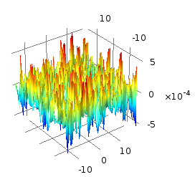
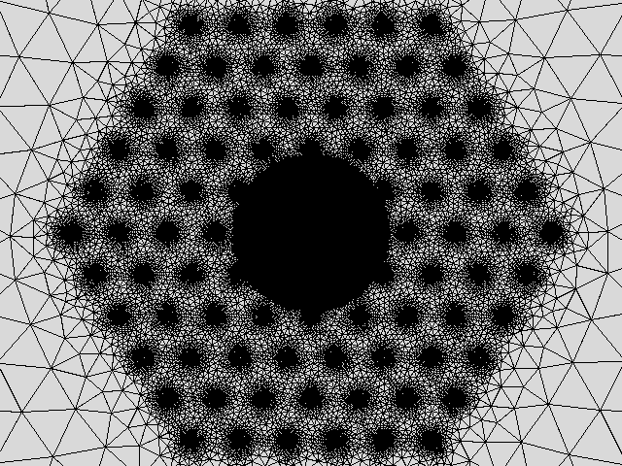
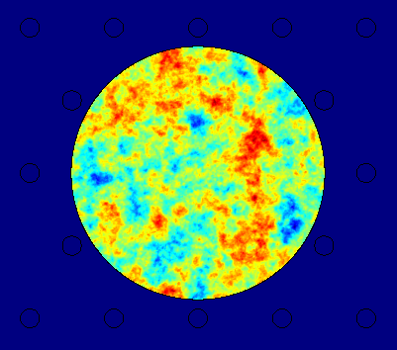
Simulation
Global Definitions :
Functions :Interpolation
n_{core}=1.4494+int1(x, y)
int1(x, y)
Mesh
Non-uniform Distribution of n_{core}
8

Slide 9
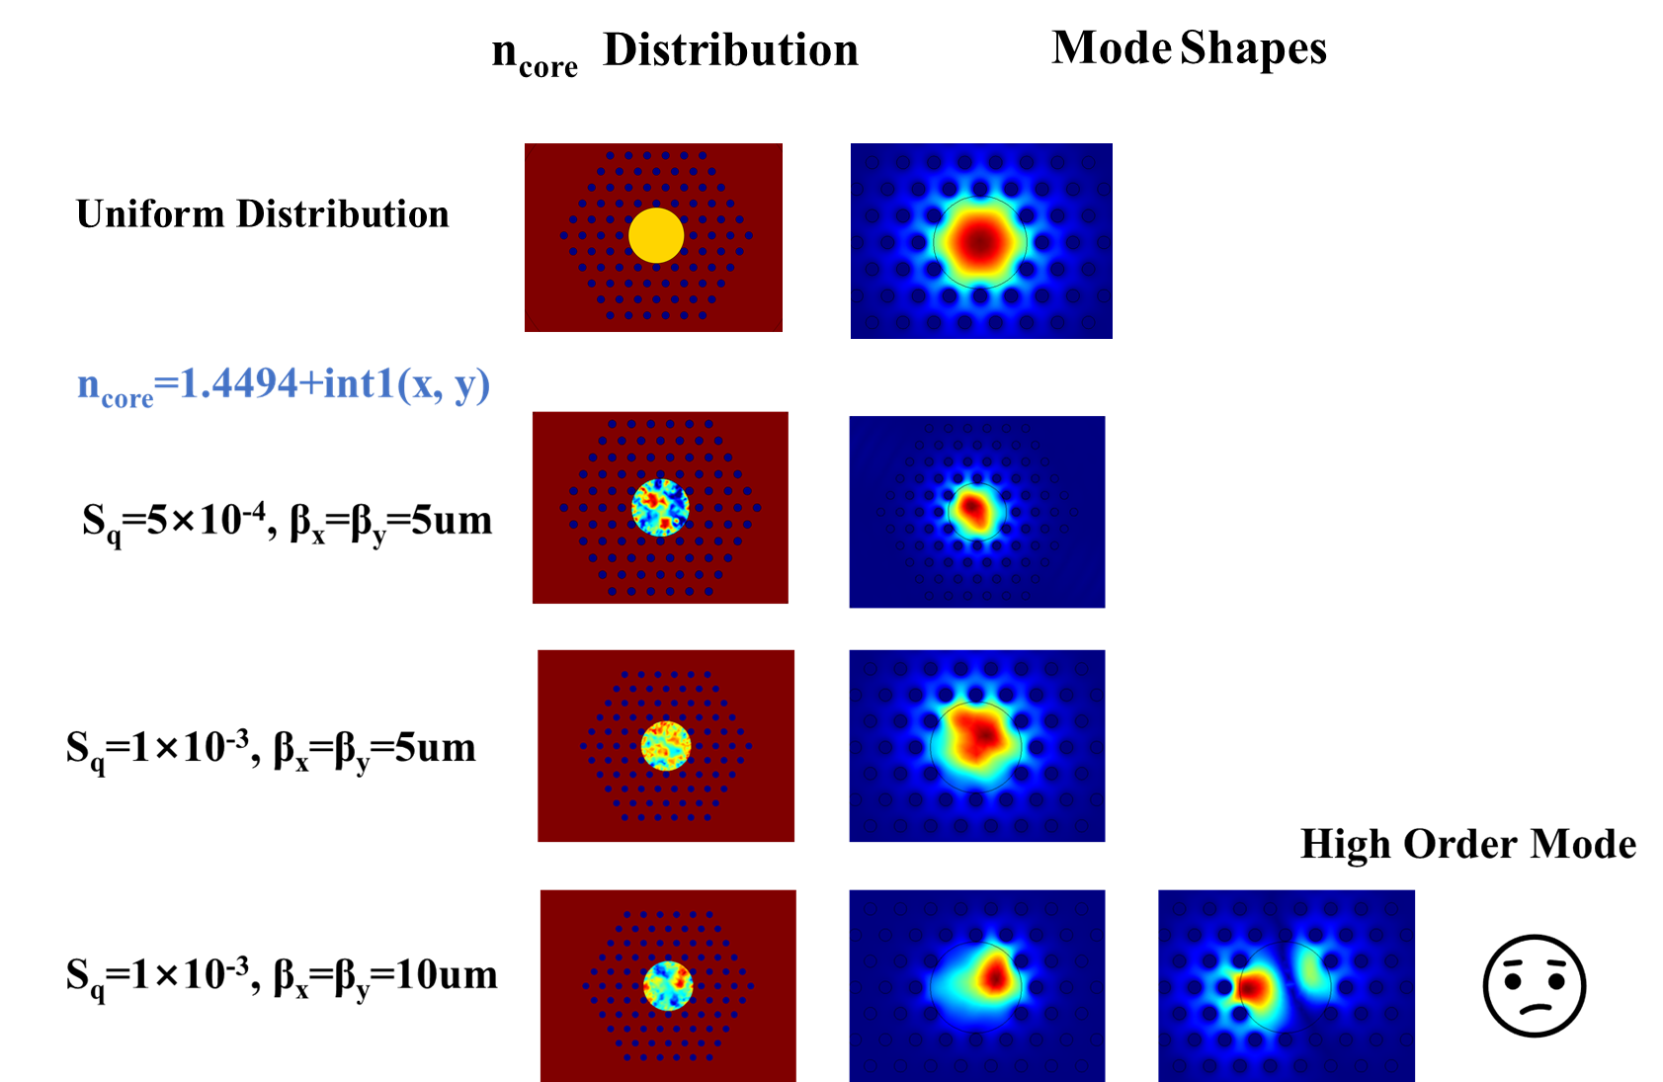
Simulation
9

Slide 10
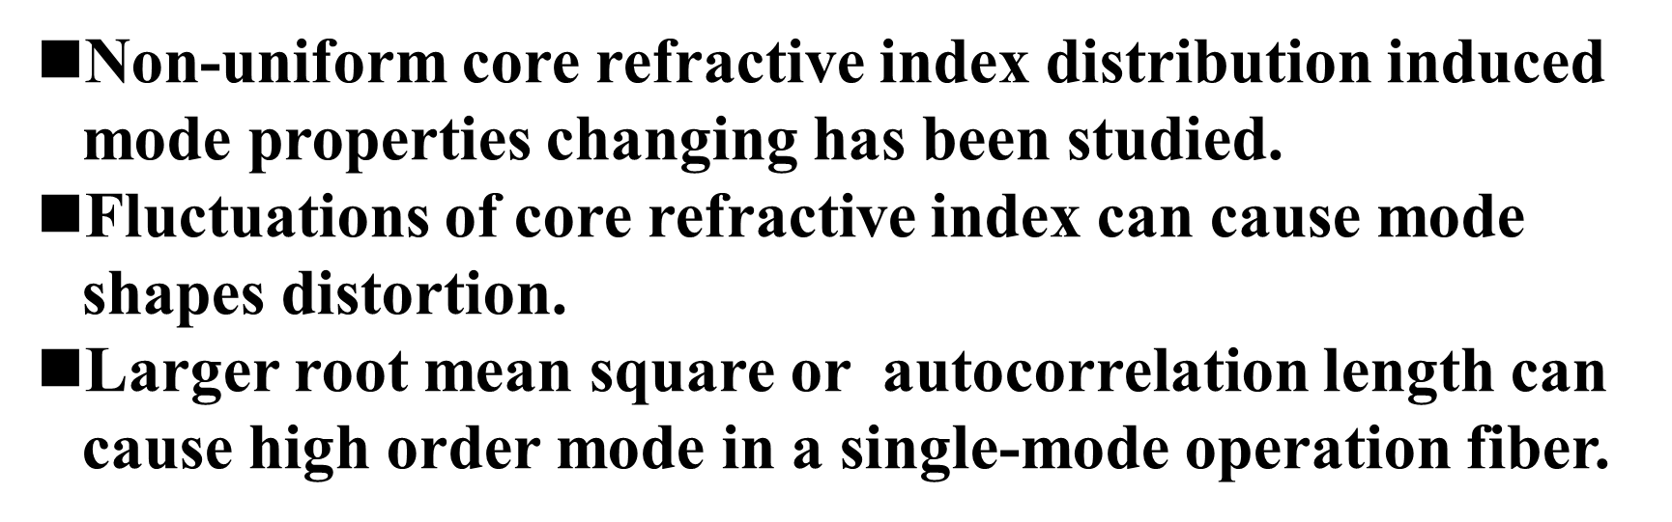
Summary
10

Slide 11
Thank you！

