Slide 1


Research on Simulation of Stress Birefringence in Polarization Maintaining Optical Fiber
Jiacheng Xu, Fei Yu, Lili Hu
The R&D Center for High Power Laser Components
Shanghai Institute of Optics and Fine Mechanics, Chinese Academy of Science
xujiacheng@siom.ac.cn yufei@siom.ac.cn
10/17/2019

Slide 2
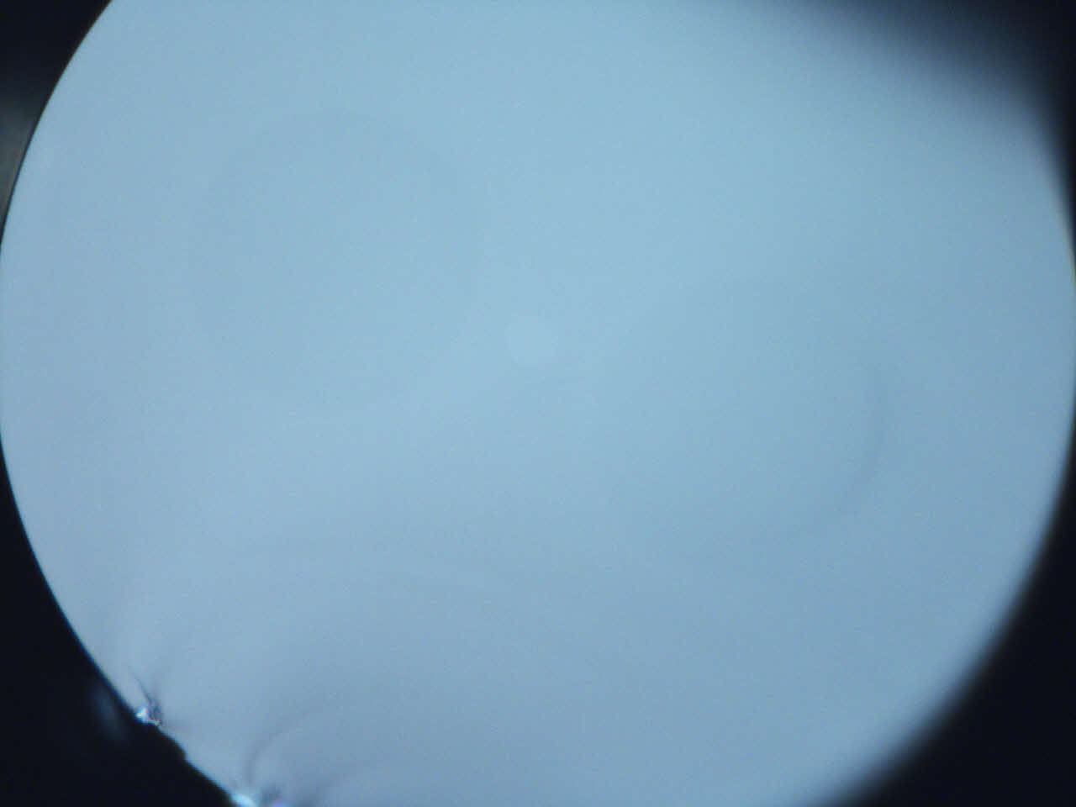
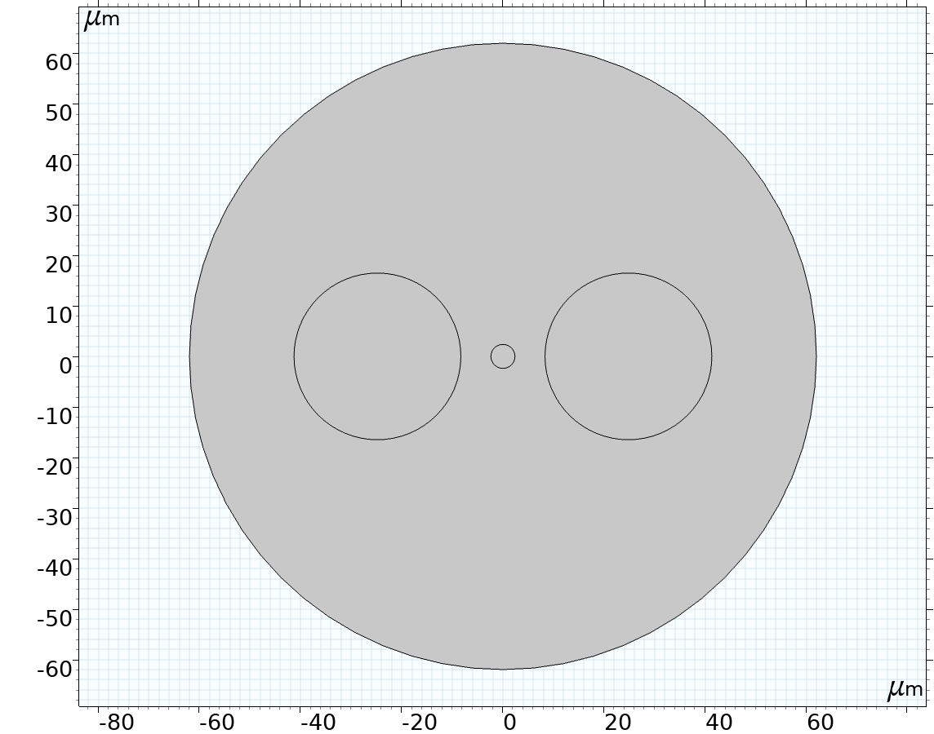
Introduction
The stress distribution in the fiber has an important influence on the refractive index distribution of the fiber because of the photoelastic effect. So the stress state of the fiber is one of the important directions of fiber performance research.
The stress-induced polarization polarization-maintaining fiber (PMF) utilizes the photoelastic effect.
2

Slide 3
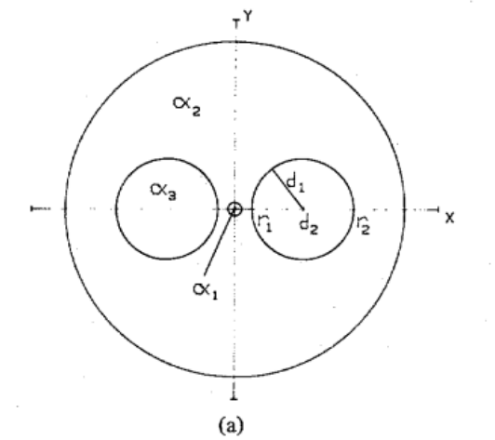

Introduction
The calculation of the traditional theoretical formula is only applicable to small-core fiber, and it is considered that the Young's modulus and Poisson's ratio are the same in each region of the fiber.
$B≅\frac{2EC}{1−γ}\left(α2−α3\right)T\left(\frac{d1}{d2}\right)2[1−3\left(\frac{d2}{b}\right)4$]
measured | 5.74×10⁻⁴
calculation | 4.6×10⁻⁴
Use COMSOL Multiphysics® to create more accurate models to analyze the stress distribution of the fiber and guide the preparation of fibers.
3
Chu, P., & Sammut, R. (1984). Journal of lightwave technology, 2(5), 650-662.

Slide 4
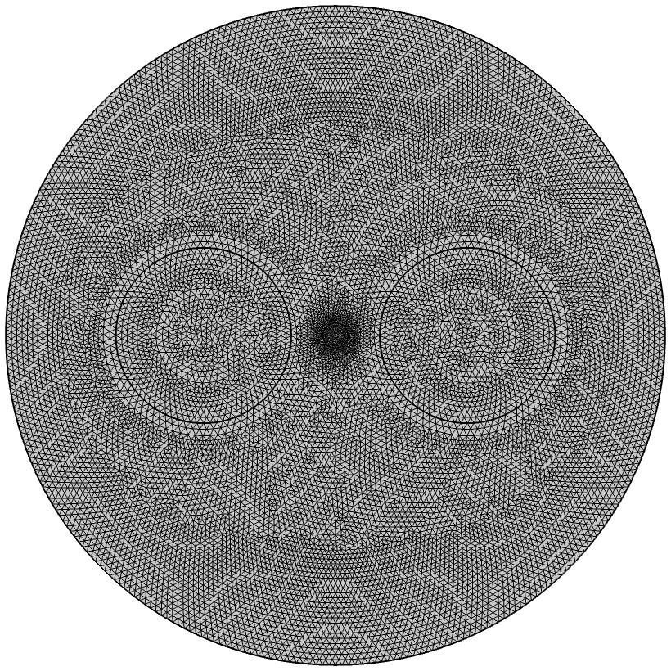
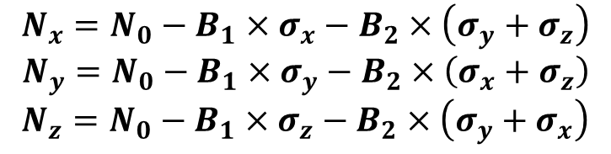
Simulation
Solid Mechanics
Linear thermoelasticity
Plane strain problem
Thermal Stress
Ignoring the thermo-optic effect
Photoelastic effect
$$N_{x}=N_{0}−B_{1}×σ_{x}−B_{2}×\left(σ_{y}+σ_{z}\right)$$
$$N_{y}=N_{0}−B_{1}×σ_{y}−B_{2}×\left(σ_{x}+σ_{z}\right)$$
$$N_{z}=N_{0}−B_{1}×σ_{z}−B_{2}×\left(σ_{y}+σ_{x}\right)$$
N₀: the index when stress is zero
σ_{i}(i = x, y, z):the positive stresses along x-, y-, z-directions
N_{i}(i = x, y, z):the principal index of stress birefringence
B₁,B₂ : stress-photoelastic coefficients
4

Slide 5
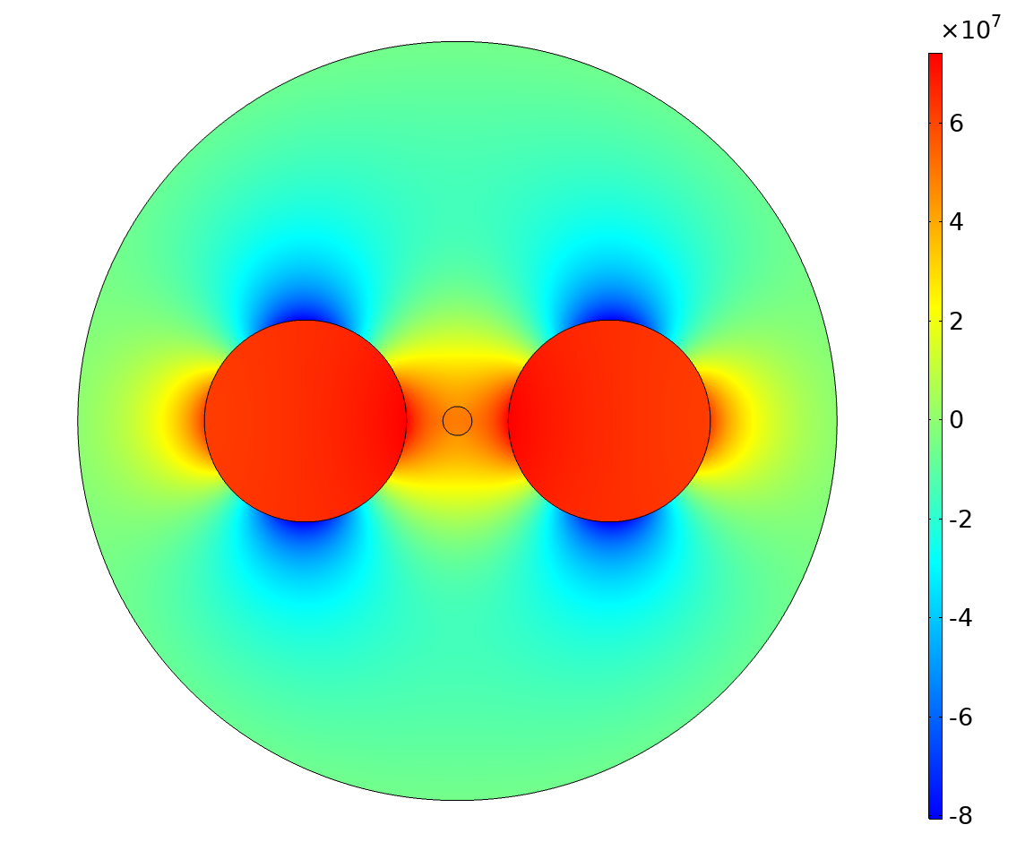
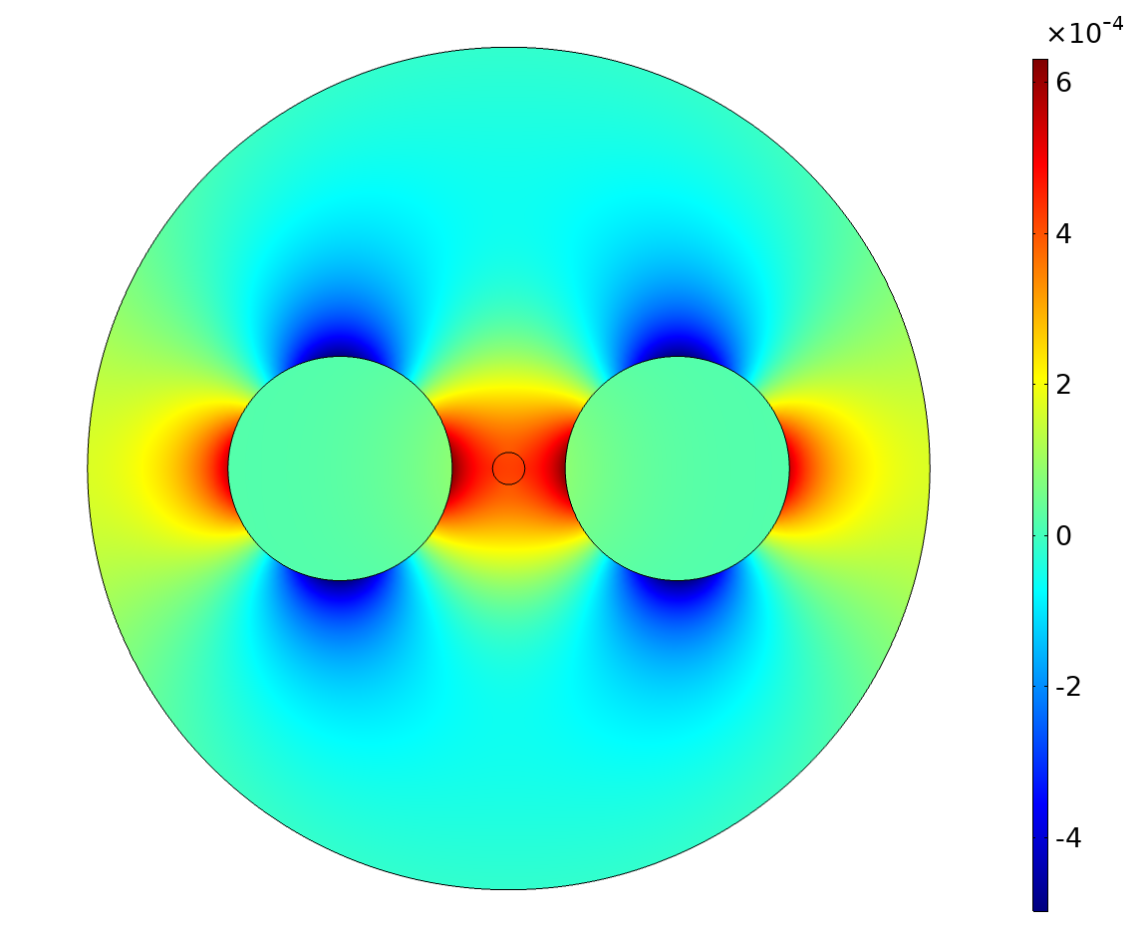
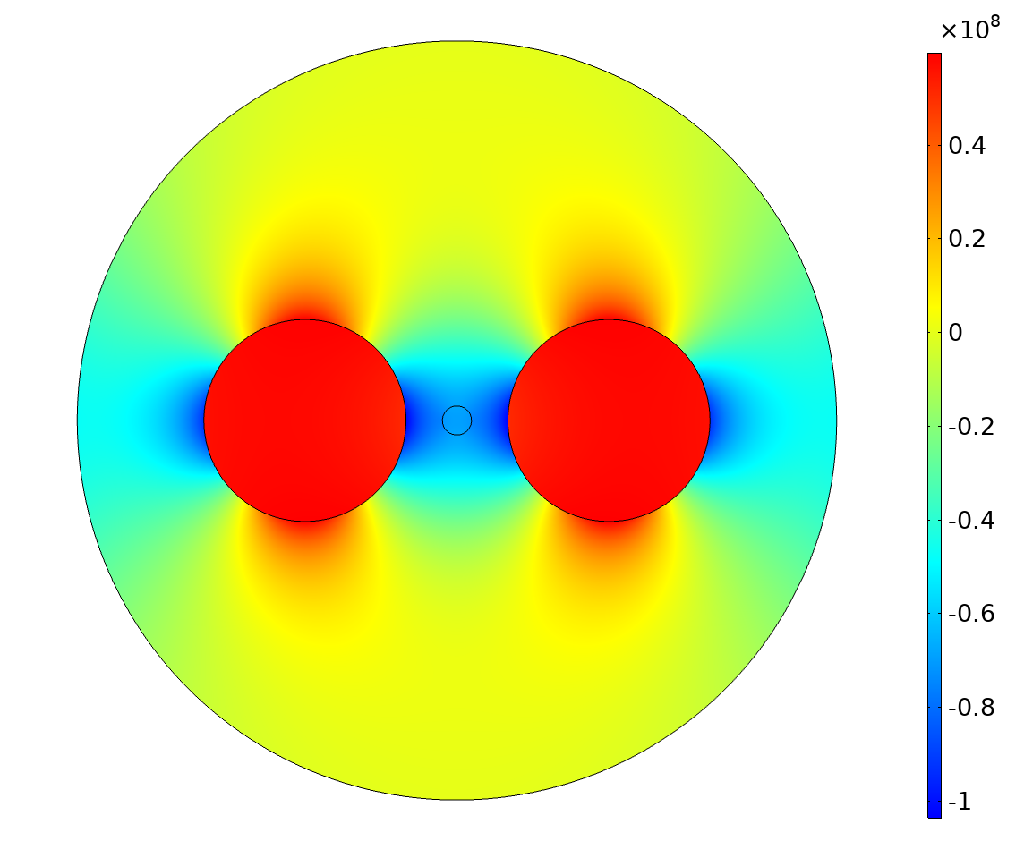
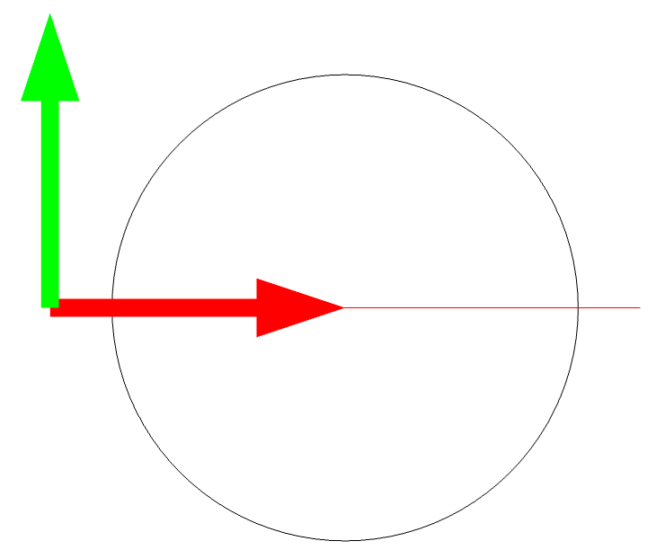
Simulation
Thermal Stress
x-component of stress
Stress birefringence(Nx-Ny)
5
y-component of stress
Stress birefringence on the x-axis near the core

Slide 6
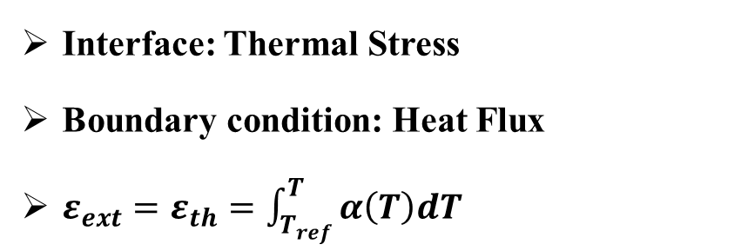
Simulation
Interface: Thermal Stress
Boundary condition: Heat Flux
$ε_{ext}=ε_{th}=\int_{T_{ref}}^{T}{α\left(T\right)dT}$
Model
The thermal expansion coefficient: α
Heat transfer coefficient: h
Thermal history
6

Slide 7
Simulation
Several sets of different step-type thermal expansion coefficients were constructed with the thermal expansion coefficient αBoron as the variable (the coefficients in the low temperature stage are all 0.5*αBoron)
7

Slide 8
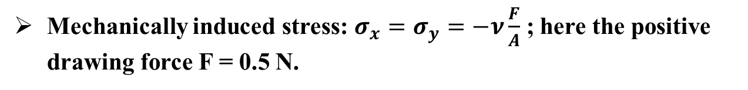
Simulation
Mechanically induced stress: $σ_{x}=σ_{y}=−ν\frac{F}{A}$ ; here the positive drawing force F = 0.5 N.
8

Slide 9
Summary
The simulation results consider the difference of the physical property coefficients in different regions of the fiber.
The accuracy of the parameters, especially the glass transition temperature, has a large effect on the results.
We cannot ignore the influence of mechanically induced stress.
9

Slide 10
Thank you！

