Slide 1
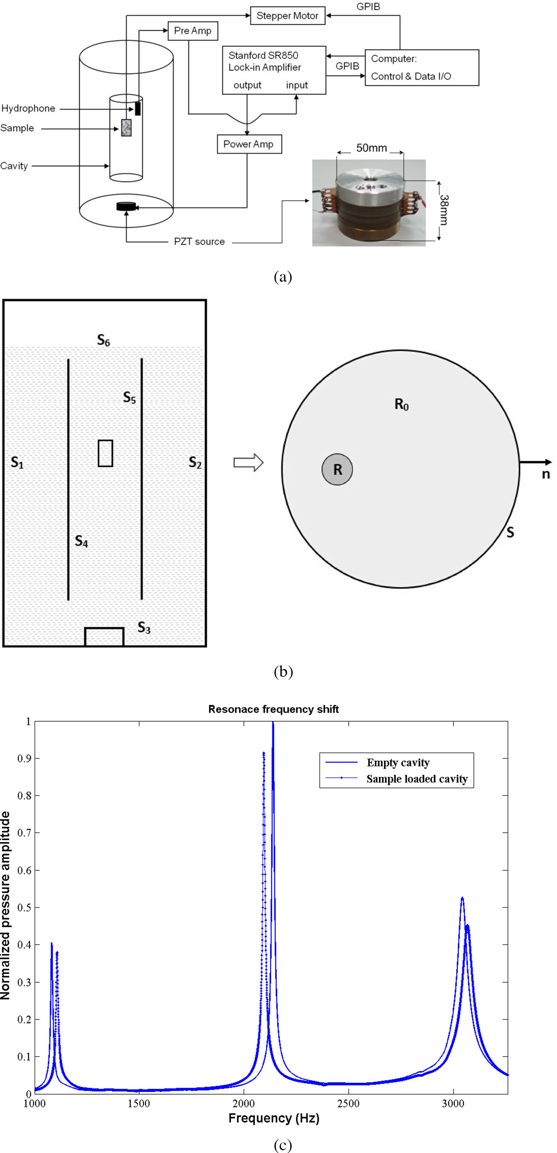
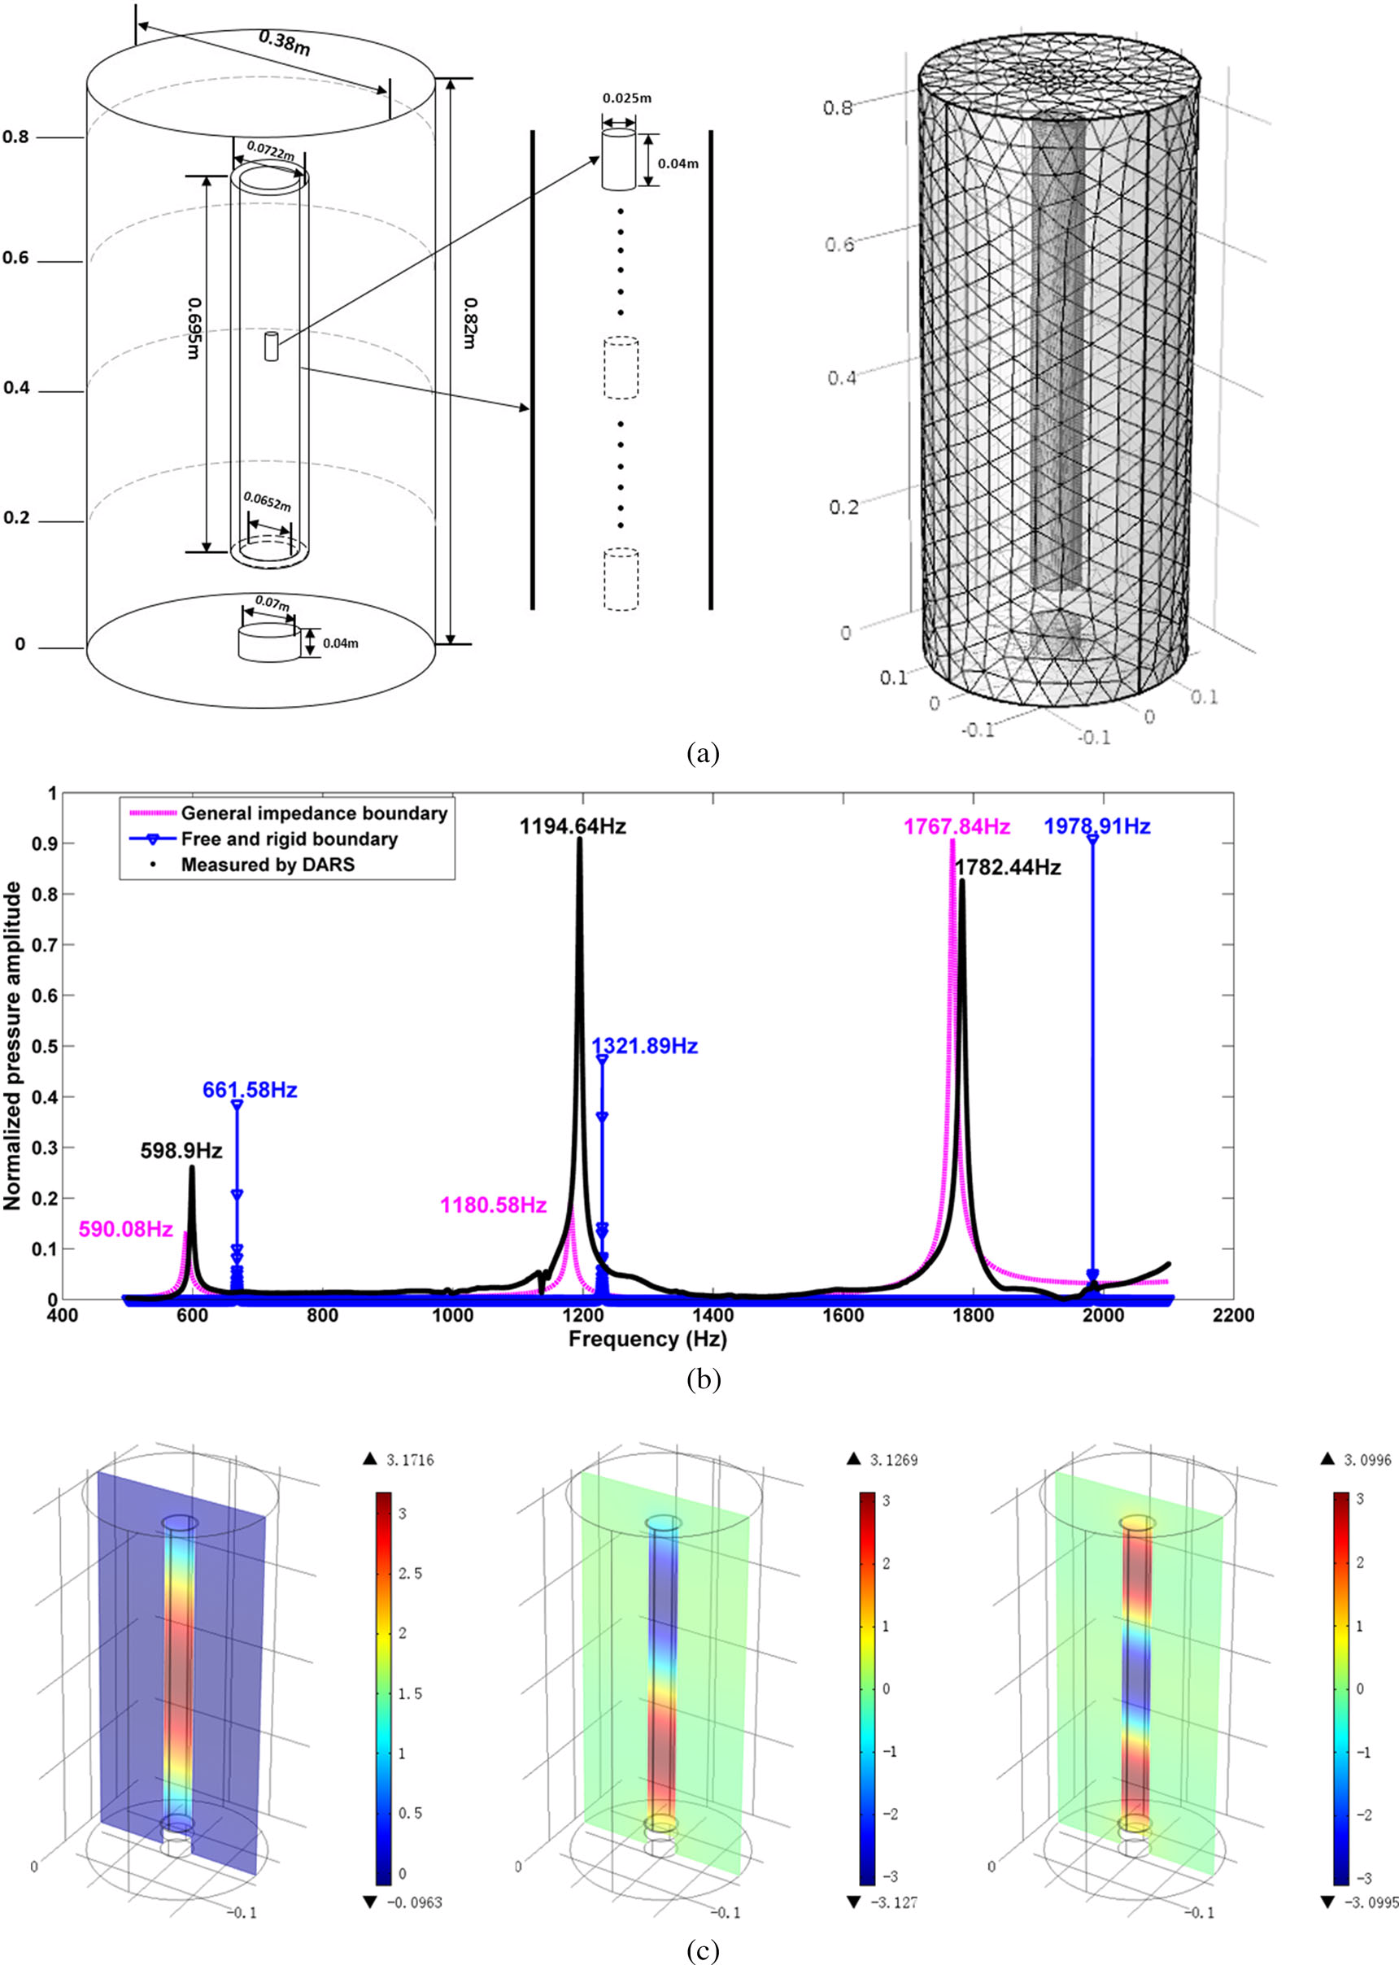
COMSOL Numerical Simulation Of Differential Acoustic Resonance Spectroscopy
段熙彬
中国石油大学（北京）
Differential Acoustic Resonance Spectroscopy (DARS) was developed to examine changes in the resonant frequencies of a cavity perturbed by the introduction of a centimetre-sized sample.
By COMSOL，we assessed whether the amended DARS perturbation equation, obtained through a Green's function-based theoretical derivation and under a general impedance boundary condition, was able to reflect the operation mechanism of the DARS system with greater precision and accuracy than past approaches
We designed a three-dimensional model, whose dimensions and geometry were kept consistent with the physical attributes, to implement the finite element simulation.
For both boundary condition settings, the DARS simulations were conducted to explore resonance occurrence by applying a sinusoidal excitation to the DARS resonance cavity, monitoring the acoustic pressure at a point inside the cavity, and repeating the process for many frequencies ranging from 500 Hz to 2000 Hz.
DARS setup and an effective perturbation model. (a) DARS setup: A cylindrical cavity with open ends was immersed in a tank filled with silicon oil.The source and receiver were connected to a lock-in amplifier through a power amplifier and a pre-amplifier, respectively. A computer-controlled stepper motor was used to control sample positioning. (b) An effective perturbation model for the DARS system. (c) DARS responses with and without a sample-loaded cavity
FEM-based DARS simulations imply that general impedance boundary conditions, in comparison with free and perfectly rigid boundaries, are better able to describe the DARS physical set-up.
Spectroscopy laboratory device, in conjunction with the amended perturbation formula are useful tools for estimating the acoustic properties of centimetre-sized rock samples in the low frequency range.
FEM-based DARS simulations. (a) A three-dimensional DARS model. (b) The simulated resonance curves under two different boundary condition settings. (c) The simulated acoustic pressure distributions.

