Slide 1
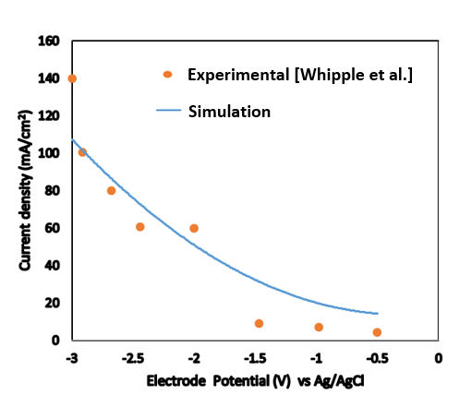
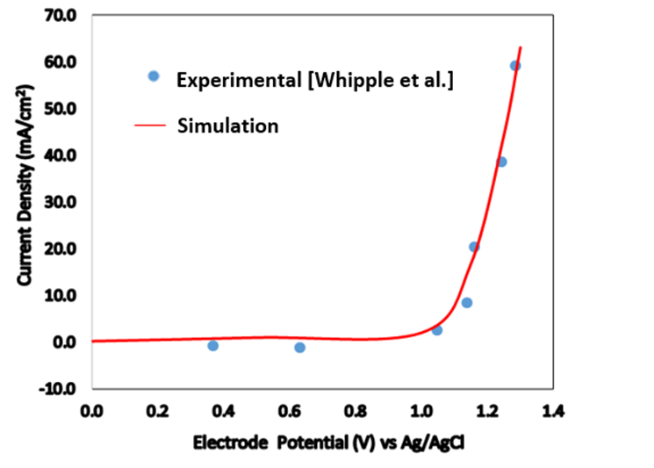
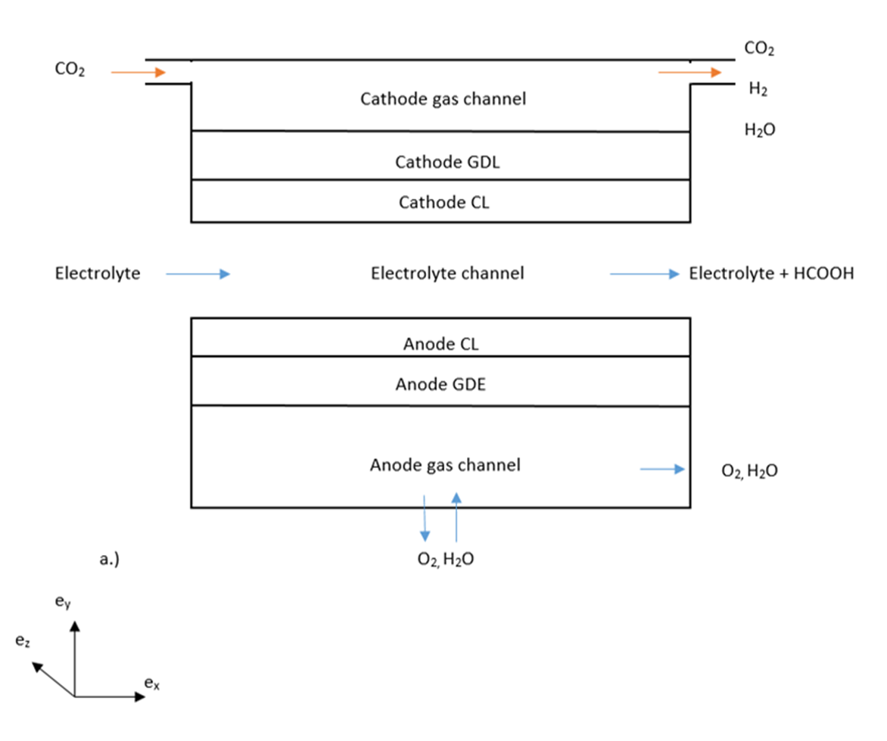
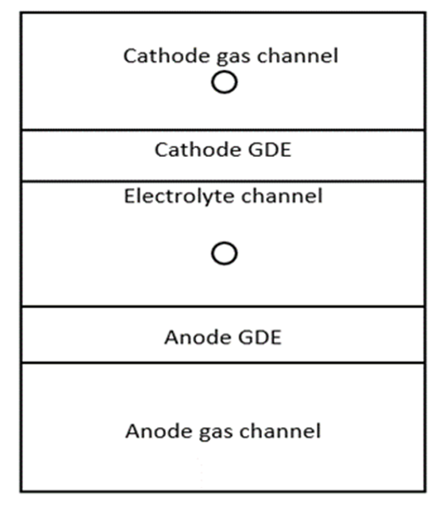
Please leave at least a 25mm margin on all sides to avoid cropping during printing. Remove this text box before submitting.
Modelling and Simulating CO₂ Electro-Reduction to Formic Acid Via MEC-Microfluidic Electrolytic Cells
Akan C. Offong¹,
1. Cranfield University, Carbon Capture and Storage Department, Cranfield, Bedfordshire/MK43 0AL, UK.
INTRODUCTION
Climate change and ocean acidification is currently a world threat. This threat, unfortunately partly stems from high CO₂ concentration in the atmosphere ca. 415 ppm. In 2019, the anthropogenic annual CO₂ emissions is ca. 38.2 billion tons [1]. However, increased usage of CO₂ as a building block for carbon-based compounds and materials can provide a stepping stone in moderating worldwide CO₂ emissions. In recent years, CO₂ conversion using electrochemical approaches in MEC─Microfluidic Electrolytic Cells has gained considerable attention for its several advantages including eliminating sweep away effect of the flowing electrolyte, reduces carbonate formation, electrode dry-out/flooding, ohmic losses as well providing high surface-to-volume ratio, efficient heat and mass-transfer rates. Formic acid, the desired product is the biggest organic compound to be formed from ECRC─Electro- chemical Reduction of Carbon. To-date, main drawbacks include sufficient numerical simulations of process efficiency, current density and CO₂ conversion.
MODEL VALIDATION/RESULTS
Present your results and findings based on the simulation work. Address your hypothesis and present your results in the form of simulated graphics of your model, tables and graphs.
Figure 2. Comparison of a. Cathodic HCOOH current density b. Cathodic H₂ current density from numerical data and experimental data
Table 1. Input parameters of the model
Parameters | Value | Unit | Ref.
Temperature | 298 | K | [2,4]
Dynamic Viscosity | 1 | Pa.s | [2,4]
HCOOH charge transfer coefficient | -0.05 | - | [3]
Channel length | 0.015 | m | [2,4]
HCOOH exchange current density | 0.1 | A/m² | [4]
Height of Cathode Gas Channel | 5.08 E-4 | m | [2]
Diffusion Coefficient of CO₂ | 9.8 E-4 | m²/s | [5]
Height of the electrolyte channel | 0.0015 | m | [2,4]
Electrolyte flow rate | 0.7 | ml/min | [2]
Please leave at least a 25mm margin on all sides to avoid cropping during printing. Remove this text box before submitting.
COMPUTATIONAL METHODS
We employed electrochemistry interface in the battery/fuel cell module, inputted necessary material, defined the domains, boundaries, and the physics, coupled and meshed the model. In detail, the full set of governing equations together with boundary conditions, electrochemical reaction kinetic equations and other constitutive equations are solved numerically with COMSOL Multiphysics using finite element method for the spatial discretisation. A comparison between the influence of two ionic liquids on overall process of the MEC.
CONCLUSIONS
This work has demonstrated an experiment-validated mathematical model for an MEC.
Further simulations reveal performance measures trade-off (current density, faradaic efficiency and CO₂ conversion). This model achieved a CD-Current Density (ca. 58 mA/cm²), FE-Faradaic Efficiency (ca. 99 %) and CO₂ conversion (ca. 82 %) in the electro-chemical reduction of CO₂ to formic acid.
REFERENCES:
E.S.R. Laboratory, G.M. Division, Trends in Atmospheric Carbon Dioxide, Glob.
Greenh. Gas Ref. Network. (2019) 1. https://www.esrl.noaa.gov/gmd/ccgg/trends/.
K. Wu, E. Birgersson, B. Kim, P.J.A. Kenis, I.A. Karimi, Modeling and Experimental
Validation of Electrochemical Reduction of CO2 to CO in a Microfluidic Cell, J.
Electrochem. Soc. 162 (2015) F23–F32. doi:10.1149/2.1021414jes.
3. X. Zhang, B., Ye, D. D., Sui, P. C., Djilali, N., & Zhu, Computational modeling of air-
breathing microfluidic fuel cells with flow-over and flow-through anodes, Power
Sources. 259 (2014) 15doi:10.1016/j.apenergy.2012.06.020. –24.
4. H. Wang, D.Y.C. Leung, J. Xuan, Modeling of a microfluidic electrochemical cell for
CO2 utilization and fuel production, Appl. Energy. 102 (2013) 1057–1062.
5. A. Shiflett, M. B., & Yokozeki, Solubilities and diffusivities of carbon dioxide in ionic
liquids:[bmim][PF6] and [bmim][BF4], Ind. Eng. Chem. Res. 44 (2005) 4453–4464.
Figure 1. Schematics of a. the front and b. the side view of a microfluidic electrochemical cell
Excerpt from the Proceedings of the 2019 COMSOL Conference in Cambridge

