Slide 1
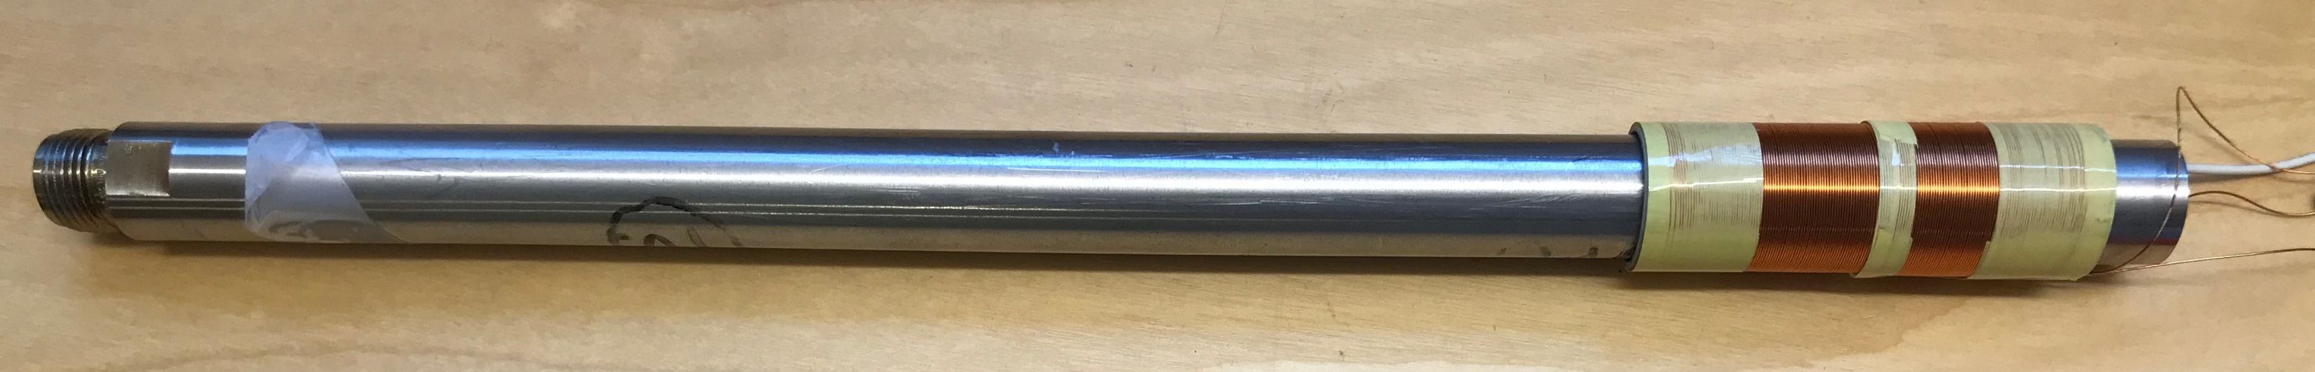
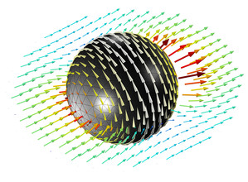
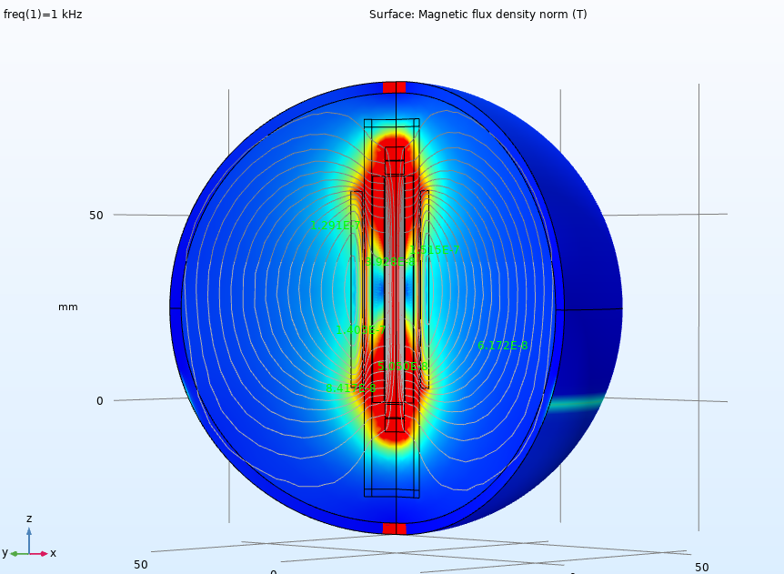
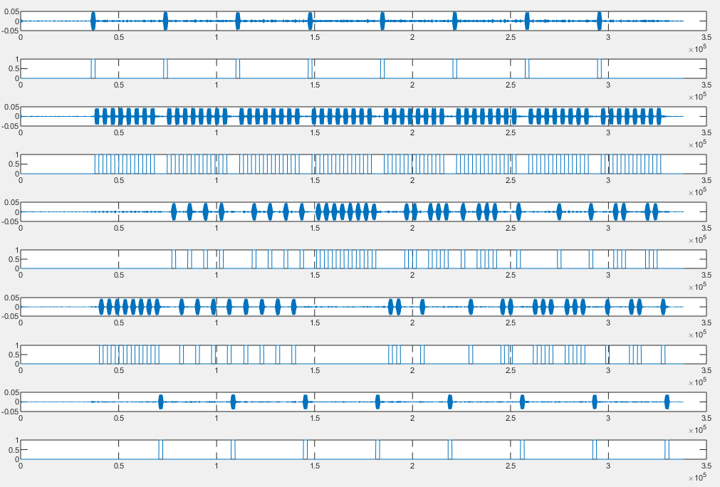
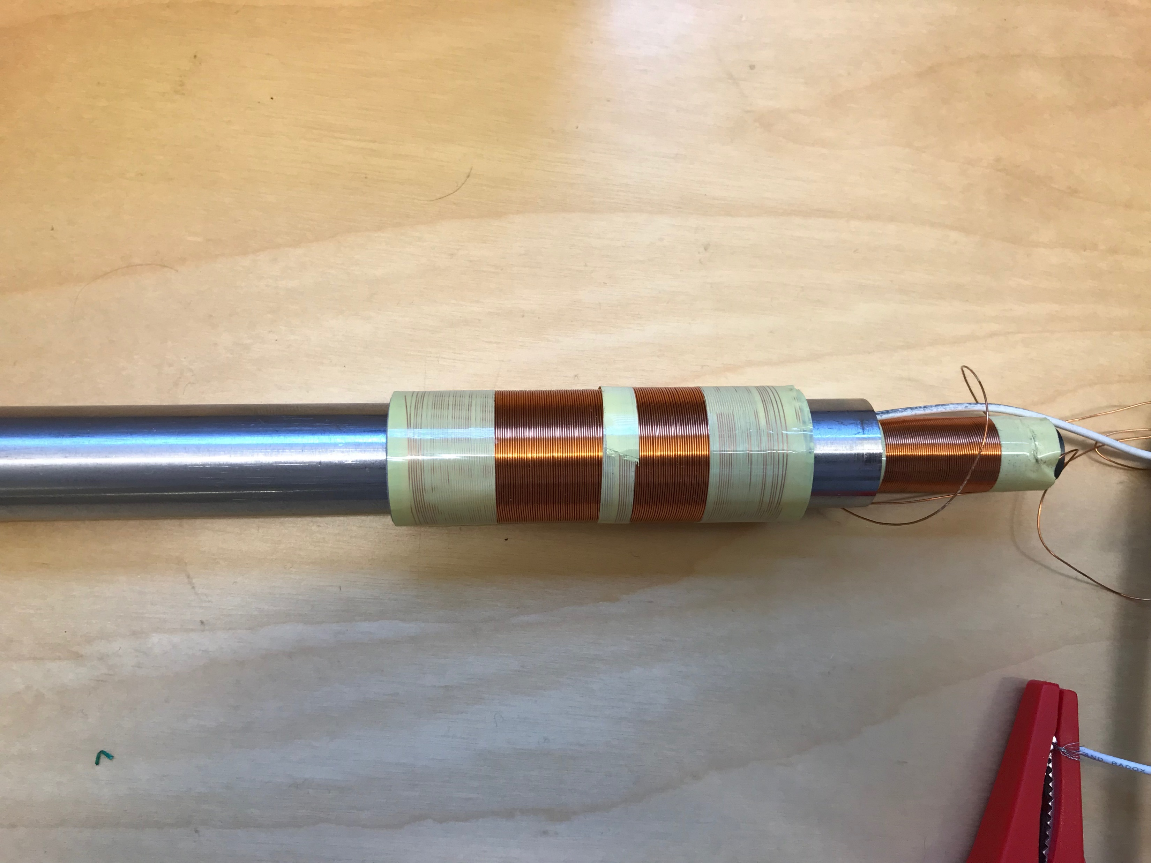
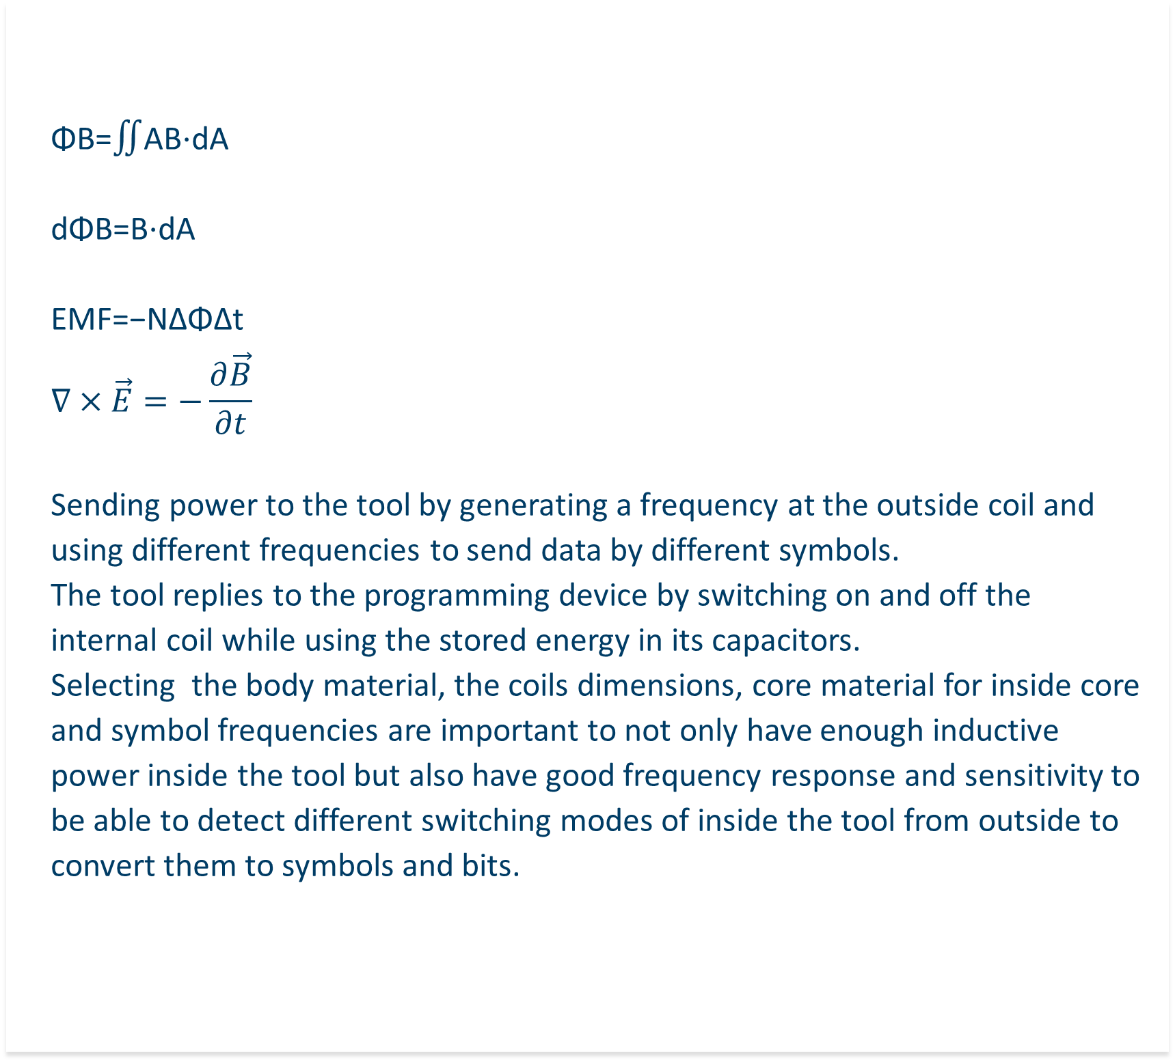
Using Inductive Communication For Programming Downhole Tools
Mostafa Koraei, Magnus Hjelstuen
SINTEF , SINTEF
In oil and gas industry communicating with tools that are supposed to be used downhole is always an issue. This kind of tools are designing to work at high temperature high pressure enviroments so it is important to have a sealed body. The problem happens when operators need to communicate with tool on after assembling it, because of the metal body and limited available energy from batteries it is a challenge to be able to send sommands to the tool after setting up it to go in well. We have used COMSOL to simulate and design an inductive communication system to communicate with the tool after packing it without using its internall battries.
Introduction
Theory
DSE with COMSOL
ΦB=∬AB⋅dA
dΦB=B⋅dA
EMF=−NΔΦΔt
$$∇×\vec{E}=−\frac{∂\vec{B}}{∂t}$$
Sending power to the tool by generating a frequency at the outside coil and using different frequencies to send data by different symbols.
The tool replies to the programming device by switching on and off the internal coil while using the stored energy in its capacitors.
Selecting the body material, the coils dimensions, core material for inside core and symbol frequencies are important to not only have enough inductive power inside the tool but also have good frequency response and sensitivity to be able to detect different switching modes of inside the tool from outside to convert them to symbols and bits.
We used COMSOL to explore
The design space by changing:
The coil length from 50 to 95mm
The core OD from 3 to 10mm
The material for the tool body
The number of outside core turns
The number of turns that we can have inside the tool
The power carier frequency
The data symbol frequencies
The tool should have 15 mm OD and 14mm ID to be used in different well conditions and the length of the tool is limited to 28 cm that a 9 cm part of it can be used as the coil and inductive communication part.
The communication must be full duplex.
The bit rate from outside to inside should be at least 200 bps.
The bit rate from inside to outside should be at least 100 bps.
The required inside power is 10 mA .
The outside current feedback signal should be at 50 mV and more with 30dB SNR.
The inside core maximum diameter can be 11 mm.
Then internal MCU can work at maximum 16MHz.
Limitations
Experimental Results
Otside to inside bit rate … 1Kbps
Inside to outside bitrate ….. 512 kbps
SNR on the current feedback signal > 42 dB
Optimized coil turns: 900/350
Ferrite 78 as the inside core material.
Stainless steel 316 as the tool body
References
COMSOL Application Library
Technology for a better society

