Slide 1


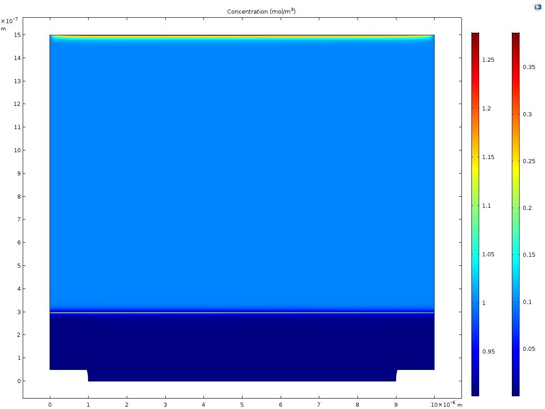
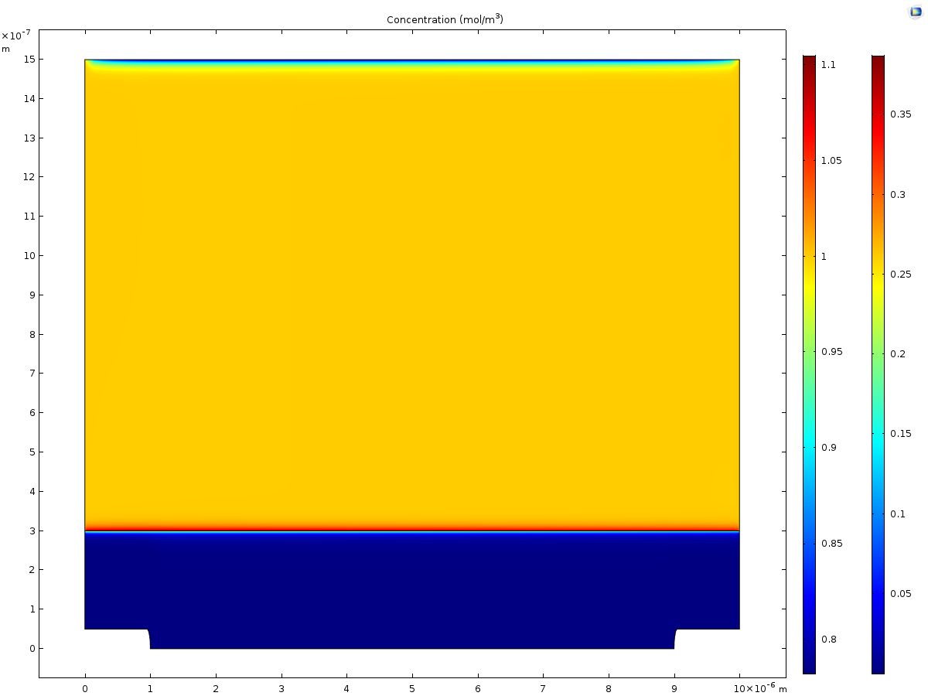
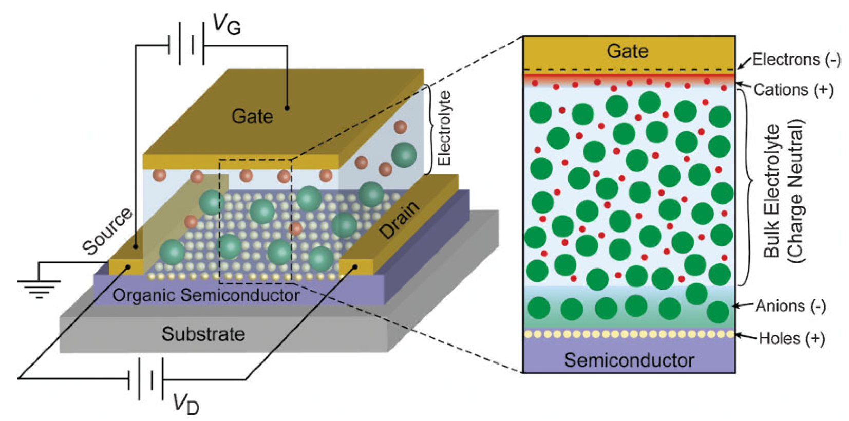
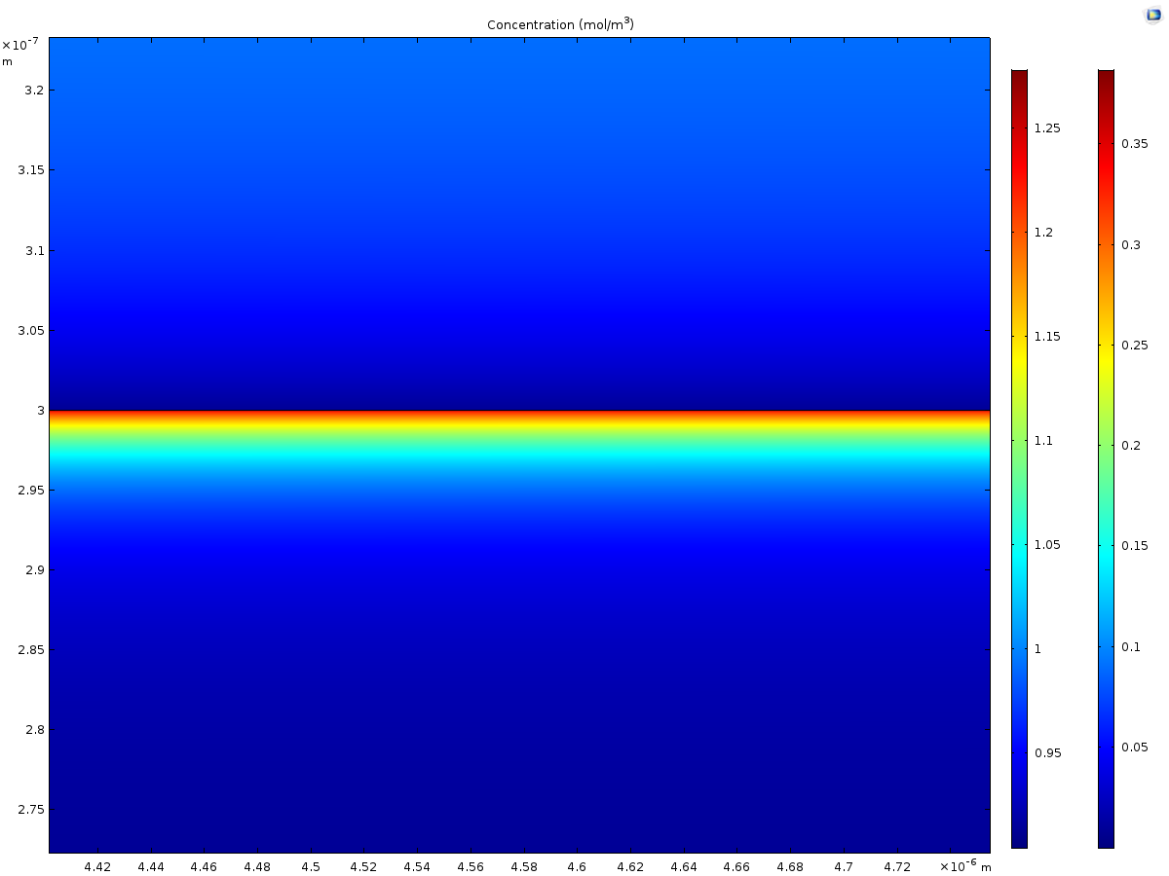
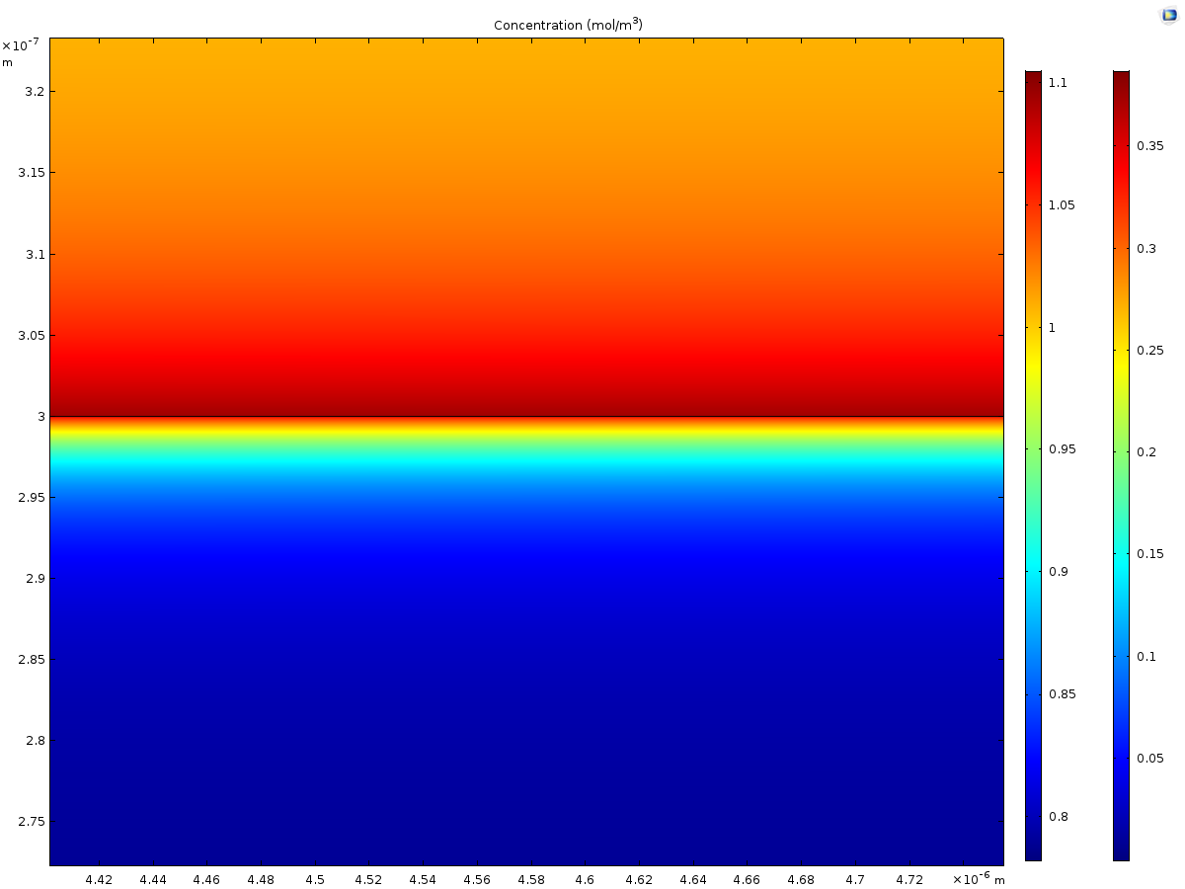
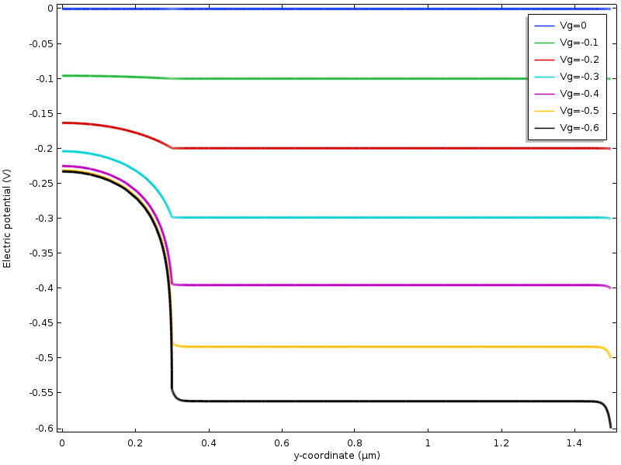
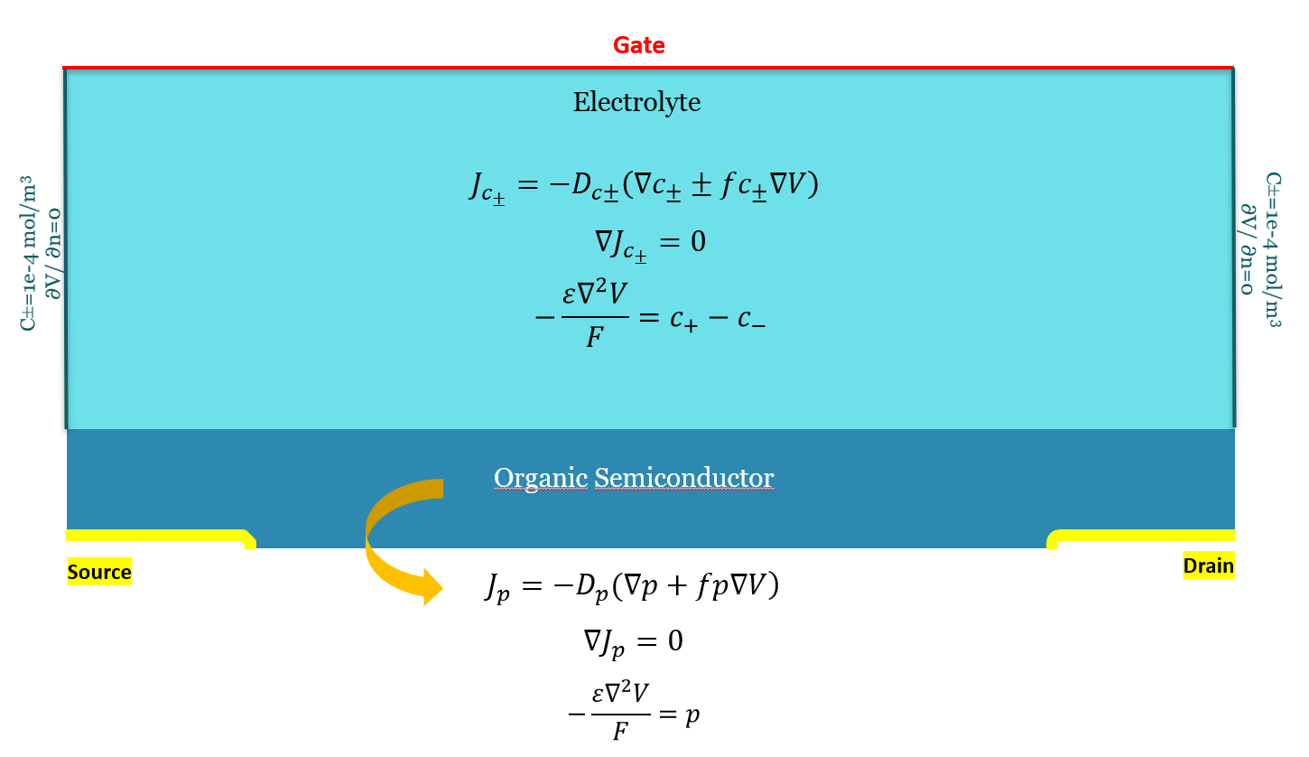
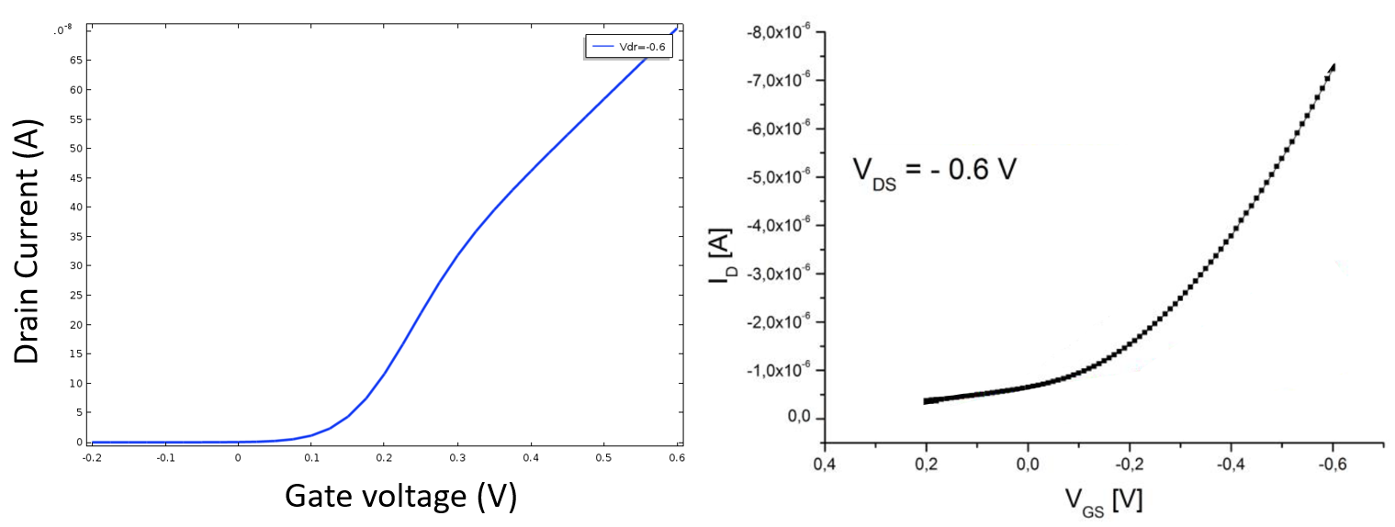
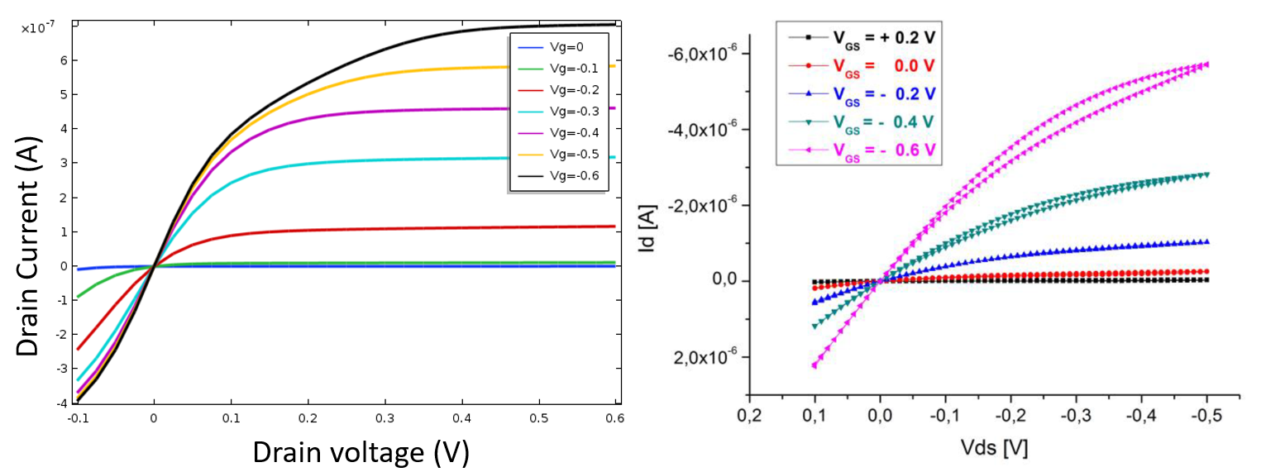
Modelling of Electrolyte-Gated Organic Field-Effect Transistor
Najmeh Delavari¹, Klas Tybrandt¹, Giorgio Mattana², Benoît Piro², Vincent Noël², and Igor Zozoulenko¹
1. Laboratory of Organic Electronics, Linköping University, Sweden
2. Univ. Paris Diderot, Sorbonne Paris Cité, France
INRODUCTION: Electrolyte-gated organic field-effect transistors differ from conventional OFETs by using an electrolyte as the gate insulating material. Operating voltage in these devices is considerably smaller than in the OFETs which makes EGOFETs ideal tools in biosensing applications. In a p-channel EGOFET, upon negative polarization of the gate, the cations in the electrolyte are attracted toward the electrolyte–gate interface, while anions migrate to the electrolyte– semiconductor interface, resulting in the formation of electric double layer (EDL) at both interfaces.
RESULTS: Concentration and potential profiles were discussed. The formation of the electric double layers at both interfaces is observed. The transfer and output characteristics of the device were modelled successfully and are in good agreement with the experimental data.
a)
b)
c)
d)
Holes
Holes
Figure 3. 2D Demonstration of the Concentration of Charge Carriers. At the electrolyte/gate interface, concentration of cations is high due to the negative polarization of the gate electrode (a,b). We can see the higher concentration of holes at the semiconductor/electrolyte interface as well as anions, and lower concentration of cations at the semiconductor-electrolyte interface (c,d). Thus, as expected, the formation of the electric double layers at both interfaces can be observed.
Figure 1. Electrolyte-gated Organic Field Effect Transistor (EGOFET)
(picture from Adv. Mater. 2008, 20, 3177–3180)
COMPUTATIONAL METHODS: We report the steady state 2D simulation of the EGOFET using Nernst-Planck-Poisson equations as implemented in COMSOL Multiphysics 5.3a.
The boundary conditions at the metal contact (source and drain electrodes) were applied as follows: Source is grounded, and Drain voltage is applied to the drain contact. Fixed amount of concentration (1E-6 mol/m3) for holes is applied as the boundary condition. The full set of equations in the different domains is denoted in Figure 2.
Figure 4. Potential profiles (along y-axis) for V_{Drain}= -0.1 and V_{Gate}= -0.6 to 0. For lower gate voltages, the potential does not change much across the device. As the gate voltage increases, more charge carriers in the form of holes come to accumulate near the interface which leads to the potential drop.
a)
b)
Figure 2. EGOFET equations (c+, c-, and p represent concentrations of mobile cations, anions, and holes, respectively).
Figure 5. Transfer Curves (I_{Drain}-V_{Gate}). Calculations (a) vs. Experimental Measurements (b).
a)
b)
Figure 6. Output characteristics (I_{Drain}-V_{Drain}). Calculations (a) vs. Experimental Measurements (b).
Excerpt from the Proceedings of the 2019 COMSOL Conference in Cambridge

