Slide 1

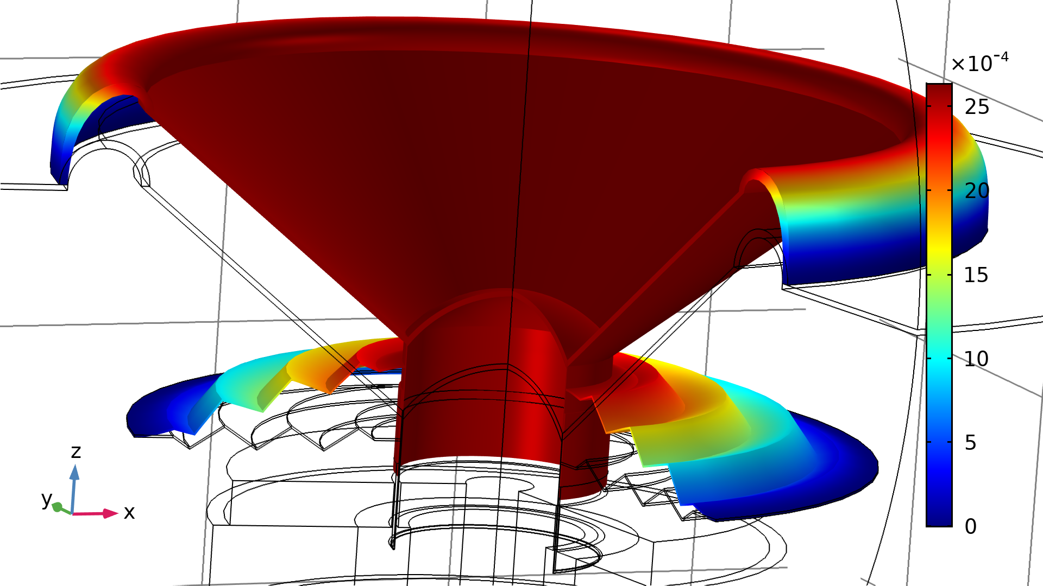
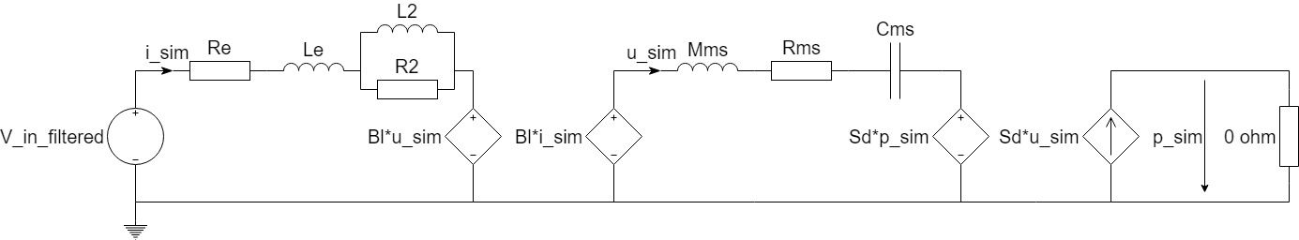
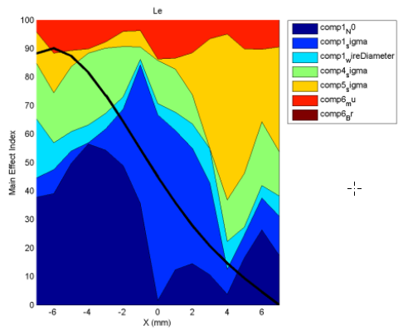
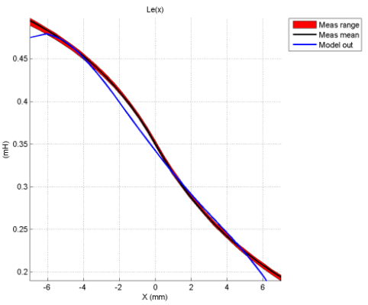
A Complete Loudspeaker Design Suite based on COMSOL® Apps
Lucio Bianchi, Ph.D.
Elettromedia s.r.l., Potenza Picena (MC) 62018, Italy
MOTIVATION:
  Multiphysical simulation is a daily-used tool for loudspeaker design and engineering.
  Time expensive process that requires specific modeling capabilities to build reliable virtual prototypes.
  Goal: increasing design and engineering efficiency by broadening the usage of multiphysical simulation.
DEPLOYMENT:
  Apps are compiled with COMSOL® Compiler and released to the design and engineering teams as standalone executable software packages.
DEMO:
OVERVIEW:
  4 apps dedicated to specific aspects of loudspeaker modeling and design:
  GUIs tailored to the needs of the design and engineering teams.
  Development of application-specific methods to simulate up to 3 virtual prototypes, with overlay of the results.
Figure 1. Demo video QR code
Figure 2. Illustrative example
VALIDATION:
  Sensitivity analysis: how variations in the input parameters affect the simulation output
    Test the robustness of the models
    Increase understanding of input / output relationships
  Accuracy verification: compare simulation results with measurements of physical prototypes
    Maximum error in the order of 5%
IMPLEMENTATION:
Apps
Lumped Parameters Design
Electromagnetic Design
Suspension Design
Vibroacoustic Design
Geometry
Materials
AC/DC Module
Electrical circuit interface
AC/DC Module
Magnetic Fields interface
Electrical impedance
Mechanical Transfer Function
Cone displacement and velocity
Sound Pressure Level
Closed and vented box design
Magnetic field
Electrical impedance
Nonlinear force factor
Nonlinear inductance
Optimization Module
Lumped parameters
Figure 3. Sensitivity analysis and accuracy verification for nonlinear inductance
CONCLUSIONS AND FUTURE WORKS:
  Up to 40 % reduction in modeling time
  Avoid reverting to modeling specialist for daily design and engineering work
  Plans for development of other apps
    Thermal Design
    Loudspeaker System Design (box, crossover, environment)
Geometry
Materials
Geometry
Materials
Nonlinear structural mechanics module
Solid mechanics interface
AC/DC Module
Electrical circuit interface
Acoustics module
Pressure acoustics interface
Thermoviscous acoustics interface
Structural mechanics module
Solid mechanics interface
REFERENCES:
W. Klippel, Sound Quality of Audio Systems, Lecture notes (2017)
Maillou et al., Modeling nonlinear viscoelastic behaviors of loudspeaker suspension-like structures, J. Sound and Vibration, 416, 213-223, (2018)
Svobodnik et al., Multiphysical Simulation Methods for Loudspeakers – Nonlinear CAE-based Simulations, Proc. 140th AES Conv. (2016)
R. Christensen, Phase Decomposition for Loudspeaker Analysis, Proc COMSOL Conf. (2016)
Cobianchi et al., Electrical Parameters of a Loudspeaker Motor System with the AC-DC Module, Proc. COMSOL Conf. (2015)
Force vs displacement
Nonlinear stiffness
Electrical and mechanical impedance
Acoustical and mechanical transfer function
Sound pressure level components
Accumulated acceleration level
Directivity map
Excerpt from the Proceedings of the 2019 COMSOL Conference in Cambridge

