Slide 1


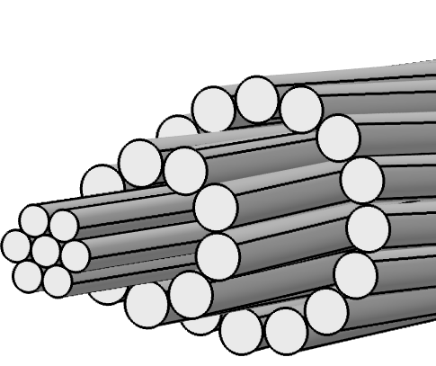
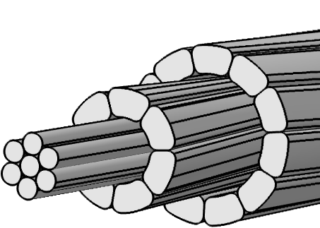
Modelling the Structural Dynamics of Electrical Overhead Line Power Conductors
M. A. Al Aqil, K. Kopsidas
The University of Manchester, Department of Electrical and Electronic Engineering, Manchester, UK
INTRODUCTION: Overhead Lines (OHLs) are constructed outdoors and exposed to various environmental conditions, which make them susceptible to wind-induced motions that are majorly act on the power conductors (Figure 1). The vast majority of experimental studies to quantify the aerodynamic forces on power conductors are conducted in costly indoor and outdoor test-spans with limited site access. The Finite Element Analysis (FEA) using COMSOL Multiphysics are deemed to be a compelling alternative tool to replace the practical experimentations.
RESULTS: The wind-conductor interaction is examined for the case of smooth cylinder, round stranded wires, and trapezoidal outer surfaces (Figure 4). The COMSOL simulations for the aerodynamic forces exerted on the power conductor geometry are produced in the graph shown in Figure 5. The results are validated against the experimental results extremely fine mesh to increase the accuracy of the results.
The fatigue stresses are computed for the conductor geometries shown in Figure 3 using the boundary conditions shown in Figure 5. The FEM simulations show that RW strands experience higher fatigue stresses due to the smaller contact surface areas between its overcrossing layers compared to the TW design.
Figure 1. Electric overhead line power conductors in the course of wind
COMPUTATIONAL METHODS: The physical phenomenon (i.e., Aeolian vibration) considered in this study implicates the flow of air across high-voltage power conductors. The Computational Fluid Dynamics (CFD) associated with COMSOL are used to solve this Fluid-Structure Interaction (FSI) model to quantify the aerodynamic forces (Lift and Drag) based on the Navier-Stokes equation, as illustrated in the wind tunnel in Figure 2.
The power conductors structural-dynamics entails also the cyclic bending of the helically stranded power conductor geometry (see Figure 3). To model the conductor bending forces and compute the fatigue stresses (i.e., Bending Stress), the conductor real geometry should be modelled, as seen in the steps of Figure 3. The structural-dynamics of the bending of the conductor geometry includes modelling the contact pairs between the longitudinal and crossover wires.
Figure 4. Calculated vs. Experimental aerodynamic forces (top) and aerodynamic forces for the round and trapezoidal designs (bottom)
Homogenous assumption
Figure 2. Conductor-wind interaction for Aerodynamic forces computations
Complex geometry – round stranded
Complex geometry – trapezoidal stranded
Free strands movement
Figure 5. Bending forces on the modelled power conductor geometry (top) and simulations of the fatigue stress (bottom)
CONCLUSIONS & Future Work:
The outer-layer affects the aerodynamic forces experienced by the power conductor.
The real conductor design allows quantifying the fatigue stresses considering the inter-layer interactions.
The effect of temperature can be further explored using the developed models.
Outer and inner layers
Round and trapezoidal wire conductor
Figure 3. Geometry of the overhead line conductor geometry
Excerpt from the Proceedings of the 2019 COMSOL Conference in Cambridge

