Slide 1


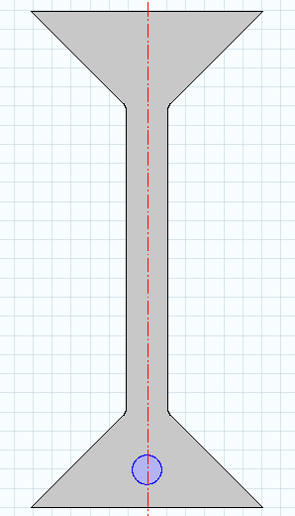
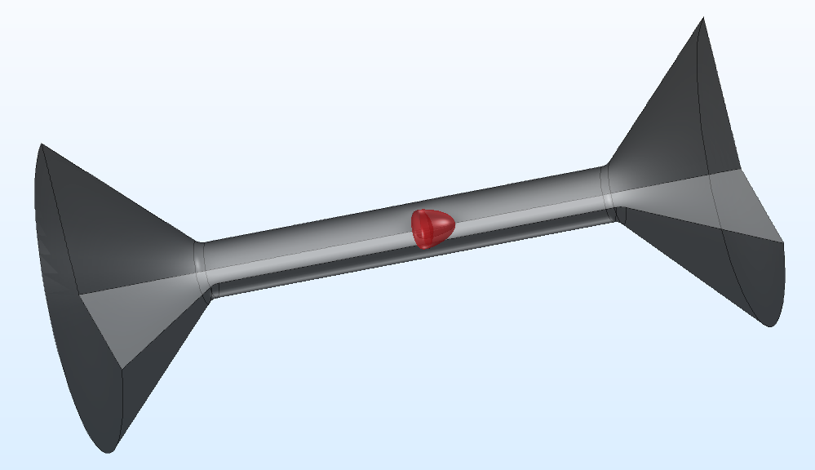
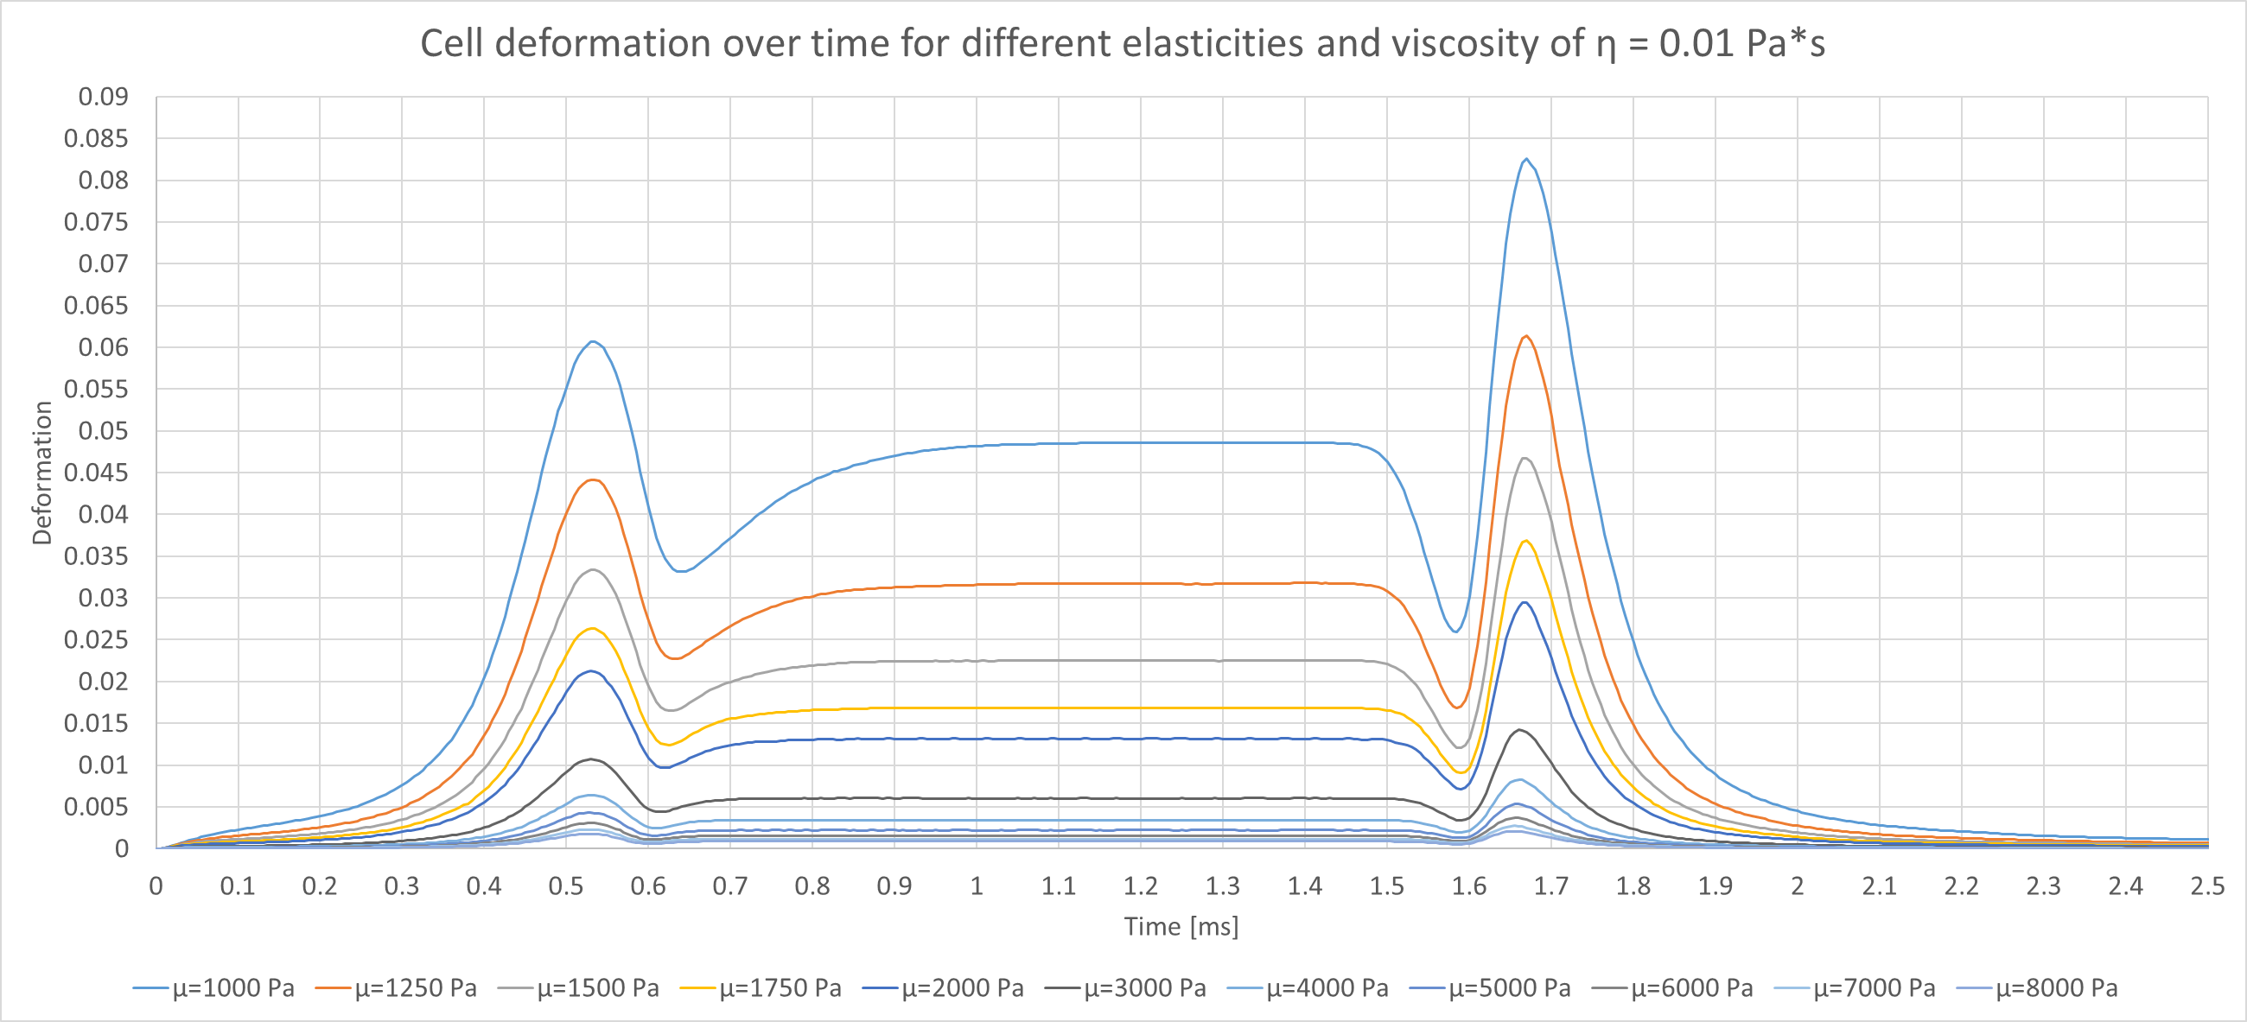
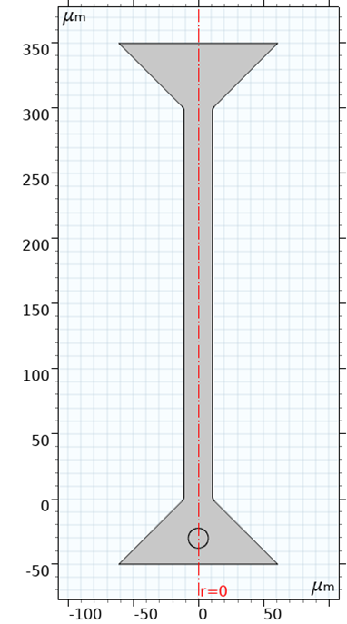
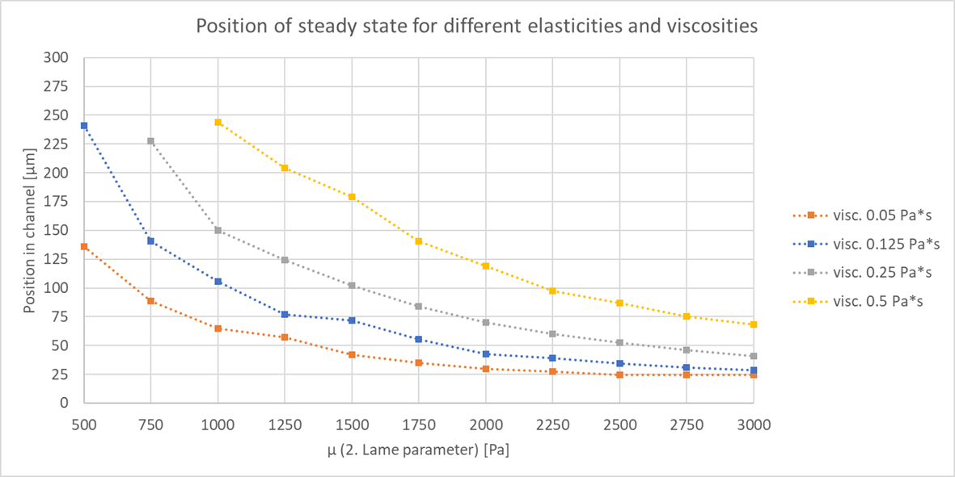
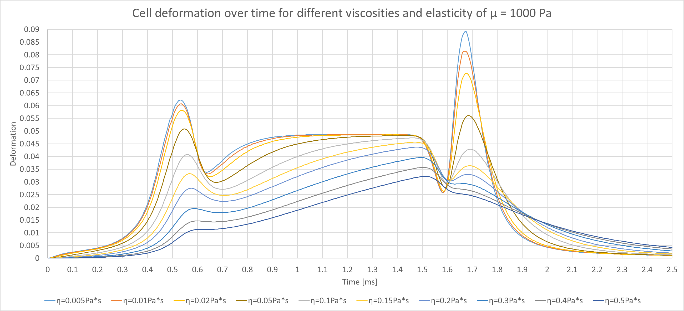
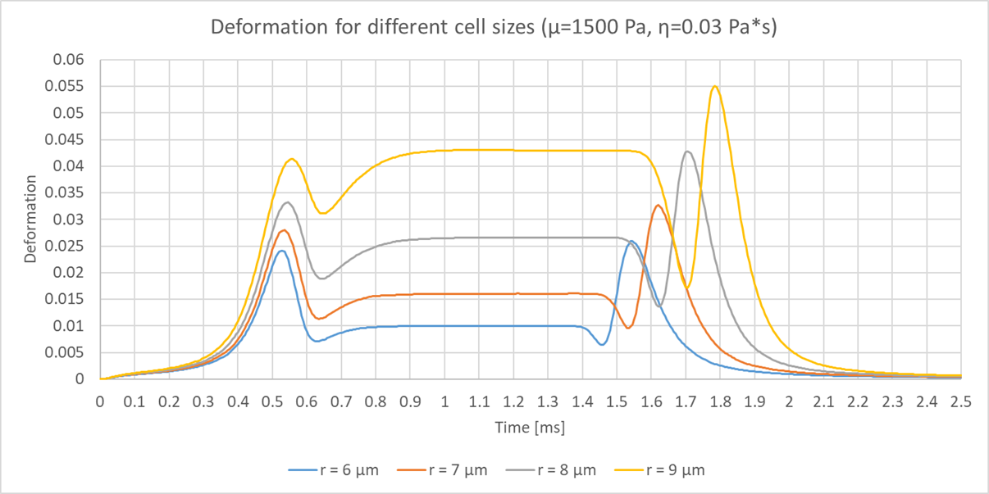
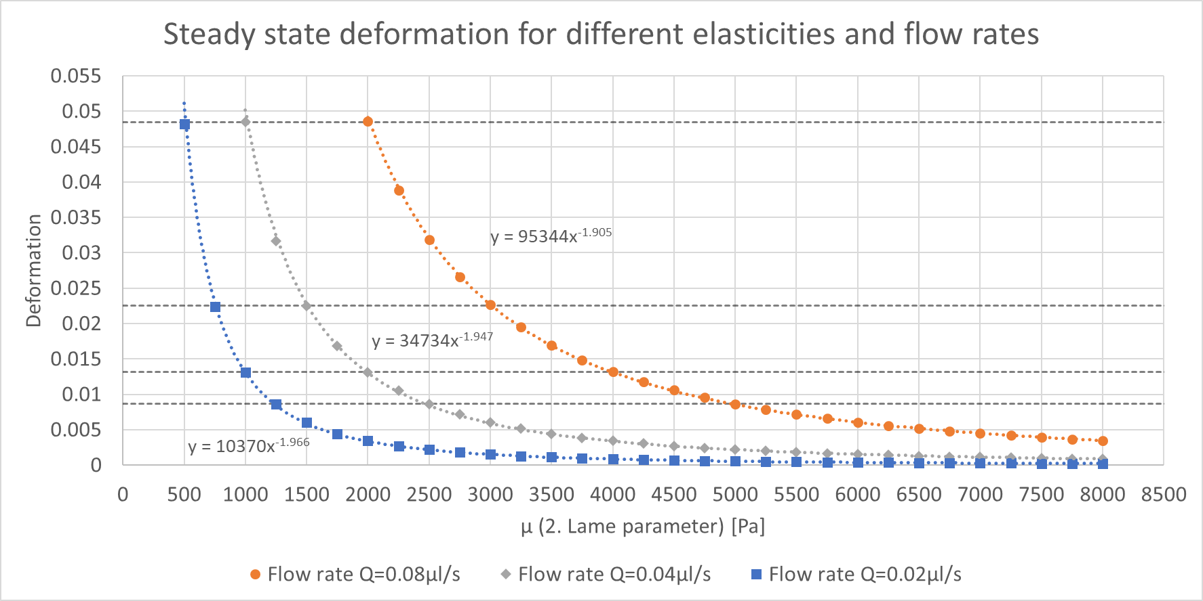



Comsol Conference 2019
Cambridge
Visco-elastic Behavior of Cells in a Microfluidic Device using FSI
R. Schuster¹, O. Marti¹
¹ Institute of Experimental Physics, Ulm University, D-89081 Ulm
1. Introduction
Variations of structure, shape of cells and their mechanical characterization play an important (patho-) physiological role. For instance, tumor and normal cells can be distinguished by elasticity, indicated by the amount of deformation under given stress. Suresh S. Acta Biomater. 2007; 3: 413-438
We aim to provide a simulation-based database for the mechanical deformation of cells in microfluidic channels. The variation of parameters of the viscoelastic models for the cells results in a library of possible cell deformation classes. The cell develops characteristic shapes, while moving through a microfluidic channel with varying width.
We achieve efficient computations using a 2D-rotational symmetric model, based on Fluid-Structure-Interaction with a hyper-elastic material. The influence of different parameters on the deformation is evaluated and will be presented. The deformation of a cell along an entire microfluidic channel can be tracked for a variety of elasticities, viscosities and flow rates. This research allowed to create guidelines for channel geometries specific for certain cell types or particles.
2. Deformation dependence on elasticity and viscosity
Stationary cell shape is identified, determined by elastic behavior.
Cell shape at in- and outlet is also of interest, determined by viscous behavior.
Non-linear hyper-elastic material (Neo-Hooke), describing stress-strain behavior of materials undergoing large deformations, e.g. rubber-like substances or biological tissues.
Definition of the deformation: $d=1−c=1−\frac{2\sqrt{πA}}{P}$
1.
4.
2.
High elongation/deformation at channel entry
Steady shape is reached, deformation remains constant
Steady shape is not reached, due to the higher relaxation time
Strong compression/deformation at channel exit
Outside the channel the primary undeformed shape is reached
5.
$$c=1$$
$$c=0.96$$
flow direction
160 µm
3.
For lesser µ (elasticity) and higher viscosity the steady state position moves towared the channel exit.
3. Investigation of different cell sizes and flow rates
Small cells move faster inside the channel and will be less deformed.
Nearly quadratic decline in deformation with increasing elasticity.
Doubling of elasticity and flow rate yield same amount of deformation.
4. Summary and Outlook
The deformation of a cell along an entire microfluidic channel can be tracked for a variety of elasticities, viscosities, cell sizes, flow rates and channel geometries.
From the amount of deformation at distinctive points, different cell types can be compared and categorized.
Influence of a shear dependent viscosity of the fluid on the deformation is currently investigated.
Email: ralf.schuster@uni-ulm.de

