Slide 1


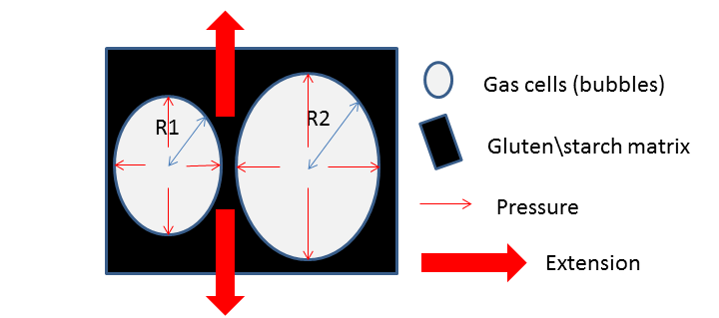
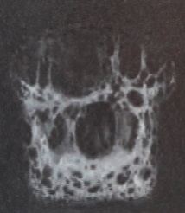
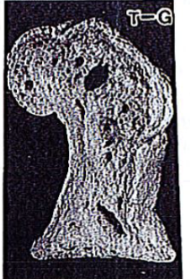
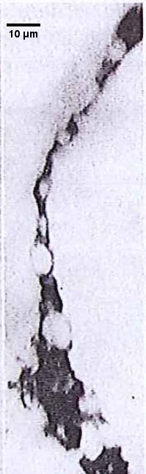
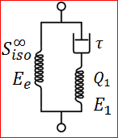
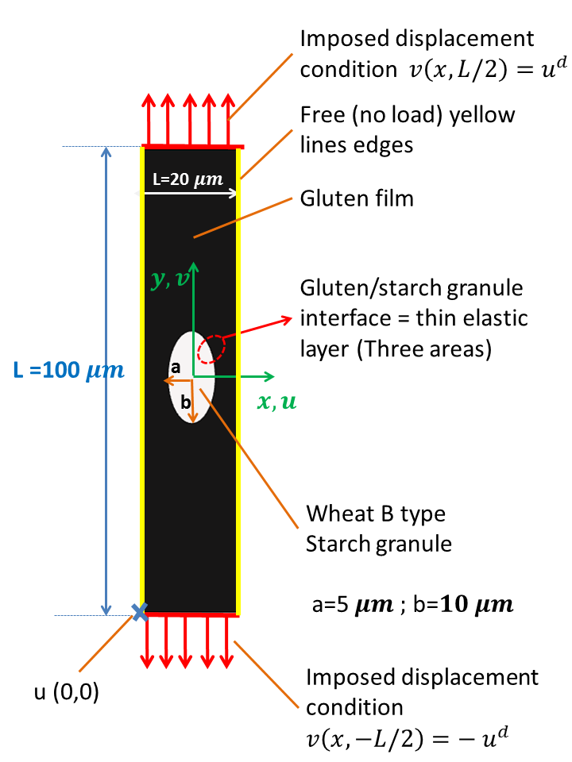
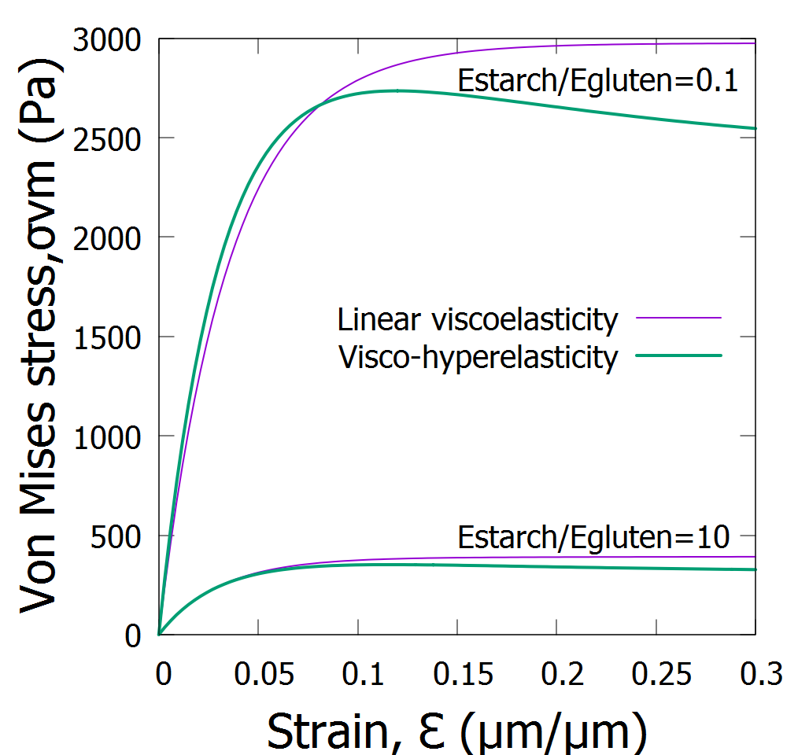
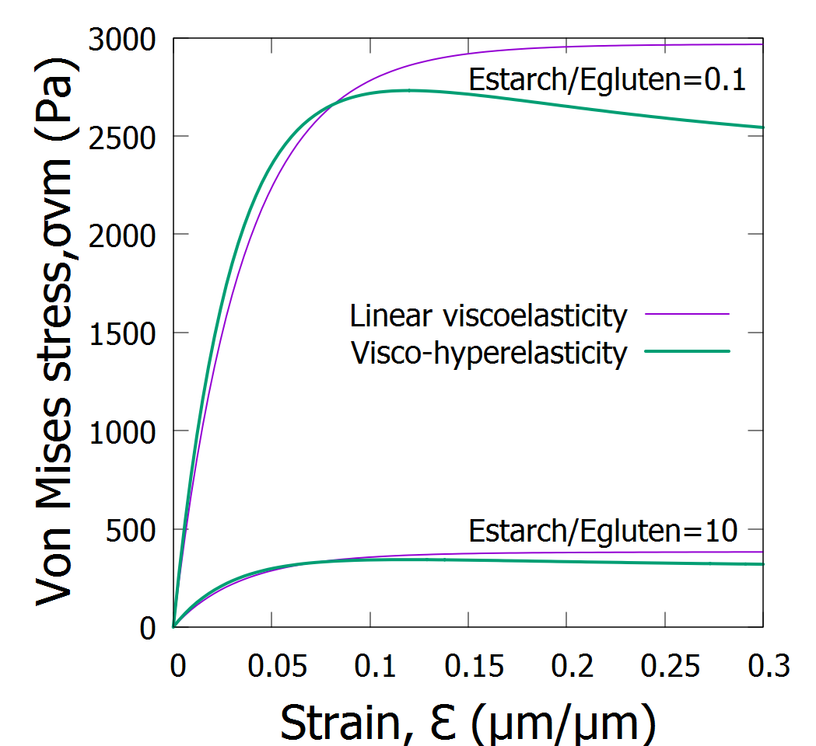
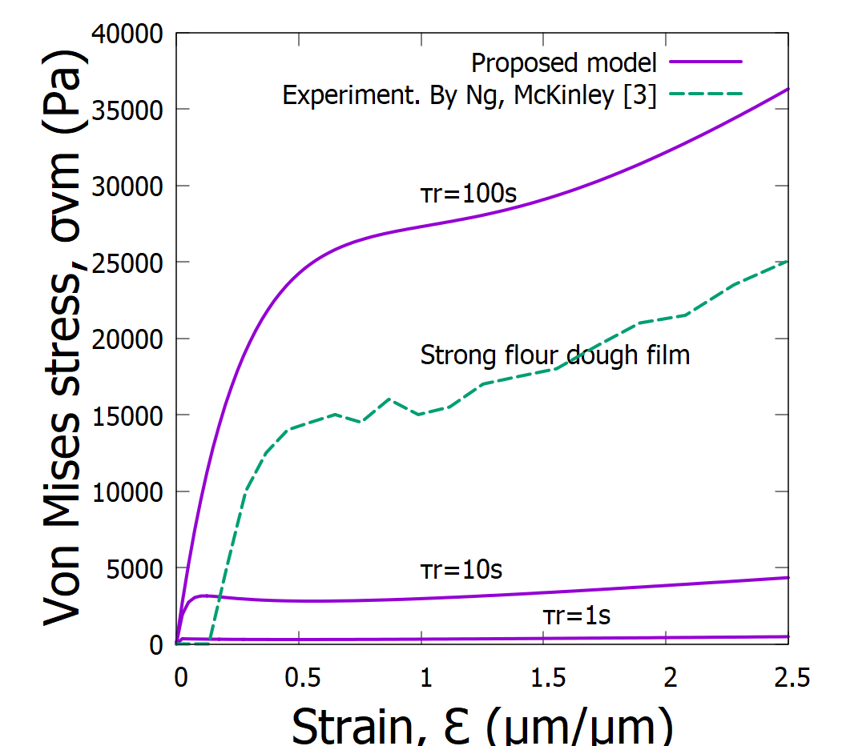
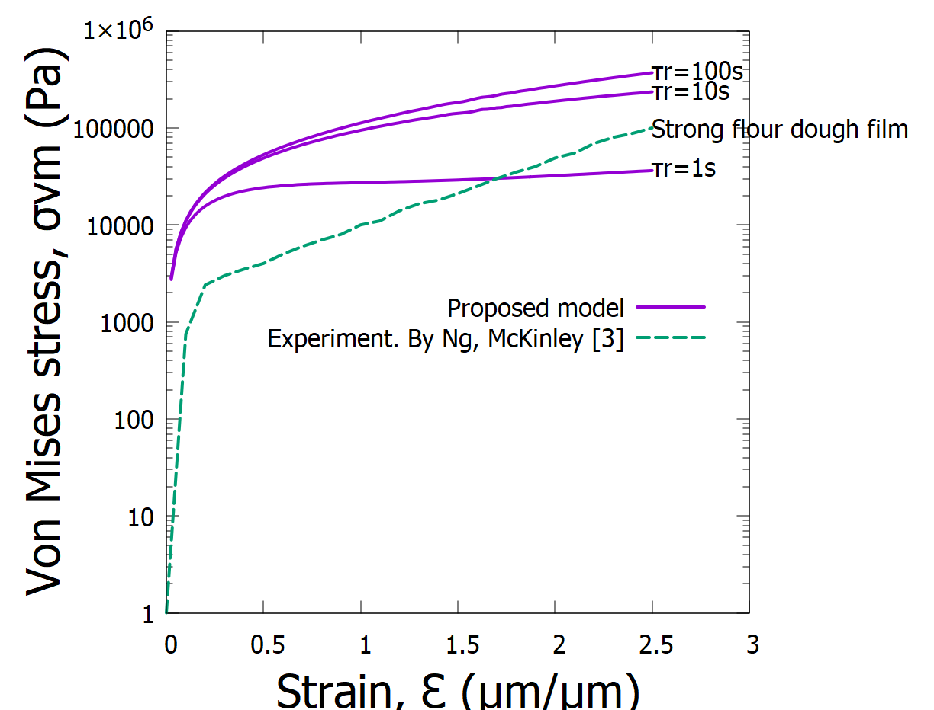
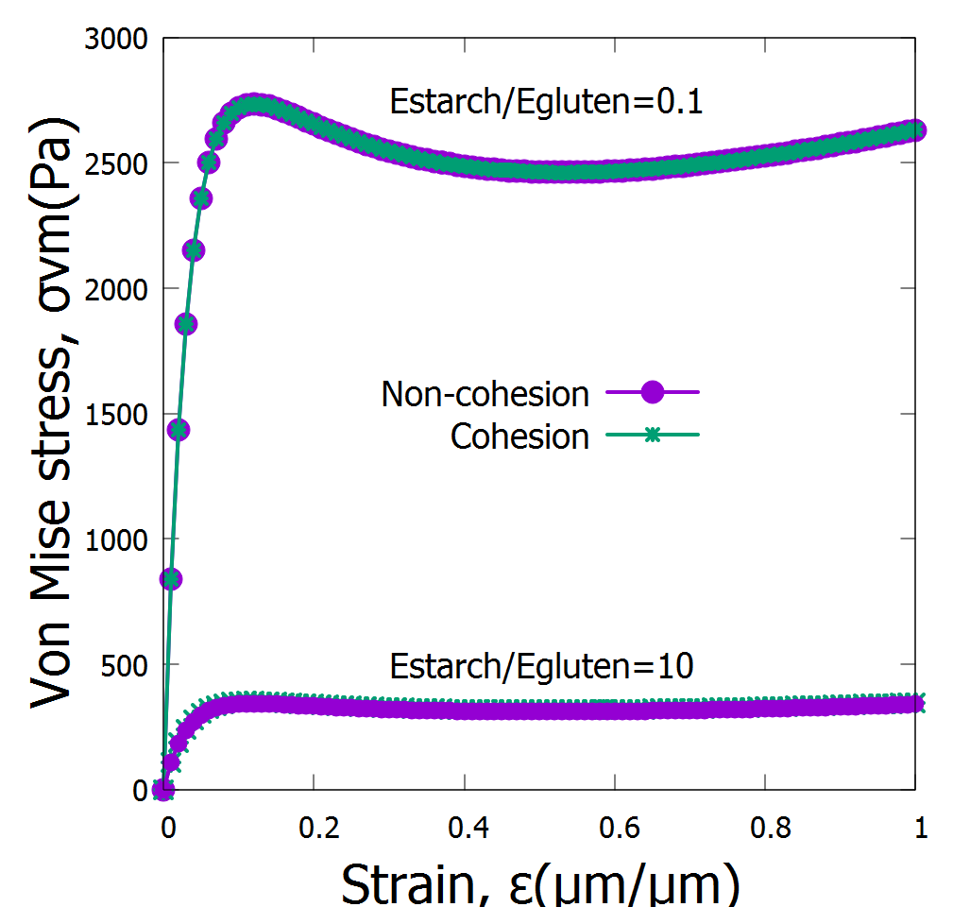
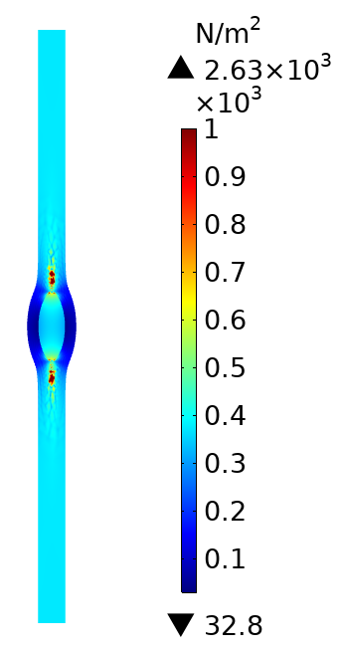
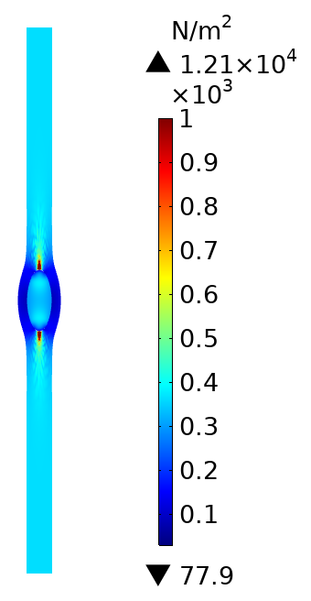
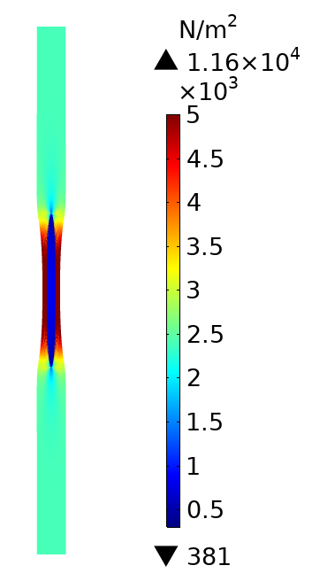



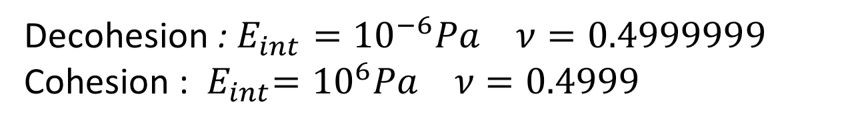
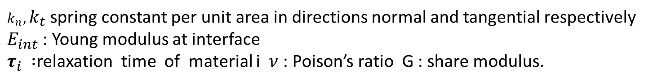
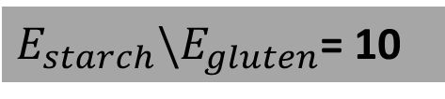
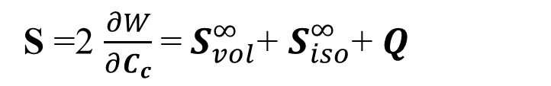
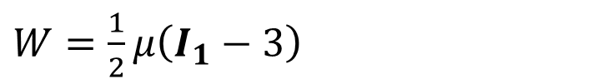


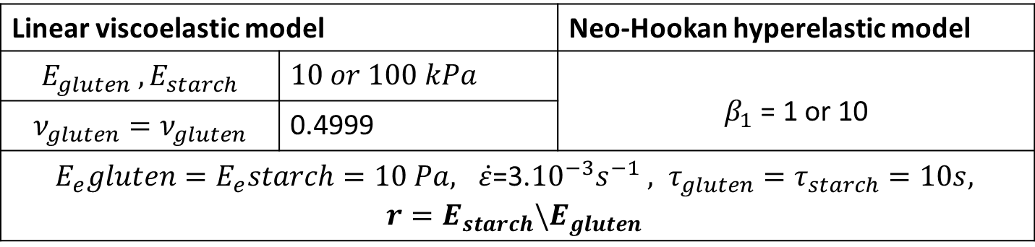
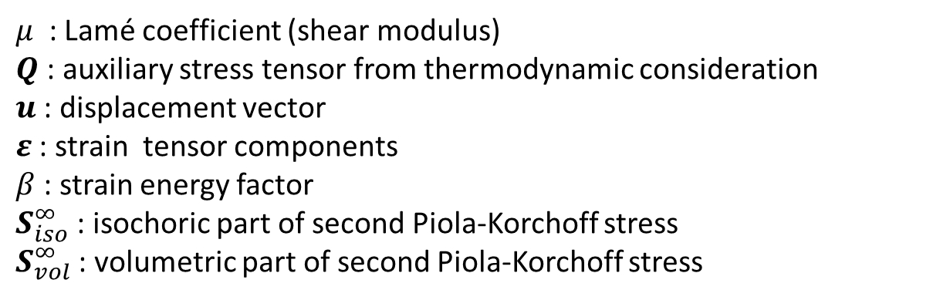
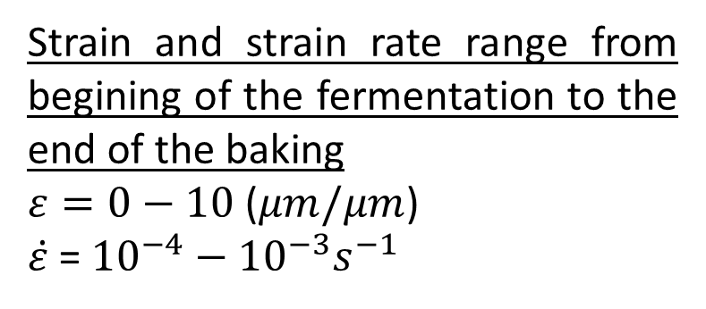


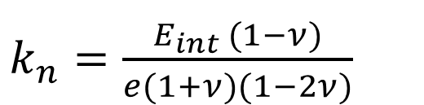
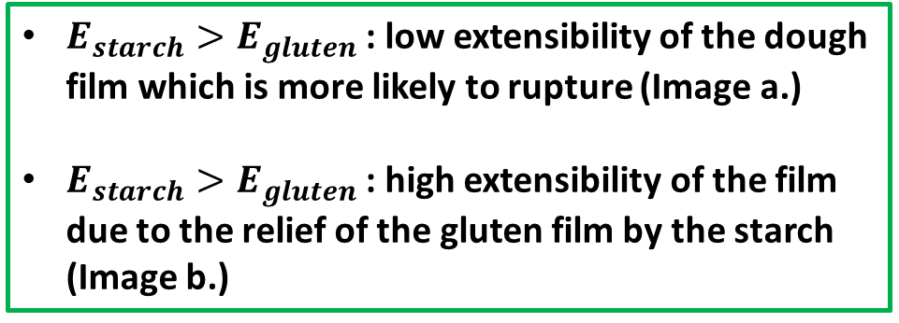


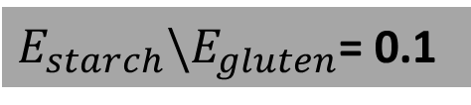
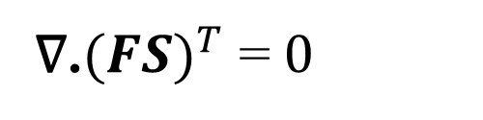
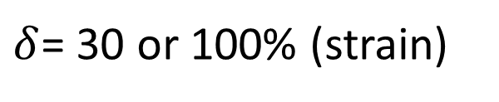


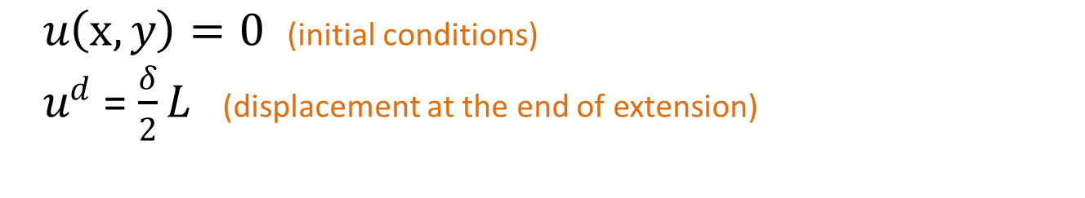
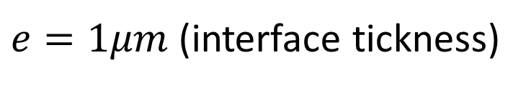



Stress Concentration Analysis in A Heterogeneous Dough Gas Cell Wall at The Microscale: the effect of gluten/starch interaction and rheological moduli ratio
Early GCW rupture
Late GCW rupture
K.B. Dedey^{1,2,3*}, T. Lucas^{1,2,3} , D. Grenier^{1,2,3}
Gas cell wall
¹ Université Rennes 1, avenue du Général Leclerc, 35042 Rennes cedex, France
² IRSTEA, UR OPAALE, 17 Avenue de Cucillé, CS 64427, F-35044 Rennes, France
³Université Bretagne Loire, France
dedeykossigan@gmail.com tiphaine.lucas@irstea.fr and david.grenier@irstea.fr
By Sandstedt [5]
By Kusunose, Fujii [4]
Bread dough strurture
Introduction : Understanding the gas cell wall (GCW) rupture behavior is crucial to control the specific volume and porosity of the bread. Between the end of the fermentation and the end of the baking the GCW must be considered as a heterogeneous material consisting mainly of gluten and starch granules [1,2].
Starch granule
Gluten film
Aim : Interactions between gluten and starch in GCW under unidirectional extension was modeled using linear viscoealsticity (small strain < 0.1) and visco-hyperelasticity (finite strain over 1).
Strain and strain rate range from begining of the fermentation to the end of the baking
$ε=0−10$ ($μm/μm$)
$\dot{ε}$ = ${{10}^{−4}−10}^{−3}s^{−1}$
-The linear viscoelasticy was compared to the visco-hyperelasticity
-The strain hardening, strain softening behaviors and sensitivity to the relaxation time were assessed in visco-hyperelasticity
-The effect of gluten/starch rheological moduli ratio on Von Mises stress concentration within GCW was studied
-Von Mises stress concentration analysis was performed to localize the spot where GCW is most likely to rupture
1. Materials and methods
GCW at the end of the baking. By Sandstedt [1]
1.1 Governing equations
1.2 Geometry, boundary conditions and material properties
Linear viscoelasticity
Neo-Hookan visco-hyperelasticity (Incompressible material)
Boundary conditions : unidirectional extention
$δ$= 30 or 100% (strain)
$$∇.(σ+τ)=0$$
(Quasi-static study)
∇.${(FS)}^{T}$ =$0$
$u\left(x,y\right)=0$ (initial conditions)
$u^{d}$ = $\frac{δ}{2}L$ (displacement at the end of extension)
$σ$ $=C:ε$
S =2 $\frac{∂W}{∂C_{c}}$=$S_{vol}^{∞}$+ $S_{iso}^{∞}$+ $Q$
1-element generalized maxwell model
Thin Elastic layer : cohesion/decohesion
$ε=∇u+{(∇u)}^{T}$
(Small strains $ε$<0.1)
$Q+ λ_{r}\dot{Q}= λ_{r}β\dot{S_{iso}^{∞}}$
$k_{n}=\frac{E_{int }(1−ν)}{e(1+ν)(1−2ν)}$
$k_{t}=\frac{G}{e}$
$e=1μm$(interface tickness)
$$τ+λ_{r}\dot{τ}=λ_{r}G\dot{γ}$$
$ε={(∇u)}^{T}+∇u+{(∇u)}^{T}. ∇u$
(Finite strains $ε>$0.1)
Decohesion : $E_{int}={10}^{−6}Pa ν=0.4999999$
Cohesion : ${ E}_{int}={10}^{6}Pa ν=0.4999$
$W=\frac{1}{2}μ\left(I_{1}−3\right)$
Neo-Hookean model
Material properties
S : elastic stress tensor; 𝝉 : viscoelastic stress tensor
$I_{1}=tr(C)$ (the first invariant of the left Cauchy–Green tensor)
G: stress relaxation modulus function
$γ$ : strain tensor
W: strain energy density function
$E_{e}$: Young’s modulus in purely elastic spring
$E_{1}$: Young’s modulus of the spring of branch 1
$μ$ : Lamé coefficient (shear modulus)
$Q$: auxiliary stress tensor from thermodynamic consideration
$u$ : displacement vector
$ε$: strain tensor components
$β$: strain energy factor
$S_{iso}^{∞}$: isochoric part of second Piola-Korchoff stress
$S_{vol}^{∞}$: volumetric part of second Piola-Korchoff stress
Linear viscoelastic model |  | Neo-Hookan hyperelastic model
$$E_{gluten} , E_{starch}$$ | $10 or 100 kPa$ | $β_{1}$ = 1 or 10
$$ν_{gluten}=ν_{gluten}$$ | 0.4999
$E_{e}gluten=E_{e}starch=10 Pa, \dot{ε}$=3.${10}^{−3}s^{−1} , τ_{gluten}=τ_{starch}=10s,$ $r=E_{starch}\backslash E_{gluten}$
The set of equations was solved using COMSOL Multiphysics software
Figure 1: Finite element model, geometry dimensions and boundary conditions.
$k_{n},k_{t}$ spring constant per unit area in directions normal and tangential respectively
$E_{int}$ : Young modulus at interface
${\text{τ}}_{i } :$relaxation time of material i$ν$ : Poison’s ratio G : share modulus.
2. Results and discussion
2.2 Sensitivity analysis on strain rate and time of relaxation
2.1 Linear viscoelasticity vs visco-hyperelasticity
a
b
a
b
The linear viscoelasticity describes material behaviors in low strain(<0.1)
The visco-hyperelasticity is more suitable for predicting GCW behavior in large strains > 0.3
Verified regardless of the nature of interactions between the gluten and the starch granule
Strain hardening and softening behavior depended on strain rate [3]
Stress in GCW greatly depends on time of relaxation especially at small strain rate
Figure 2: Mean of the Von Mises stress, comparaison between linear viscoelasticity and visco-hyperelasticity in the case of a. cohesive bond, b. non-cohesive bond at the gluten/starch interface.
Figure 3: Mean of the Von Mises stress within GCW, comparison of the proposed model to Filament Stretching Rheometry (FiSER) experiment on a strong flour dough by Ng, McKinley [3] for different relaxation times (𝜏𝑟= $τ_{gluten}=τ_{starch}$=1, 10, 100 𝑠 ) a. $\dot{ε}$ = 3.${10}^{−3}s^{−1}$: strain softening and, b. $\dot{ε}$ = 3.${10}^{−1}s^{−1}$: strain hardening ($E_{starch}=E_{gluten}$).
2.3 Effect of gluten/starch rheological moduli ratio and interactions
2.4 Stress concentration analysis: critical rupture spot within the GCW
Cohesion
$E_{starch}\backslash E_{gluten}$= 10
$E_{starch}\backslash E_{gluten}$= 0.1
a
b
On the mean of Von Mises stress
Non-cohesion
Cohesion
Non-cohesion
No critical effect of the nature of gluten/starch interactions
Great effect of gluten/starch rheological modulus ratio
$E_{starch}>E_{gluten}$ : low extensibility of the dough film which is more likely to rupture (Image a.)
$E_{starch}>E_{gluten}$ : high extensibility of the film due to the relief of the gluten film by the starch (Image b.)
Figure 4: Mean of the Von Mises stress in the case of cohesion and non-cohesion at the gluten/starch interface for r<1 and r>1 ($\dot{ε}$ = 3.${10}^{−3}s^{−1}$).
Figure 5: The Von Mises stress concentration fields in the case of cohesion and non-cohesion at the gluten/starch interface for r<1 and r>1($\dot{ε}$ = 3.${10}^{−3}s^{−1}$ and $ε=1(μm/μm)$).
3. Conclusions
Strain hardening and strain softening were reproduced by the proposed model
Great sensitivity of the mean of Von Mises stress within GCW with respect to the ratio between the gluten and starch rheological moduli
The softening of starch granule (r<1) relieves stress concentration and increases ability of GCW to extend without rupture
The nature of the interactions at the gluten/starch interface shown no great effect on the mean of Von Mises stress within GCW for the considered gluten/starch proportion
References
Aknowledgements
[1] Sandstedt, R., The microscopic structure of bread and dough. Cereal Chem., 1954. 31: p. 43-49.
[2] Mohammed, M.A.P., et al., Mechanical characterization and micromechanical modeling of bread dough. Journal of Rheology, 2013. 57(1): p. 249-272.
[3] Ng, T.S., G.H. McKinley, and M. Padmanabhan, Linear to non-linear rheology of wheat flour dough. Applied Rheology, 2006. 16(5): p. 265-274.
[4] Kusunose, C., T. Fujii, and H. Matsumoto, Role of starch granules in controlling expansion of dough during baking. Cereal chemistry, 1999. 76(6): p. 920-924
[5]Sandstedt,R.M.1961.Thefunetionofstarehinthebakingofbread.Baker'sDig.35:36.
This work was co-funded by Université Bretagne Loire (UBL, France) and the National Research Institute of Science and Technology for Environment and Agriculture (IRSTEA, France).

