Slide 1
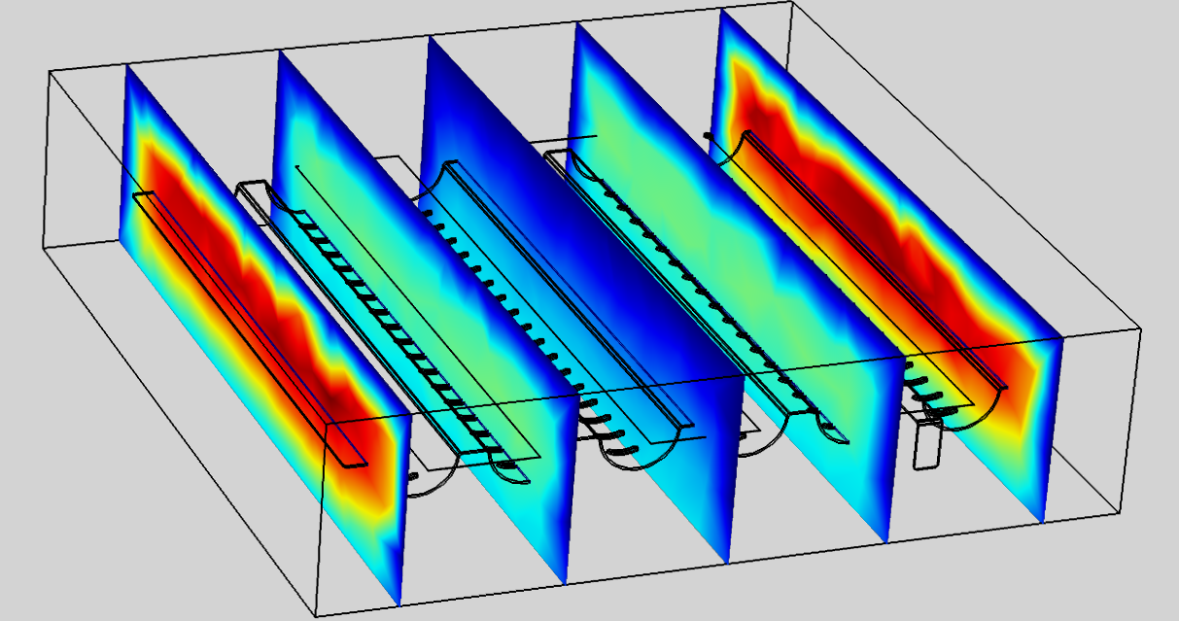
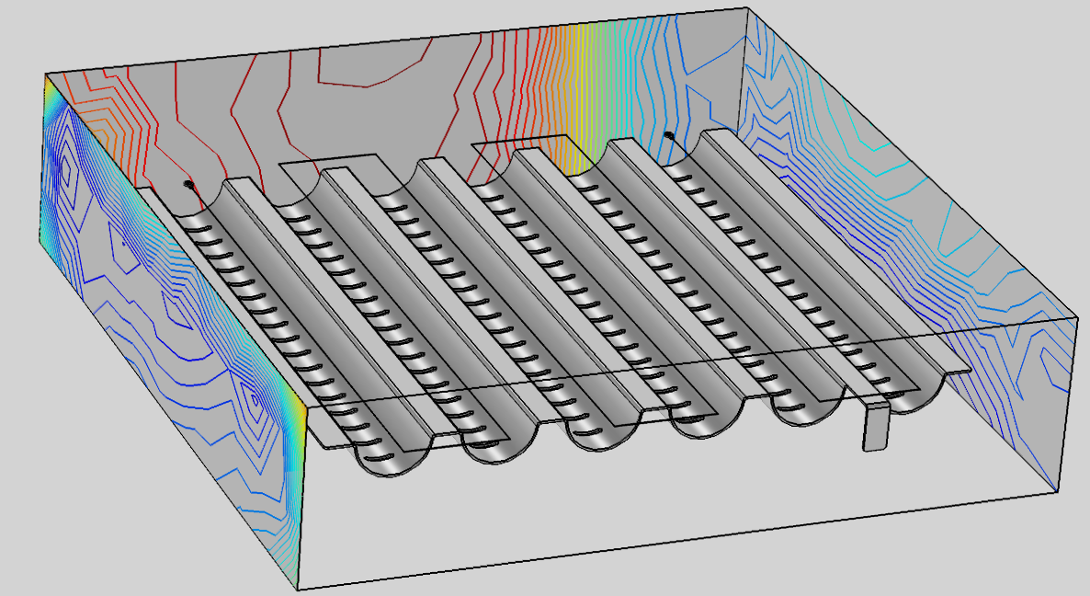
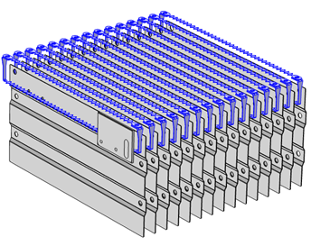
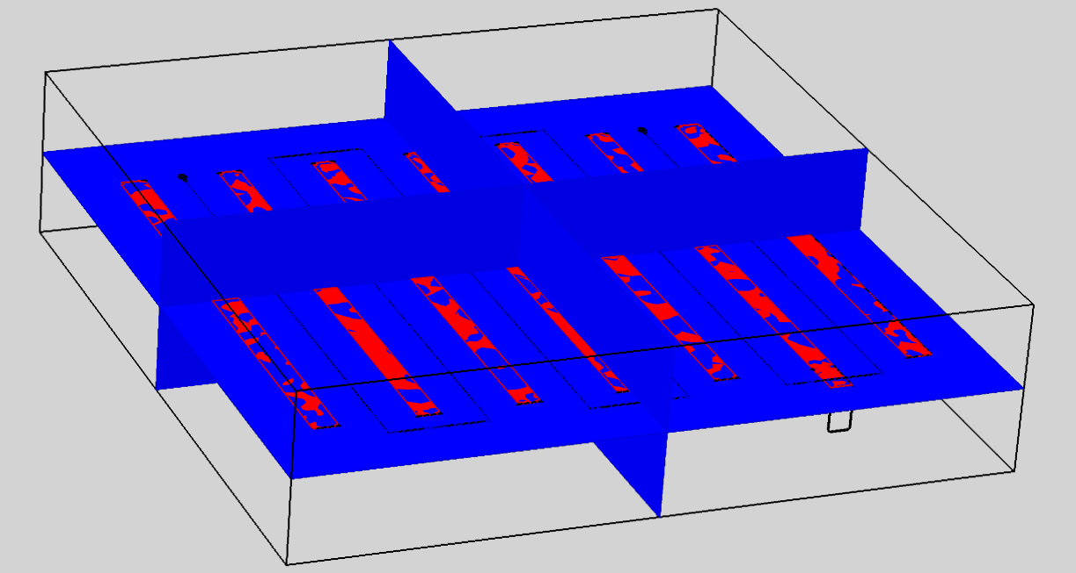
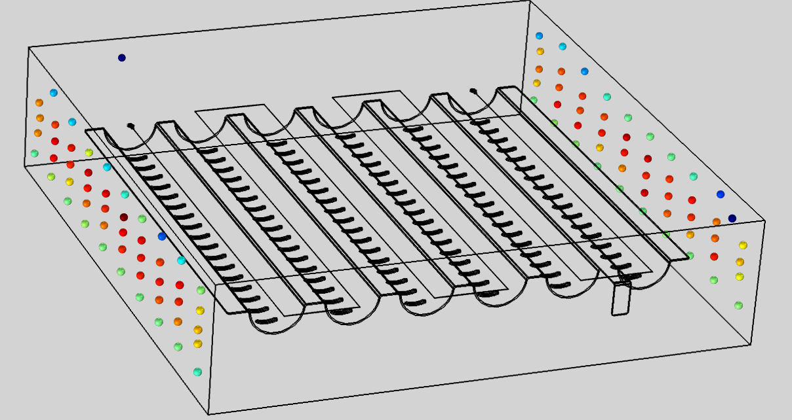

Design and Implementation Of A Deodorizing Electrostatic Filter In Hoods
Okan Ozgonenel¹, Sezgin Bahtiyar², Tugce Simsek³, Ali Erkoc³
1. Electrical & Electronic Engineering, Ondokuz Mayis University, Samsun, Turkey
2. Silverline, R&D Director, Merzifon – Amasya, Turkey
3. Silverline, R&D Section, Merzifon – Amasya, Turkey
INRODUCTION: This paper proposed design and implementation of a deodorizing electrostatic filter in hoods. The proposed model is aimed to be used in home applications. Electrostatic analysis is used to define maximum voltage level in order to refrain electrical breakdown (arc). It is vital because excessive heat is produced during arc phenomena and harms insulation materials. Multiphysics approach is used for design procedure. These are electrostatic, particle tracing for fluid flow, and laminar flow. The suggested modelling technique ensures to have hold particles over 90%.
RESULTS: In the case of the corona discharge problem in an ESP it is eﬃcient to use a ﬁne mesh close to the corona electrode and an extremely ﬁne mesh close to the boundary between the air region and the dust layer and inside the layer, because a signiﬁcant variation of potential is concentrated there. Mainly, the proposed model has 3 physics such as electrostatics, particle tracing for fluid flow and laminar flow. The whole model is surrounded by air. Particle tracing solution is given in Fig. 3, 4, and 5.
EELCTROSTATIC PRECIPITATOR:The electrostatic precipitator (ESP), shown in Fig. 1, is a universal apparatus for industrial gas cleaning of solid and wet particles. High collecting eﬃciencies (approximately 99%) and low energy expenditures are the main beneﬁts of ESPs. Electric potential distribution is given in Fig. 2.
Figure 4. Velocity of particles
Figure 5. Distribution of the pressure from the electrodes
Figure 1. Schematic description of an ESP
CONCLUSIONS: This paper proposed design and implementation of an ESP for in-house applications. The proposed ESP is modelled using FEA in Comsol™ (ver. 5.2a) environment. It can be concluded from the simulations that the proposed ESP design can hold particles with the amount of 95%. Real time experiments have been achieved using smoke (burning a paper). To avoid electrical arc between the electrodes the applied voltage is controlled by a microprocessor controller.
The precipitation process in an ESP with a dust layer at the collecting electrode includes the following factors:
Applied voltage between collecting and corona electrodes, U;
Electric ﬁeld, E;
Ion space charge density, ρ;
Resistivity of the dust layer, $α$;
Thickness of the dust layer, l;
Relative permittivity of the dust layer, $ε_{r}$.
The authors are deeply thankful to THE SCIENTIFIC AND TECHNOLOGICAL RESEARCH COUNCIL OF TURKEY (TUBITAK) for its support.
REFERENCES:
1. W.C. Hinds, Aeorosol technology - properties, behavior, and measurements of airborne particles (1999). J. Benitez, Process engineering and design for air pollution control (1993).
2. M. D. Allen et al., Slip correction measurements of spherical solid aerosol particles in an improved Milikan apparatus, Aerosol Science and Technology, 3rd edition p.269-286 (1985).
3. H.J. White, Industrial electrostatic precipitation (1963).
4. R.C. Flagan et al., Fundamentals of air pollution engineering (1988).
Figure 2. Electric potential distribution
Figure 3. Particle trajectory distribution of the proposed model
Excerpt from the Proceedings of the 2019 COMSOL Conference in Cambridge

