Slide 1
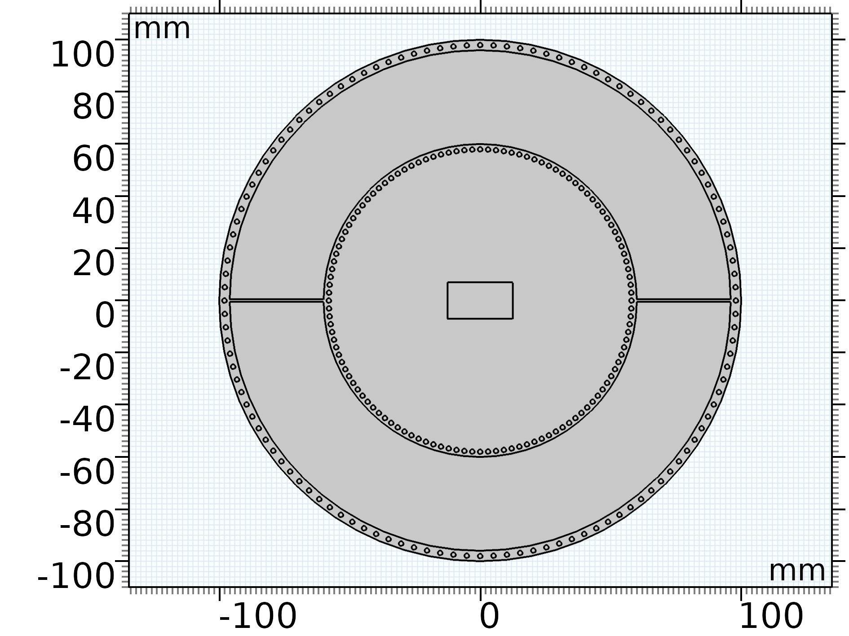
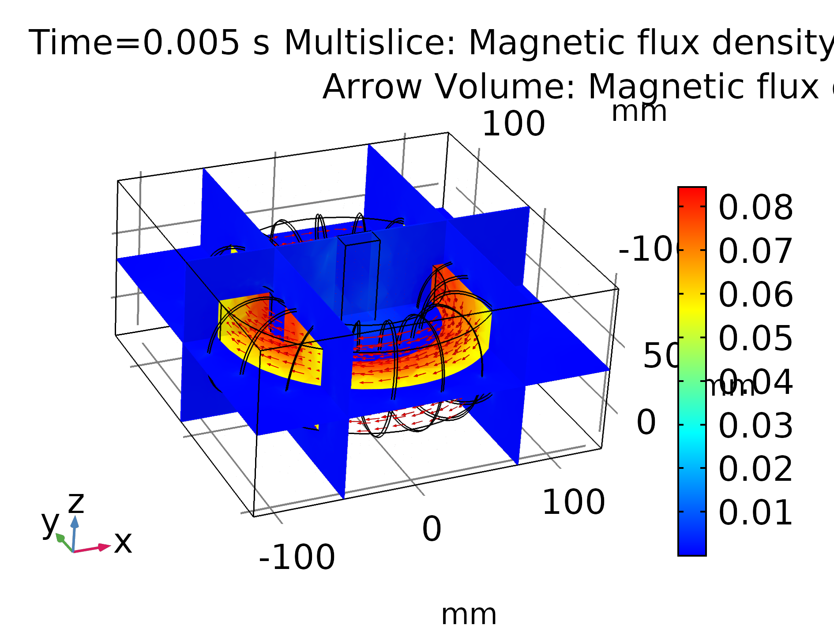
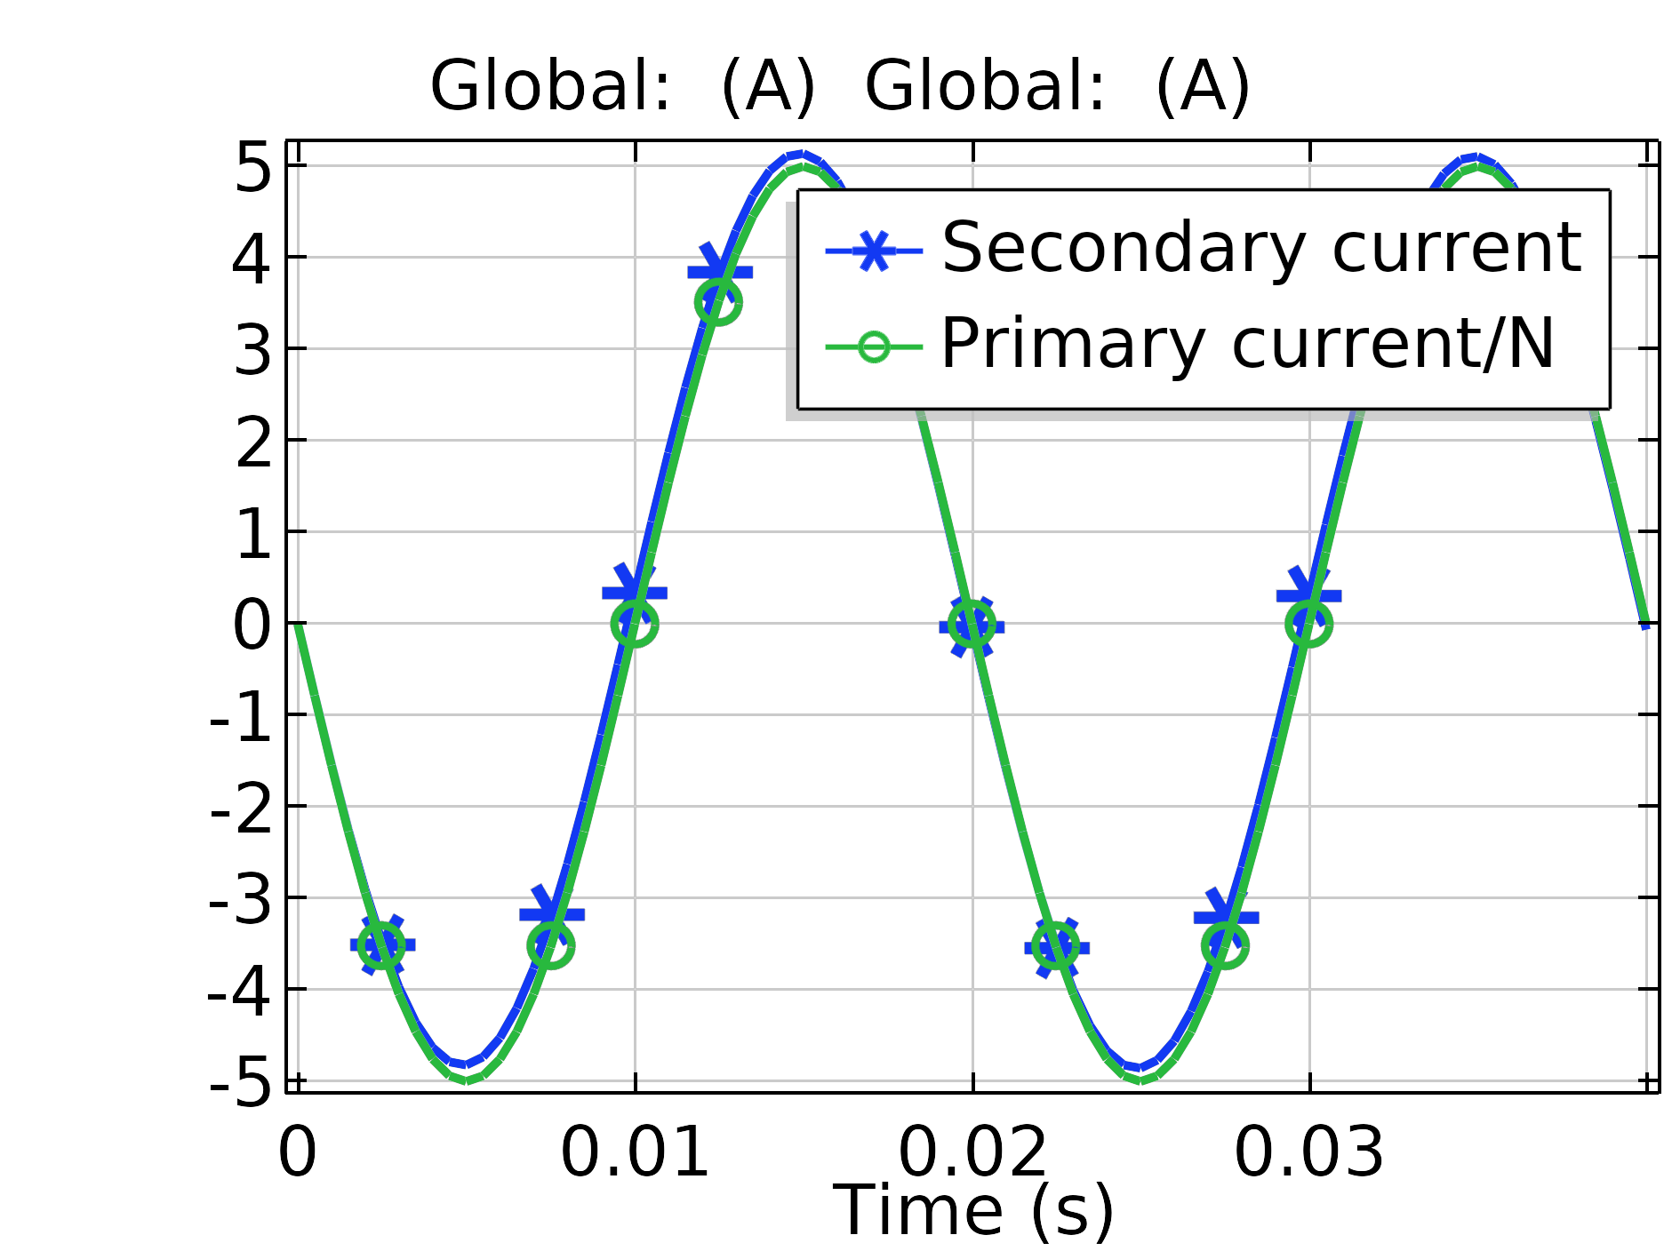

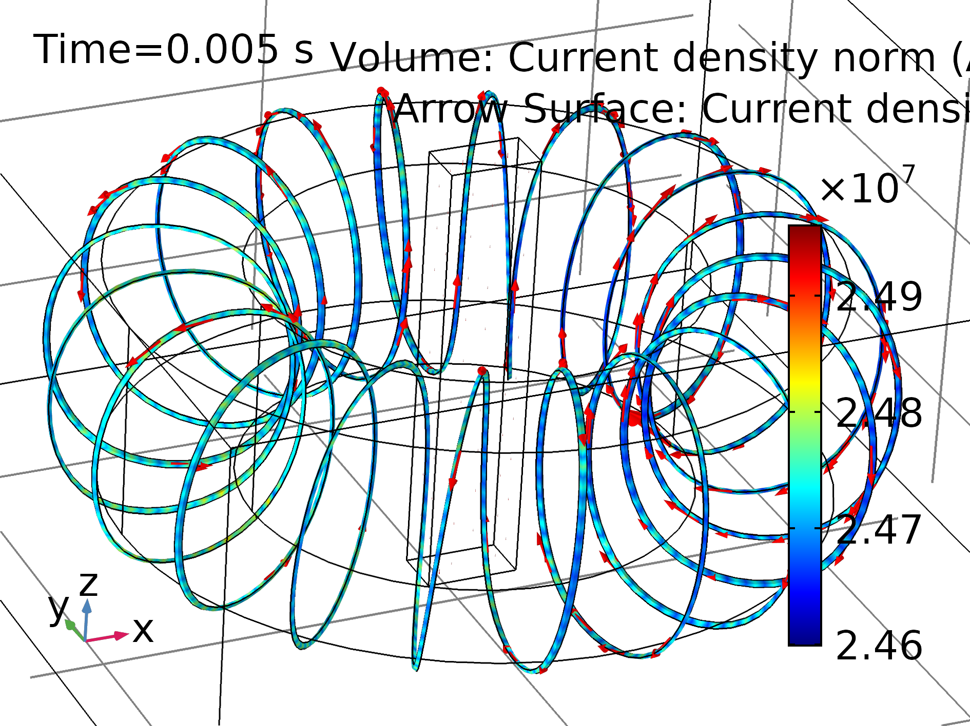

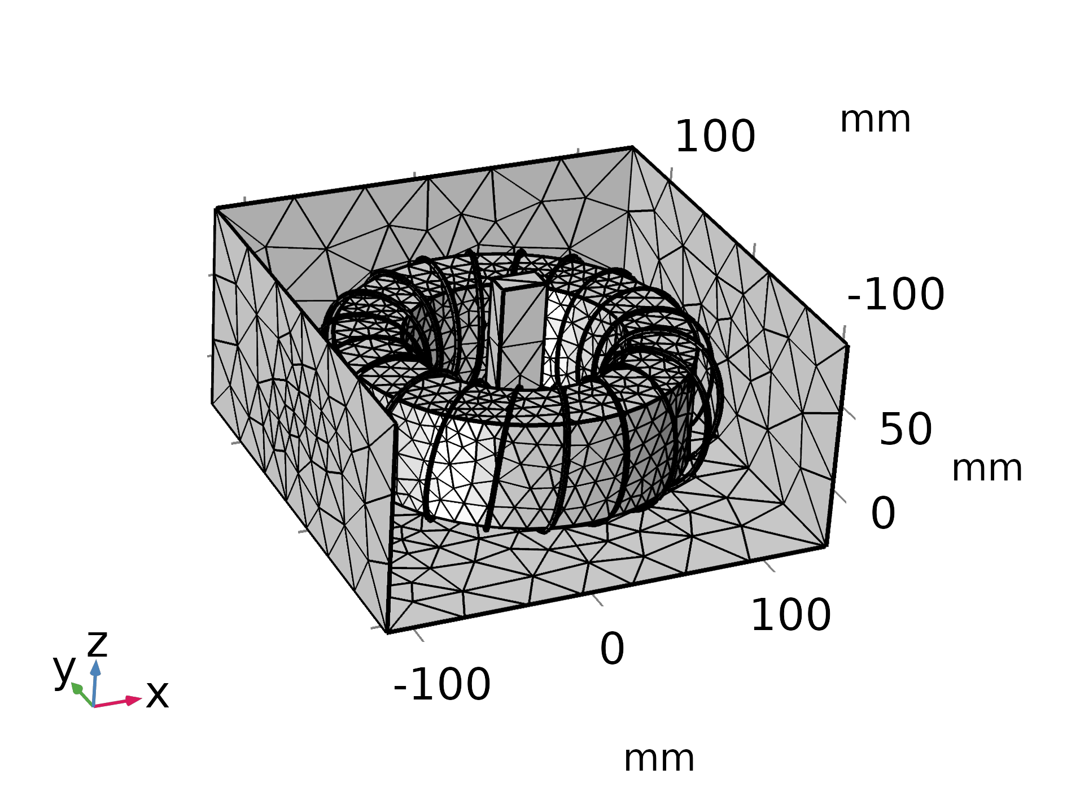
Protection Type Current Transformer Modeling With Air Gaps
O. Ozgonenel¹, B. Cepken² , B. Cilsal ²
1. Ondokuz Mayis University, Electrical and Electronic Engineering, Samsun, 55200, Turkey
2. ESİTAŞ, Instrument Transformers, Istanbul, Sancaktepe 34791, Turkey
INRODUCTION: Current transformers (CTs) used for the purpose of measurement and design of our company has come a long way and have original designs. In the proposed paper, protection type current transformer design and manufacturing at medium voltage level (up to 36kV) will be modeled. Protection type current transformers are used in case of current conditions where the current measurement function is required in the power system (percentage protection, distance protection, overcurrent relays etc.). Traditionally, the protection current transformers (at MV and HV levels) are in the standards of 5P and 10P (accuracy) and are manufactured in the core structures required by these standards. In the design phase, permenant flux factor, K, will be modified within the values of <= 10%.
First, traditional modeling is applied to 3D model of proposed CT and then 2D models are solved for air gap studies (Fig. 2).
Figure 2. 2D model with air gaps
RESULTS: As seen from the performance figures, it can be concluded that the proposed CT type with air gaps fulfills the required IEC and IEEE standards.
COMPUTATIONAL METHODS: The model is consisted of Magnetic Fields and Electrical Circuit (in AC/DC Module). Physics. The constitutive equations ar as follow:
a) Ampere Law for core material
b) Coil definitions
The problem is solved in time domain with a sampling frequency of 2000Hz. Fig. 1 shows the complete 3D model. In Fig. 1, secondary winding has 30 turns due to reducing of mesh elements. Normally it has 240 turns for a 600/5 PR Type current transformer.
Figure 3. Magnetic flux distribution
Figure 4. Primary and secondary currents
Figure 5. Current density of secondary winding at the time 5msec
CONCLUSIONS: This paper proposes PR type CT for power system applications. The main purpose is to achieve required IEC and IEEE standards with air gaps in the core. According to performance curves and calculations the suggested model is able to achieve the standards.
Acknowledgement
The authors are deeply grateful to TUBİTAK for its TEYDEB support for this project and would like to kindly acknowledge it. Without this support, this project would never have succeeded.
REFERENCES:
1. N. Locci, C. Muscas, Hysteresis and eddy currents compensation in current transformer, IEEE Trans. Power Deliv., 16, no. 2, 154-159, (2001).
2. J.H. Chan, A. Vladimirescu, X.C. Gao, P. Liebmann, Y. Valainis, Nonlinear transformer model for circuit simulation, IEEE Trans. Comput.-Aided Des. Integr., 10, no. 4, 476-482, (1991).
3. O. Ozgonenel, U.K. Terzi, I. Guney, A different algorithm for correcting secondary current of current transformer, Proc. 10th Int. Conf. Developments in Power System Protection, (2010).
Figure 1. 3D model of PR type CT without air gap
Excerpt from the Proceedings of the 2019 COMSOL Conference in Cambridge

