Slide 1
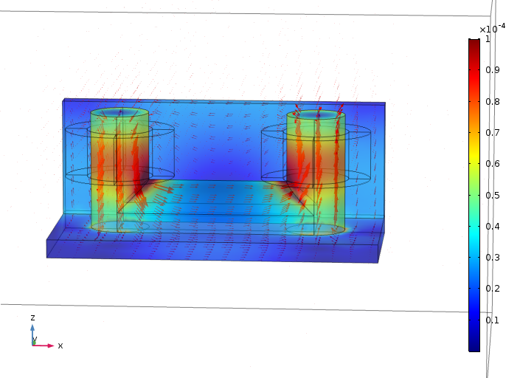
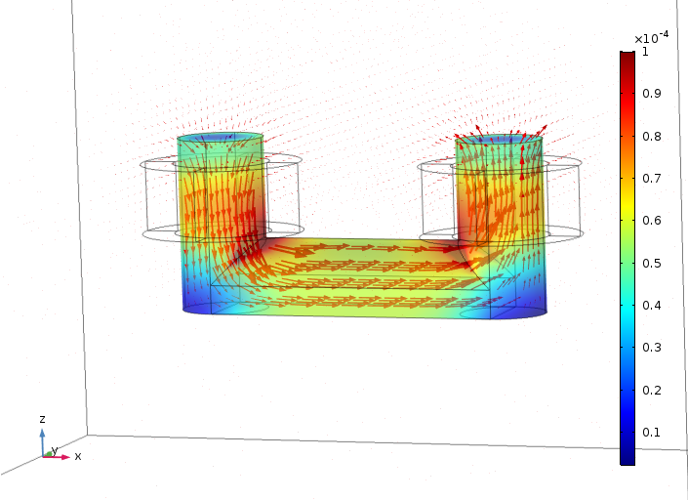
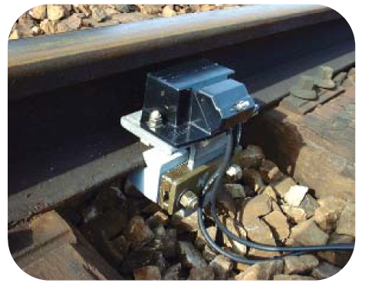
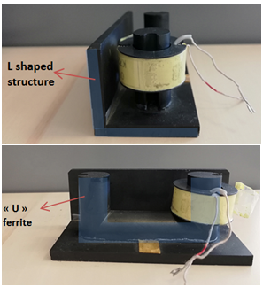
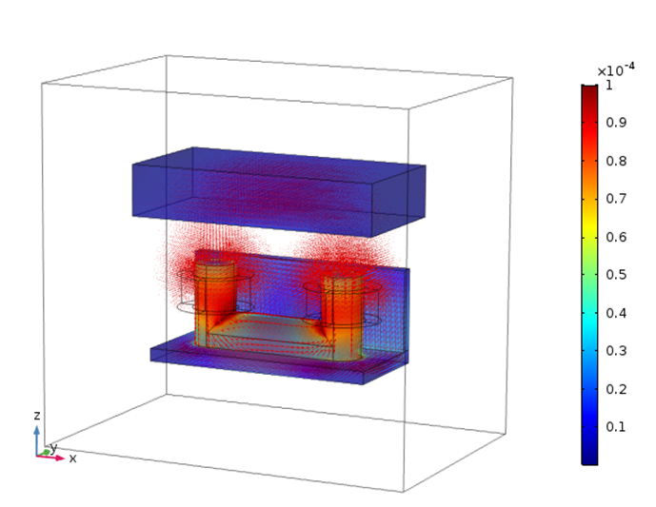
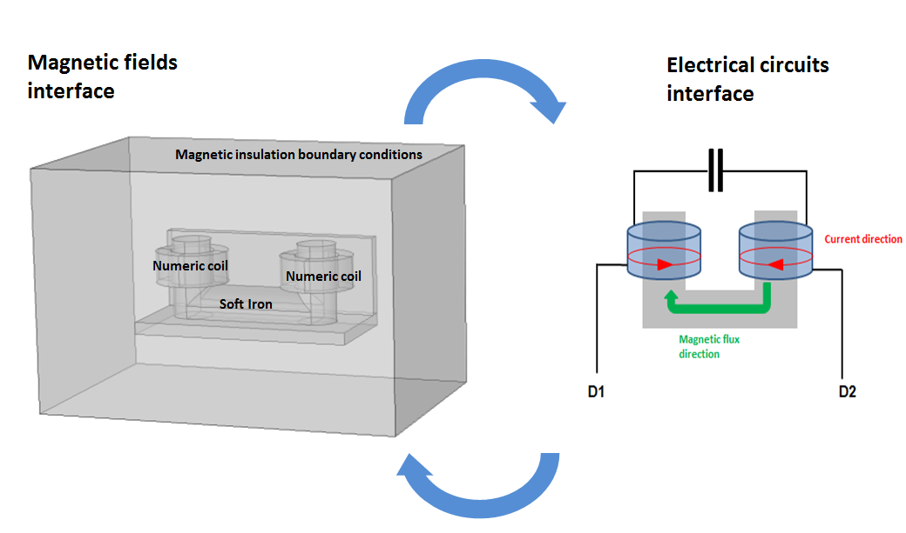
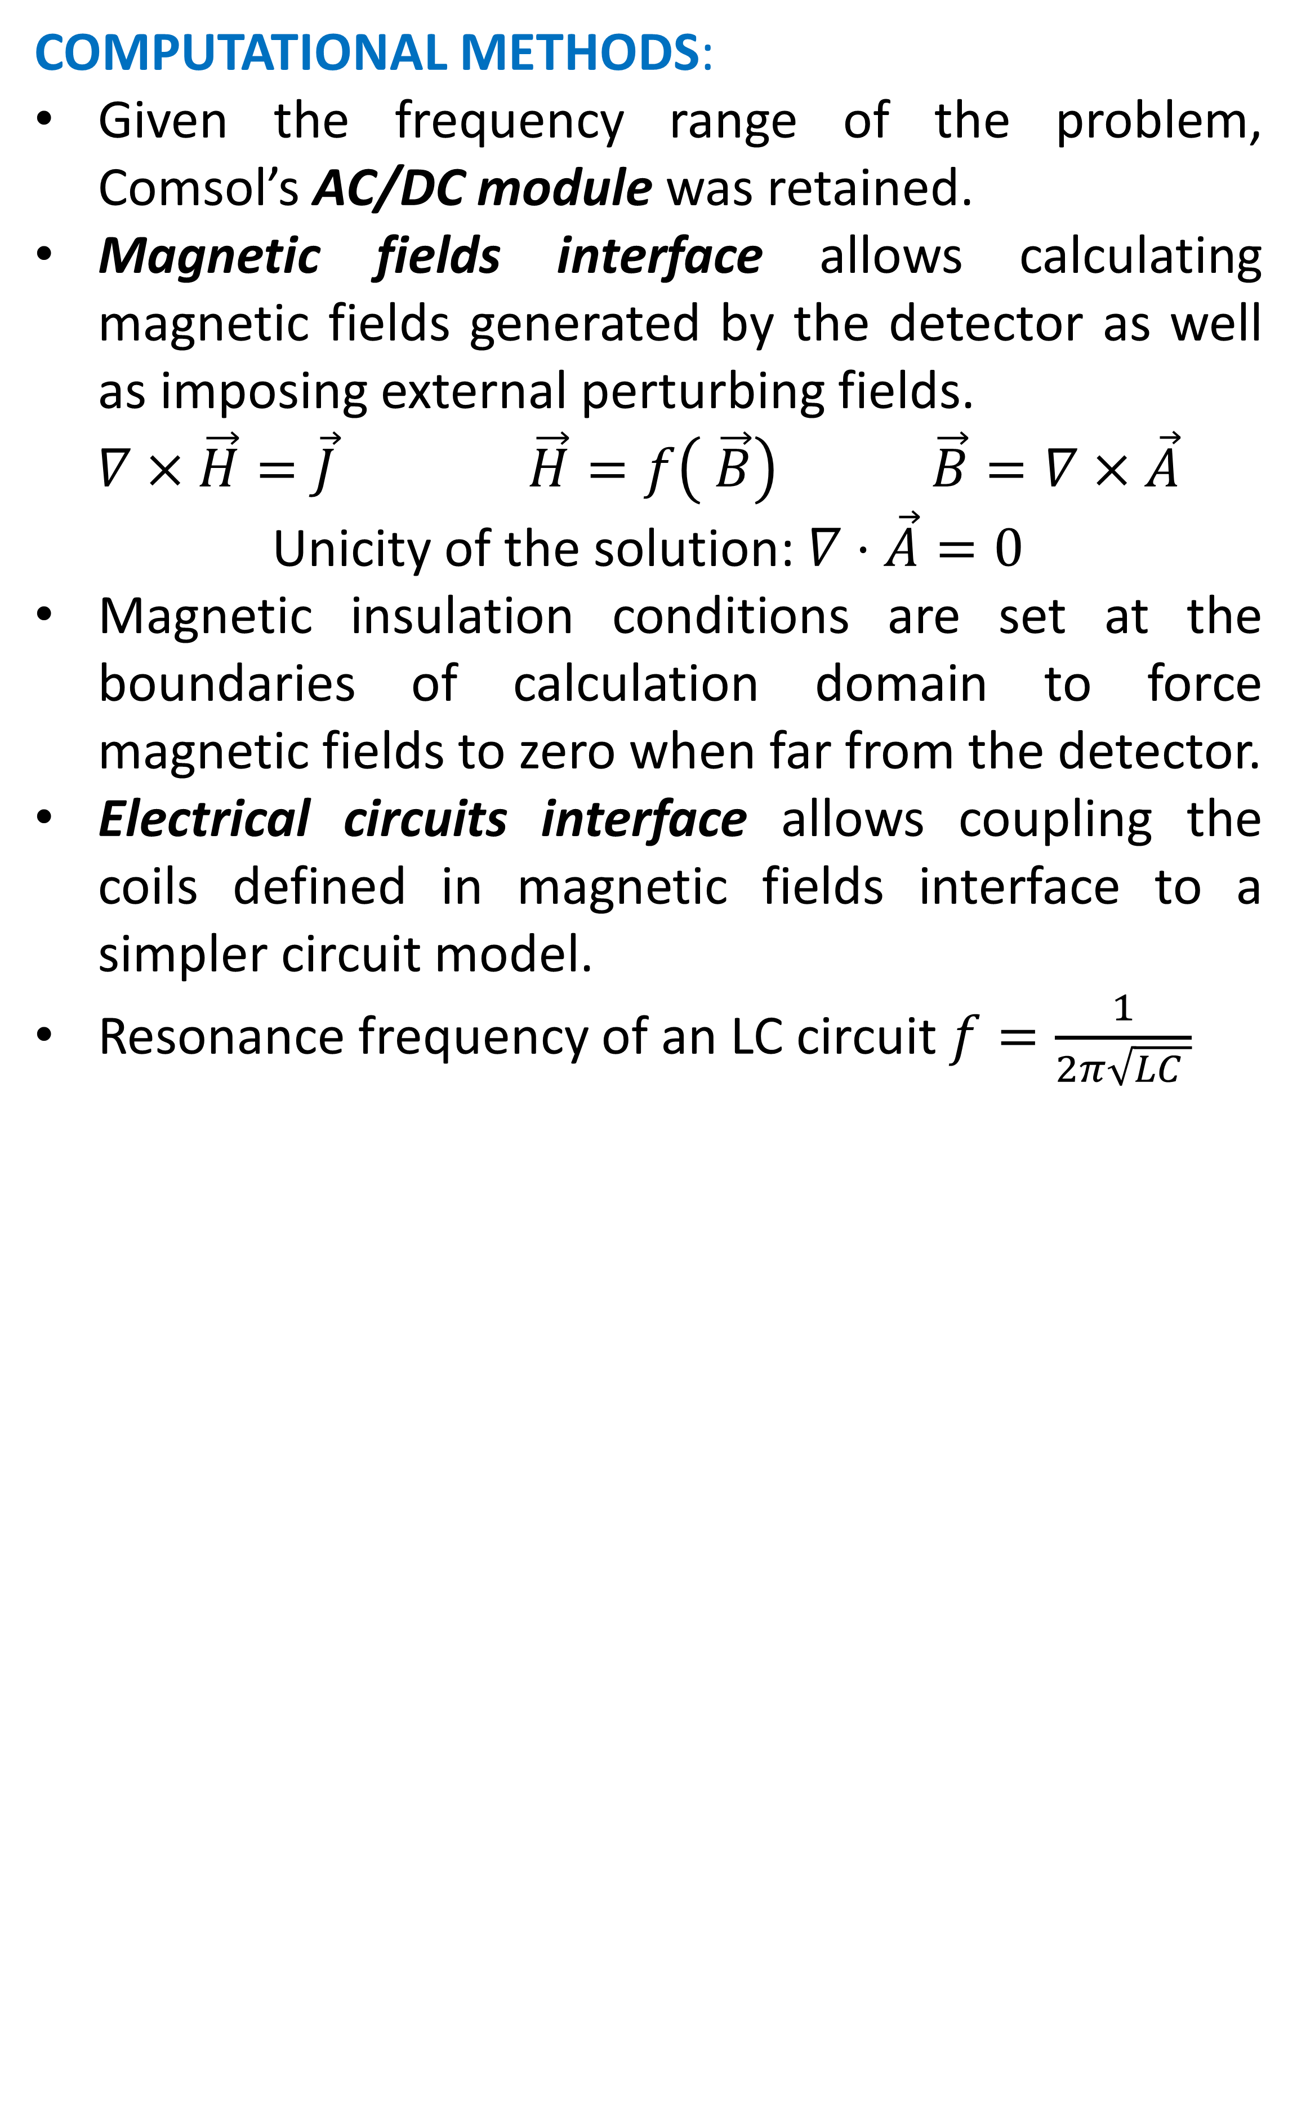
FEM simulation and reverse engineering of an Electronic Wheel Detector
J. J. Munoz¹, S. Karoui¹
1. SNCF Réseau, DGII Telecommunications Department, 93210 La Plaine Saint Denis, France
INRODUCTION:
Electronic wheel detectors allow detecting trains passage. Some dysfunctions have been noticed in recent years, apparently due to their sensibility to external magnetic fields. This is why CEM team at SNCF’s Telecommunications Department has been working on developing a numerical model of such detectors, so it can further be used to simulate potential failure conditions.
Such detectors consist in an “U” ferrite; this “U” is closed by the passage of a wheel, which results in an impedance augmentation of the detector at its resonating frequency (39kHz or 50kHz).
RESULTS: A step voltage was applied between detector’s terminals. Resonance frequency corresponds to the pseudo-frequency of oscillations in the circuit’s transient response, it equals approximatively its theoretical 39kHz value and it is sensible to model’s geometric details.
Figure 3. Transient current for a unit
step voltage excitation.
Figure 4. Simulated B field
Figure 1. Electronic wheel detector D39
COMPUTATIONAL METHODS:
Given the frequency range of the problem, Comsol’s AC/DC module was retained.
Magnetic fields interface allows calculating magnetic fields generated by the detector as well as imposing external perturbing fields.
$∇×\vec{H}=\vec{J}$ $\vec{H}=f\left( \vec{B}\right)$ $\vec{B}=∇×\vec{A}$
Unicity of the solution: $∇⋅\vec{A}=0$
Magnetic insulation conditions are set at the boundaries of calculation domain to force magnetic fields to zero when far from the detector.
Electrical circuits interface allows coupling the coils defined in magnetic fields interface to a simpler circuit model.
Resonance frequency of an LC circuit $f=\frac{1}{2π\sqrt{LC }}$
Figure 5. Impedance of the circuit
in function of the gap between
the (approximate) wheel and the detector.
Figure 6. Simulated B field (detector perturbed
by the passage of a wheel)
CONCLUSIONS:
Convergence with respect to mesh size is reached.
The detector modeled through reverse engineering corresponds to its theoretical characteristics in terms of resonance frequency and sensibility region.
Considering detector’s full geometry is necessary for its resonance frequency to be as close as possible to its theoretical value.
External fields may have an impact on detector’s transient response.
Further work includes:
Experimental validation of the model.
Development of simulation cases in which possible failure sources can be detected.
Dynamic modeling of a wheel’s passage.
REFERENCES:
1. Guillaume Éric, Électronique modernisée des pédales D50, 2015
2. Peetenut Triwong. Modélisation numérique 3D des phénomènes couplés dans les procédés d’élaboration par induction : couplage faible et couplage fort. Institut National Polytechnique de Grenoble – INPG, 2008.
3. EPSF, Protocole de vérification de la compatibilité des matériels roulants avec les détecteurs électroniques, 2016.
Figure 2. Simulation setup
Excerpt from the Proceedings of the 2019 COMSOL Conference in Cambridge

