Slide 1
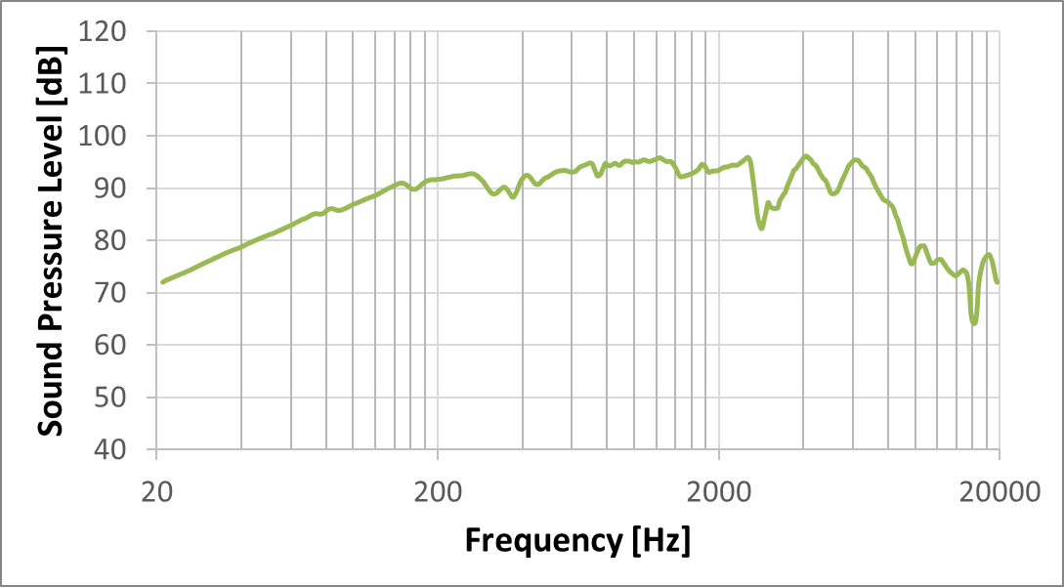
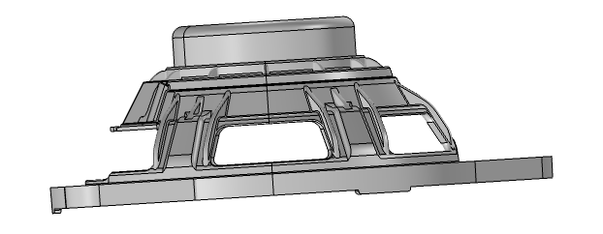
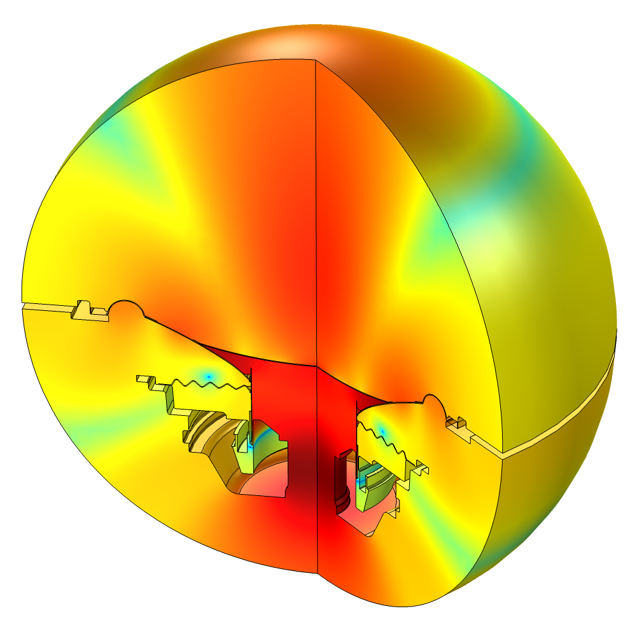
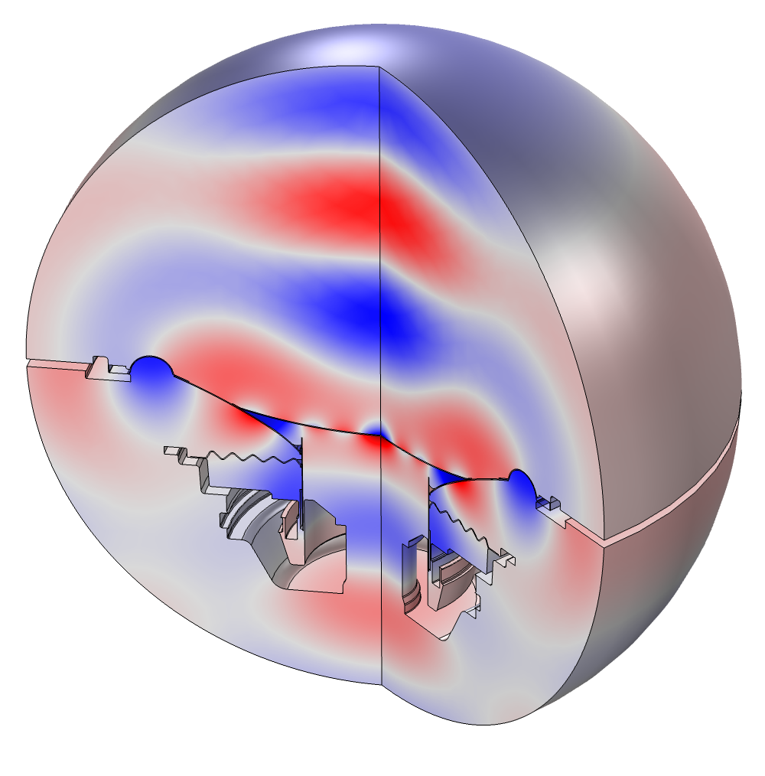
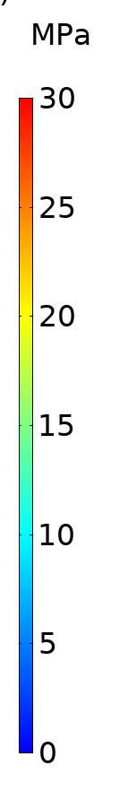
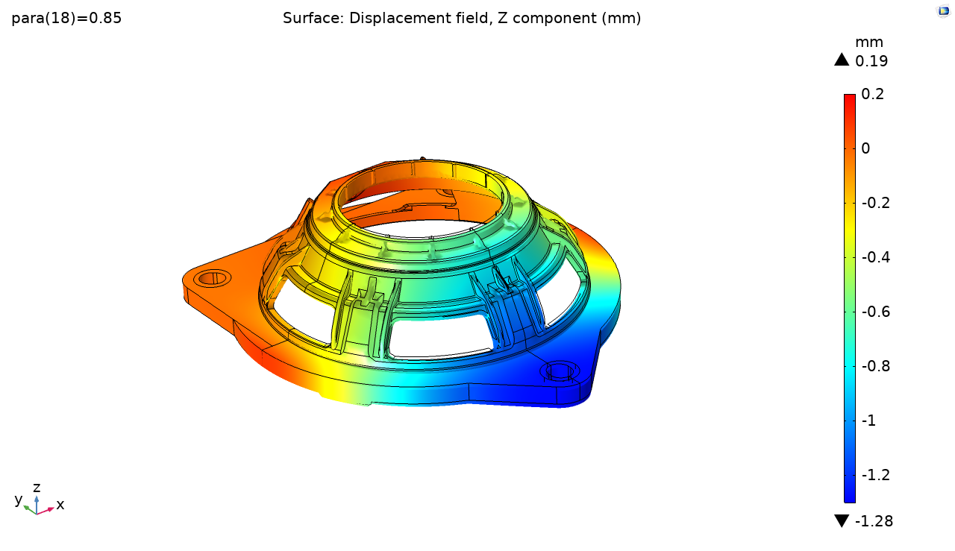

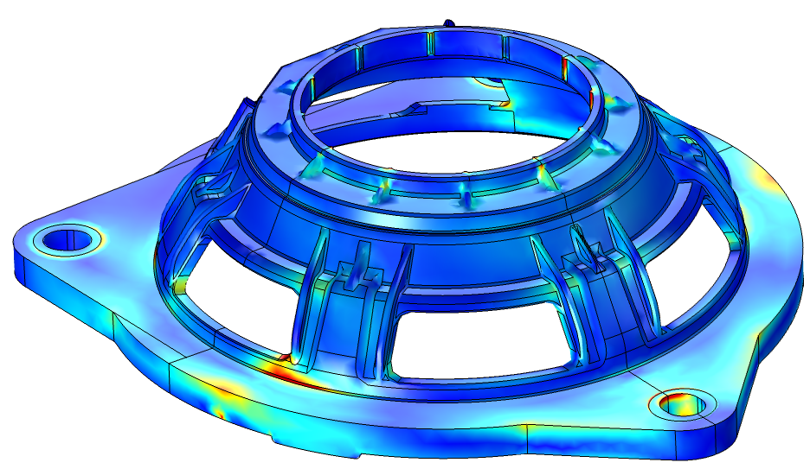
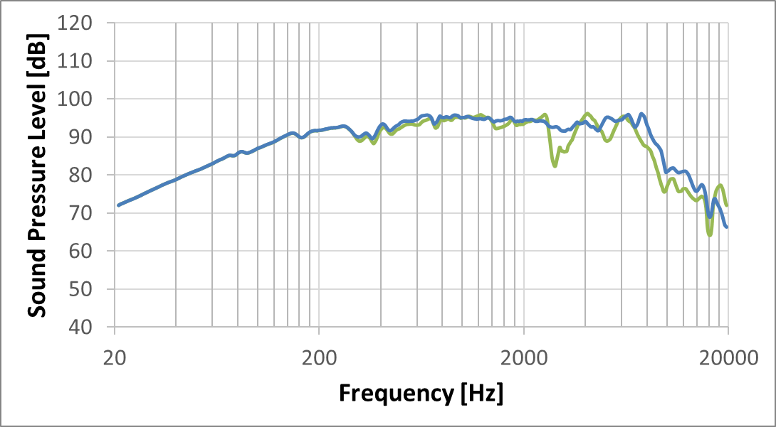
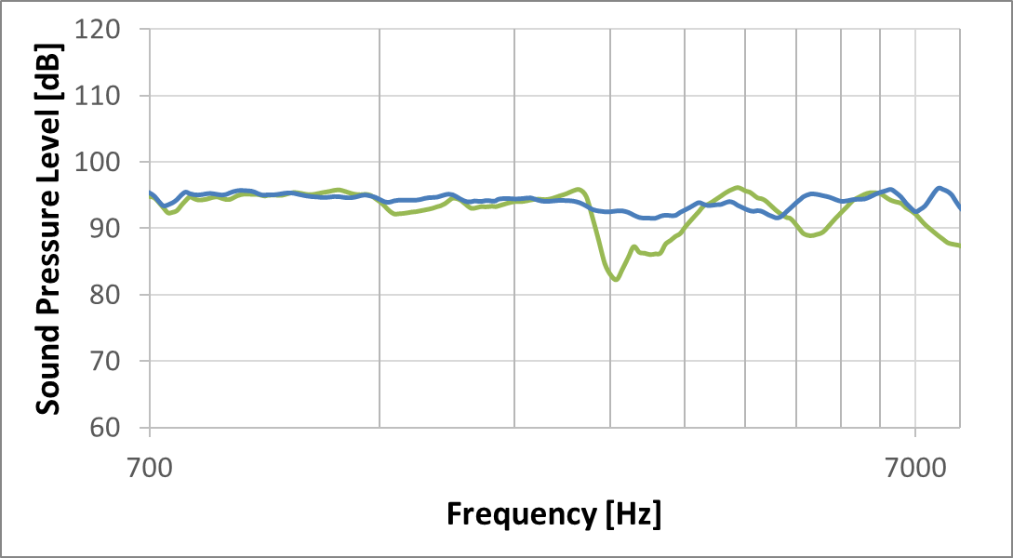
FEM Simulation in Loudspeakers Design:
Focus on Mechanical and Acoustic-Structural Analysis
G.Spatafora, E.Capucci, C.Corsini and R.Toppi
Faital SPA, Via Bruno Buozzi, 12, 20097 San Donato Milanese MI - ITALY
INTRODUCTION
Finite Element simulations are becoming a crucial tool in the transducer design process. In this work, we will focus on typical analysis used in FAITAL during the product development.
ACOUSTICAL STRUCTURAL INTERACTION:
Pressure Acoustic Interface (Acoustic Module), Solid Mechanics Interface (Structural Mechanics Module) and a Multiphysics node Acoustic Structure Boundary able to connect the two interfaces are needed to implement Acoustic-Structure Interaction Models. In our case, an Electrical Circuit Interface (AC/DC Module) is also added to reproduce the Magnetic Circuit contribute. This kind of simulation may be useful both to optimize/improve existing product and to completely develop new devices. In this work an example of a product improvement related to 6-inch neodymium mid woofer is presented (Figure 3).
DESIGN: FEM MODELS AND RESULTS
Loudspeakers need to be developed according to the technical specifications related to the application and typical usage.
NO-MOVING PART:
Usually loudspeakers may be subjected to several kinds of loads. In this work, our emphasis is on the capability of the basket (automotive application) to support torsional and/or flexural load. It uses the Solid Mechanics interface (Structural Mechanics Module) including the Safety attribute (Figure 1 ).
Force
Initial SPL Measurement to improve
Blocked displacement in positive normal direction
Roller
Contact zones
Von Mises Stress evaluated in Gauss Point
Displacement
FEM model: changes in geometry/materials are implemented and studied
Contact zones
New measurement on FEM improved sample
Figure 1. Geometry and BCs (up) and stress Distribution (down left) and displacement in force-direction (down right)
MOVING PART:
The diaphragm is usually manufactured with a cone- , dome- or annular-shaped profile. To evaluate the mechanical response of both dome-shaped and annular membrane for our compression driver, a Model Method is developed (Figure 2). The Model Method is able to automatically define the membrane that fits our technical requirements.
Figure 3. Schematic representation of 6inch improvement
(measurement in semi-anechoic chamber @1m on axis)
CONCLUSIONS
The use of FEM models during the design process permits to evaluate different aspects related to our products before the prototype realization. Mechanical validation tests, acoustic measurements and magnetic circuits performance can be replicated using COMSOL Multiphysics to maximize their capabilities according with the technical requirements. Obviously, models are an “idealized” version of the final products, but their analysis will be a guideline to avoid unexpected problem in the following development steps. FEM approach is an efficient and effective way to reduce design time and cost related to the number of physical prototypes to realize and test.
2D-axy Diaphragm Parametric Model definition
Model Method: Evaluation Results and Ranking
Model Method: Automatic creation of 3D models (from 2D axy better results)
Model Method: Evaluation of rocking modes
Figure 2. Schematic representation of how the Membrane Development Method works
Excerpt from the Proceedings of the 2019 COMSOL Conference in Cambridge
Notes:
NO-MOVING PART: Mechanical response is a crucial point, usually loudspeakers may be subjected to serious shock/vibrational loads (both in automotive and professional application). In this work, our focus is on the capability of the basket for automotive application to support torsional/flexural load. The developed COMSOL model uses the Solid Mechanics interface (Structural Mechanics Module) including the Safety attribute, that enables you to study the use of materials in the structure, particularly with respect to safety factors. The safety factor can be computed with respect to a large number of different isotropic, orthotropic, or anisotropic failure criteria, including user-defined expressions. When a Safety node is included, you can access postprocessing variables for the safety factor, margin of safety, and damage and failure indices.
MOVING PART: Soft Parts movements generate sound. The diaphragm is usually manufactured with a cone- or dome-shaped profile. A variety of different materials may be used, but the most common are paper, plastic, and metal. The ideal material would 1) be rigid, to prevent uncontrolled cone motions; 2) have low mass, to minimize starting force requirements and energy storage issues; 3) be well damped, to reduce vibrations continuing after the signal has stopped with little or no audible ringing due to its resonance frequency as determined by its usage. In practice, all three of these criteria cannot be met simultaneously using existing materials; thus, driver design involves trade-offs. For example, paper is light and typically well damped, but is not stiff; metal may be stiff and light, but it usually has poor damping; plastic can be light, but typically, the stiffer it is made, the poorer the damping.

