Slide 1
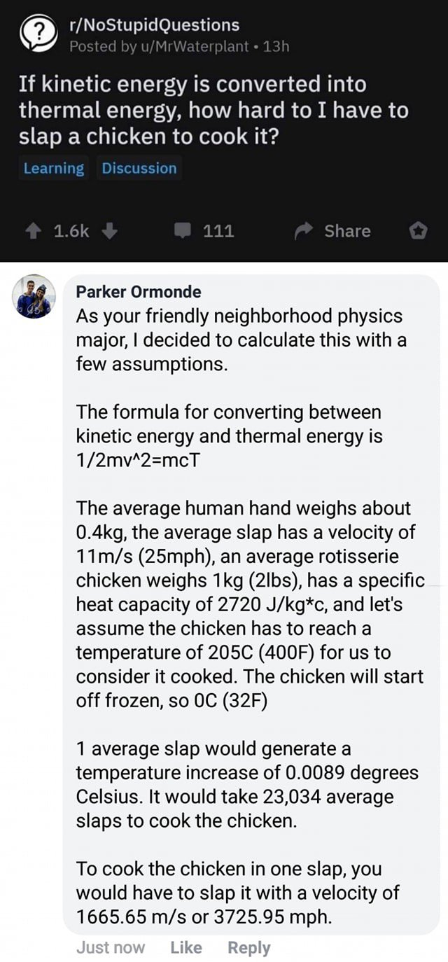
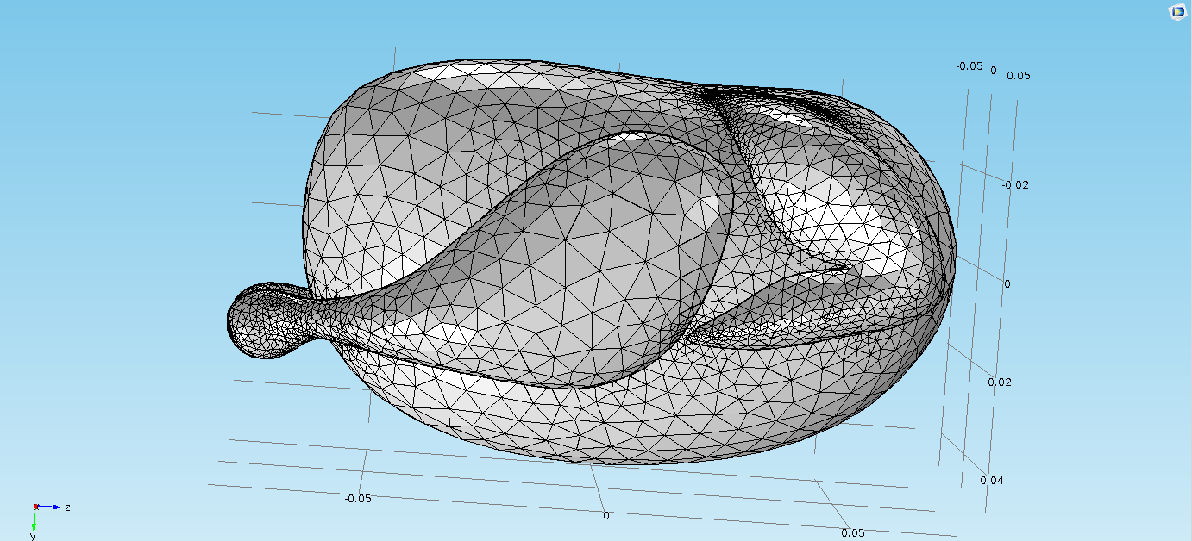
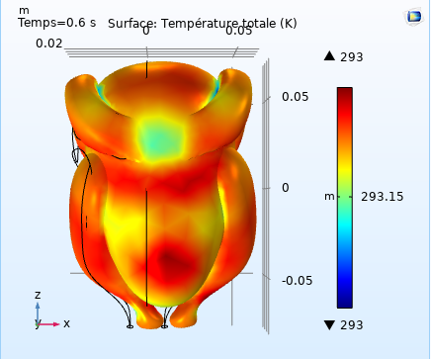
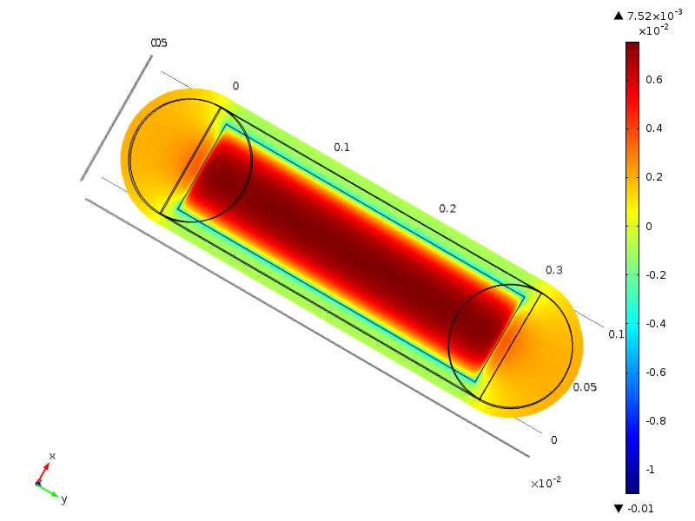
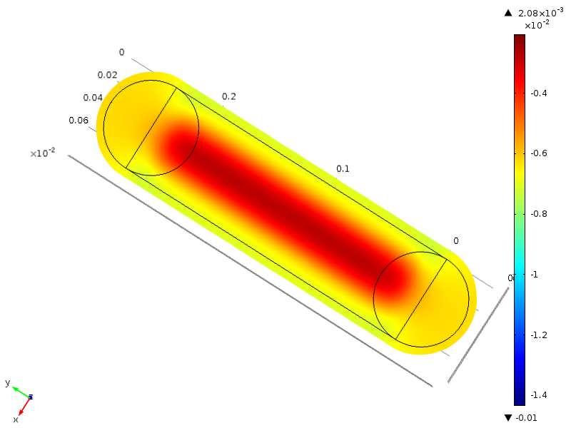
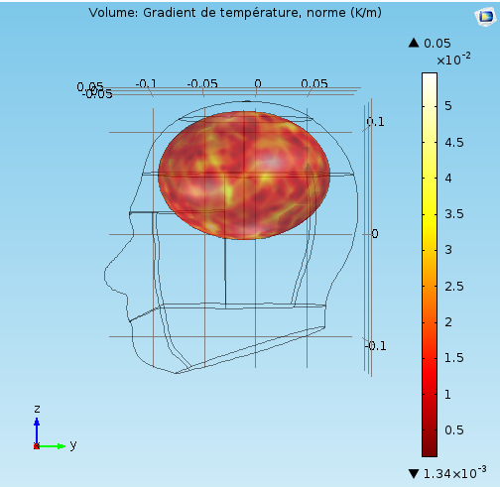
Please leave at least a 25mm margin on all sides to avoid cropping during printing. Remove this text box before submitting.
Example of Educational Selected Projects with Comsol Class-Kit at Department of Physics, University of Orleans
Nadjib Semmar
Université d’Orléans, Département de Physique, Faculté des Sciences et Techniques 45067 Orléans Cedex
INRODUCTION: One of our chalenges this scholar year was to motivate our bachelor students (3rd Year at Faculty of Science, Department of Physics) to built their own simulation process in the frame of ‘Scientific Modelling and Numerical Experiments’ learning module.
After the presentation of Comsol tool and its environment with the classkit module (2 X 2h), and with practical physics examples (acoustics, fluid and thermal engineering, AC/DC module …), students (working in pairs on the base of active pedagogy) have to select their project/application, to built the physics modelling sequences, and to start solving their problem.
40 students (18 practical projects with a wide variety of applications : Venturi distorsion inside a vehicle engine, Eolian energy harvesting by a piezoelectric device, or acoustic and thermal effects in human brain…),
After one-day oral and technical defence of all projects by a panel composed by students themself, only four practical projects were selected to be recognized and included to this poster, considering their originality and the high rate of project achievement.
1- Comsol based graphical visualisation of the acoustic resonance of musical instruments, by Benjamin D.,Michel J., and Mathieu D’.
2- Comsol simulation of thermoelastic and thermal behiour in a chiken, by Axel R. and Mohamed-Riad A..
3- Piezoelectric Outsole for energy conversion, by Fekher T. and Maxime L.,
4- Acoustic and thermal waves propagation in a human brain, by David E., Thibault N.
RESULTS:
Project n° 2 starts with the question listed bellow on the number of slap to cook a chicken.
Figure 1. Temperature rise on a chiken surface due to one slap with a pressure of 20 N/m2
Comsol simulation return a solution in the case of 1 slap in 0.6 sec with a pressure of 20 N/m2. The time of cooking is then 28 hours!!! (number of slap close to 168000).
Please leave at least a 25mm margin on all sides to avoid cropping during printing. Remove this text box before submitting.
Adult outsole deformation
Kids outsole deformation
Figure 2. Deformation of outsole for an adult and kids (project n°3)
PEDAGOGY METHODS :
All student tandems used the Comsol class-kit (5.1) to built their practical project from february 15th to April 30th. During this period all students take free access to the teaching room.
On first weeks period (typically three weeks), the students were exited by the use of Comsol and also certain to success in the project achievement.
The second period (four following weeks), was hard for students and for the teacher him-self. Students become more realistic on what we can do by our self and what the computation with Comsol can return! It was the starting point to master the skills!!!
The third and last period, was more technical. Students have to produce results, to write and return reports and to built their oral defense.
This teaching unit was evaluated to be very useful for them, and allows to discover a scientific computation tool that friendly-fit with their ‘Mathematical Equation Word’.
Figure 3. Temperature gradient in a human brain (project n°4)
CONCLUSIONS:
The main result for my staff was to convict our administration that through this active pedagogy, and via ambitious projects for day-life conducted by students gives a positive opinion on Physics studies.
The practical result for us was also to obtain the financial support from our Faculty to obtain the last updated Class Kit Licence (CKL).
AKNOWLEDGEMENTS:
Physics Bachelor students from Faculty of Science in University of Orleans are very grateful to Damien Audoux and Pierre-Sylvain Allaume for their technical assistance.
Excerpt from the Proceedings of the 2019 COMSOL Conference in Cambridge

