Slide 1
Simpleware Software Solutions
Combining Image-Based Solutions with COMSOL Simulation
Matt Howard – Applications Engineer
COMSOL Conference 2019, Cambridge
Notes:
Remember From 3D Images to Models –
For general audience DON T JUMP to CAD/CAE/3D printed models
For a more CAE focussed audience DON T JUMP to our unique meshing capabilities – explain that we export to NURBS etc.. first

Slide 2






Simpleware Product Group
Developers of high-end 3D image processing software
Dedicated sales, support and service teams
Global presence
Clinical and broader life sciences / materials applications
USA
UK
Germany
China
Japan
India
Southeast Asia
Brazil
Notes:
Context/Key Messages:
Simpleware Product Group
Provide IMAGE PROCESSING SOFTWARE- we sell software!
SPG is GLOBAL
DEDICATED Support, Services and Sales Team
Sell across wide range of INDUSTRIES

Slide 3
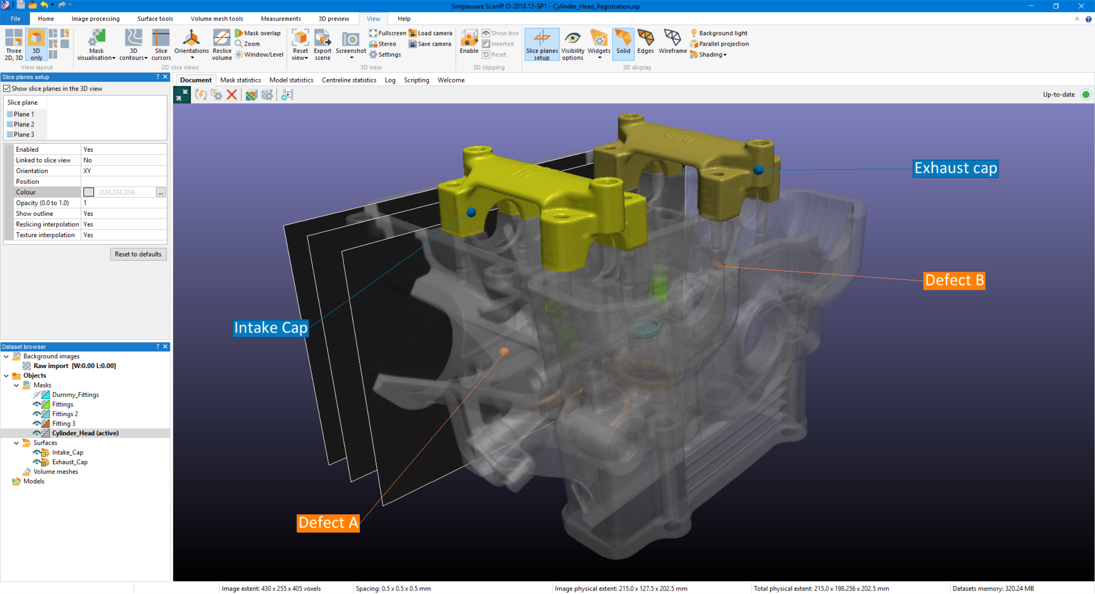
Simpleware Software Solutions
GUI-based High-end 3D Image Processing Platform which provides Comprehensive Range of Tools for:
Visualization including animations
Filtering and segmentation
Measurement and quantification
CAD and image integration
3D print, CAD and FEA/CFD model export

Slide 4
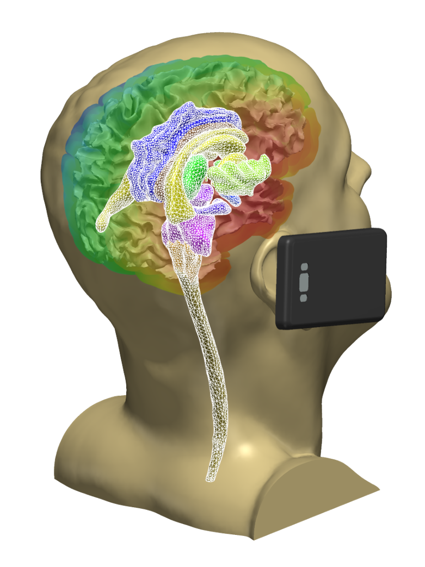
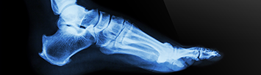
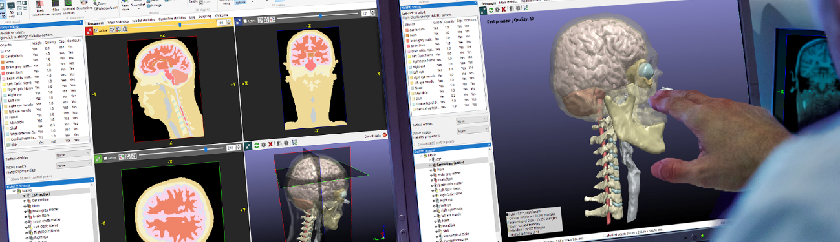
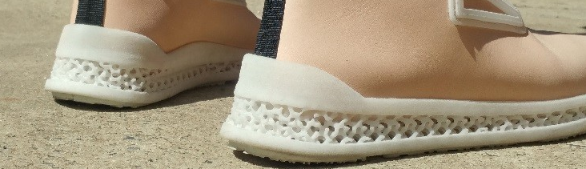
What does the Simpleware Product Group offer for me?
Product Development:
Based on human body models from CT or MRI
Integrate product designs
Carry out virtual planning, e.g. virtually check fit of design on human body
Simulation / 3D Print: simulate performance, print customized products
→ Accelerate new product development and improve efficacy

Slide 5
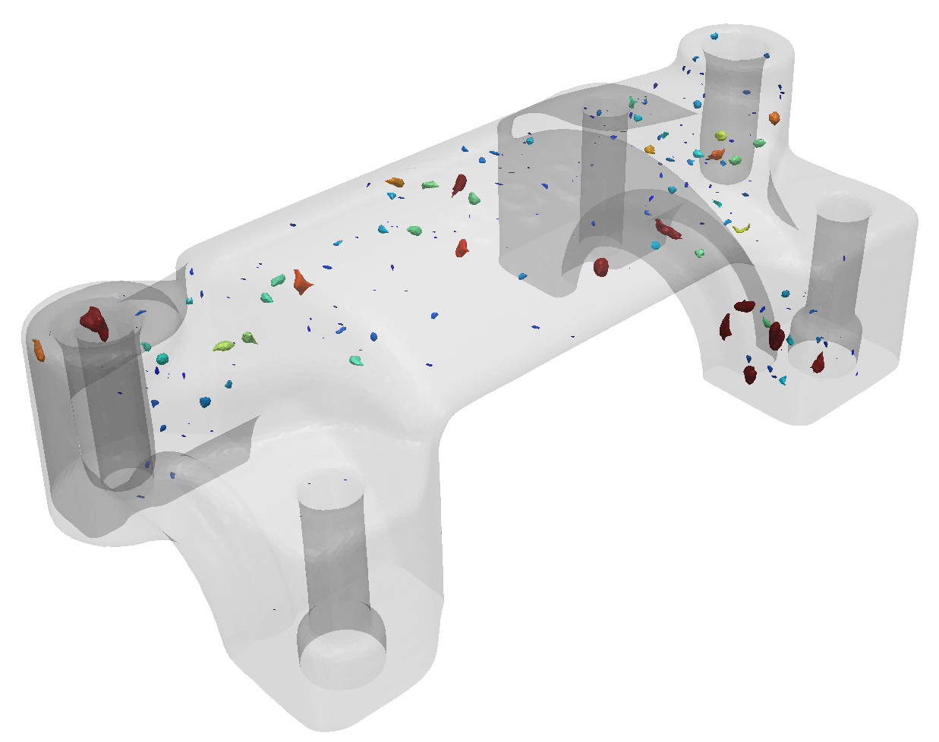
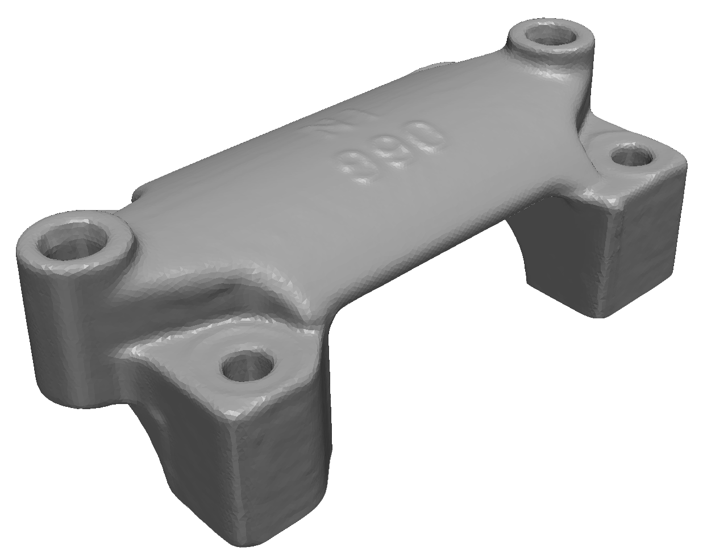
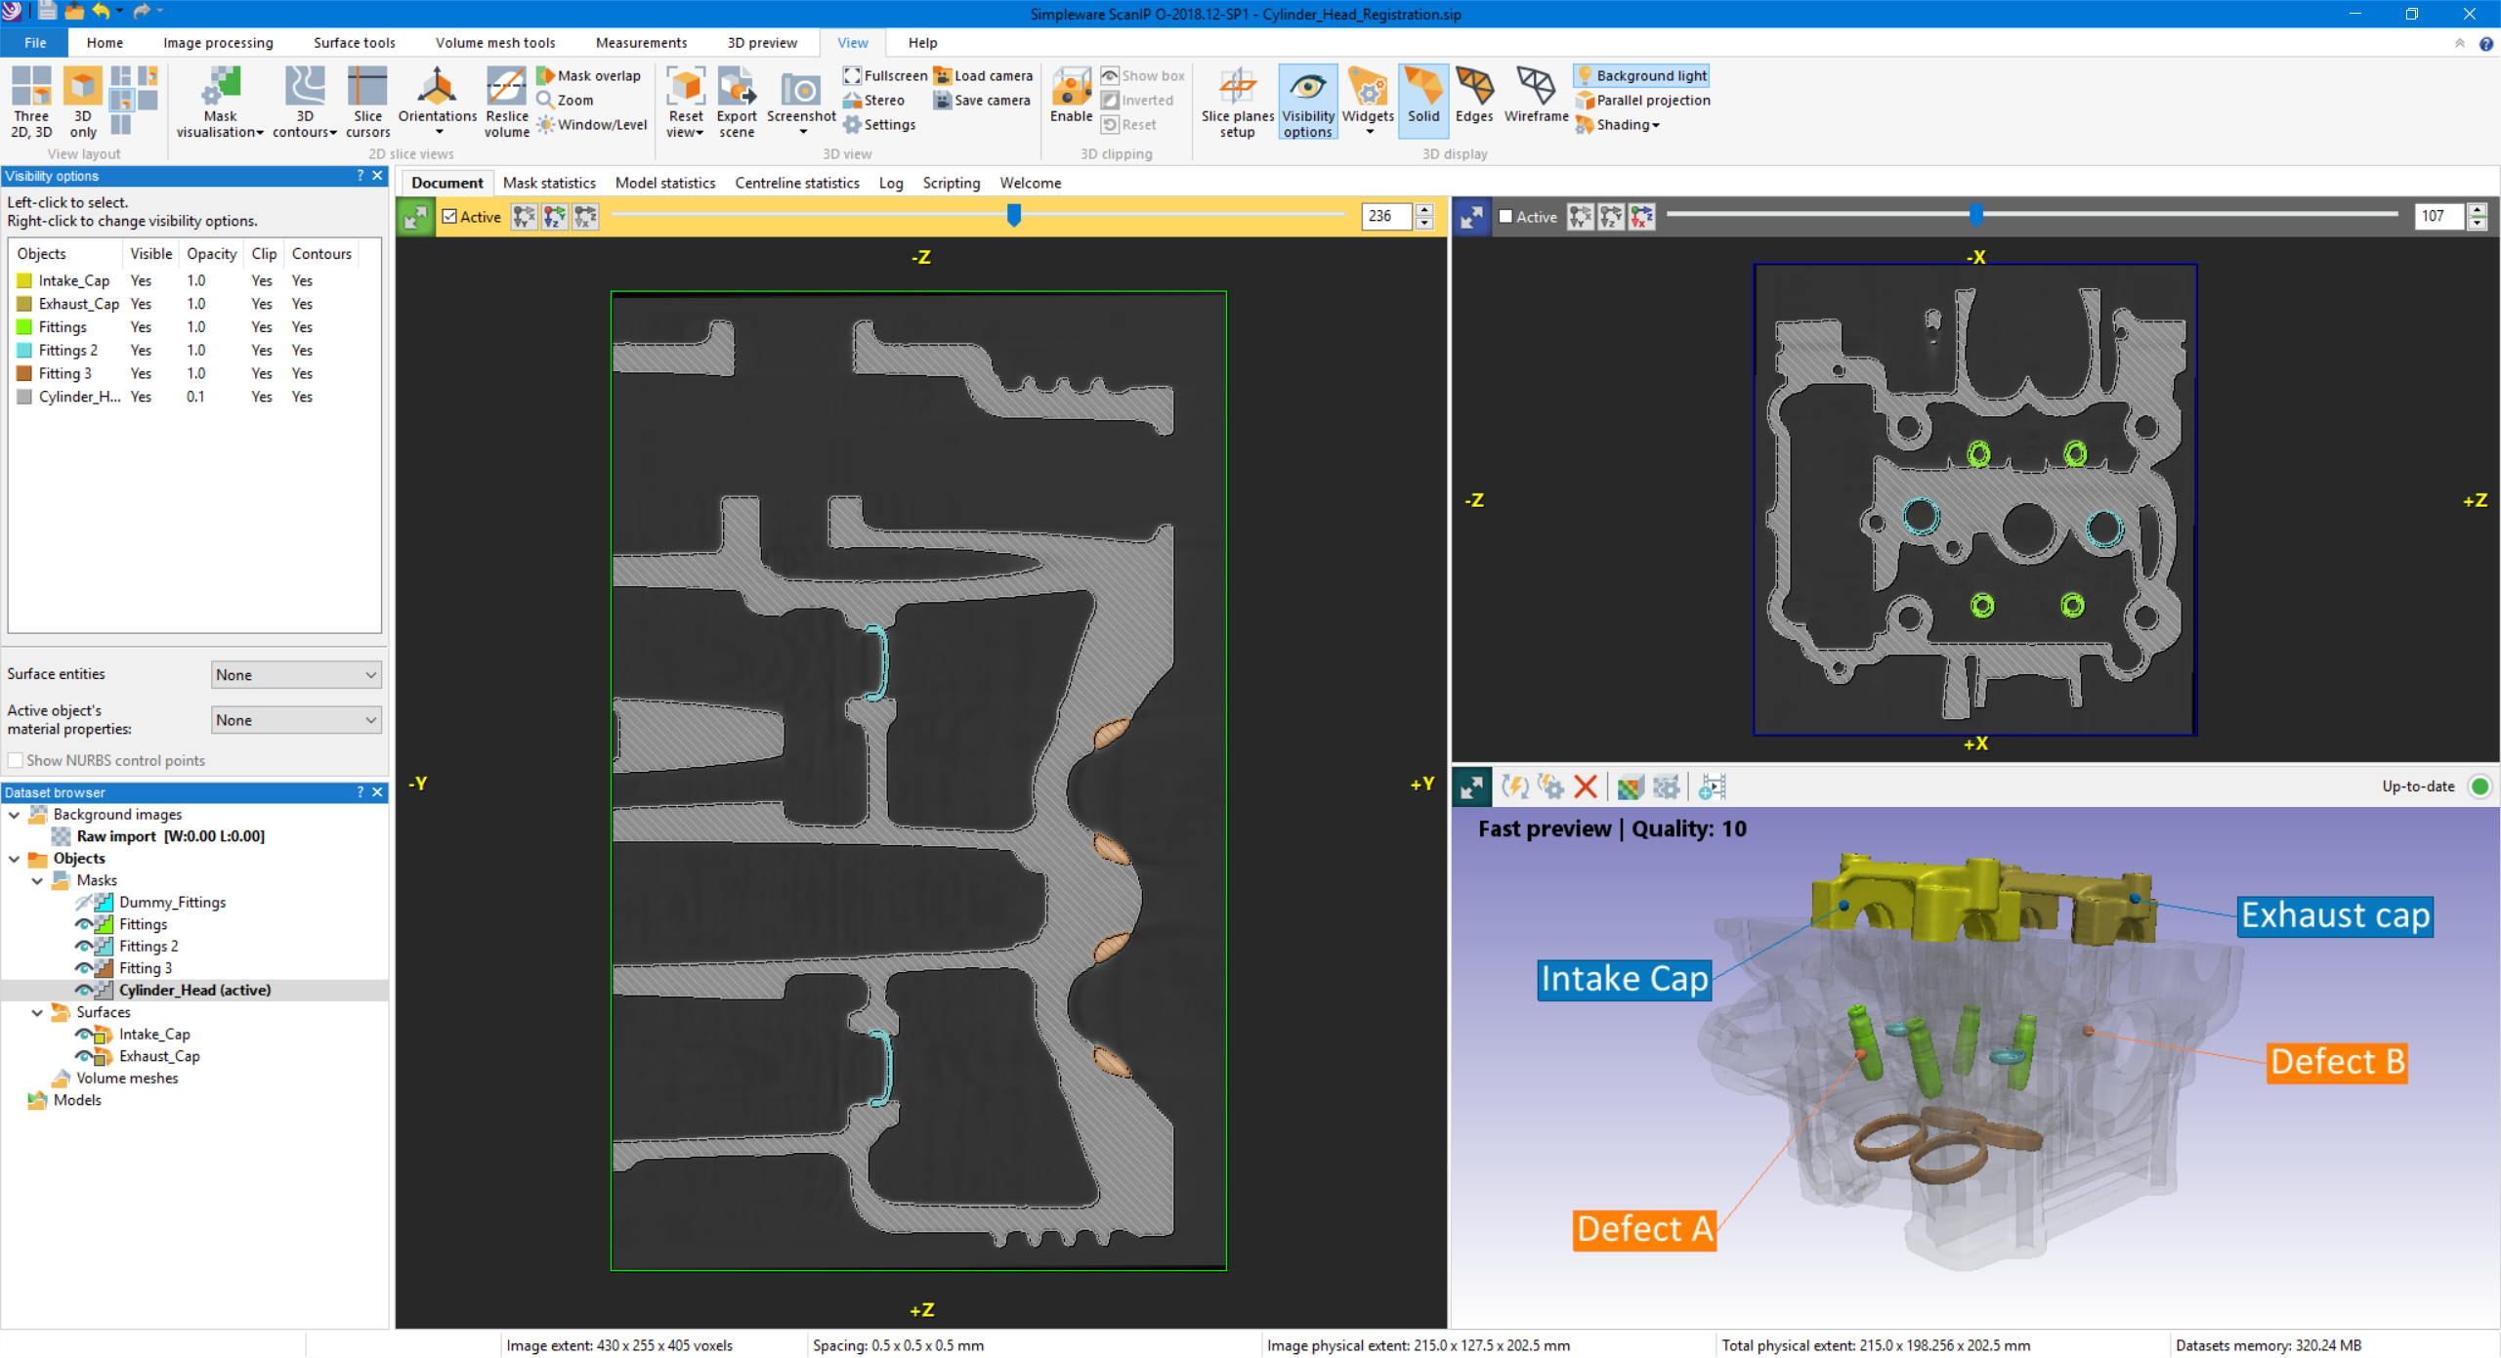
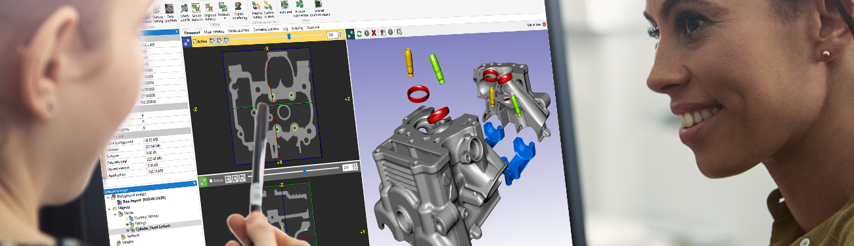
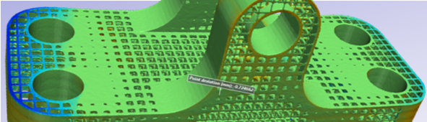
What does the Simpleware Product Group offer for me?
Industrial Reverse Engineering Example:
Inspect and validate as-built parts and compare to designs
Take scans of a manufactured part, e.g. casting, ALM, injection moulding…
Non destructive 3D visualisation, e.g. to quantify defects
Carry out geometric metrology, measurements, compare to original CAD
Facilitate simulation on as built or damaged part to check still fit for purpose
Notes:
Context/Key Messages:
Why use Simpleware Software?: To analyze and validate as-built parts !
How? Say you have scans of a manufactured part (casting, …) with Simpleware software tools you can
Visualise and quantify defects
Carry out metrology (measurements, compare to original CAD)
Carry out simulation on as built or damaged part to check still fit for purpose
Sell across wide range of INDUSTRIES

Slide 6
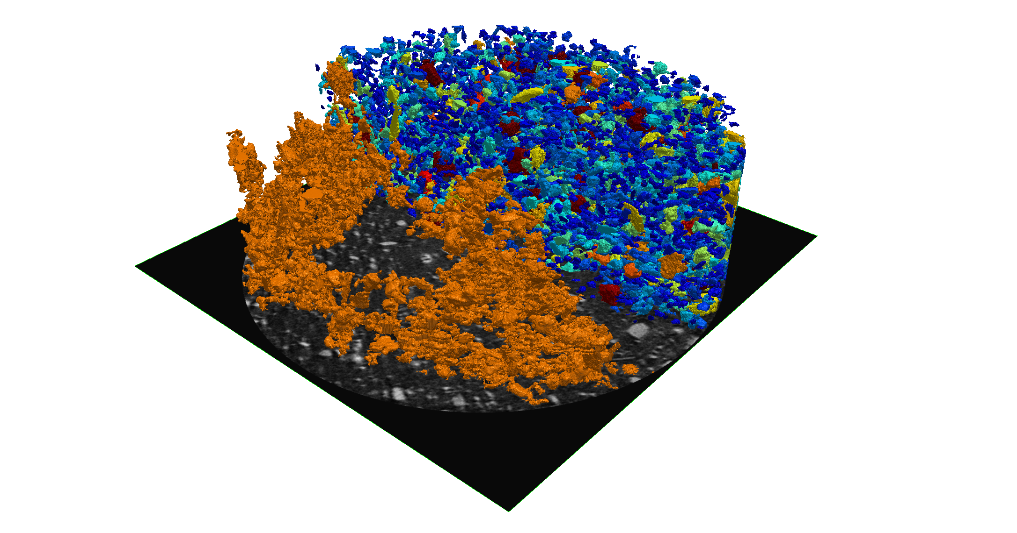
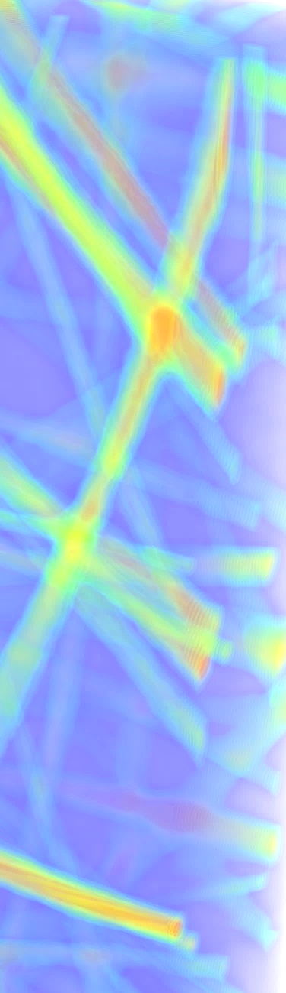
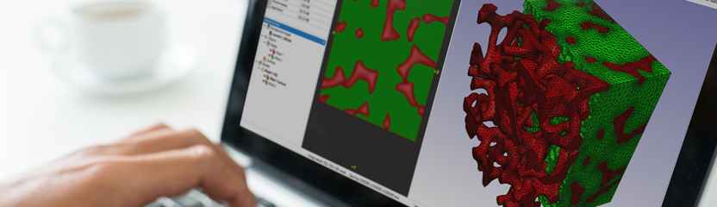
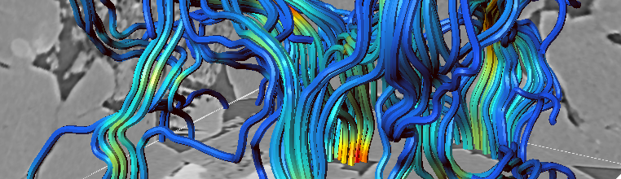
What does the Simpleware Product Group offer for me?
Materials Industry Example:
Understand or improve performance of a microstructure, e.g. filter, foam, composite, textile, soil, asphalt…
Visualise internal structure from scans or synthetic data
Calculate porosity, surface area, pore/particle distribution, fibre orientation…
Analyse network structures, e.g. centrelines, shortest routes…
Obtain homogenised material properties, e.g. effective permeability, Young’s Modulus…
Notes:
Context/Key Messages:
To analyse and optimize microstructures !
Say you have scans or synthetic models of microstructure such as a filter (or a foam, or soil, or composite material or asphalt or textile…)
Visualise
Calculate porosity, surface area
Measure centrelines
Obtain homogenised material properties: e.g. effective permeability
Sell across wide range of INDUSTRIES

Slide 7
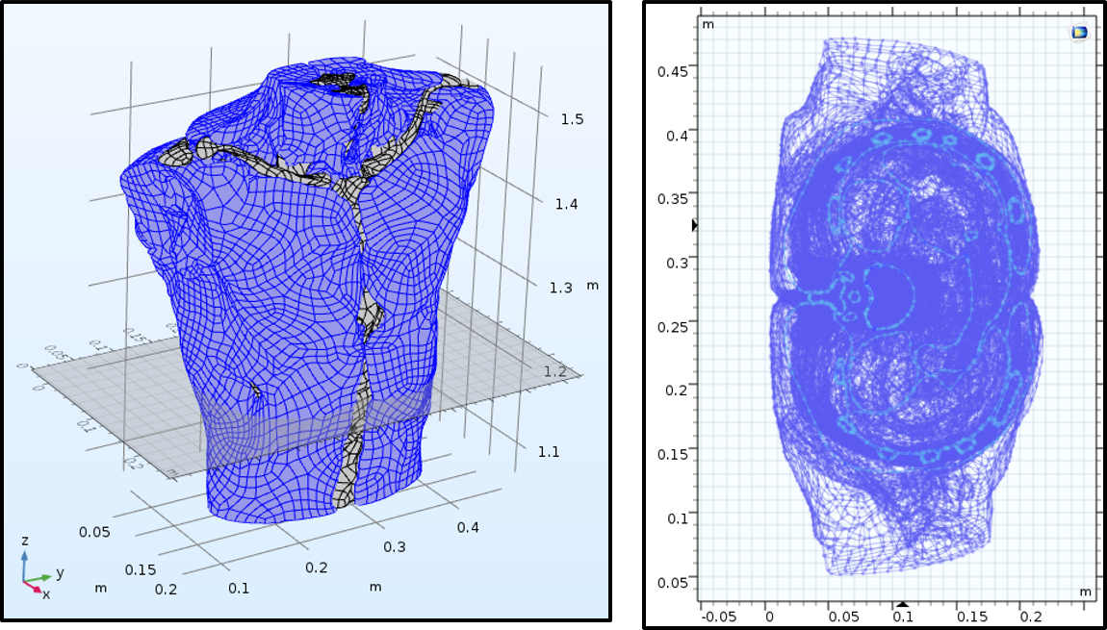
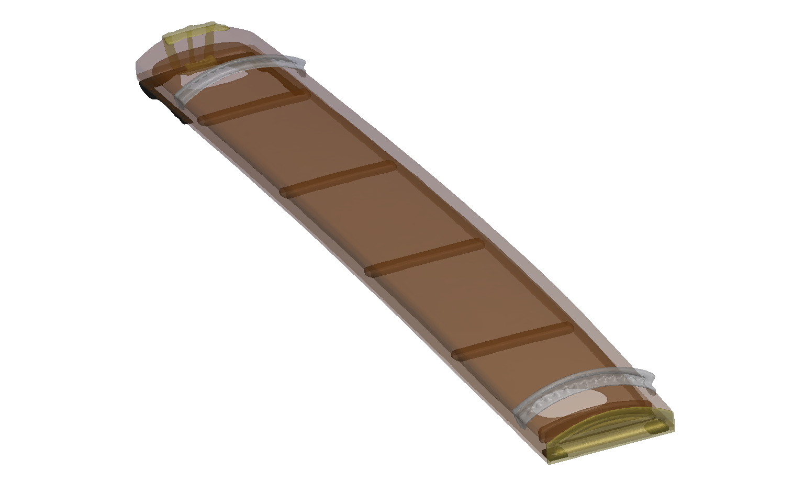
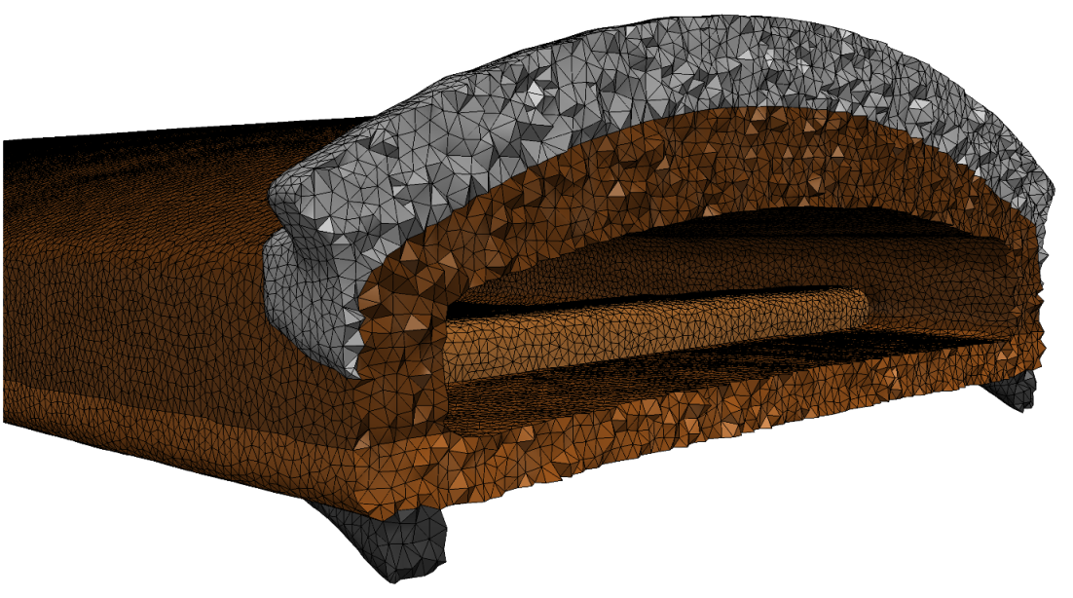
Simpleware / COMSOL Customer Applications
MicroPort CRM
University of Adelaide

Slide 8
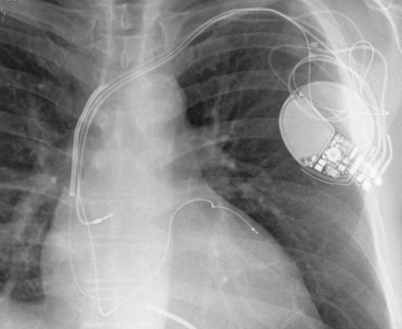
MicroPort CRM
Torso Model Generation for Simulating Pacemaker Performance
Develop cardiac rhythm management devices (CRM) for treating heart rhythm disorders and failures
MicroPort typically use animal testing for their devices, but this is expensive, time-consuming, and has significant ethical risks when trying to reduce errors.
Image-based finite element (FE) analysis with COMSOL reduces reliance on animal testing, cuts risk of device failure and provides new insights without ethical hazards.
Thanks to: I. Rattalino (Systems Engineer), MicroPort CRM
“We had the idea to simulate our medical devices in a virtual platform, but were stuck with the importation of a human body in the simulation software. Thanks to Synopsys Simpleware software, we easily solved our problem of importation, and the virtual simulation has become part of our feasibility practice today. I highly recommend Simpleware software!”. I. Rattalino

Slide 9
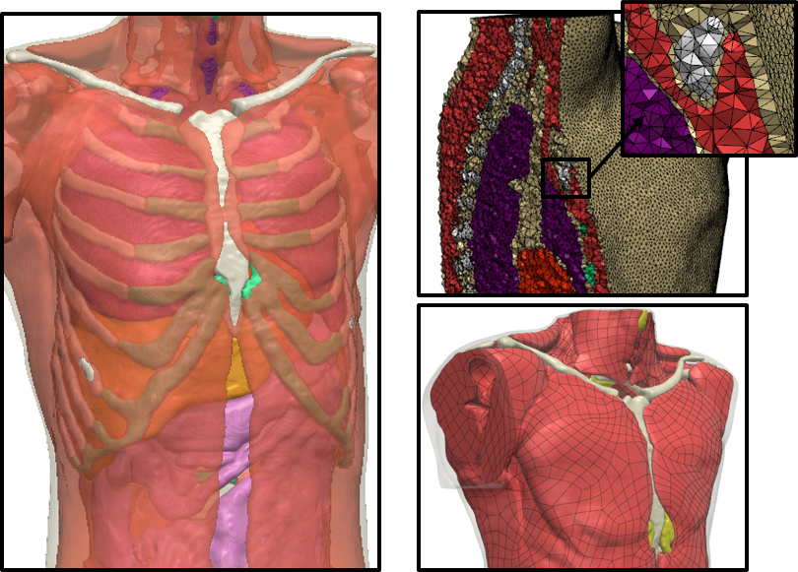
MicroPort CRM
Torso Model Generation for Simulating Pacemaker Performance
Simpleware software used to develop detailed torso model for simulating pacemaker performance
Export of robust FE meshes and NURBS IGES files suitable for use in COMSOL.
FE meshes provide a convenient simulation ready model – Merely define the physics in COSMOL
NURBS models are watertight CAD and provide flexibility to integrate additional geometries i.e. various devices before simulation in COMSOL

Slide 10
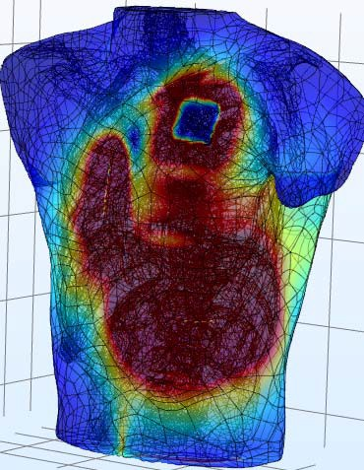
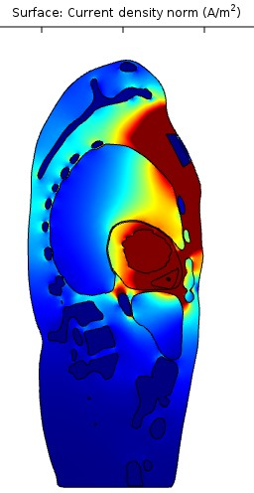

MicroPort CRM
Torso Model Generation for Simulating Pacemaker Performance
Electromagnetic Simulation in COMSOL Multiphysics® to test placement of electrodes and tissue conductivity
Tests also carried out using heart models
Results help determine optimal device-anatomy configurations and increase efficiency for MicroPort’s workflows

Slide 11
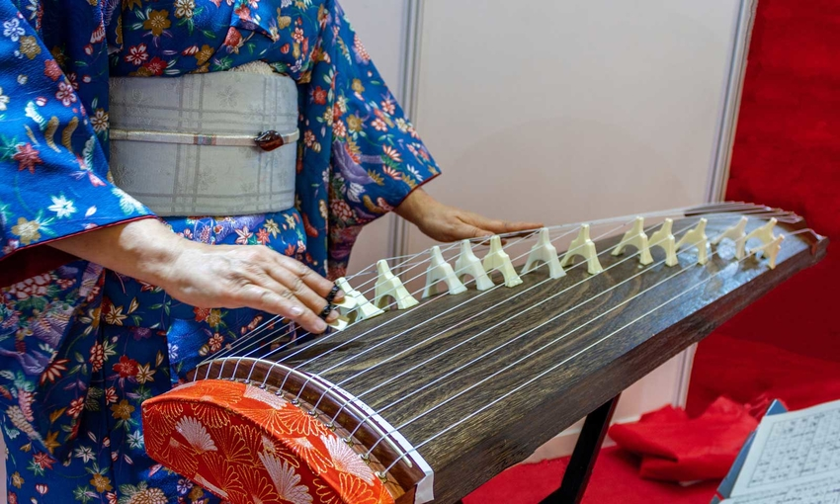
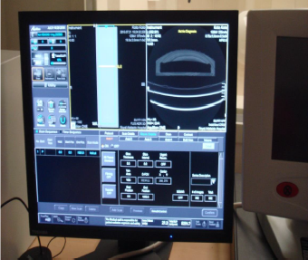
University of Adelaide
Demystifying the sound of the Japanese koto
Computer-aided techniques help characterize musical instruments that that are too valuable or old to disassemble
CT images of the Japanese koto can be used to build a digital twin and virtually characterise it’s frequency response
Thanks to: University of Adelaide (Elder Conservatorium of Music): Prof A. Kimi Coaldrake
“I needed to see inside my valuable musical instrument without splitting it open and damaging it. Other methods had been unsuccessful. The Simpleware tools allowed me to take 2300 DICOM images from a CT scan and convert them to a mesh suitable for finite element modeling. It helped me to understand the origins of the unique and complex sounds of the Japanese koto that have rarely been studied.” Prof. A. Kimi Coaldrake

Slide 12
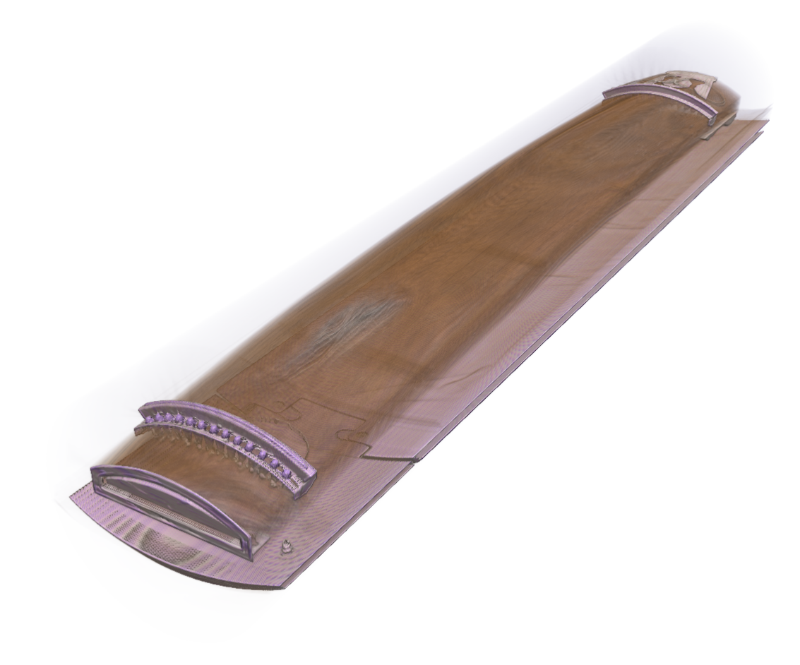
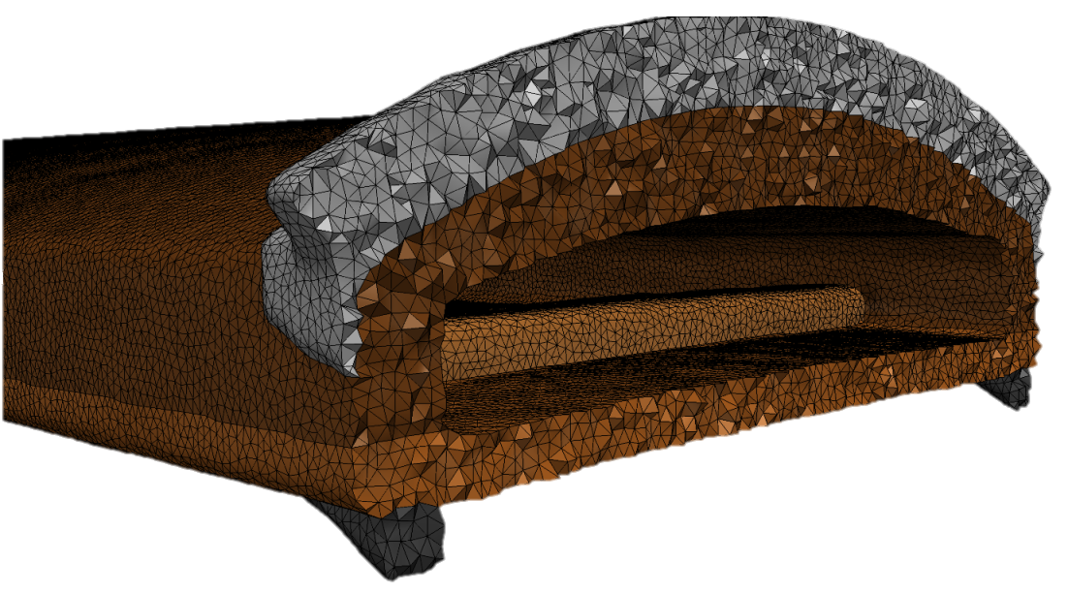
University of Adelaide
Volume rendering
Demystifying the sound of the Japanese koto
Koto geometry obtained using high-resolution CT scan and SEM used to study grain orientation
Simpleware ScanIP used to segment Koto into 7 components and remove artefacts caused by greatly varying densities in the CT scanner
Simpleware FE exported high-quality multi-part volume mesh
Simpleware model
Simpleware volume mesh

Slide 13
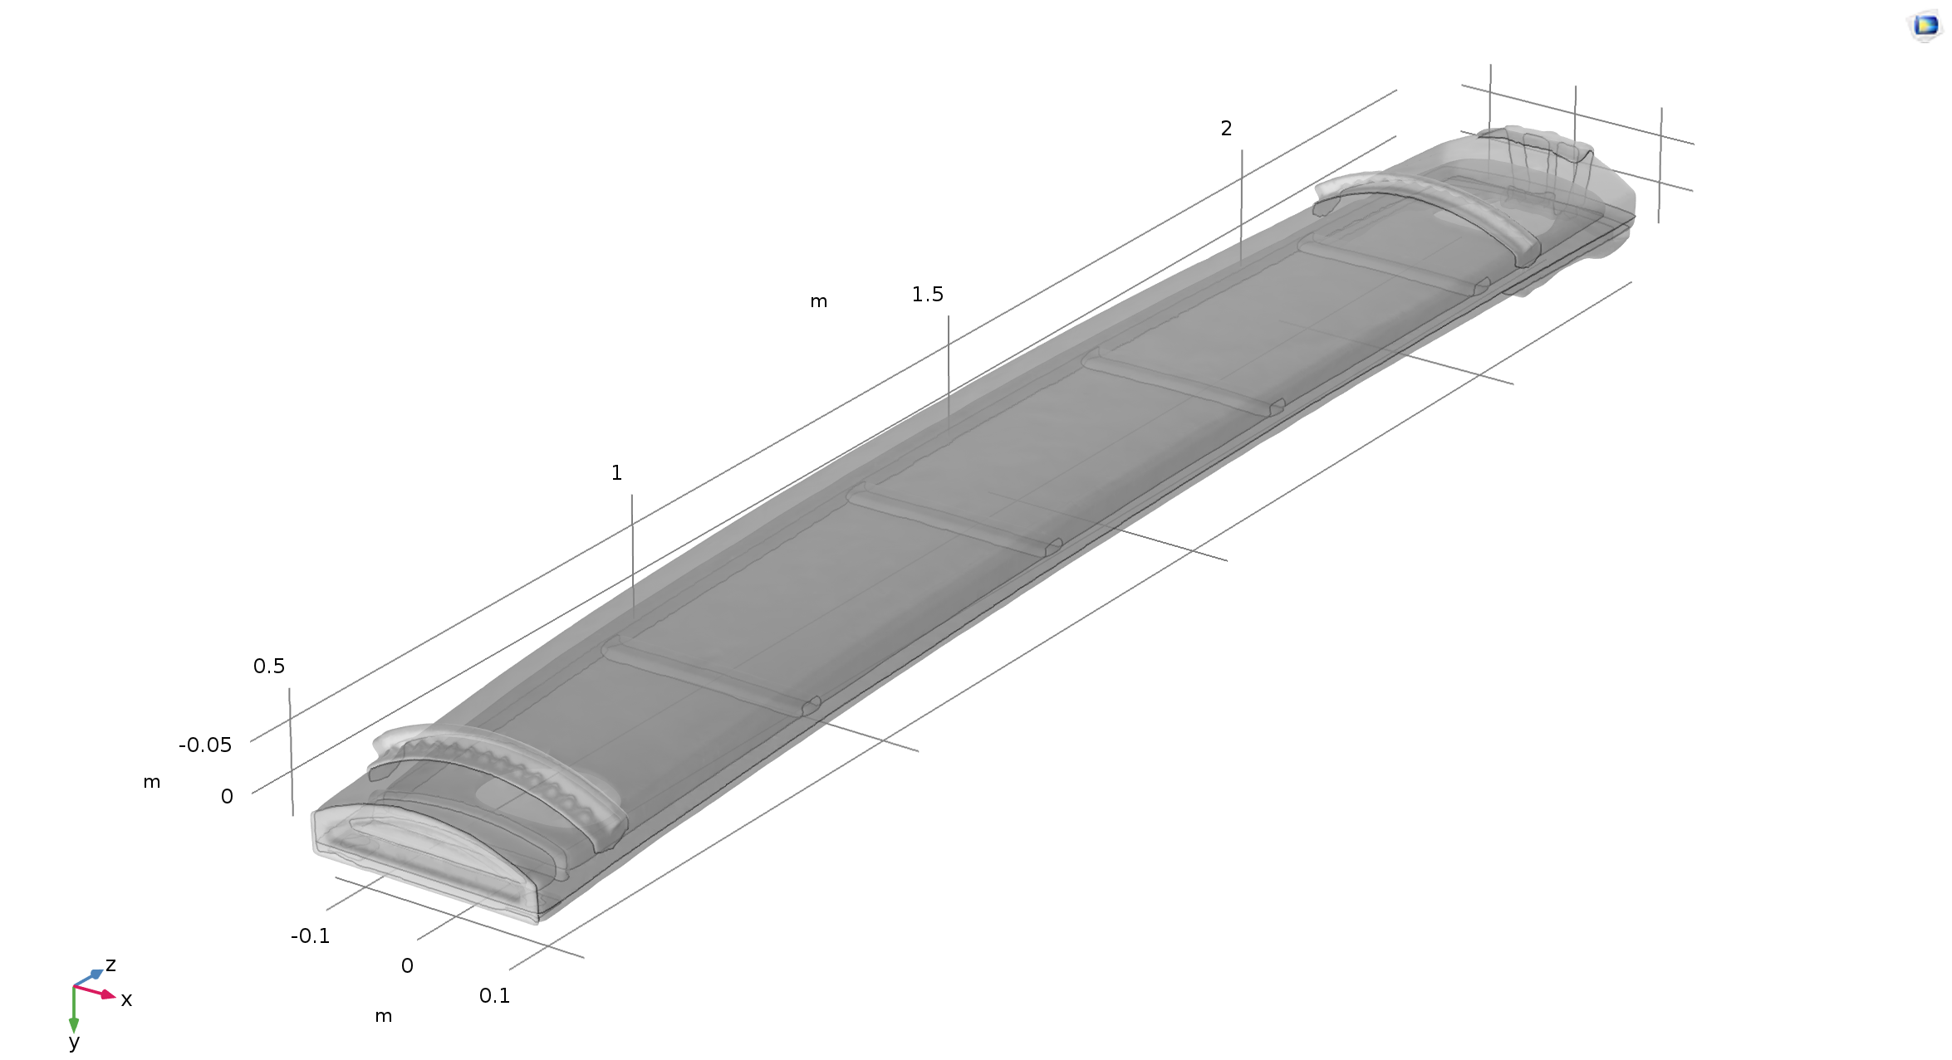
University of Adelaide
Demystifying the sound of the Japanese koto
COMSOL model analysed to understand solid mechanics of vibrations, acoustics, and comparison of different types of playing
Results backed by experimental data and the literature
Method solved problem of characterizing physical properties of the Koto wood and internal features
Simpleware meshing preserves accuracy and creates a more practical model for simulation

Slide 14
The Simpleware Advantage
State-of-the Art Technology:
Robust proprietary algorithms (patented)
Best in class segmentation tools
Ease-of-use:
User-friendly interface
Customizing through scripting
Support:
Expert support (dedicated point of contact)
One-to-one sessions, web-meetings and tailor-made training courses
Regulatory Approval:
FDA 510(k)
CE
ISO
Notes:
Support: mention that one point of contact assigned from initial benchmarking through to production use
Regulatory approval: ONLY needed for Med applications

Slide 15
See and Try Simpleware Software
Get a 30-day Free Trial:
Receive a fully functional trial version of the full Simpleware product suite
Contact support with any questions, for advice or help in setting up your workflow
Arrange a Personal Software Demonstration:
Arrange a personalized software demonstration via WebEx
With our expert Application Engineers using your own data
Watch product videos, on-demand webinars, download datasheets:
See our extensive library of product information: www.synopsys.com/simpleware/resources.html
Contact Us:
Email: simpleware@synopsys.com
Website: www.synopsys.com/simpleware
Notes:
Support: mention that one point of contact assigned from initial benchmarking through to production use
Regulatory approval: ONLY needed for Med applications
ISO: quality management system for medical devices. It is like a medical version of the ISO 9001 and more stringent requirements.

