Slide 1


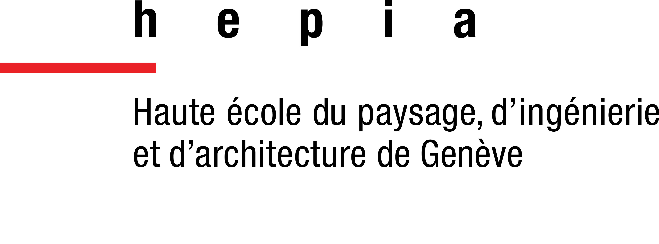

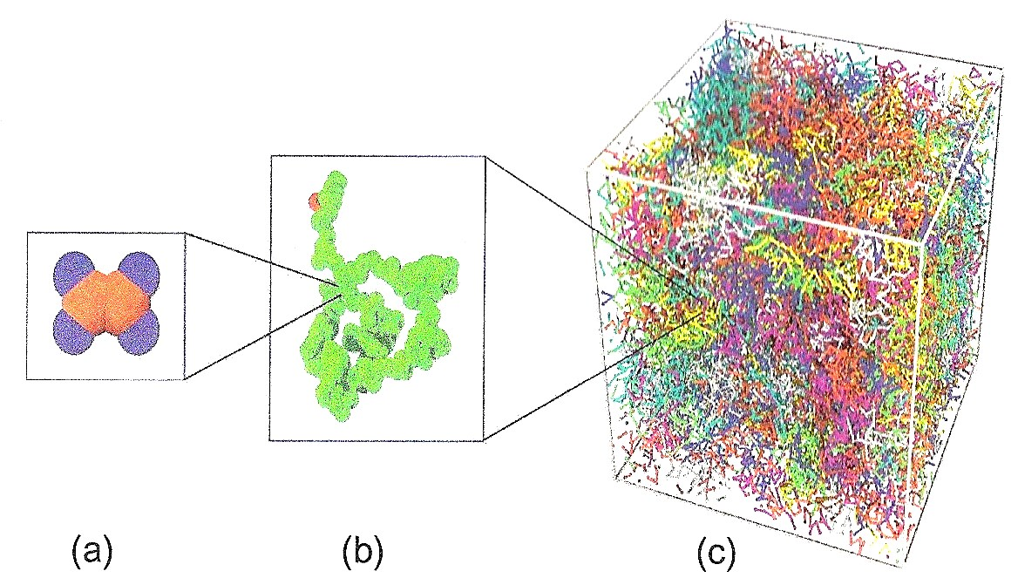
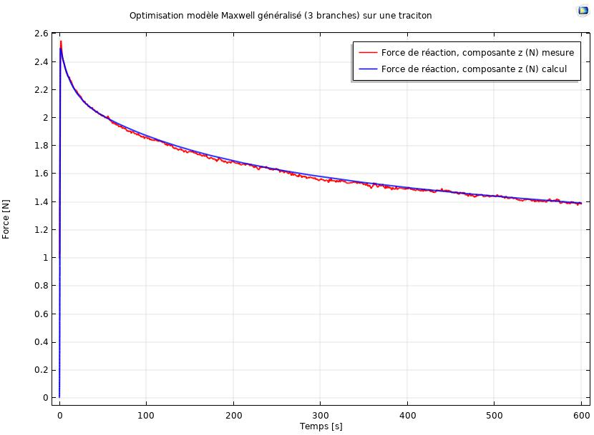
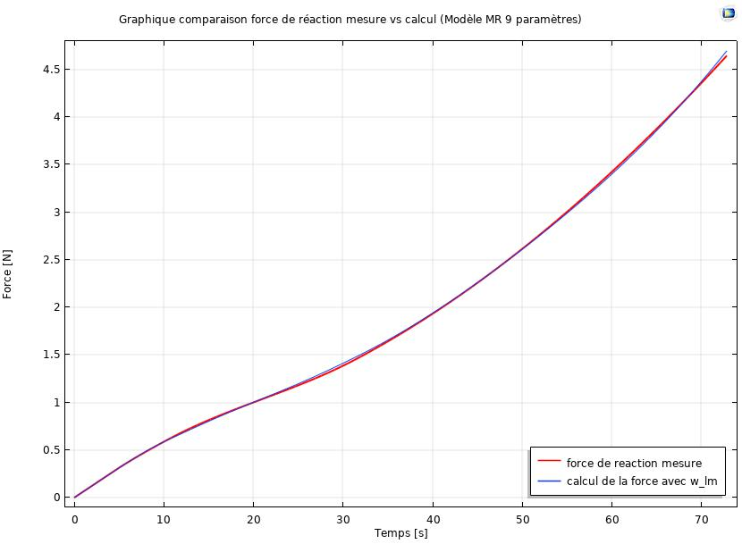
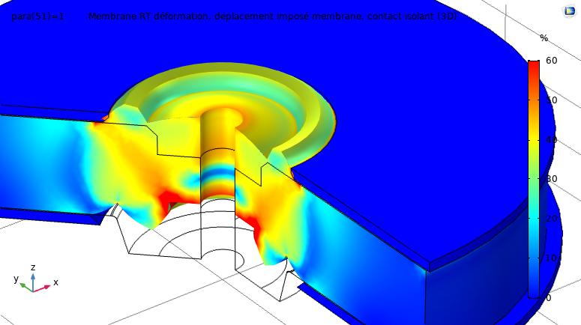
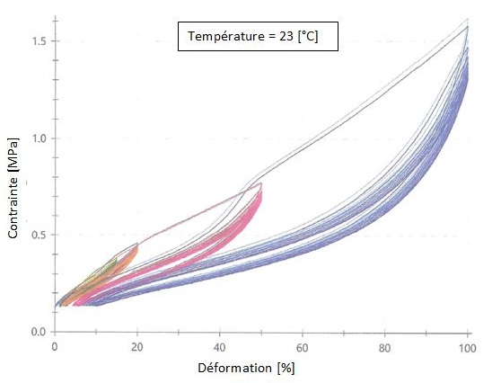

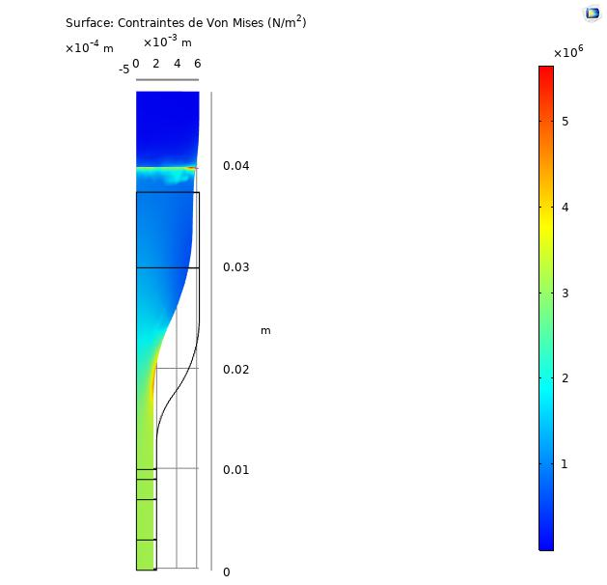
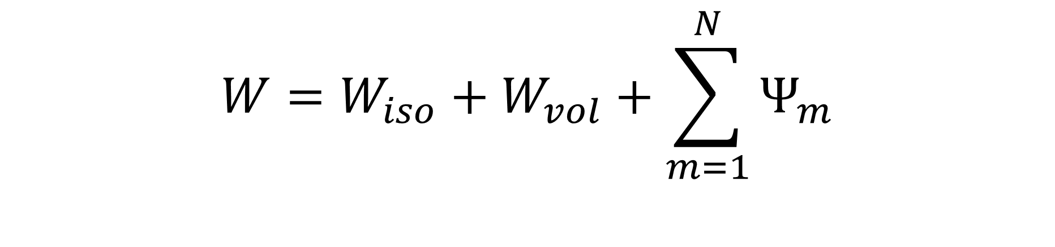
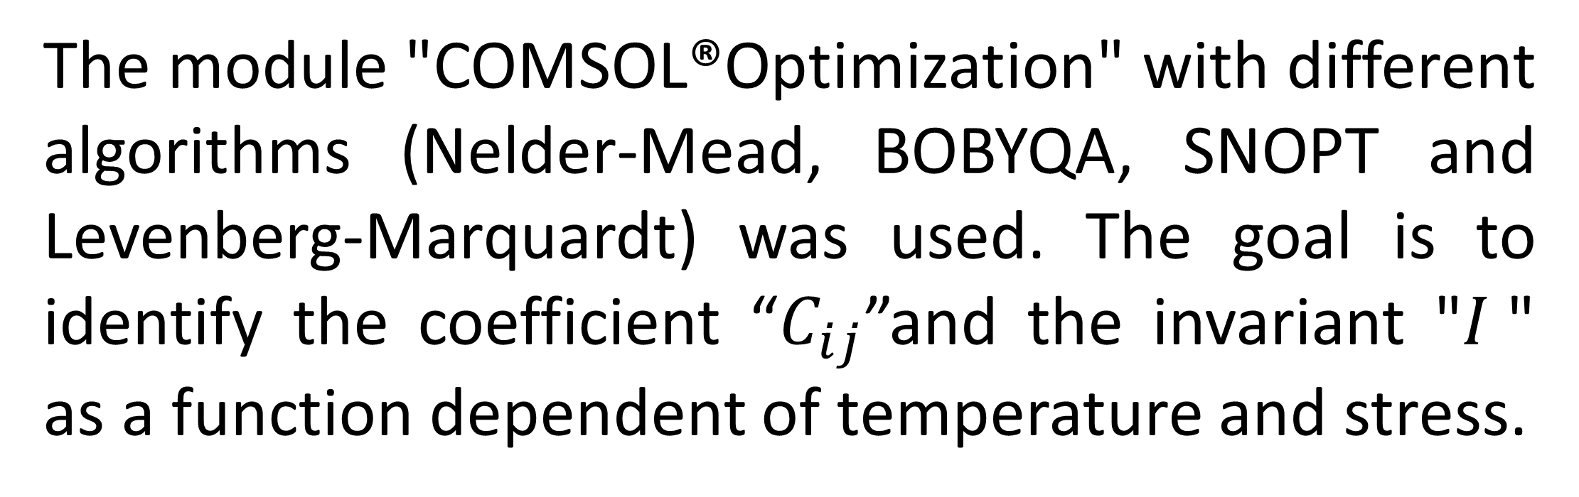
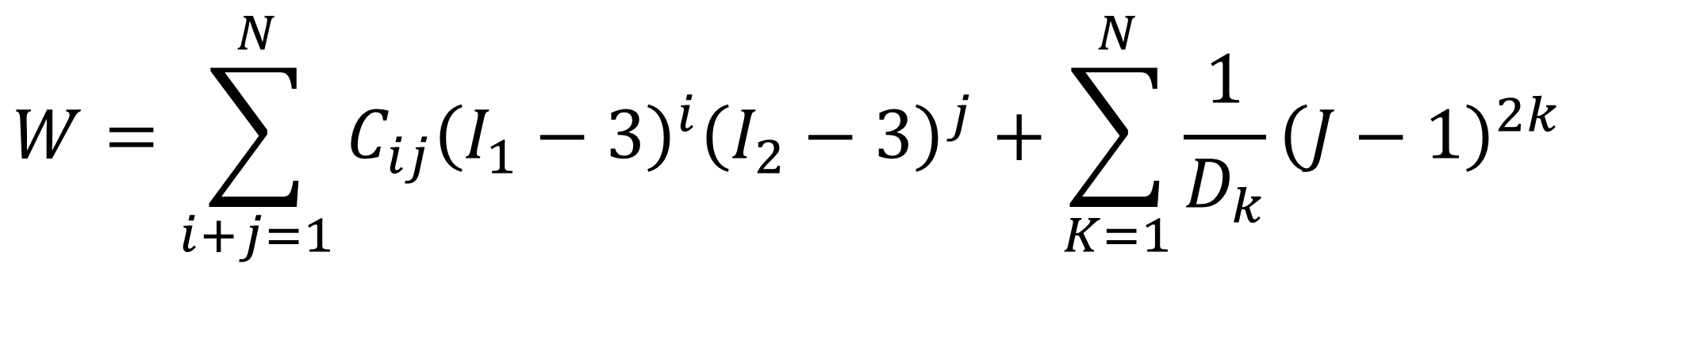
Characterization of physical
properties of silicone
R. Paridant de Cauwere¹, T. Goldhorn¹, R. Rozsnyo²
1. Fischer Connectors SA, Switzerland
2. HES-SO Genève, Swiss University of Applied Sciences
and Arts Western Switzerland, Geneva
Contact: r.paridant@fischerconnectors.ch
INRODUCTION:
The following study was conducted to model the different behaviours of a silicone. The studied material is part of the elastomer’s family with a complex internal structure. it is used in a wide temperature range.
RESULTS:
Hyperelastic parameters were identified for the initial tensile step and the tenth tensile step. A model (Yeoh) could be clearly identified as best representing the material behaviour. Hyperelastics parameters were mapped in function of the test temperature and the nominal strain.
The viscoelastic parameters were identified for each step separately regarding the complete stepwise test, the Maxwell model fits the best. Nine parameters were optimized for this analysis.
Fig 1. Complex internal structure of an elastomer [1]
A series of laboratory experiments were conducted on the material in order to obtain real data according to a wide temperature range (cycle tensile, step wise and DMA).
COMPUTATIONAL METHODS:
Finding the parameters of the hyperelastic and viscoelastic models by fitting the curves of the experimental results and those calculated by COMSOL®.
Fig 3. Comparison of experimental and simulated curves for viscoelastic and hyperelastic behavior [2].
$$W=W_{iso}+W_{vol}+\sum_{m=1}^{N}{Ψ_{m}}$$
As shown in the figure above [Fig. 3] the fit between the experimental curves and the simulation are very close.
$$W=\sum_{i+j=1}^{N}{C_{ij}{\left(I_{1}−3\right)}^{i}{\left(I_{2}−3\right)}^{j}+\sum_{K=1}^{N}{\frac{1}{D_{k}}{\left(J−1\right)}^{2k}}}$$
It was possible with these results to simulate a version of a real section of the final component that was studied [Fig. 4.]. This simulation combines hyperelastic and viscoelastic behaviour.
Eq 1. General equations use to represent the hyperelastic and viscoelastic behavior.
The two general equations above [Eq.1.] are the mathematical representation of the general equations for the hyperelastic and viscoelastic behaviour..
With the of the COMSOL ® software, the goal is to reproduce simulations of experiments, allowing to reverse engineer and extract the right models to represent comportment of the material.
Fig 2. Simulation combining two behavior of the polymer [2]
The purpose of this simulation is to verify if the experimental test ranges are good.
CONCLUSIONS:
In conclusion, the COMSOL® software and its different modules made it possible to obtain theoretical / mathematical models allowing to represent certain isolated behaviour of silicone. It has been possible to identify models (Yeoh and Maxwell) to describe the main behaviours of the silicone. An identification of the parameters according to the constraints (temperature, stress) was possible.
Fig 2. Data obtained from experiences [3] and COMSOL Multiphysics ®[2]
The module "COMSOL®Optimization" with different algorithms (Nelder-Mead, BOBYQA, SNOPT and Levenberg-Marquardt) was used. The goal is to identify the coefficient “$C_{ij}$”and the invariant "$I$" as a function dependent of temperature and stress.
REFERENCES:
Jörgen Bergström, Mechanics of Solid Polymers Theory and Computational Modeling, ISBN 978-0-323-31150-2, (2015)
“COMSOL Multiphysics V 5.4”, 2018
Fischer Connectors, Internal propriety, Thierry Goldhorn, Romain Paridant de C.
Excerpt from the Proceedings of the 2019 COMSOL Conference in Cambridge

