Slide 1
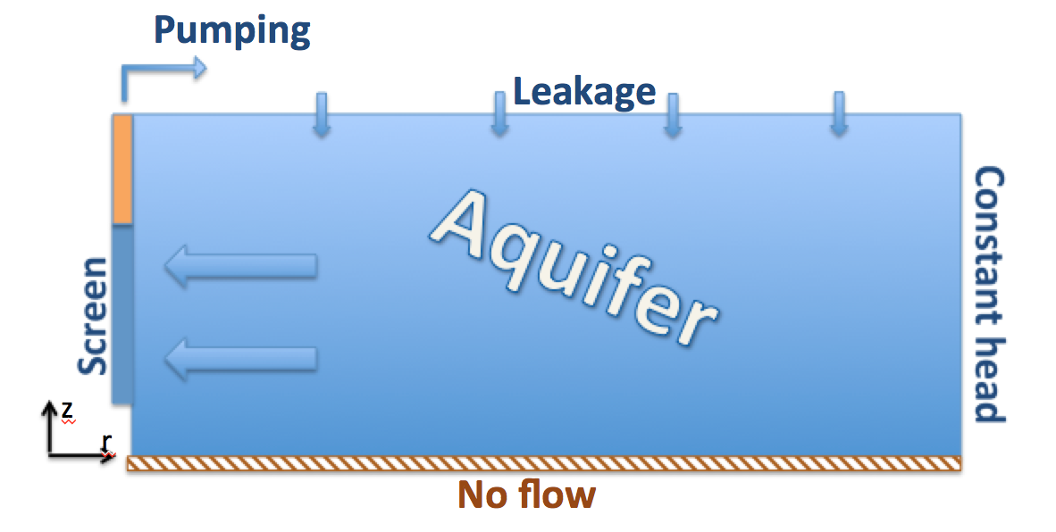
.
Pumping Tests: Comparison of 2D Numerical and 1D Analytical Solutions
E. Holzbecher
German University of Technology in Oman (Gutech), Applied Geosciences, Muscat 130, Oman
INTRODUCTION: Pumping tests are the major field experiments within the toolbox of a hydrogeologist. The evaluation of the tests depends on specific and local groundwater conditions. Mostly these cannot be considered by common evaluation methods, which are based on 1D analytical solutions. 2D numerical models offer the chance to overcome this obstacle. Simulations using COMSOL Multiphysics are set up and performed for fully and partially penetrating wells in confined, leaky and unconfined aquifers. We compare numerical with analytical solutions of Theis and Hantush. The simulations can easily be extended to include anisotropy, general boundary conditions, skin zone effects etc. In connection with an optimization module such simulation models may become a more flexible and reliable tool for hydrogeologists.
MODEL SET-UP: COMSOL-Multiphysics models are set up based on the Darcy-mode for flow in porous media from the subsurface flow module. The free surface of the unconfined aquifer was modelled using the moving mesh ALE mode (Jin et al. 2014). The analytical solutions were programmed in MATLAB® and called by MATLAB LiveLink.
RESULTS: Runs with three different well screens were performed for models of confined, leaky and unconfined aquifers. The figures show drawdown development at three observation points. Grey markers indicate the analytical solutions.
Figure 3. Drawdown for the confined aquifer
Figure 4. Drawdown for the leaky aquifer
Figure 1. 2D model region and boundary conditions
COMPUTATIONAL METHODS: The drawdown is computed in a 2D vertical cross-section using cylinder coordinates r and z. The relevant differential equation is:
For confined isotropic aquifers this can be simplified to:
1D analytical solutions are given by the following formulae:
(1) without groundwater recharge
with well-function W(u) (Theis 1937);
(2) for the leaky aquifer
with Hantush well-function W(u,v) (Hantush 1967).
Please leave at least a 25mm margin on all sides to avoid cropping during printing. Remove this text box before submitting.
Figure 5. Drawdown for the unconfined aquifer
CONCLUSIONS: Numerical and analytical solutions coincide perfectly, if the conditions for the validity of the analytical solutions are fulfilled. As the analytical solutions are derived for fully penetrating wells in confined or leaky aquifers; they are not valid for partially penetrating wells or unconfined aquifers. The 1D analytical solution cannot represent the 2D flow patterns in the vicinity of the well. In contrast the numerical solutions can do the job. The model runs show clearly that the 1D solutions become completely invalid, when the well is not ideal. If the well screen is cut by a factor of half, the drawdown increases roughly by a factor of 2, indicating inverse proportionality.
The presented numerical approach for confined and leaky aquifers is extended to simulate drawdown due to pumping in unconfined aquifers. The water table is then conceived as a free boundary. The exact position of the free boundary is a result of the computations. Results of the 2D models show how much the drawdown calculated for the unconfined case deviates from the confined case.
The proposed modelling approach can account for
fully and partially penetrating wells
confined, leaky and unconfined aquifers
anisotropy
various far field boundary conditions
variable thickness
skin-zone effects
constant rate or constant head pumping tests
changing pumping rates
Variable | Symbol | Variable | Symbol
Drawdown | s [m] | Time | t [s]
Hydraulic conductivity (horizontal) | K_{h} [m/s] | Transmissivity | T [m²/s]
“ (vertical) | K_{v} [m/s] | Storativity | S [-]
Specific storativity | S_{s} [1/m] | Leakance | λ [m]
REFERENCES:
Hantush M.S., Flow of groundwater in relatively thick leaky aquifers, Water Res. Res., 3(2), 583-590 (1967)
Jin Y., Holzbecher E., Sauter M., A novel modeling approach using arbitrary Lagrangian-Eulerian (ALE) method for the flow simulation in unconfined aquifers, Computers & Geosciences, 62, 88-94 (2014)
Theis C.V., The relation between the lowering of the piezometric surface and the rate and duration of discharge of a well using groundwater storage, Trans. Am. Geophys. Union, 16, 519-524 (1937)
Table 1. Parameter list, SI units in square brackets
Excerpt from the Proceedings of the 2019 COMSOL Conference in Cambridge

