Slide 1


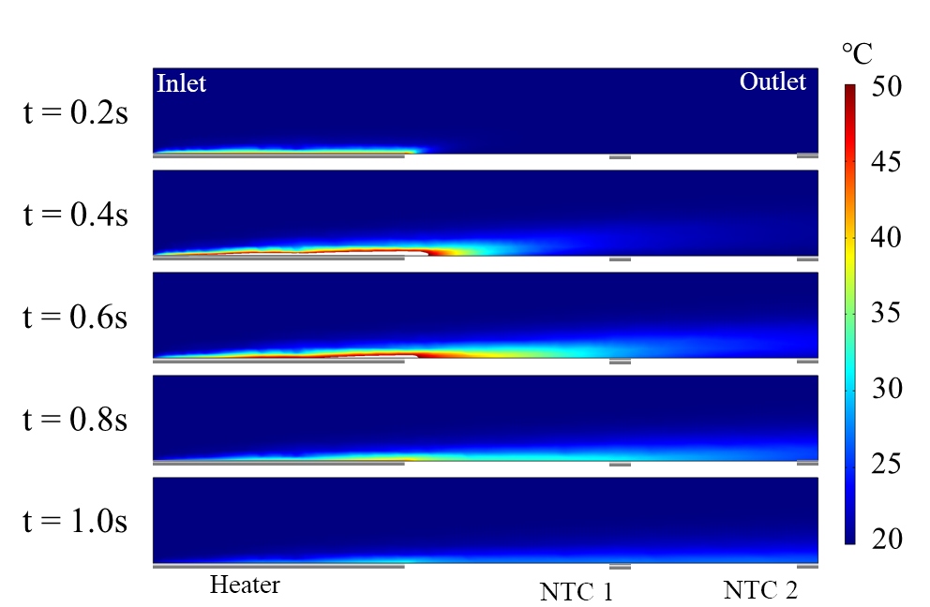
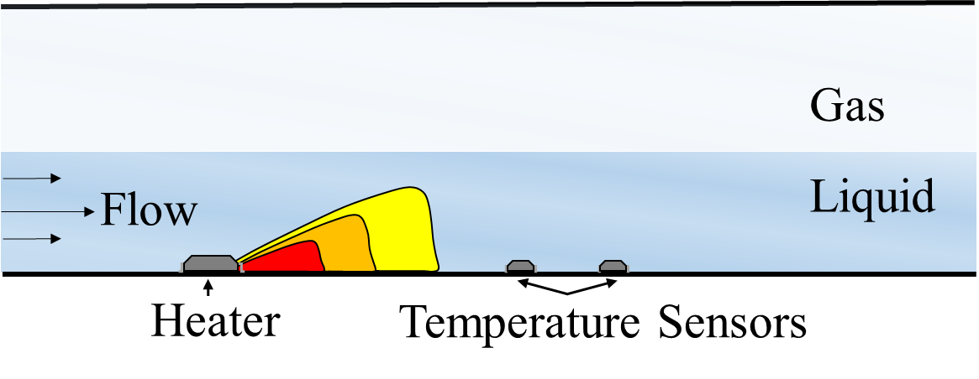
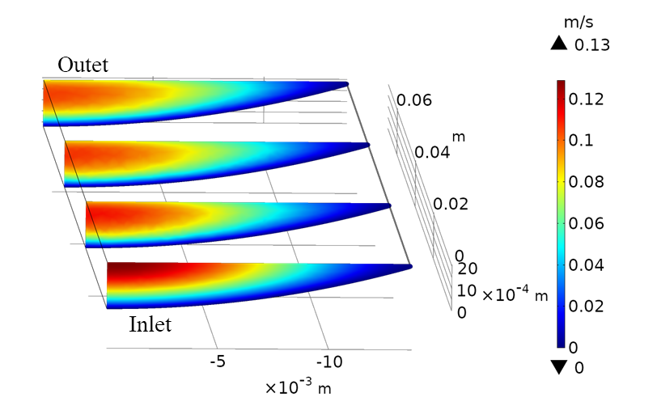
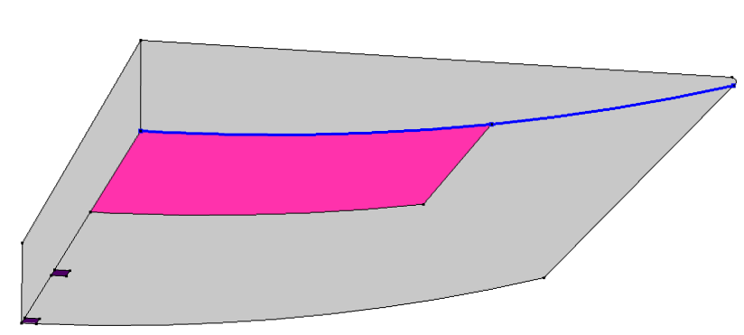
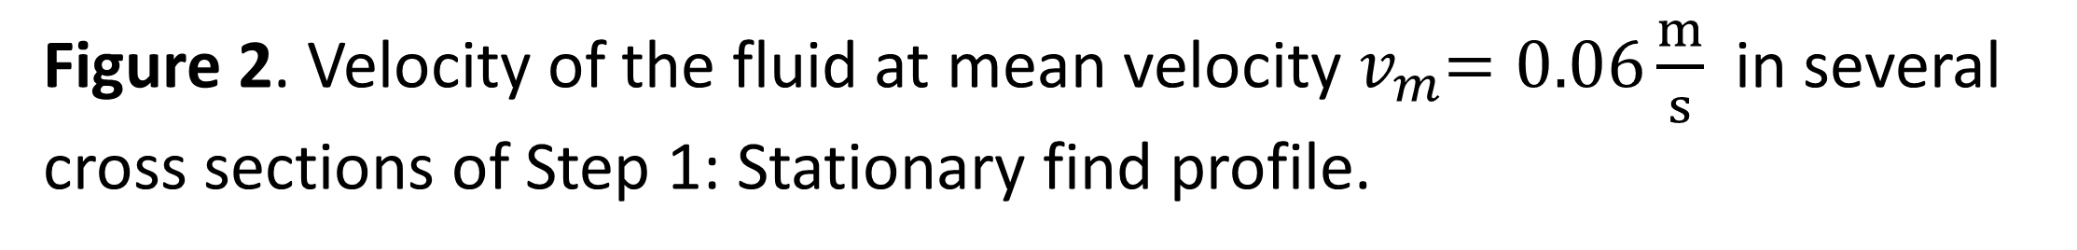


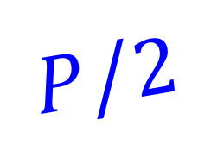

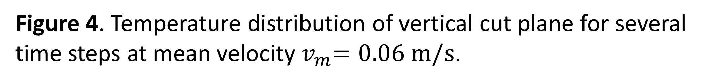
Modelling of a Thermal Time-of-Flight Sensor for Low Rate Open Channel Flow
C. Panhans¹, T. Koch², I. Kuehne³, S. Leonhard¹, R. Hilliges¹, R. Stolle¹, A. Frey¹
¹ University of Applied Sciences, Augsburg, Germany
² COMSOL Multiphysics GmbH, Goettingen, Germany
³ Heilbronn University of Applied Sciences, Kuenzelsau, Germany
INTRODUCTION: Water transport in the public sewer system is often based on open channel flows, e.g. in a DN100 drainage pipe. Many established methods of measuring flow rates require a fully filled pipe [1]. In order to enable the measuring of very low flows, a novel measurement method was developed. The principle of TTOF (thermal time-of-flight) measure-ment is used (cf. Fig.1).
RESULTS: The temperature distribution inside the fluid as well as the temperatures measured with the sensors NTC 1 and NTC 2 are obtained (cf. Fig. 4–5).
Figure 1. Principle measurement setup of a TTOF flow sensor in an open channel.
Figure 4. Temperature distribution of vertical cut plane for several time steps at mean velocity${ v}_{m}=0.06 m/s$.
COMSOL® IMPLEMENTATION: The simulation model is based on the Nonisothermal Laminar Flow Multiphysics interface coupling Single-Phase Flow and Heat Transfer. The velocity profile results from a No Slip BC at the pipe wall and a Navier Slip BC for the fluid-gas surface.
Figure 5. Temperature response over time at NTC 1 and NTC 2 for several mean flow velocities.
CONCLUSIONS: The presented TTOF flowmeter simulation model provides insight into the measurement principle and provides results in reasonable agreement with measurement results. It shows that only the bottom layers of the open channel are involved in the heat transport, especially for higher flow velocities. This leads to a non-linear relation between peak-to-peak time shift and mean velocity. Moreover, it becomes apparent that minimizing the thermal time constants of the heat and sensor elements is essential to improve the sensitivity of the measurement setup.
Figure 2. Velocity of the fluid at mean velocity${ v}_{m}=0.06\frac{m}{s}$ in several cross sections of Step 1: Stationary find profile.
$$h$$
$$r$$
Flow direction
$$A/2$$
$$P/2$$
Heater
NTC 1
NTC 2
Figure 3. Model geometry for transient simulation (view from below).
In order to optimize computation time, the model is built of two components. One is used to calculate the steady state flow profile (cf. Fig. 2). The other is utilized for the transient simulation (cf. Fig. 3).
REFERENCES:
[1] Ecin, O. et all: Modelling Thermal Time-of-Flight Sensor for Flow Velocity Measurement, Proceedings of the COMSOL® Conference 2009.

