Slide 1
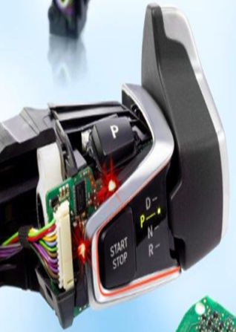
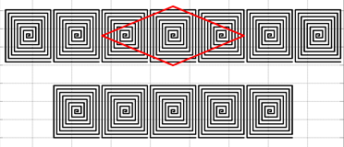
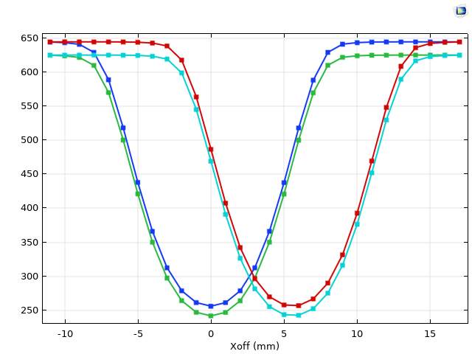
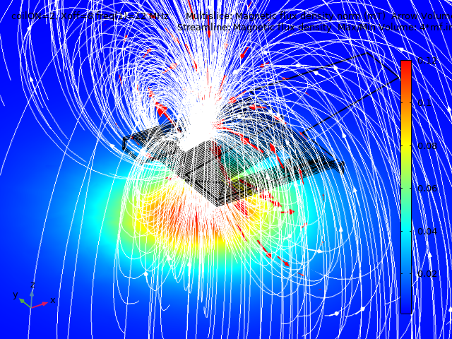
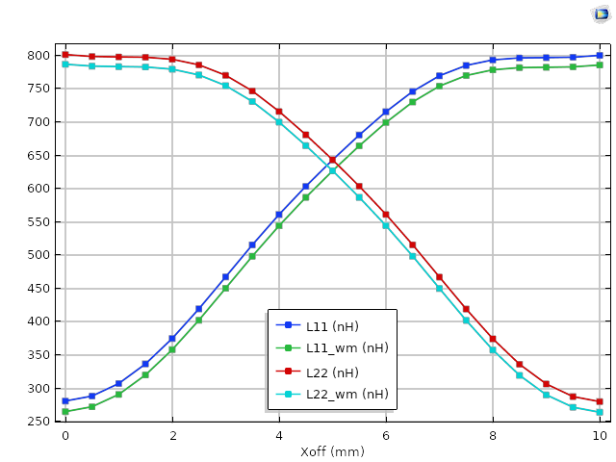
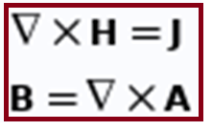
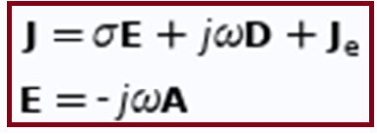
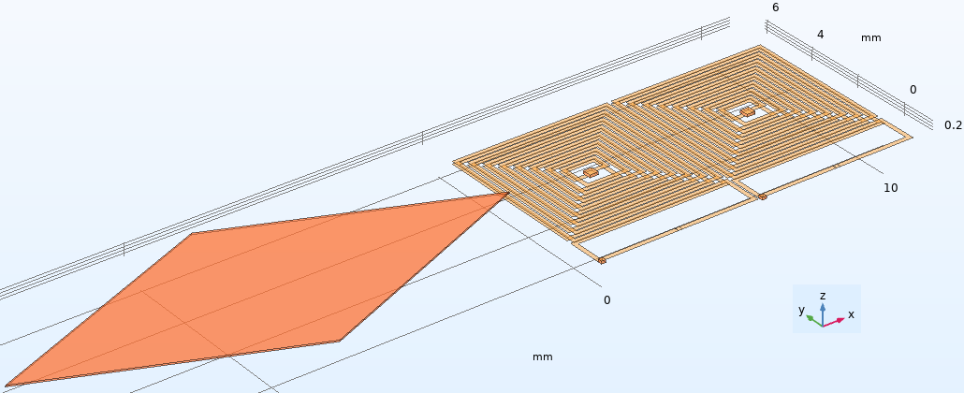
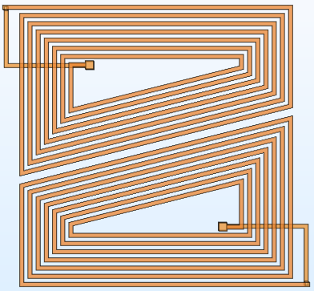
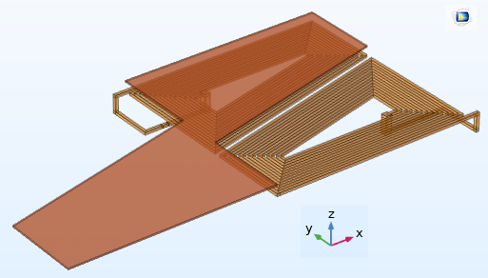
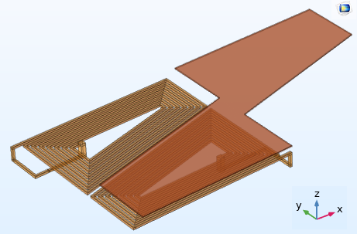
SCIS: Small & Compact Inductive Sensors for Position Sensing in the Automatic Gear Shifters
A. K. Palit
ZF-Lemförder Electronic GmbH (ZF-Friedrichshafen AG.), System Development, Germany / Univ. of Bremen, FB1-ITEM, Germany
INRODUCTION: ZF-Friedrichshafen AG is one of the biggest supplier of Automatic Gear Shifters (AGS) for the modern cars and ZF- Gear Shifter needs sensing of (P, R, N, D, S) & (M+, M-) positions etc. either by contactless inductive sensor or by magnet based Hall-principle. Hall sensors, although much costlier than ZF-patented inductive sensors, are often used as they require less PCB-area. PCB-area optimization and design of fault tolerant behavior of the inductive sensors are the main motivations of the SCIS project.
RESULTS: Simulation results of the planar coils (of Figs. 2b-2d) are shown in Figs. 4-5 and Table-1. Fig.-5 shows the “Scissor or X-shape” two curves i.e. X_{off}(mm) vs. L₁₁(nH) & L₂₂(nH) inductance values of top and bottom coils respectively. L₁₁(nH) & L₂₂ (nH) values correspond to the Cu-Activator’s position (X_{off}(mm)), which slides over the two trapezoidal coils (Figs. 2c-2d). Both curves are complements to each other. If normalized within 0 & 1 (use eq.(6.46) Ref.[3]) they yield 1 when added.
Figure 1. ZF-Automatic Gear Shifter and Inductive Sensors
Figure 3. Simulation of Fig.2(a)
Figure 4. Magnetic fields from coils
COMPUTATIONAL METHODS: Inductive sensors (SCIS) were modeled and simulated in frequency domain with magnetic field (mf) physics interface, applying ACDC module of Comsol-Multiphysics. Following Maxwell’s equations (full field) were solved/used for the magnetic field simulation.
Figure-2 shows the CAD-models (2D & 3D) of two square & trapezoidal planar coils arranged laterally in X and in Y-directions. In Figure 2(a) two square or rectangular planar coils are arranged laterally in X-direction (similar to top row of Figure-1) and their simulation results are presented in Fig.-3 & Ref. [1].
X_{off}(mm) | L11(nH) | L22(nH)
0 | 260 | 800
4 | 550 | 700
5 | 635 | 640
10 | 800 | 260
Figure 5. X_{off}(mm)-vs-L(nH) curves
Table 1. Trapez. Coils’ inductances
CONCLUSIONS: Proposed sensor (SCIS) scheme reduces the PCB-area by approx. 50% and yet can sense all five positions accurately. The “X-shape” (complimentary) nature of two inductance curves guarantee a fault tolerant behavior of SCIS. Optimal shape and contour of the Cu-Activator can produce X-curves with higher slopes and again, this ensures a better fail-safe system (automatic-gear-shifter) in the event of a single-coil failure. Individual bigger size (10 mm x 5 mm) of planar coils with multiple-layers will increase the both sensor sensitivity and robustness of inductive sensors’ system against temperature change and in small variation of the air-gap between the planar coils and Cu-activator.
a: 3D-Square coils ( X-dirn.)
b: 2D-Trapez. coils (Y-dirn.)
REFERENCES:
A.K. Palit, Frequency Domain Modeling of Inductive Sensor using FEM, Comsol Cambridge Conference 2014, Churchill College/Univ. of Cambridge, UK, (2014).
A.K. Palit, ZF Friedrichshafen AG. Patent (pending): Sensoranordnung, 011272-DE-NP, EM-180290, Patent File: 10-2018 220 458.6 , Appl. Date: 28. Nov. (2018)
A.K. Palit & D. Popovic, “Computational Intelligence in Time Series Forecasting, Theory & Engg. Applications”, Springer-Verlag, London, Ch.-6, pp. 258, (2005).
c: 3D-Trapez. Coils & Activator
d: 3D-Trapez. & sliding Activator
Figure 2. Models of trapezoidal coils with(out) Lump-Port & Activator
Excerpt from the Proceedings of the 2019 COMSOL Conference in Cambridge

