Slide 1

A MODEL OF CONCRETE CARBONATION USING COMSOL MULTIPHYSICS ®
A. Rodriguez R.¹, B. Chinè¹, R. Cuevas H.², R. Jimenez S.¹, 1. School of Materials Science and Engineering, Costa Rica Institute of Technology, Cartago, Costa Rica 2. School of Construction Engineering, Costa Rica Institute of Technology, Cartago, Costa Rica

Slide 2
CONCRETE CARBONATION
CO₂ permeates the porous and fractured structure of concrete.
Establishes conditions of concrete degradation.
May cause corrosion around reinforcing bars, causing deterioration of material and structure mechanical properties.
Figure 1. Carbonation of an OPC, validated also for pozzolanic cements [Papadakis et al, 1992]

Slide 3
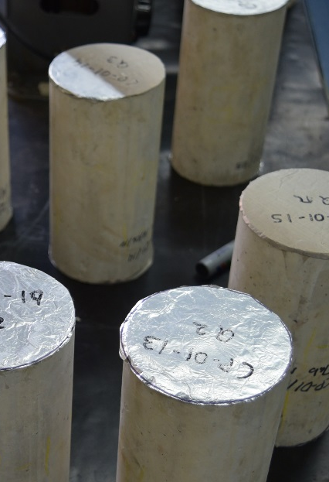
Physical model
10 cm diameter and 20 cm height cylinders.
Two base surfaces covered with aluminum foil to set up a radial diffusion process.
Pozzolanic cement MP/A-28 manufactured by Lafarge-Holcim
Samples in accelerated carbonation chamber.

Slide 4
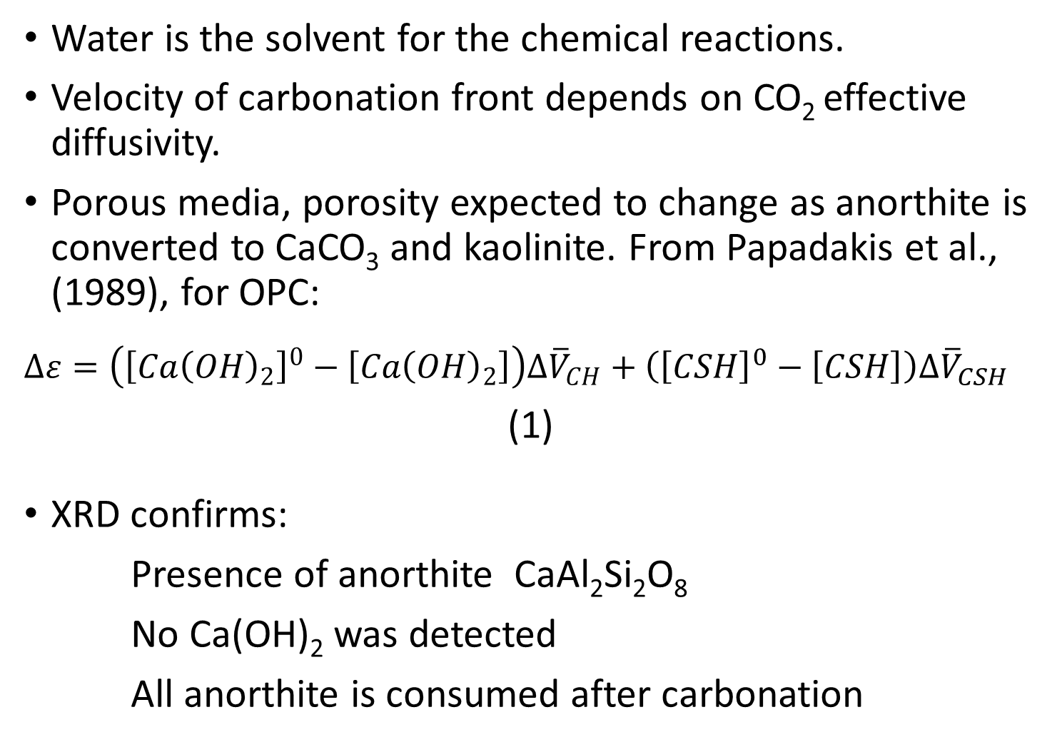
Water is the solvent for the chemical reactions.
Velocity of carbonation front depends on CO₂ effective diffusivity.
Porous media, porosity expected to change as anorthite is converted to CaCO₃ and kaolinite. From Papadakis et al., (1989), for OPC:
$$∆ε=\left({\left[{Ca\left(OH\right)}_{2}\right]}^{0}−\left[{Ca\left(OH\right)}_{2}\right]\right){∆\overline{V}}_{CH}+\left({\left[CSH\right]}^{0}−\left[CSH\right]\right){∆\overline{V}}_{CSH}$$
(1)
XRD confirms:
Presence of anorthite CaAl₂Si₂O₈
No Ca(OH)₂ was detected
All anorthite is consumed after carbonation

Slide 5
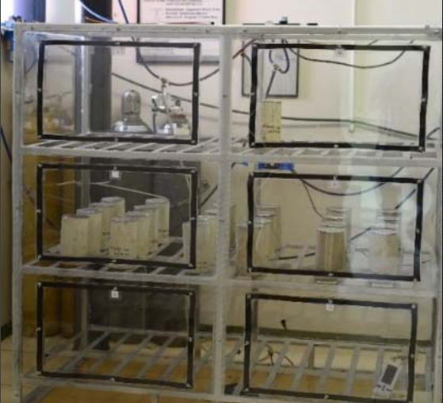
Main objective
Develop a computer model to calculate pH and porosity changes, as well as oxygen diffusion, which would participate in the corrosion reaction in the reinforcement steel bars
Results are compared
with experimental data.

Slide 6
MATHEMATICAL MODEL
Comsol Multiphysics® Chemical Reaction Engineering Module.
Transient, bi-dimensional diffusion for species transport.
Convective processes are neglected, isothermal conditions are assumed.
Chemical species are considered to be diluted.
Water saturation in concrete is considered constant. Reaction in the liquid phase between anorthite and CO₂ gas:
CO₂ +CaAl₂Si₂O₈ +2H₂O = CaCO₃ + AlSi₂O₅(OH)
[Oelkers et al., 2008] (2)

Slide 7
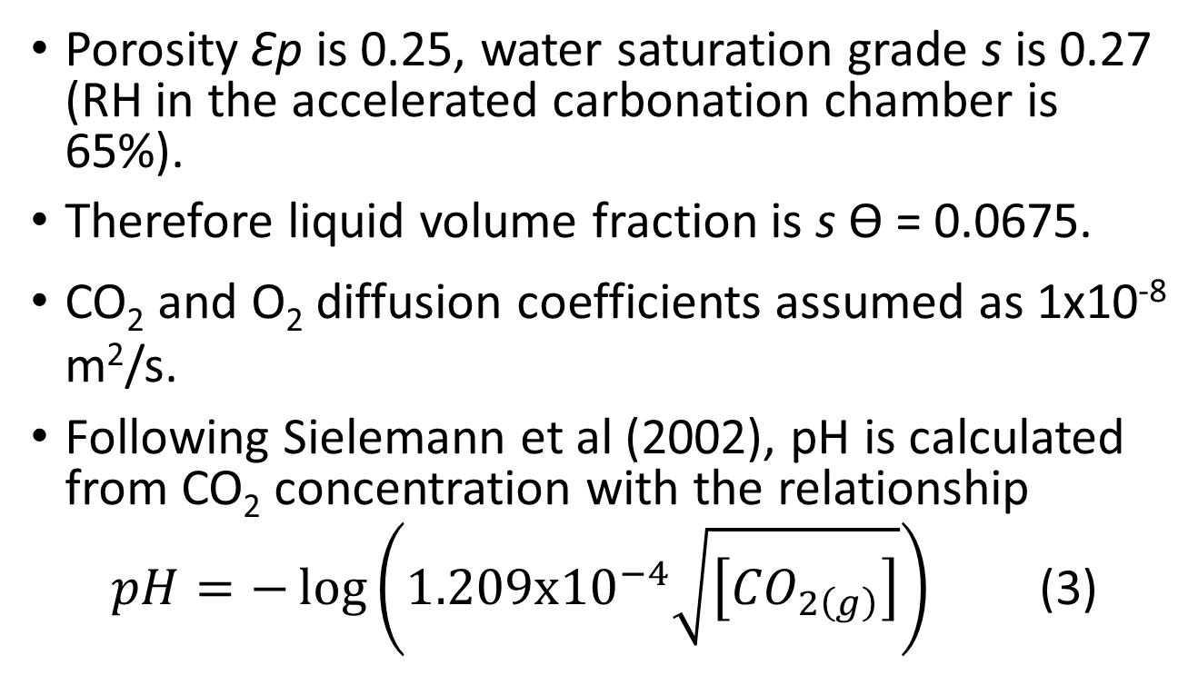
MATHEMATICAL MODEL
Porosity Ꜫp is 0.25, water saturation grade s is 0.27 (RH in the accelerated carbonation chamber is 65%).
Therefore liquid volume fraction is s Ɵ = 0.0675.
CO₂ and O₂ diffusion coefficients assumed as 1x10⁻⁸ m²/s.
Following Sielemann et al (2002), pH is calculated from CO₂ concentration with the relationship
$pH=−\log\left(1.209x{10}^{−4}\sqrt{\left[{CO}_{2\left(g\right)}\right]}\right)$ (3)

Slide 8
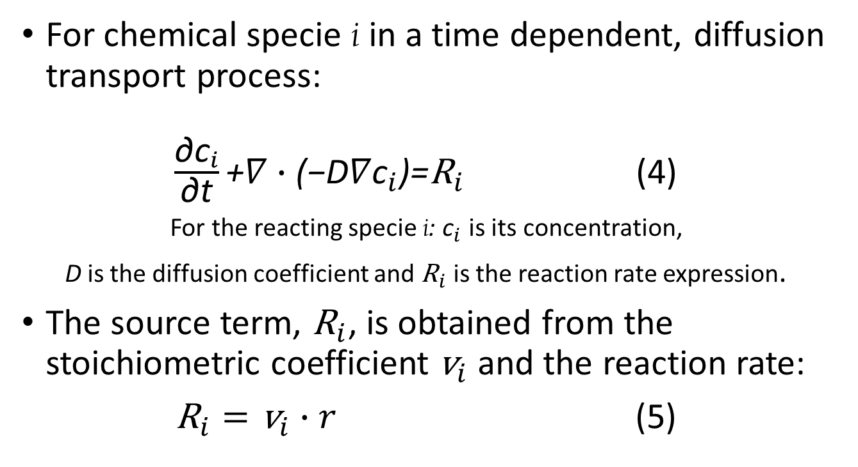
EQUATIONS
For chemical specie i in a time dependent, diffusion transport process:
$\frac{{\text{∂}\text{c}}_{i}}{\text{∂}\text{t}}\text{+}∇∙\text{(}\text{−}{\text{D}∇\text{c}}_{i}\text{)}\text{=}{\text{R}}_{i}$ (4)
For the reacting specie i: ${\text{c}}_{i}$ is its concentration,
D is the diffusion coefficient and ${\text{R}}_{i}$ is the reaction rate expression.
The source term, ${\text{R}}_{i}$, is obtained from the stoichiometric coefficient ${\text{v}}_{i}$ and the reaction rate:
${\text{R}}_{i}={\text{v}}_{i}∙r$ (5)

Slide 9
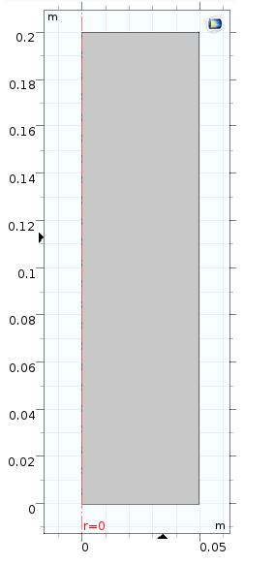
BOUNDARY AND INITIAL CONDITIONS
No flux for all species
Initial values:
Anorthite 100 mol/m³
All other species 0 mol/m³
From controlled chamber conditions:
6.448 mol/m³ for O₂
10.22 mol/m³ for CO₂
No flux for all
other species
Axial symmetry
No flux for all species

Slide 10
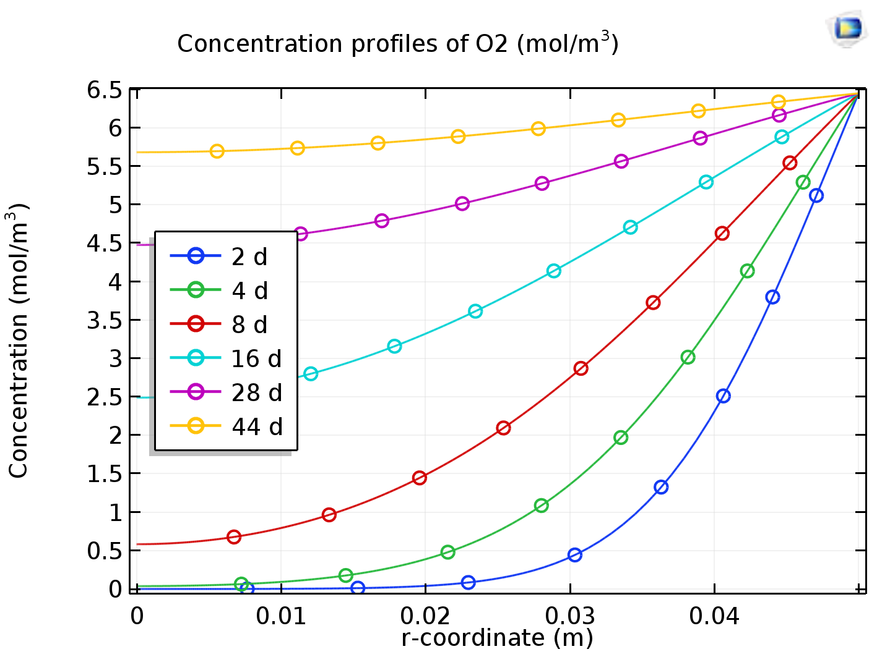
RESULTS
As expected from the assumption that oxygen does not react with other species, it diffuses into the concrete at a faster rate than CO₂

Slide 11
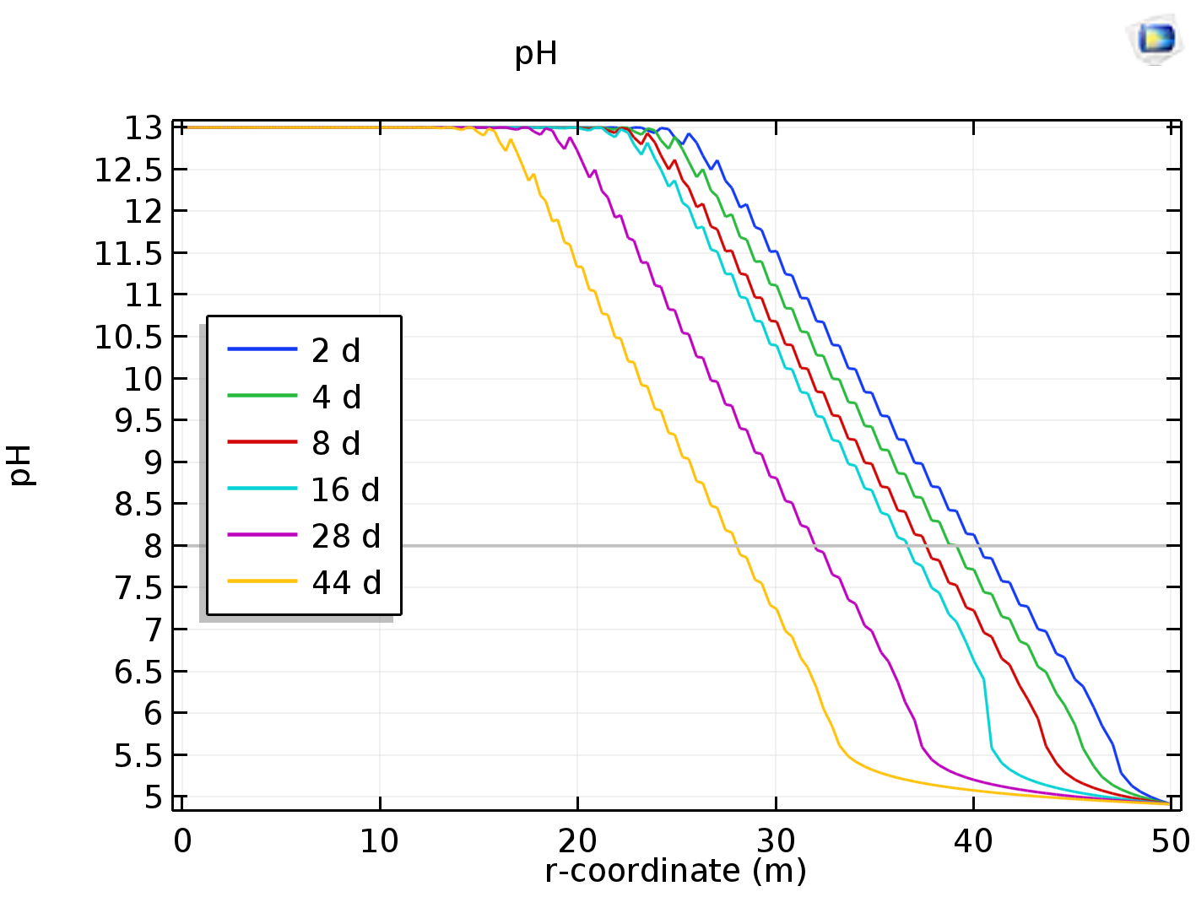
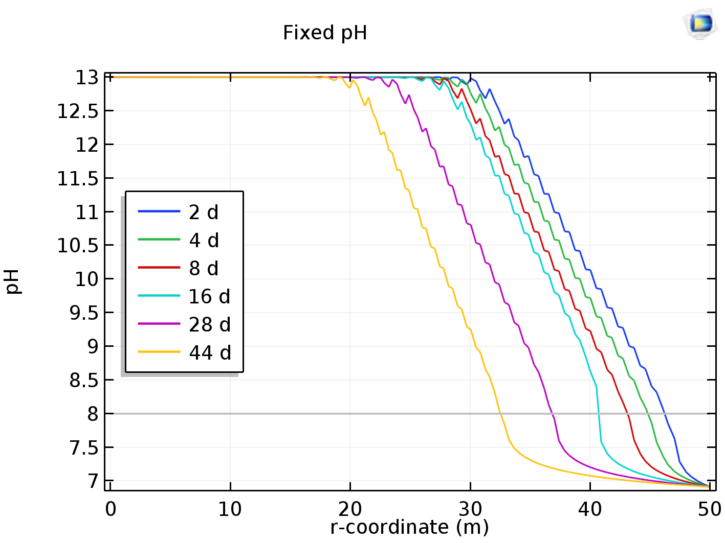
pH level follows a relationship to experimental results but require a correction factor to adjust to measured values
Difference might come from other reactions that are not modelled and might act as sinks for CO₂ concentration

Slide 12
Table 4. Carbonation depth variation in time inside the concrete at specified conditions.
Time (days) | Carbonation depth (mm)
 | Experimental value | Derived formula | Fixed formula
2 | 4 | 9 | 3.5
4 | 6 | 11 | 5.5
8 | 8 | 12.5 | 7
16 | 10 | 13 | 9
28 | 12 | 18 | 13
44 | 15 | 22 | 16
* r² = 0.98.

Slide 13
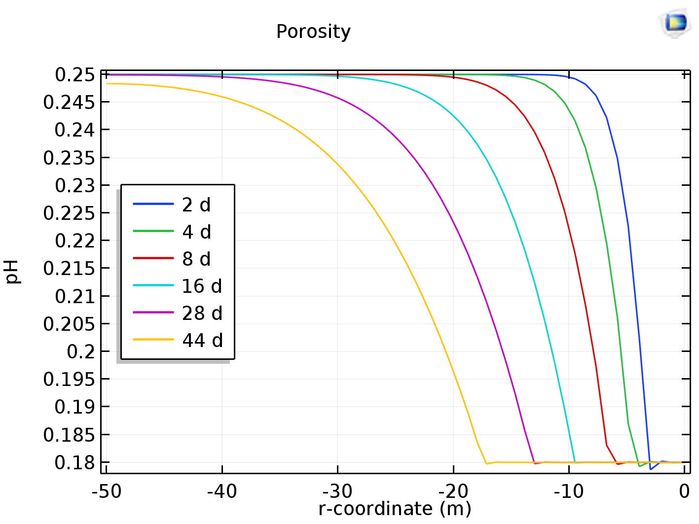
Numerical instability of the model affected modelling the porosity change
Attempts to model a transient change of porosity caused convergence problems.
Some analysis is required to find the possible causes for this
Temporarily the porosity change was calculated through a relationship to CaCO₃ concentration

Slide 14
Conclusions
A finite element analysis of a concrete sample subject to carbonation was performed. Other chemical reactions must be considered in order to analyze how they affect pH levels.
The anorthite - CO₂ reaction does not consider how much of both species dissolve into water.
A thorough composition analysis is necessary to continue improving the model.
The numerical stability of the model should be improved for future, more complex analysis.

Slide 15
Acknowledgements
The authors gratefully acknowledge the financial aid provided by the Vicerrectoria de Investigación y Extensión of the Instituto Tecnológico de Costa Rica, through the project 1490017.

