Slide 1


The Acoustics of a 3D Kelvin Foam Cell Based on Thermoviscous Acoustics Fluid Modelling
Brad Semeniuk
Department of Aeronautical and Vehicle Engineering
KTH Royal Institute of Technology – Stockholm, Sweden
Peter Göransson
Department of Aeronautical and Vehicle Engineering
KTH Royal Institute of Technology – Stockholm, Sweden

Slide 2
Presentation Outline
In previous work, COMSOL supported our validation of viscous drag and oscillatory heat transfer analytical expressions for acoustic models of fibre materials.
We have realized that the COMSOL FE modelling could be used to generate inputs to our porous acoustic models for many kinds of cellular geometries...
This leads to a generalized procedure for the acoustics of porous materials without transport parameters, or assumed pore shapes.
Currently working on cellular foam materials and lattice structures which can be 3D printed, but will explore materials with more geometric dispersion...

Slide 3
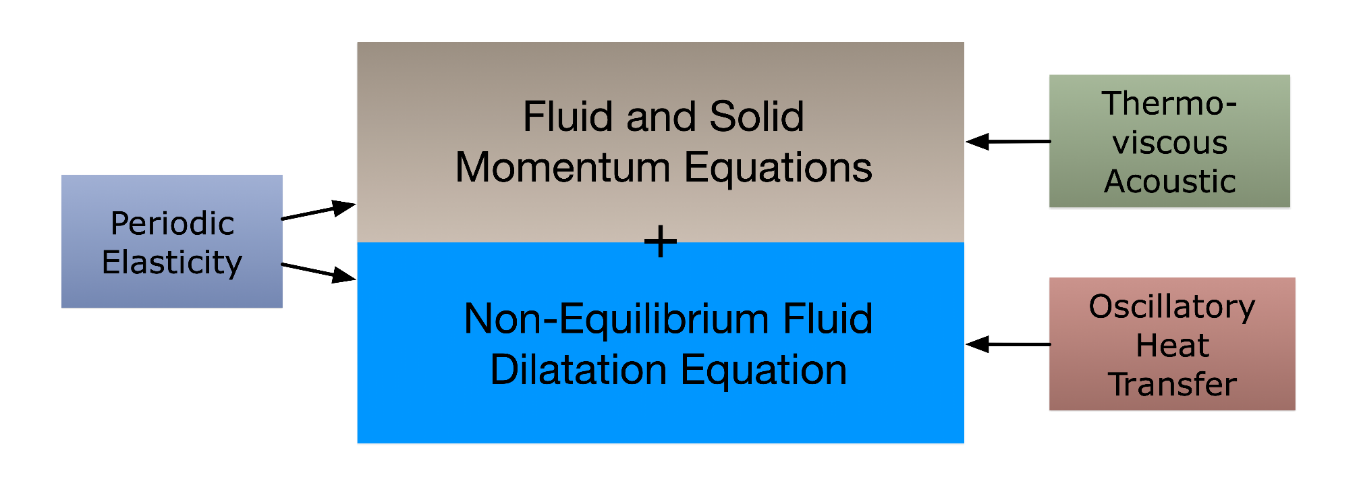
Acoustics of Porous Materials – General Approach
Governing equations can be solved using Finite Elements or Transfer Matrix Methods.
Elasticity, Thermoviscous and Oscillatory Heat Transfer inputs from any combination of measurement, analytical expressions or FE solutions.
For this work, we have used COMSOL FE solutions from the Structural Mechanics, Acoustics and Heat Transfer modules to provide all inputs.

Slide 4
Momentum Equations in Terms of Viscous Drag Forces
Solid Momentum Equations
Viscous Drag Force Impedance Matrix
relative motion between solid and fluid
Fluid Momentum Equations
isotropic, orthotropic, transversely isotropic and fully anisotropic
For cubic foam cell symmetry (isotropic)
Provides the dynamic viscous dissipation in the model.
COMSOL Thermoviscous Acoustic Fluid solutions to estimate the drag force impedance terms.

Slide 5
Fluid Dilatation with Solid – Fluid Oscillatory Heat Transfer
Stress-Strain Relations
Thermal Impedance at solid/fluid interface
based on oscillatory fluid and solid thermal fields
Fluid Dilatation modified for Non-Equilibrium
(heat flow from foam cell solid to fluid results in a thermal expansion of the fluid)
Dynamic Scaling Coefficient
Alters the fluid wave propagation through the porous material.
COMSOL Structural Mechanics solutions to estimate the elasticty matrix.
COMSOL Heat Transfer solutions to provide the thermal impedances.

Slide 6
3mm Kelvin Foam Cell Geometry
3 mm Cell Size
0.5 mm Cylindrical Strut Diameter
0.8788 Porosity
3D Printing – PLA filament material.
21.1 MPa Bulk Modulus
0.3 Poisson’s Ratio
0.16 W/mK Thermal Conductivity
1600 J/kgK Specific Heat
Air properties at 20 deg. C
Geometric and constitutive material properties for the COMSOL modelling.
Actual geometry and material properties will deviate due to thermal aspects of printing.

Slide 7
Determination of Elasticity Matrix
Assume that the isotropic Kelvin foam cell is part of a periodic array of cells.
Using periodicity boundary conditions, 6 load cases are used to determine Elastic Matrix.

Slide 8
Dynamic Viscous Drag Force Impedance
Symmetric foam cell, surrounded by thermoviscous fluid, and encased by acoustic pressure fluid.
Viscous dissipation effects dominate, but only become significant at higher frequencies for this coarse geometry.
Low frequency asymptote provides static airflow resistivity (261 Ns/m4 vs 262 Ns/m4 from Creeping Flow CFD analysis.

Slide 9
Velocity & Viscous Dissipation Fields at 1000 Hz
Concentration of velocity field, and especially viscous dissipation field near foam surfaces.
The most computationally intensive of the COMSOL simulations in this study.
Any cell geometry can be considered with this approach.
Viscous drag impedance gives a strong indication of acoustic absorption performance.
velocity field
viscous dissipation density

Slide 10
Oscillatory Heat Transfer – Thermal Impedances
Solid – fluid oscillatory heat transfer results in a freq-dependent expansion of the fluid.
This changes the propagation of the fluid wave through the porous material (neglected in classical porous theories).
Important when solid impedance is low (reduced resistivity to heat flow).

Slide 11
Thermal Fields at 1 Hz and 1000 Hz
Heat does not flow through the struts of foam cell as frequencies increase.
Corresponds to the increase of the solid thermal impedance.
This means that we can probably neglect oscillatory heat transfer in the acoustic analysis..., maybe, but not true for all cases...
1 Hz
1000 Hz

Slide 12
Predicted Impedance Tube Sound Absorption
TMM Simulation: 50 mm sample thickness, rigid backing impedance tube.
Oscillatory heat transfer provides limited acoustic impact in this case…
Expected poor acoustic performance in lower frequencies, indicated by the viscous drag force analysis.

Slide 13
Micro Glassfibre Array – Importance of Heat Transfer
Average 1.28 micron fibre diameters
Heat flow within solid fibres remains significant in audible frequency range.
Strong impact on acoustic performance.

Slide 14
Conclusions
We have shown how COMSOL FE modelling can be used to generate inputs to our porous acoustic models for cellular geometries...
This leads to a generalized procedure for the acoustics of porous materials without transport parameters, or assumed pore shapes.
We have introduced the new concept of oscillatory solid-fluid heat transfer in porous materials, allowing thermal influence on wave propagation to be explored.
Much work still to do...

