Slide 1
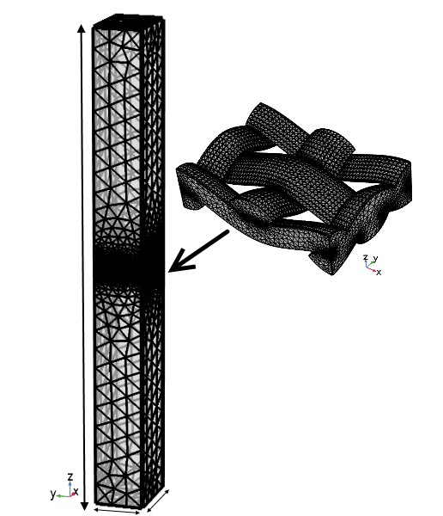
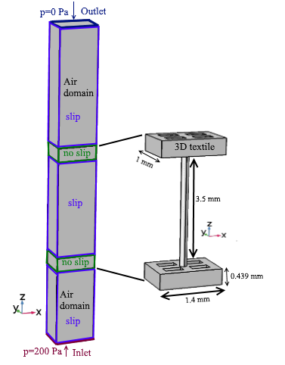
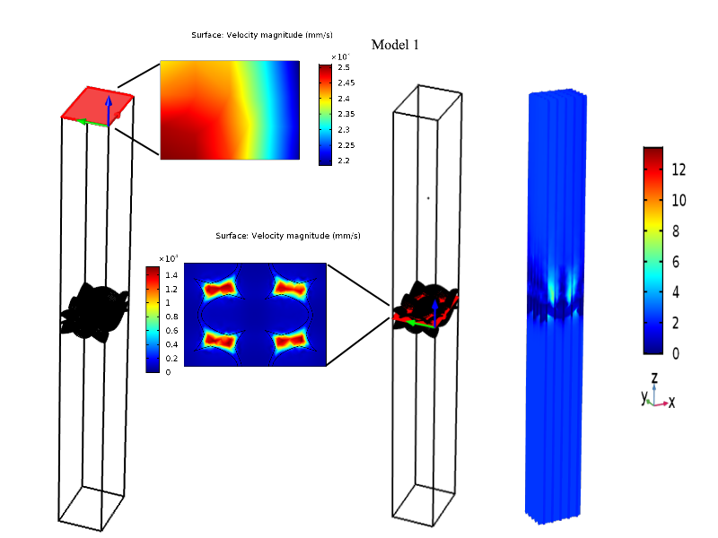
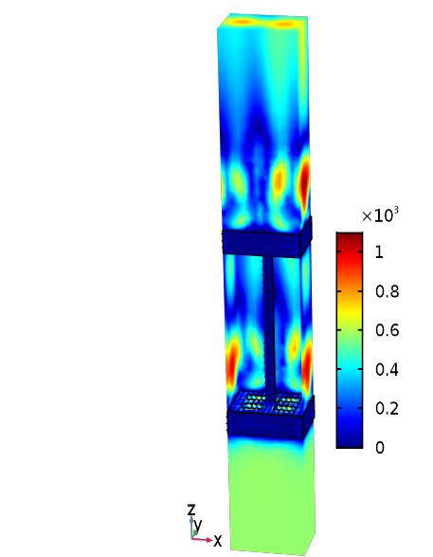
Numerical Simulation of Air Permeability Coefficient of 3D Textile Layer
A. Gadeikytė, R. Barauskas
Kaunas University of Technology, Department of Applied Informatics, Kaunas, Studentu Str. 50-407, LT-51368, Lithuania
E-mail: ausra.gadeikyte@ktu.lt, rimantas.barauskas@ktu.lt
INRODUCTION: 3D textile structures are formed from two fabric layers (top and bottom layer) combined by a spacer yarn or connecting layer. The computational analysis of 3D textile materials allows to predict heat and mass transfer properties such as the effective heat transfer, heat capacity, water vapor transmission, air permeability coeﬃcients, which influence the wearing comfort of the clothes [1, 2].
This study focuses on air permeability coefficient. It has a huge impact for processes of heat exchange (vapor and moisture transport, thermal properties) which occurs between human skin and textiles [3].
The outlet pressure was set to 0 Pa (that corresponds atmospheric pressure). Slip conditions were set on surrounding walls except the walls that are from textile layer.
10 mm
Note. TexGen software was used to create geometry of Model 1 (.stp file was imported into COMSOL Multiphysics® 5.3a software).
1 mm
1.4 mm
COMPUTATIONAL METHODS: In this work we present 3D steady state computational models to predict air permeability coefficient.
Both the Free and Porous Media Flow (fp) interface and Laminar Flow (spf) interface allows in COMSOL Multiphysics® 5.3a software to use Navier-Stokes, Brinkman equations for simulating the air flow through fabric. The simulations were created with the Laminar Flow interface (Note. Fluid Flow-> Single-Phase Flow-> Laminar flow (spf) or Fluid Flow->Porous Media and Subsurface Flow->Free and Porous Media Flow (fp)).
Navier-Stokes equations were used in the free flow spaces (air domain).
where ∇- the gradient operator, u- fluid flow velocity, ρ - fluid mass density, p -fluid pressure, μ- fluid dynamic viscosity, I- identity matrix.
Brinkman equations were used in the porous parts of the structure (textile domain).
where εp -constant porosity, κ- permeability, Qm- mass source, βF-is forchheimer drag coefficient. In our case βF=0, Qm=0 (for zero mass source the equation of continuity, eq. 2 reduces to eq. 1. ).
Boundary conditions. Air permeability is defined as fabrics resistance to the air flow at a given differential pressure.
The inlet pressure was set to 200 Pa according to the ISO 9237:1995(E) standard.
Figure 1. Extremely coarse mesh (Model 1)
Figure 2. Boundary conditions
(Model 2)
Model 1 and Model 2 consist of the same governing equations, boundary conditions. Model 1 presents one-layer woven fabric (set density warp/weft 22/15) which air permeability coefficient has been measured and numerically simulated in the literature [3, 4]. Model 2 – 3D textile structure that top and bottom layer made from simplified Model 1.
RESULTS: Air permeability coefficient of Model 1 is 2387.7 mm/s and it shows good agreement with literature [3, 4]. Measured value is 2391.67 mm/s [4]. Velocity magnitude of Model 2 see in Fig.4. (Note. Results->Derived values->Surface Average->spf.U or comp1->definitions->Boundary Probe->type integral->spf.U/A[mm^2]. A- surface area. )
momentum eq.
(1)
continuity eq.
momentum eq.
(2)
continuity eq.
Figure 3. Velocity magnitude mm/s
(Model 1)
Figure 4. Velocity magnitude mm/s
( Model 2)
CONCLUSIONS: The study was useful to predict the air permeability coefficient of 3D Textile Layer in micro scale (which can be used in macro scale modeling).
REFERENCES:
R. Barauskas and A. Abraitiene, “A model for numerical simulation of heat and water vapor exchange in multilayer textile packages with three-dimensional spacer fabric ventilation layer,” Text. Res. J., vol. 0, no. 00, pp. 1–21, 2010.
G. Ertekin and A. Marmarali, “Heat, air and water vapor transfer properties of circular knitted spacer fabrics,” Tekst. ve Konfeksiyon, vol. 21, no. 4, pp. 369–373, 2011
A. Pezzin. Thermo-physiological comfort modelling of fabrics and garments. PhD thesis. (2015)
Ž. Zupin, A. Hladnik, and K. Dimitrovski, “Prediction of one-layer woven fabrics air permeability using porosity parameters,” Text. Res. J., vol. 82, no. 2, pp. 117–128, 2011
Comsol, CFD Module User’s Guide
Excerpt from the Proceedings of the 2019 COMSOL Conference in Cambridge

