Slide 1

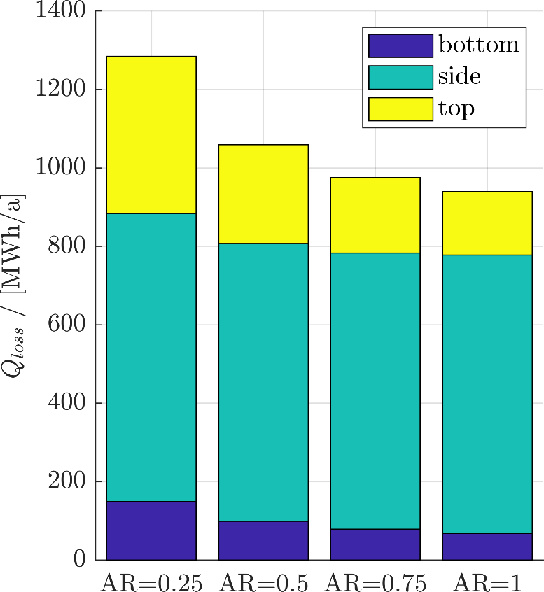
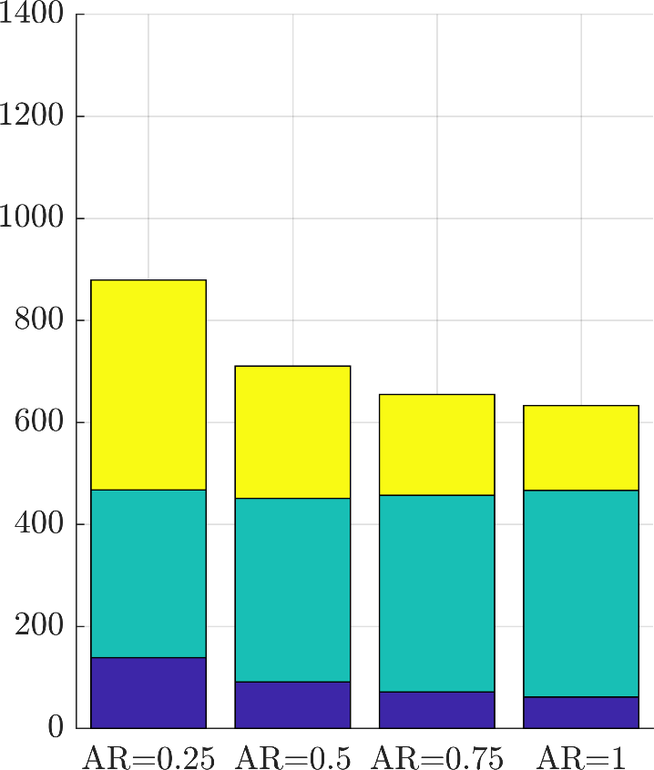
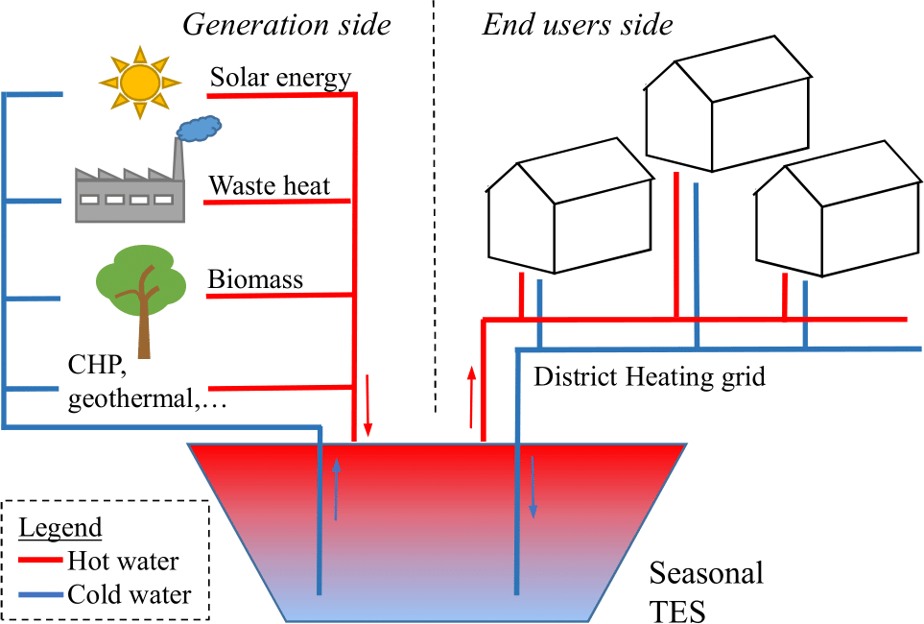
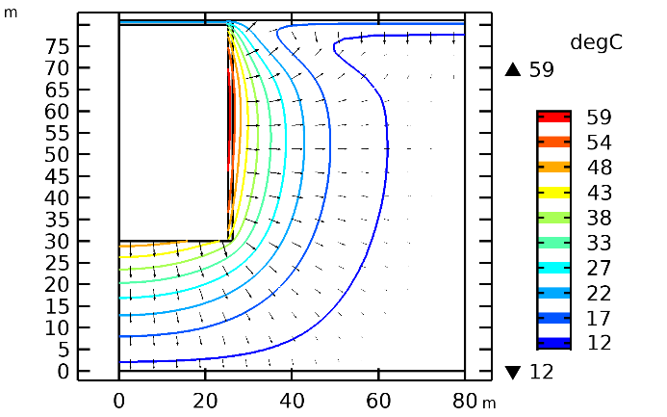
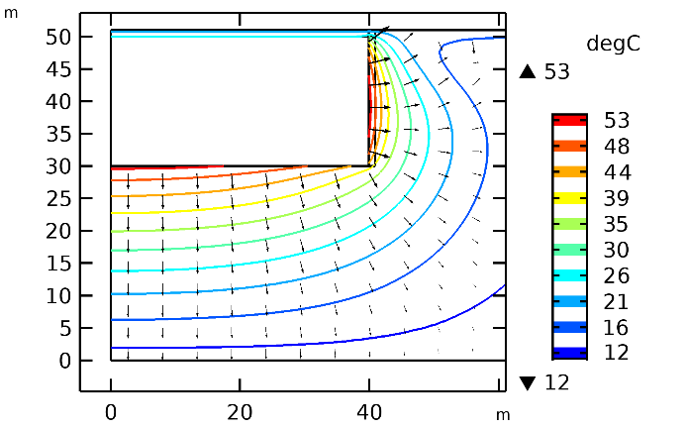
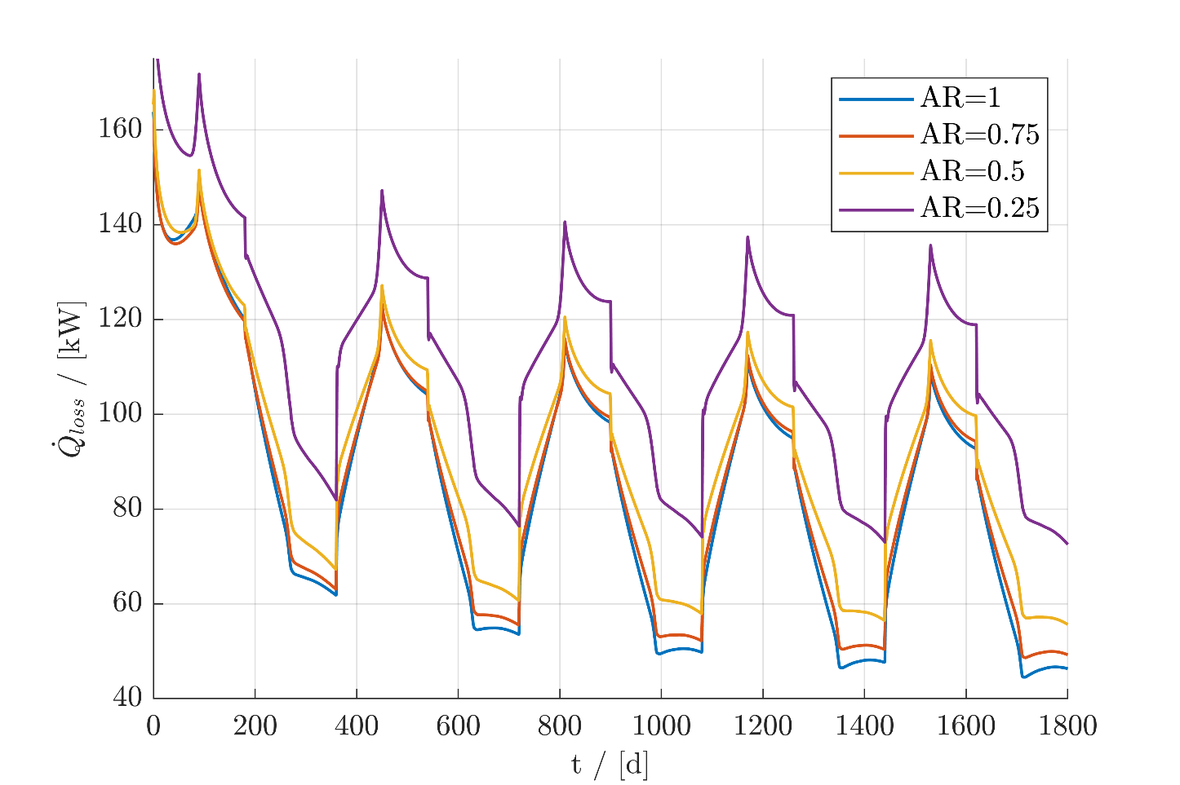

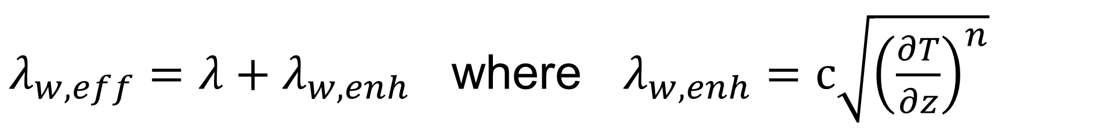
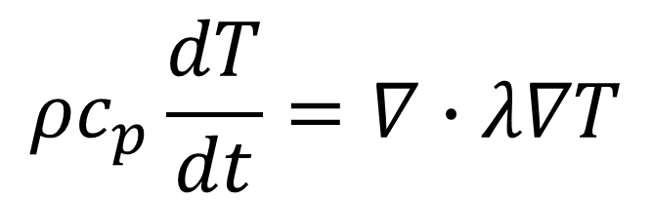
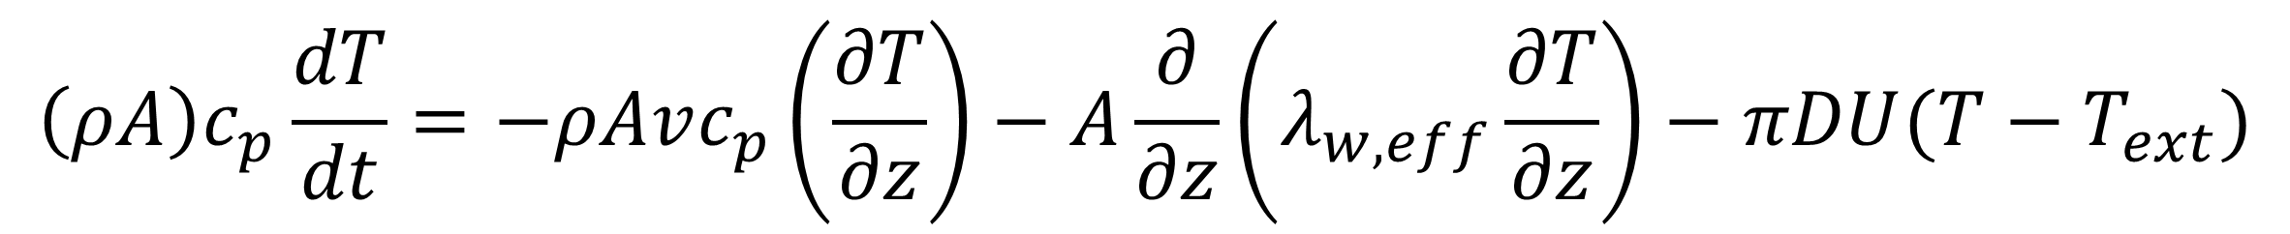
Development of a Numerical Model for Large-Scale Seasonal Thermal Energy Storage for District Heating Systems
A. Tosatto, A. Dahash, F. Ochs and M. Bianchi Janetti
Unit of Energy Efficient Buildings, Department of Structural Engineering and Material Sciences, University of Innsbruck, Innsbruck, Austria
INTRODUCTION
In district heating networks, Thermal Energy Storage (TES) systems are a good solution to decouple heat demand and its availability.
Figure 2. Total losses during the 5th year of operation for the cases without insulation (left) and with insulation (right).
Figure 1. Basic schema of the operation principle of a seasonal TES.
COMPUTATIONAL METHODS
Water domain
1-D model: energy balance equation is implemented using the PDE Interface Coefficient Form Boundary PDE.
Ground
2-D axial symmetric model: the heat transfer is modelled using the Heat Transfer in Solids interface in the Heat Transfer Module
$$\left(ρA\right)c_{p}\frac{dT}{dt}=−ρAvc_{p}\left(\frac{∂T}{∂z}\right)−A\frac{∂}{∂z}\left(λ_{w,eff}\frac{∂T}{∂z}\right)−πDU(T−T_{ext})$$
$λ_{w,eff}=λ+λ_{w,enh}$ where $λ_{w,enh}=c\sqrt{{\left(\frac{∂T}{∂z}\right)}^{n}}$
$${ρc}_{p}\frac{dT}{dt}=∇∙λ∇T$$
RESULTS
The aspect ratio (tank height over diameter) is varied to analyse the influence of the geometry on the distribution of the thermal losses.
Figure 4. Isothermal contour and flux distribution for the tank TES with AR=1 (upper figure) and AR=0.25 (lower figure), both with insulation .
CONCLUSIONS
Higher losses are observed in tanks with lower aspect ratio, because of the wider cover surface and the lower damping effect provided by the ground.
Aspect ratio alone is not a good parameter to define the performance of the TES, which is also strictly linked to the quality of the insulation.
The model validation is ongoing.
Figure 3. Thermal losses profile through the TES envelope for the case with insulation.
Acknowledgements: This project is financed by the Austrian “Klima- und Energiefonds” and performed in the frame of the program “Energieforschung”. It is part of the Austrian flagship research project “Giga-Scale Thermal Energy Storage for Renewable Districts” (giga_TES, Project Nr.: 860949). Therefore, the authors wish to acknowledge the financial support for this work.
Excerpt from the Proceedings of the 2019 COMSOL Conference in Cambridge

