Slide 1
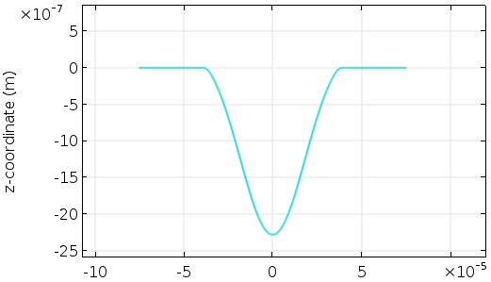
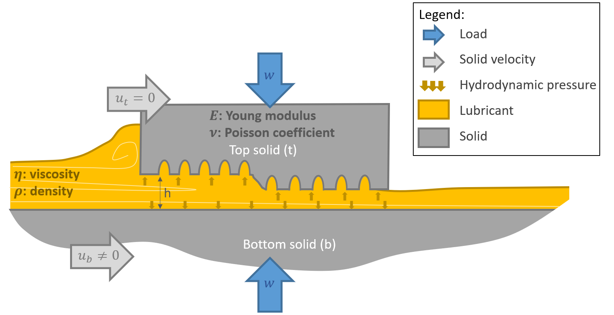
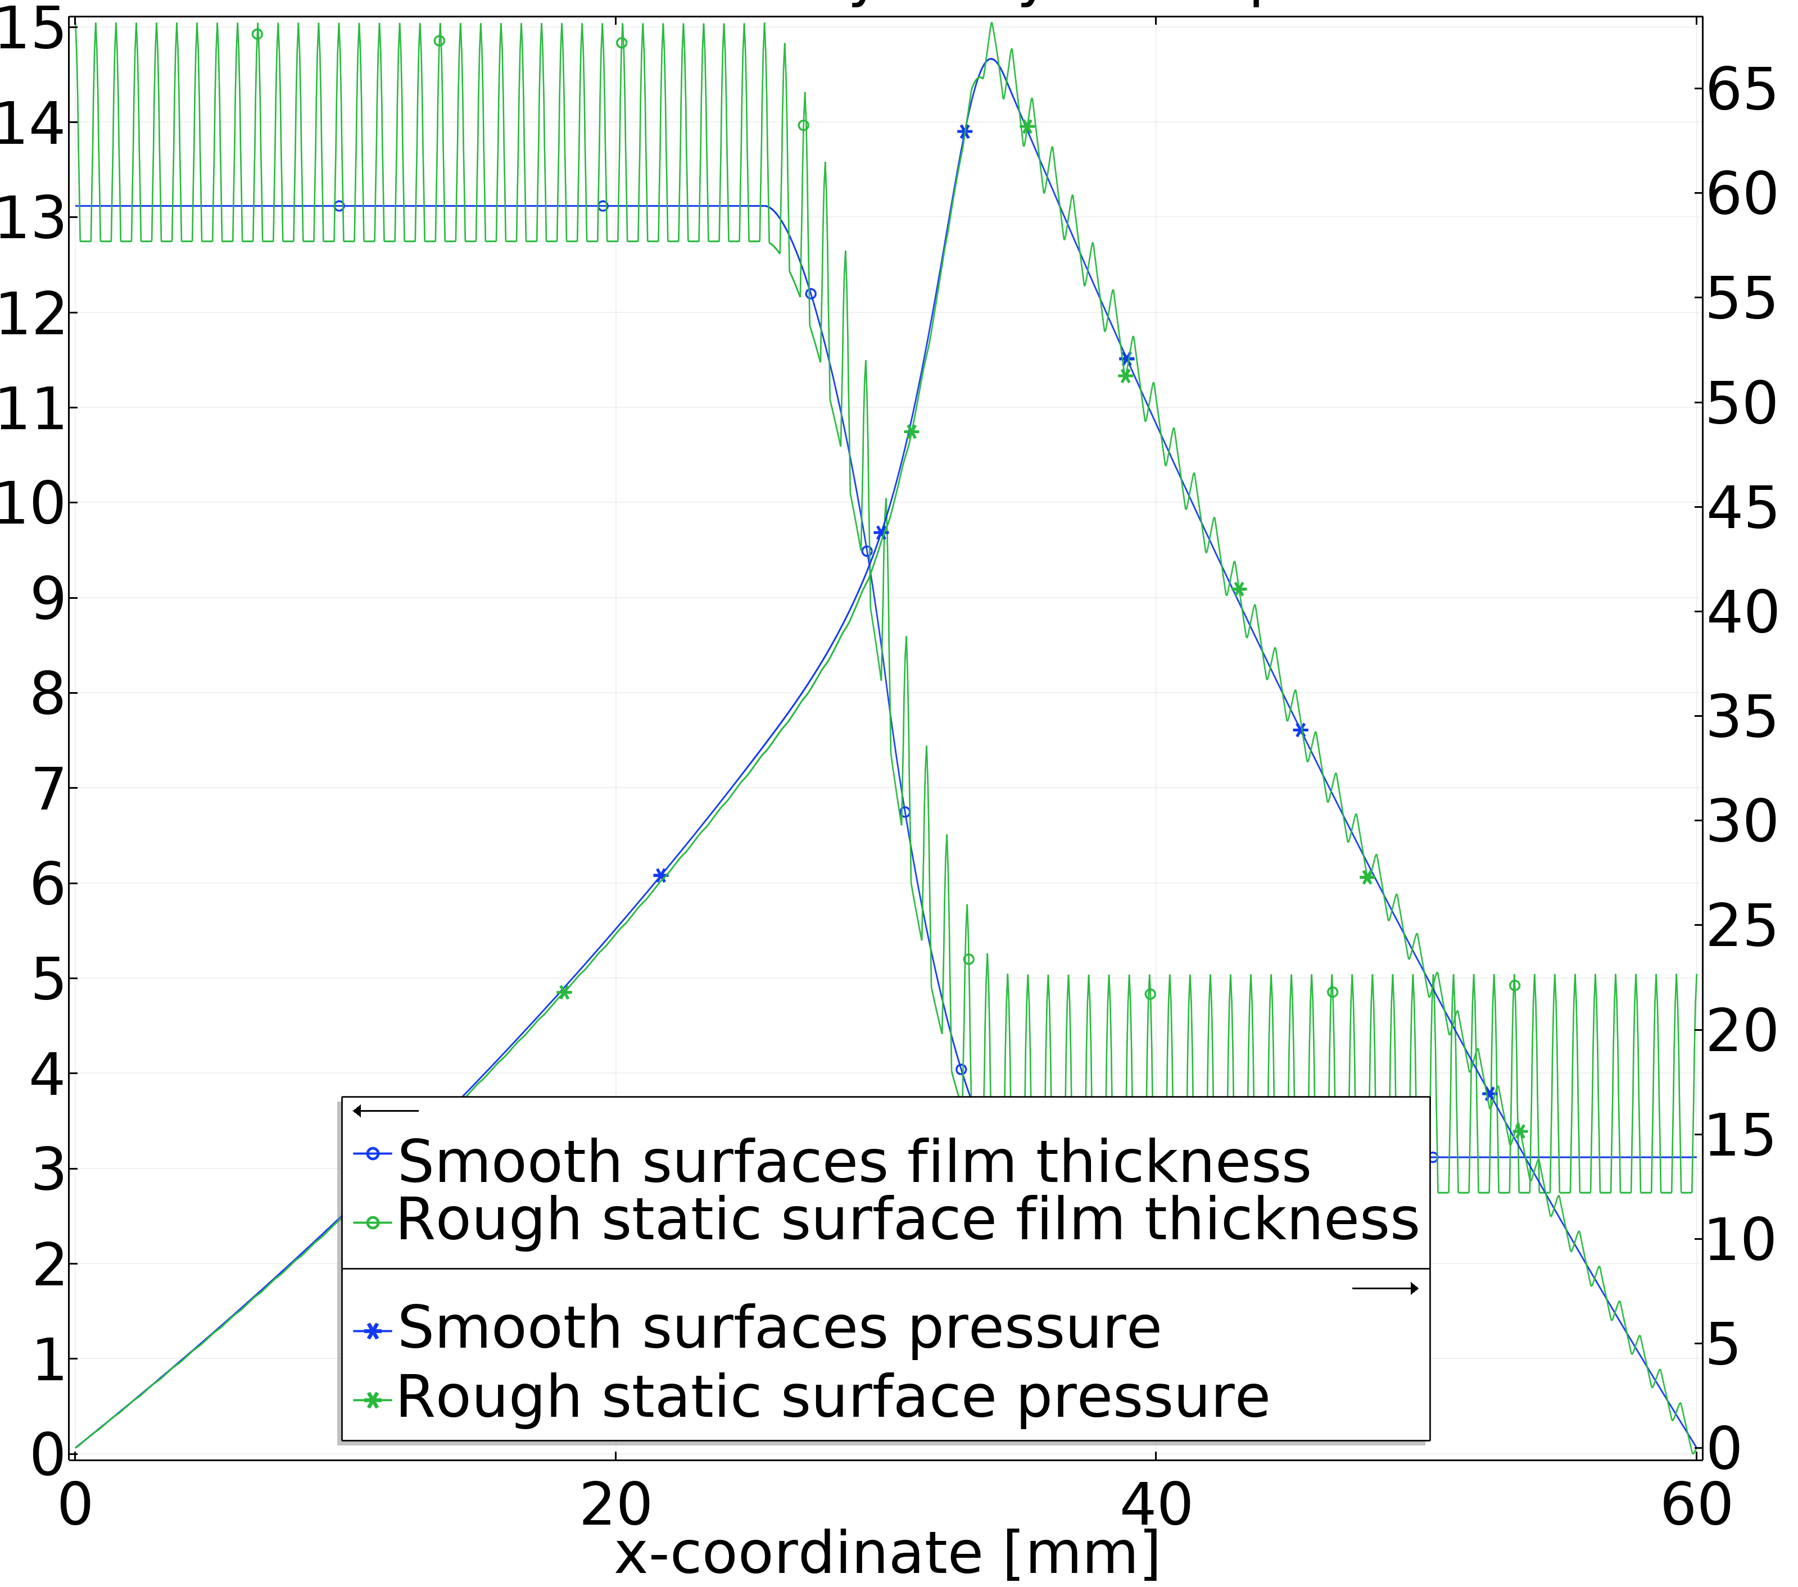
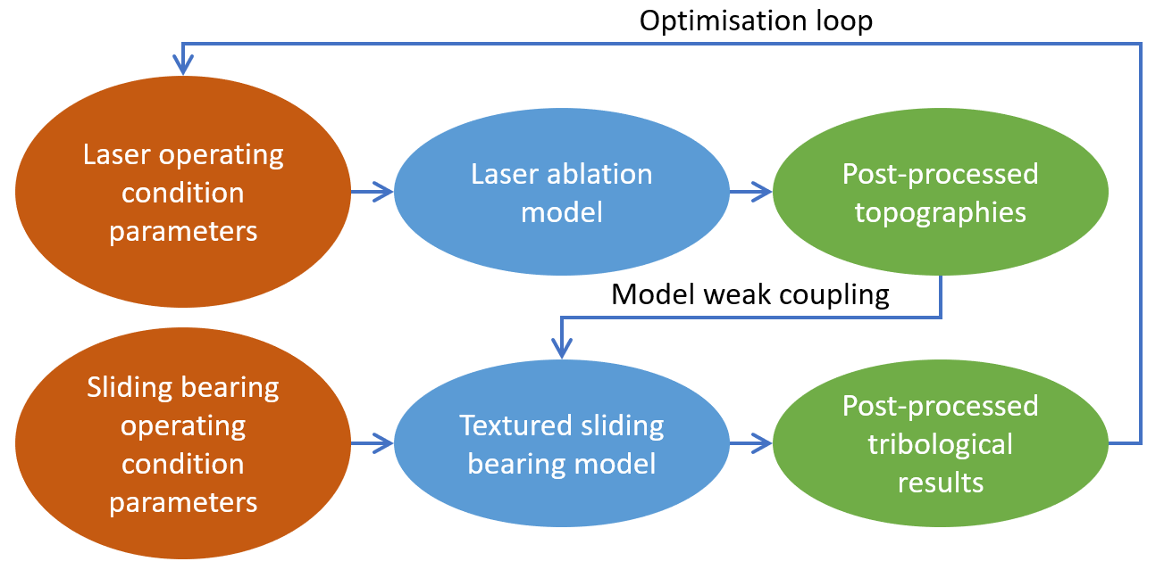


FROM THE LASER PARAMETERS TO THE TRIBOLOGICAL PROPERTIES WITH COMSOL MULTIPHYSICS®
V. Bruyère¹, J.-D. Wheeler¹, P. Namy¹
1. SIMTEC, Grenoble, France
INTRODUCTION: The engineer has mainly two methods to model lubricated contacts with textured surfaces: make a prototype of the considered surface and measure its topography or predict this topography through a modelling of the process applied to the contacting solids. Whereas the latter approach may require a complex model, it enables to test a wide range of the process operating conditions and their influence on the contact behaviour. The authors follow here the second method and apply it to the sliding bearing with laser surface texturing (see Figure 1).
This topography prediction can then feed the textured sliding bearing model which predicts its film thickness $h$ and hydrodynamic pressure distributions $p$ (see Figure 4). These two variables highly influence the lifespan of the bearing. This direct link between the two models allows for varying the laser parameters in a wide range for parametric or optimisation analysis of the sliding bearing model.
Laser ablation depth [m]
Cross crater abscissa [m]
Figure 1. Textured Rayleigh sliding bearing
Figure 3. Laser ablation model profile prediction. Exp. comparison in (1)
COMPUTATIONAL METHODS: In this work, a chain of continuum models has been used (see Figure 2). The laser ablation model⁽¹⁾ solves the heat equation in the solids on a deformed geometry. A localised heat flux represents the laser heating and the heated boundary deforms to accommodate the solid evaporation rate.
Film thickness [µm]
Pressure [MPa]
Sliding bearing abscissa [mm]
Figure 2. Model workflow
Figure 4. Textured sliding bearing model predictions of pressure and film thickness ; based on the laser ablation model results
The laser ablation model predicts the surface topography of a single crater and feeds the textured sliding bearing model with a topography pattern function $F$ (see Figure 3). The textured sliding bearing model⁽²⁾ is mainly composed of Reynolds equation:
$\frac{∂}{∂x}\left(\frac{ρh^{3}}{12η}\frac{∂p}{∂x}\right)−\frac{u_{b}}{2}·\frac{∂\left(ρh\right)}{∂x}=0$
with $η$ the lubricant viscosity, $ρ$ the lubricant density and $h$ the film thickness:
$$h=h_{0}+h_{r}+F$$
CONCLUSIONS: This chaining between two complex models demonstrates the flexibility that modelling can bring to innovative product development. Together they allow to realistically create surfaces to optimise bearing losses or lifespan. Even if the models come from different research backgrounds, they can be intimately related and enable a new level of device performance.
RESULTS: The laser ablation model provides topography predictions at an early stage of the development of a new textured sliding bearing (i.e. before any prototype, see Figure 3).
REFERENCES:
E.C. Chevallier, V. Bruyère, T. See, P. Namy, Laser Texturing Modelling using COMSOL Multiphysics ®, COMSOL Conference in Lausanne, 22nd-25th October 2018
J.-D. Wheeler1, V. Bruyere1, P. Namy1, When precise numerical predictions come to the rescue of liquid lubrication, COMSOL Conference in Lausanne, 22nd-25th October 2018
Excerpt from the Proceedings of the 2019 COMSOL Conference in Cambridge

