Slide 1

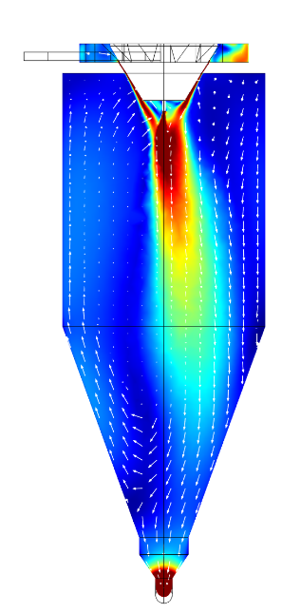
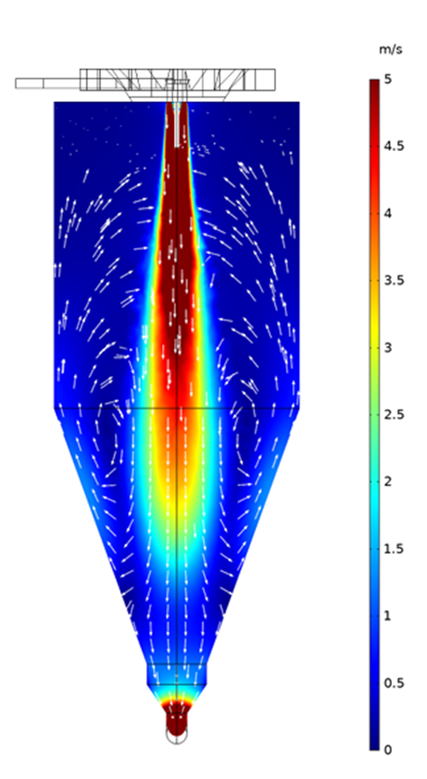
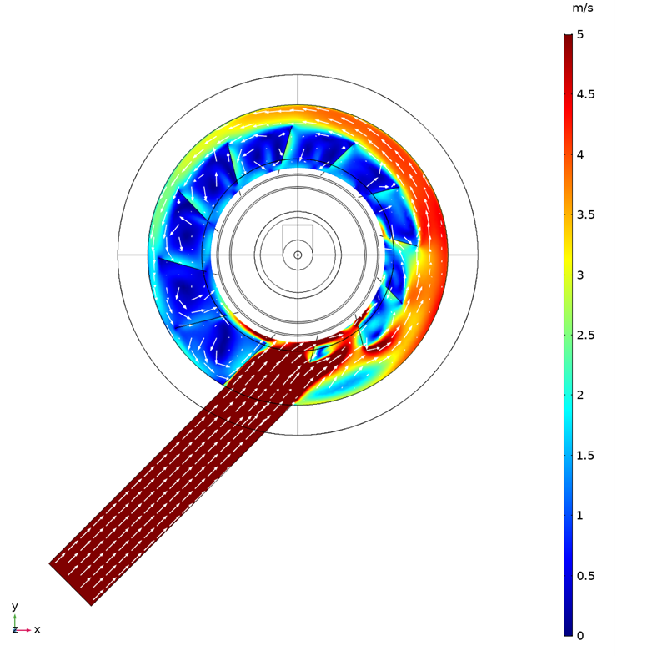
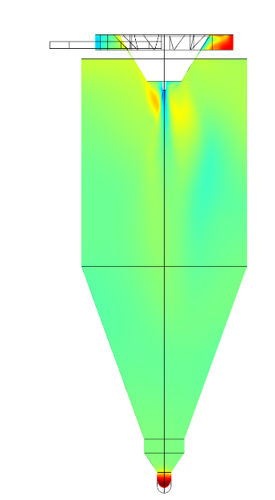
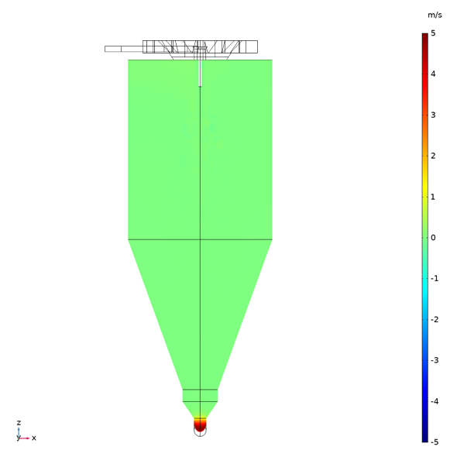
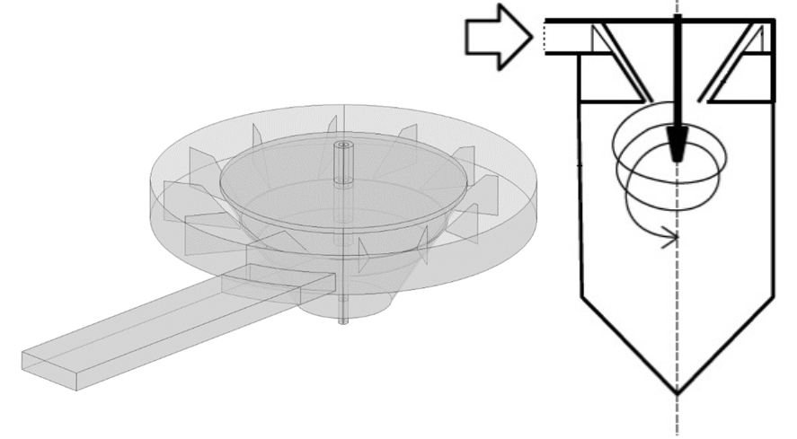
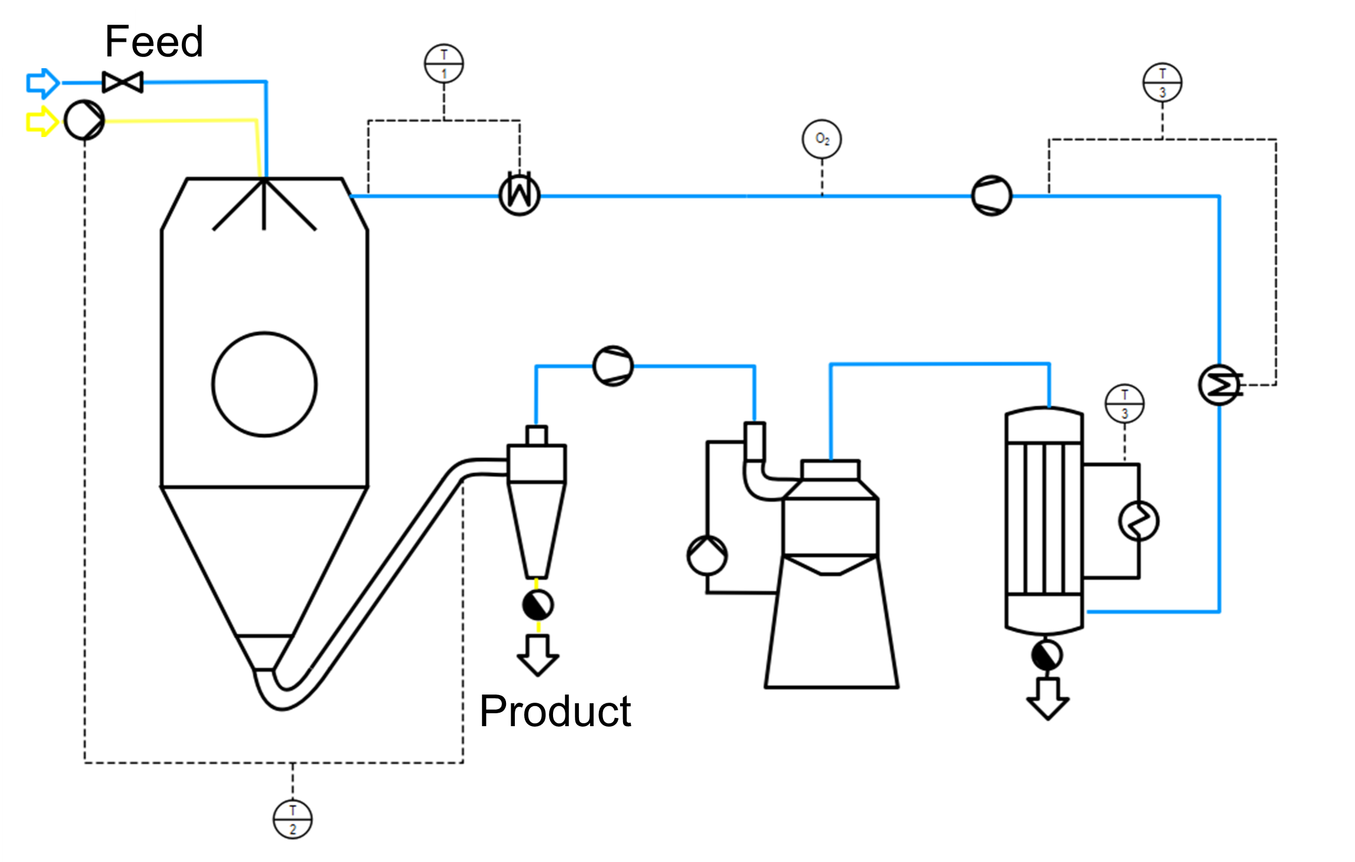
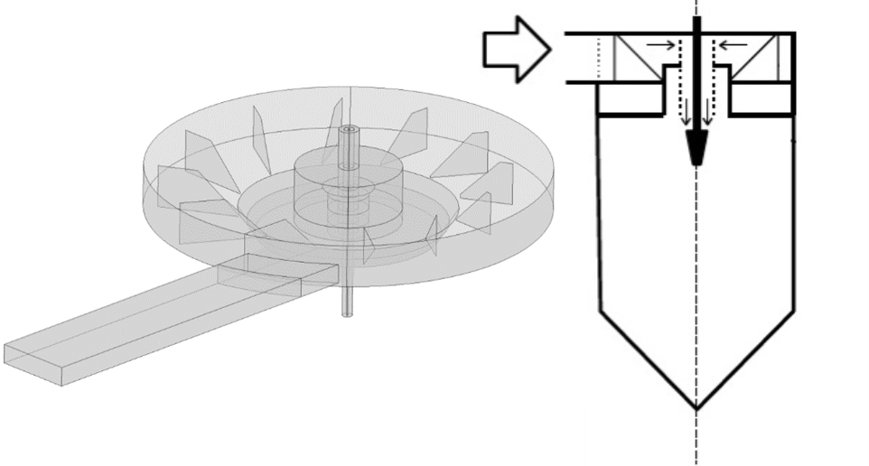
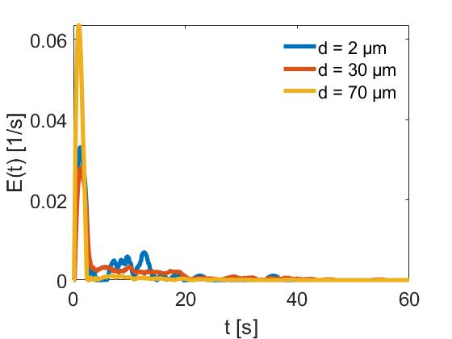
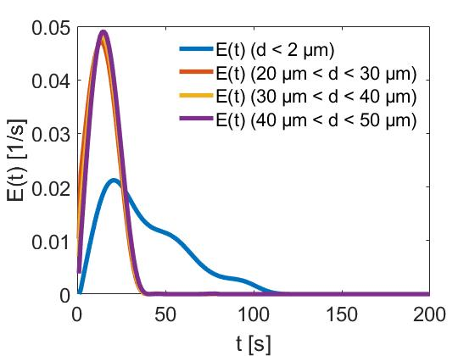
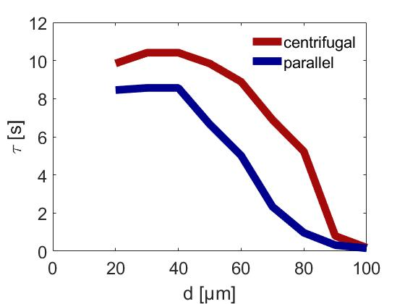
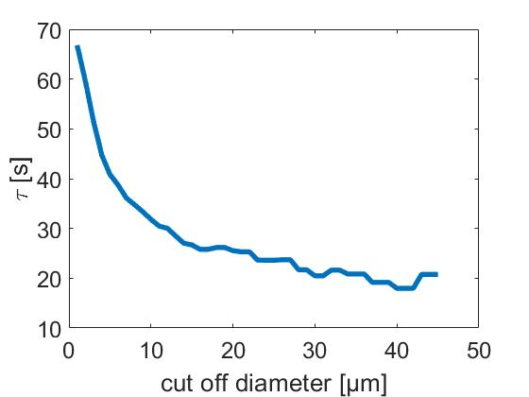
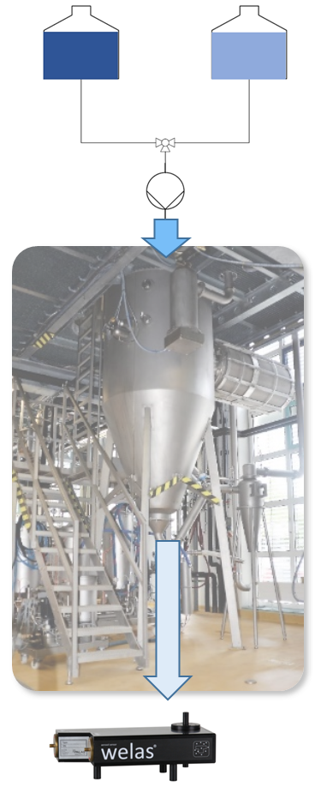
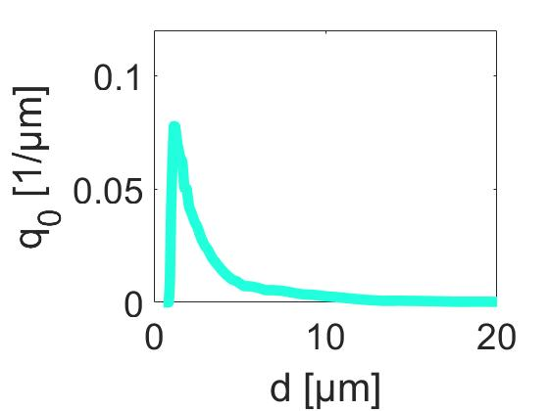
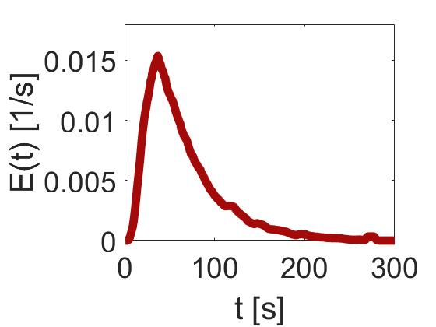
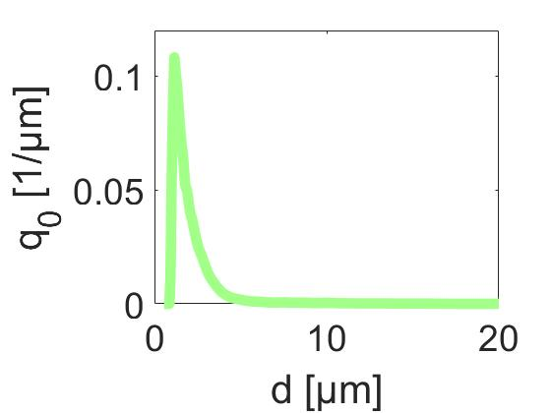
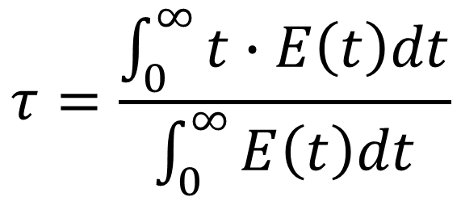
Modelling and measurement of the particle size dependent residence time distribution in spray drying
N. Ruprecht, J. Senge, H. Teichmann, R. Kohlus
Process Engineering and Food Powders, University of Hohenheim, Stuttgart, BW, Germany
Introduction
Spray drying is a commonly used method to produce a powder out of a liquid and is widely used in the food industry. During spray drying, the liquid is atomised into hot air and dried in the drying chamber within seconds to minutes. The residence time, which is the contact time of the product with the drying medium, is of great importance as it is a trade-off between the removal of moisture and thermal damage to the product. The residence time distribution (RTD) is therefore a key parameter for the resulting product quality.
In this study, the air flow pattern and resulting particle residence time distribution for different particle sizes with two different air distributors were modelled and compared to a novel measurement technique.
Results
Flow profile – different air distributors
The initial swirl of the flow is maintained by the centrifugal air distributor
Velocity air distributor plates
Centrifugal air distributor
Velocity profile centrifugal (left) and parallel (right) air distributor
Y- component of velocity for centrifugal (left) and parallel (right) air distributor
Residence time distribution
Parallel air distributor
Model | Measurement
Normalized concentration over time for different particle sizes (parallel air distributor)
Mean residence time in dependency of particle size
Computational Methods
A full 3D model of a pilot plant spray dryer (1.2 m diameter, 2.85 m height) was developed using COMSOL Multiphysics®.
The air flow pattern in the drying chamber was modelled using CFD Module and the residence time distribution for different particle size fractions was obtained using the Particle Tracing Module with a particle counter at the dryer outlet.
From the particle number as a function of time, the mean residence time was calculated.
$$τ=\frac{\int_{0}^{∞}{t∙E\left(t\right)dt}}{\int_{0}^{∞}{E\left(t\right)dt}}$$
Big particles show shorter mean residence time and more narrow distribution
→ follow central core of flow profile
Measurement
Conclusion
Model and measurement show similar trends, thus proving the suitability of the measurement for model validation.
The particle residence times increased for the centrifugal air distributor in comparison to the parallel air distributor due to additional swirl.
Both model and measurement show a dependency of the particle residence time on particle size.
As the residence time is dependent on the particle size and density - which both change during drying - a drying model will be implemented.
.
Injection of a pulse of feed solution in a continuous water stream → Particle concentration and size measured continuously by a scattered light detector (Aerolossensor welas 2300, Palas, Karlsruhe, Germany) connected to the outlet of the drying chamber.
Particle size distribution at t₁
Normalized concentration
Particle size distribution at t₂

