Slide 1
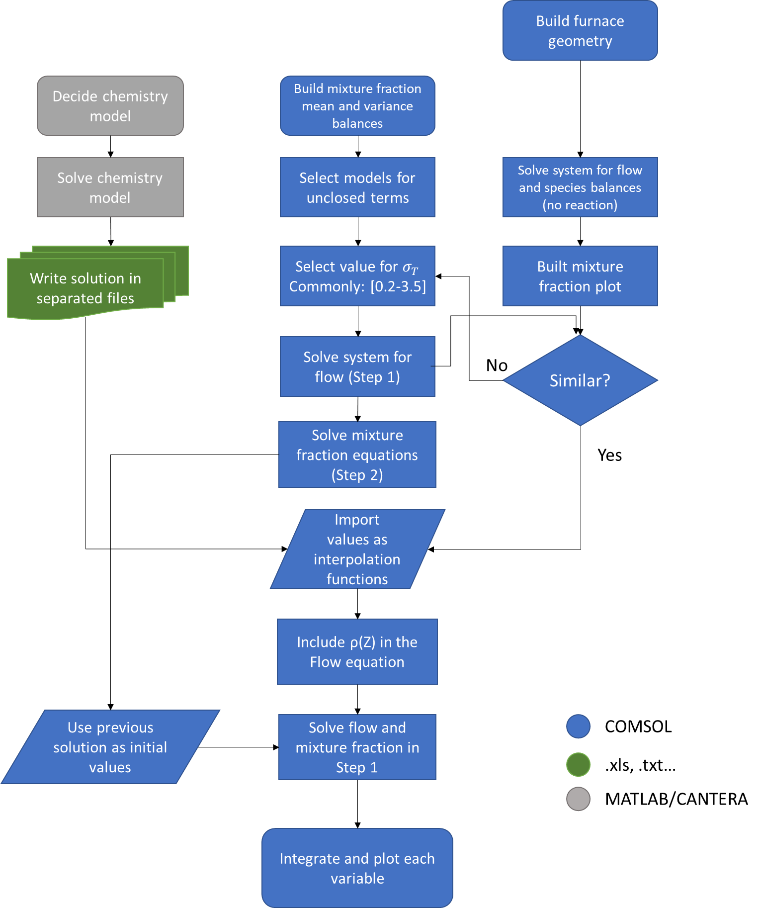
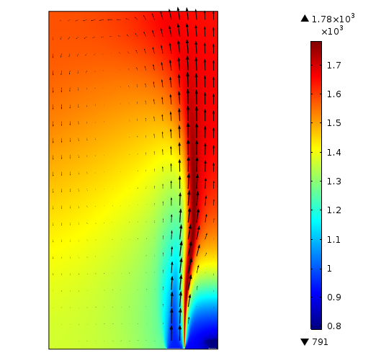
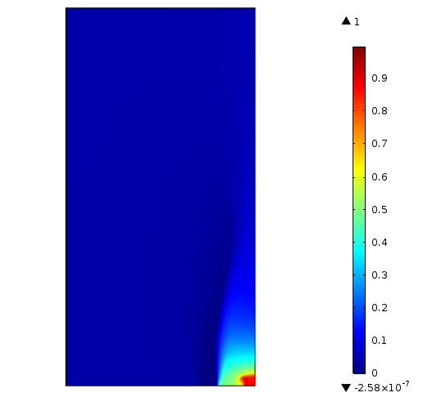
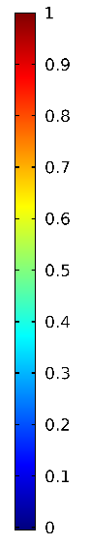
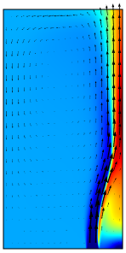
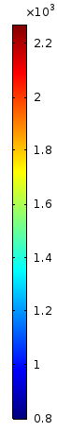
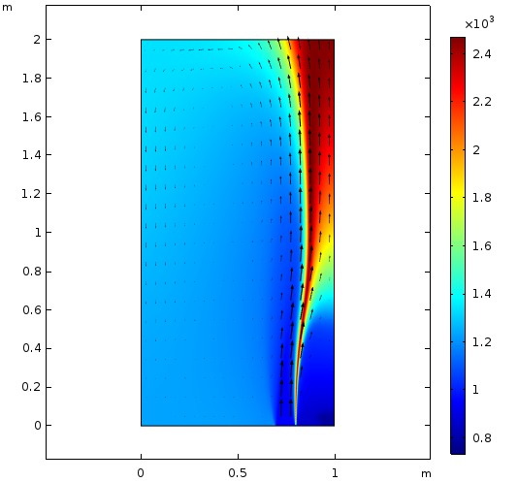
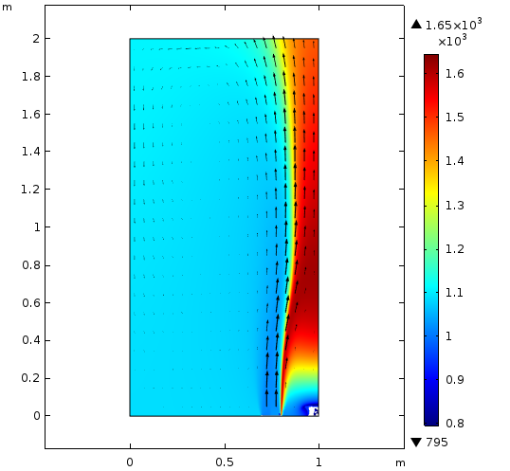
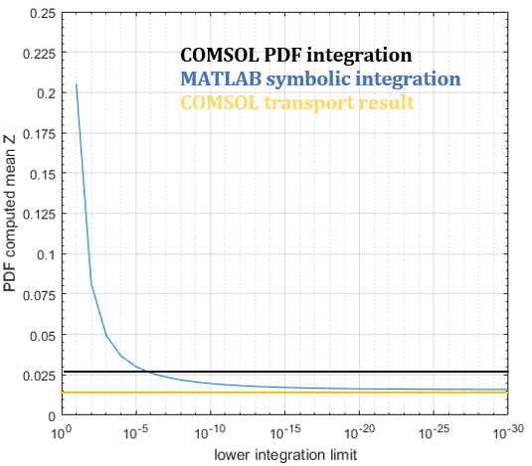
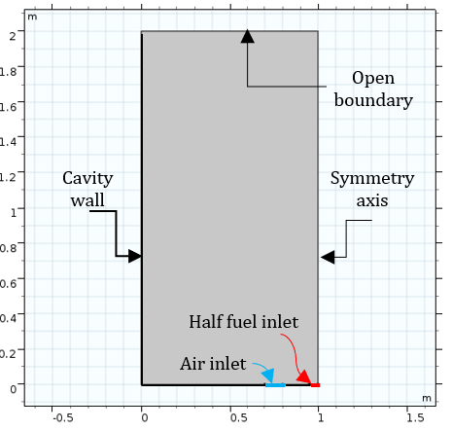

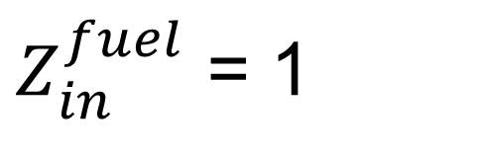


Presumed Beta-PDF Model for the Prediction of the NOx
and CO Emissions in Combustion Chambers
A. Martínez González, P. Nakate, D. Lahaye
TU Delft, Delft, the Netherlands
Presumed β-PDF mixture fraction model:
This mathematical model can describe the mean thermochemical state and its variation by computing the transport equation of just 3 variables.
Procedure:
K
T
Z
Integrate each variable in MATLAB
Figure 1. Temperature profile of a simple square burner and the
corresponding mean of the mixture fraction profile
Figure 3. Flowchart to successfully used a presumed
PDF model in COMSOL.
COMPUTATIONAL METHODS: The stabilized convection-diffusion equation interface and the k-ε flow interface were used:
$$∇·\left(\overline{ρ}\tilde{uZ}\right)−∇·\left(\left(\frac{μ_{T}+μ}{σ_{T}}\right)∇\overline{Z}\right)=0$$
$$\overline{ρ}\overline{u}·∇\left[\overline{{Z^{′}}^{2}}\right]−∇\left(C\frac{μ_{T}}{σ_{T}}·∇\overline{Z^{2}}\right)−∇\left(\left(\frac{μ+{2μ}_{T}}{σ_{T}}\right)∇\overline{Z^{′2}}\right)+2\overline{ρ}\frac{ε}{k} \overline{{Z^{′}}^{2}}=0$$
$$P\left(Z\right)=\frac{Z^{α−1}·{\left(1−Z\right)}^{β−1}}{\int_{0}^{1}{{Z^{+}}^{α−1}·{\left(1−Z^{+}\right)}^{β−1}dZ^{+}}}$$
$$\tilde{φ}\left(Z\right)=\int_{0}^{1}{φ\left(Z^{+}\right)P\left(Z^{+}\right)dZ^{+}}$$
An equilibrium chemistry model (Potential Element Method) defined the thermochemical state. The model was applied to a squared 2D open furnace.
RESULTS:
ER = 1
$Z_{in}^{air}$ = 0
Fuel inlet velocity = 5 m/s
$Z_{in}^{fuel}$ = 1
Feed inlet temp = 800 K
ΔP = 0
K
K
K
Post-processing
EDS model
Mixture fraction model
PDF model
Figure 5. Temperature field comparison between different models.
CONCLUSIONS:
A more realistic temperature profile was found. (This is key for NOx fraction prediction)
It is possible to predict the amount of unburnt fuel, even with simple models.
Adding the energy balance would provide more realistic results and should be the next step.
REFERENCES:
Grégoire, F. and L. Gosselin, Comparison of three combustion models for simulating anode baking furnaces, Vol. 129, 532-544, (2018)
Wrobel, J.R., Application of the Element Potential Method to Gaseous Chemical Equilibrium Calculation. California Institute of Technology. (1963)
Veynante, D. and L. Vervisch, Turbulent combustion modeling. Progress in Energy and Combustion Science, 28(3): p. 193-266, (2002)
Figure 2. Geometry employed in the study.

