Slide 1


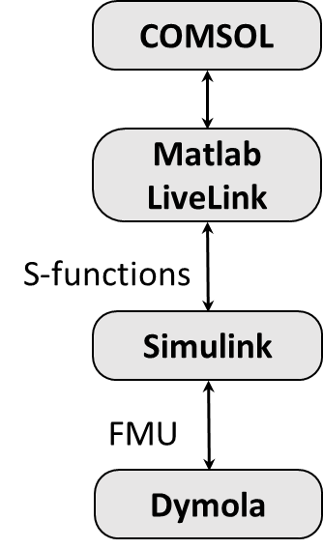
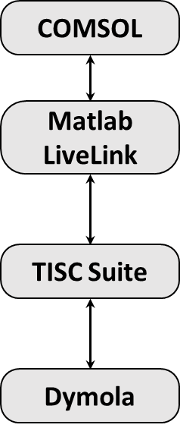
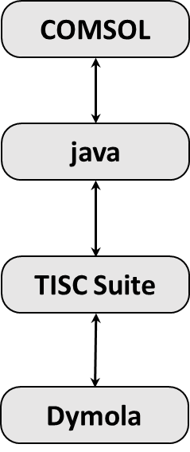
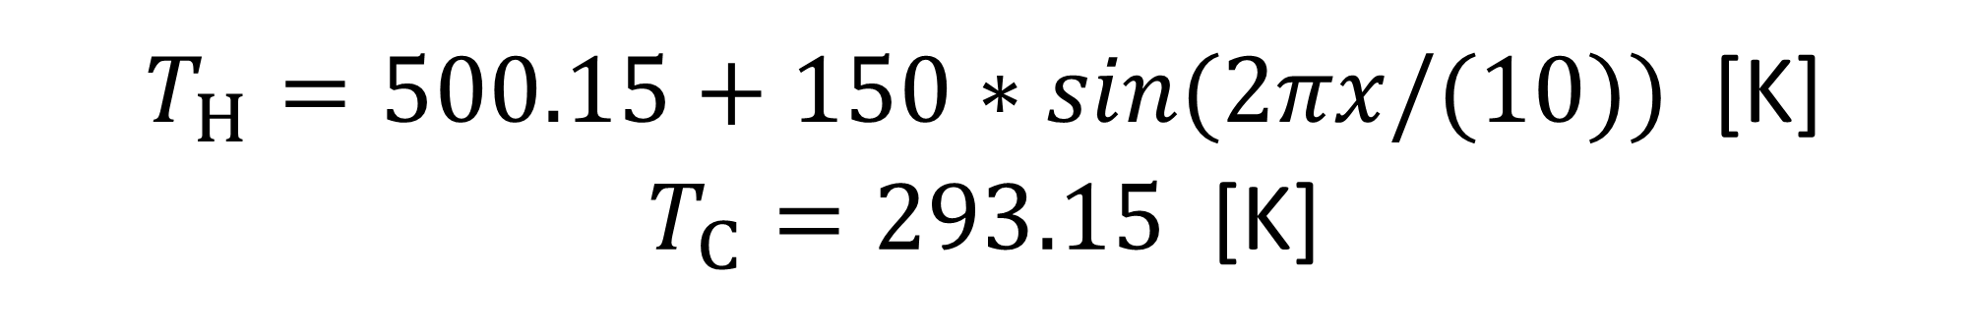
Please leave at least a 25mm margin on all sides to avoid cropping during printing. Remove this text box before submitting.
Co-Simulation of Dynamic Energy System Simulation and COMSOL Multiphysics®
A. Dahash, F. Ochs and A. Tosatto,
Unit of Energy Efficient Buildings, Department of Structural Engineering and Material Sciences, University of Innsbruck, Innsbruck, Austria
INTRODUCTION:
COMSOL Multiphysics® is used to develop a numerical model for a large-scale thermal energy storage (TES) in a renewable-district heating (R-DH) system.
R-DH system was implemented in a dynamic system simulation tool (Modelica/Dymola).
Thus, co-simulation approaches arise as a promising technique to couple both simulation tools.
Experimental Co-Simulation Setup and Results:
Model: 2-D stainless-steel rectangle with 2x1 m².
Physics: Heat Transfer in Solids.
Boundary conditions:
$T_{H}=500.15+150∗sin(2πx/(10))$ [K]
$T_{C}=293.15$ [K]
Examples of Co-Simulation in Energy Systems:
(a)
(b)
Figure 4. (a) Representation of the investigated case with the assigned boundary conditions, and (b) Sheet’s internal energy change over time where the blue line represents the co-simulation and the red line represents COMSOL benchmark.
Table 1. Computational performance comparison.
Case | Simulation time [sec]
COMSOL Benchmark | 2
Option Matlab LiveLink | 38
Option java | 54
Please leave at least a 25mm margin on all sides to avoid cropping during printing. Remove this text box before submitting.
Figure 1. A possible co-simulation whereby R-DH system involving the generation (heat sources, buffer storage and heating back-up unit) and demand (load) with the control unit developed in Modelica/Dymola, whilst TES and surroundings developed in COMSOL Multiphysics.
Discussion and Conclusions:
The co-simulation results show the pattern of the so-called “ping-pong” approach.
Both options with TISC Suite work and deliver results.
Matlab LiveLink option outperforms java option.
Yet, both suffer from the long execution time.
Both are infeasible in terms of computation efforts.
Figure 2. A possible co-simulation scenario between TES model in Dymola and ground model in COMSOL.
Co-Simulation of COMSOL Multiphysics:
Figure 5. Schematic representation of ping-pong co-simulation.
Acknowledgements: This project is financed by the Austrian “Klima- und Energiefonds” and performed in the frame of the program “Energieforschung”. It is part of the Austrian flagship research project “Giga-Scale Thermal Energy Storage for Renewable Districts” (giga_TES, Project Nr.: 860949).
Figure 3. Co-simulation options for COMSOL Multiphysics and Modelica/Dymola.
Excerpt from the Proceedings of the 2019 COMSOL Conference in Cambridge

