Slide 1
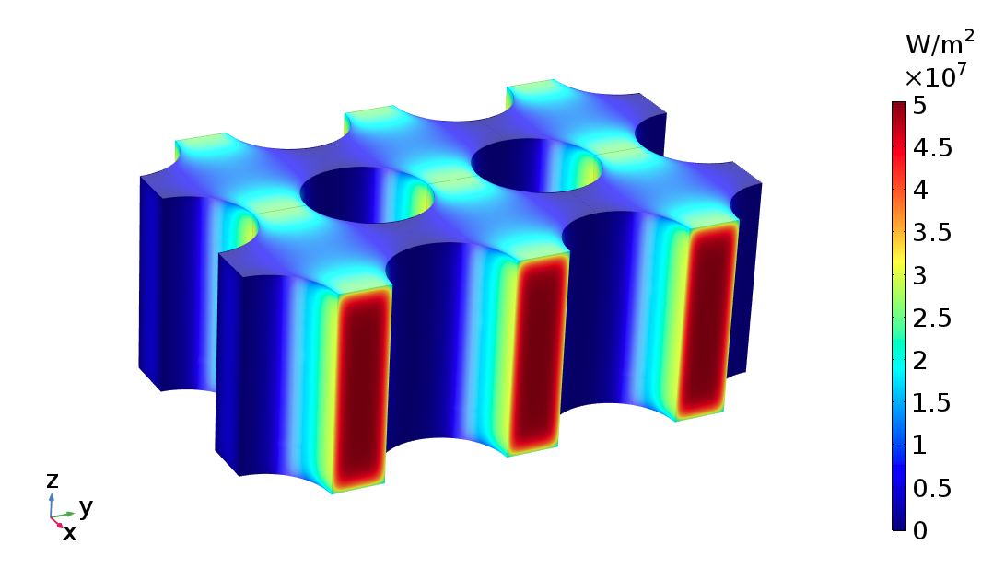
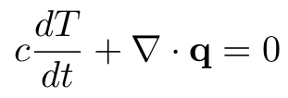

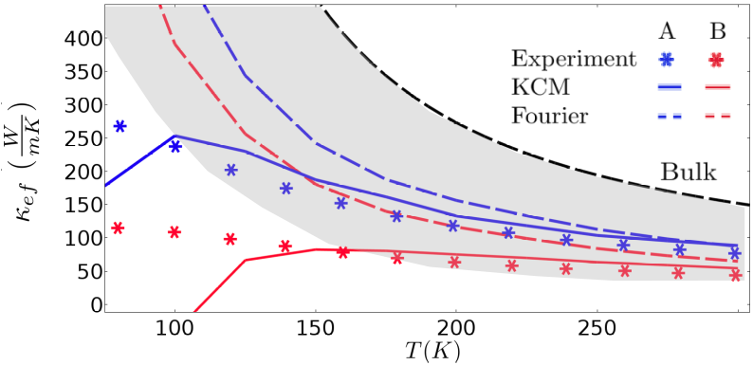


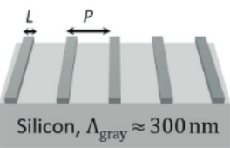
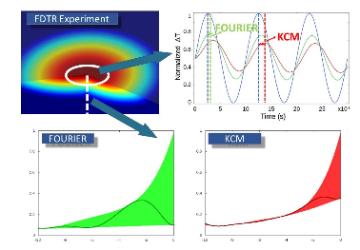
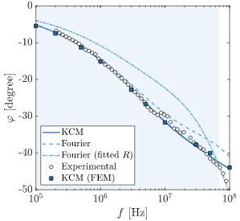
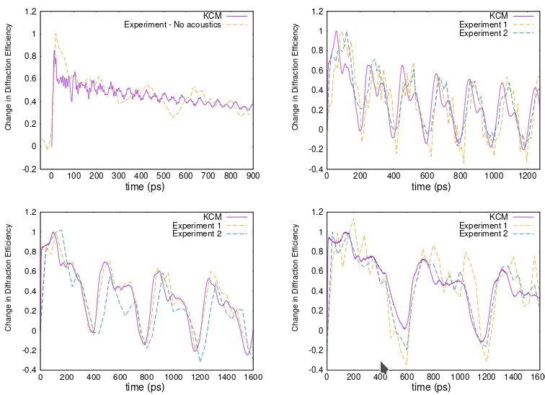
Hydrodynamic Heat Transport Model for nanoscale electronic devices with complex geometries including metal-semiconductor interfaces
A. Beardo¹, L.Sendra¹,J. Camacho¹,J. Bafaluy¹,F. X. Alvarez¹,
1. Universitat Autònoma de Barcelona, Physics Department, Bellaterra 08193, Spain
We present the Kinetic Collective Model (KCM), consisting in the hydrodynamic heat transport equation with ab initio calculated coefficients and the corresponding boundary conditions. This model generalizes Fourier’s law and can be solved using Finite Elements to predict the thermal response of electronic devices with complex geometries. We validate the model for Silicon in a variety of experiments including metal-semiconductor interfaces.
KINETIC COLLECTIVE MODEL
Energy Conservation Equation
Hydrodynamic Heat Transport Equation
Slip Boundary Condition (implemented using Discontinuous Galerkin Method)
Metal-Semiconductor Interface Condition
SILICON COMPLEX NANOSTRUCTURES
HEATER GEOMETRY EFFECTS IN THE COOLING EFFICIENCY OF ELECTRONIC NANODEVICES
FREQUENCY DOMAIN THERMOREFLECTANCE
Study of the mechanical relaxation of laser-pulse heated periodic nanoheaters on top of a Silicon substrate.
Substrate thermal response when a periodic laser pulse
with variable frequency is applied. The phase lag between the heating pulse and the temperature is predicted.
The KCM is coupled with the Solid Mechanics COMSOL
Interface to predict the deformation of the heaters, which is measured experimentally through the diffraction pattern.
L=20nm P=400nm
L=250nm P=1000nm
L=500nm P=2000nm
L=750nm P=3500nm
REFERENCES:
P. Torres. Emergence of hydrodynamic heat transport in semiconductors at the nanoscale. Physical Review Materials, 2(7):076001, 2018.
2. A. Ziabari. Full-field thermal imaging of quasiballistic cross-talk reduction in nanoscale devices. Nature Communications 9:255, 2018.
3. A. Beardo. Hydrodynamic Heat Transport in Silicon compact and holey thin Films.
Physical Review Applied 11, 034003 (2019)
4. A. Beardo. Phonon hydrodynamics in frequency domain thermorereflectance experiments.
Submitted article.
Notes:
<number>

