Slide 1


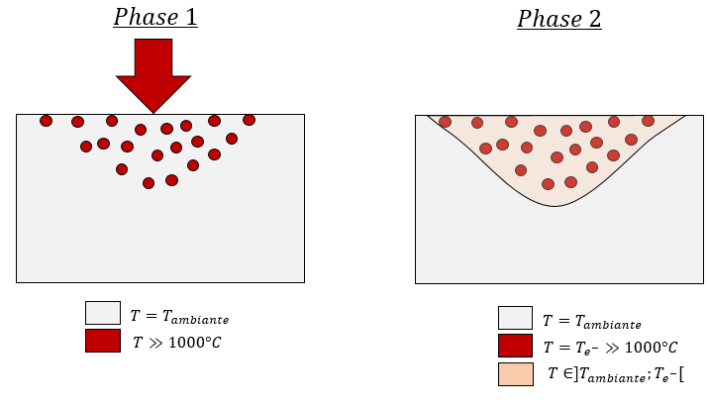
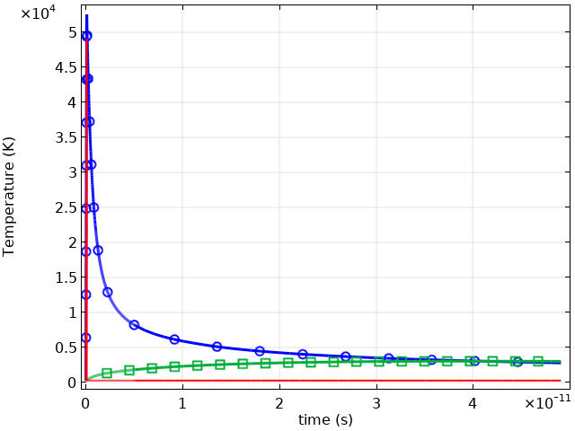
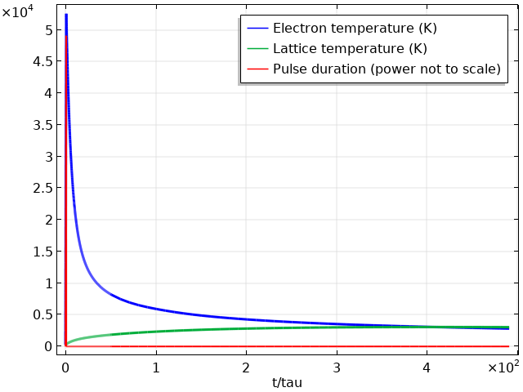
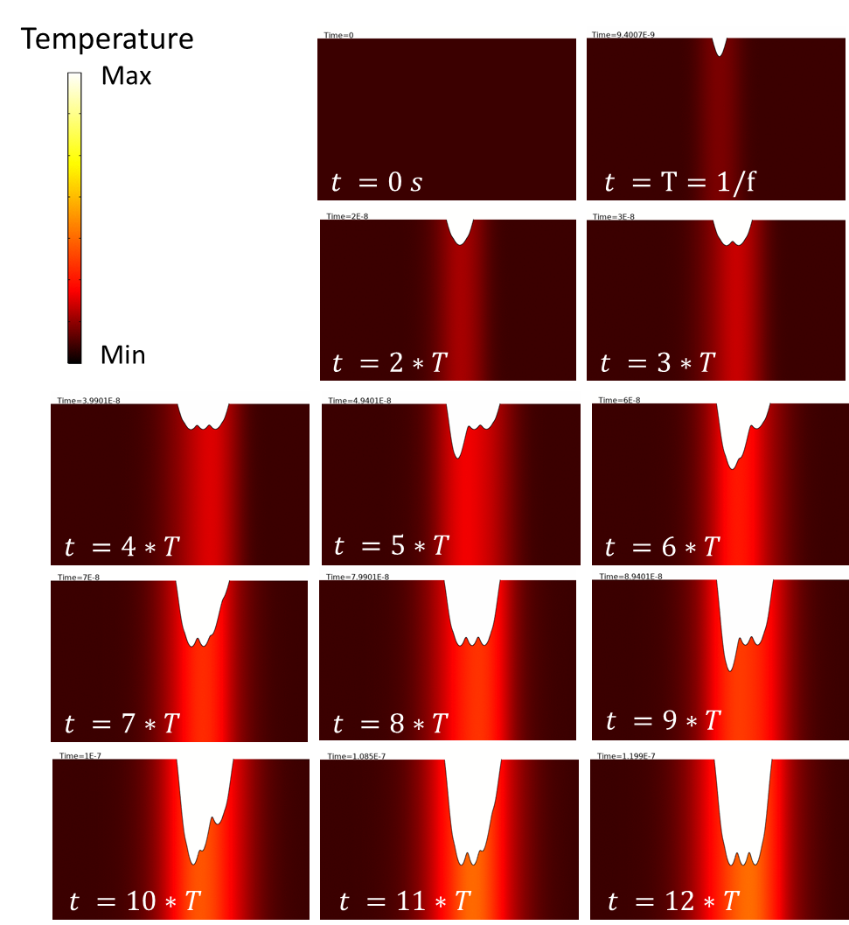





Femto-second laser texturing prediction using COMSOL Multiphysics®
E.C. Chevallier¹, V. Bruyère¹, G. Bernard² and P. Namy¹
¹: SIMTEC, Grenoble, France
²: GFMS, Meyrin, Switzerland
FEMTO-SECOND LASER TEXTURING:
Laser surface texturing (LST) is a non-contact process that shows excellent repeatability as well as the ability to achieve small-size features.
The use of ultra-short laser pulses in LST offers the possibility to reduce significantly the amount of molten material hence increase the quality of the finishing.
Developing laser surface texturing from the current trial-and-error, lab-scale concept to a highly predictable, data driven industrial approach.
This project has received funding from the European Union’s Horizon 2020 Framework Programme for research and innovation under grant agreement No 768701.
More info on www.sharkproject.eu
FEMTO-SECOND LASER ABLATION MODELLING:
Thermal problem: the Two-Temperature Model
Continuous model used to describe the time evolution of the temperatures of the sub-systems by coupled differential equations:
$$ρ_{e}C_{e}\frac{∂T_{e}}{∂t}=∇\left[k_{e}∇(T_{e})\right]−κ\left(T_{e}−T_{l}\right)+S\left(x,t\right)$$
$${ρ_{l}C}_{l}\frac{∂T_{l}}{∂t}=∇\left[k_{l}∇\left(T_{l}\right)\right]+κ\left(T_{e}−T_{l}\right)$$
Where $T$ is the temperature of the system, subscripts $e$ and $l$ denotes the electrons and the lattice respectively. $C, ρ$ and $k$ are the specific heat capacity, mass density and thermal conductivity. $κ$ is the electron-phonon coupling constant and $S(x,t)$ is the laser source term.
Phase 1
Phase 2
$T=T_{ambient}$
$T=T_{e^{−}}^{ }≫T_{vap}$
$T≈T_{vap}$
Figure 1: Energy transmission phases of the femto-second laser source to the lattice.
Temperature ($×{10}^{4}$K)
Laser ablation modelling
Numerical convective heat flux
$$Flux_{vap}=h∙\left(T−T_{vap}\right)$$
Where $h$ is a numerical parameter and $T_{vap}$ is the vaporization temperature.
Vaporization modelling using deformed geometry with the mesh velocity set at the liquid/gas interface :
$$v_{mesh}∙n=\frac{Flux_{vap}}{ρL_{v}}$$
Where $n$ is the surface normal vector and $L_{v}$ is the latent heat of vaporization.
Time (s)
Figure 2: Electron and lattice temperature evolution during the laser impact of 100 fs.
Model prediction possibilities:
It is possible to make predictions on the shape of a single and multi-impact craters.
Further work on the model would include the development and experimental validation of the prediction of the topography produced after hundreds of ultra-short laser impacts.
Figure 3: Multi-impact crater progression using fs laser ablation.
Keep this space clear for COMSOL use. Remove this text box before submitting.

