Slide 1
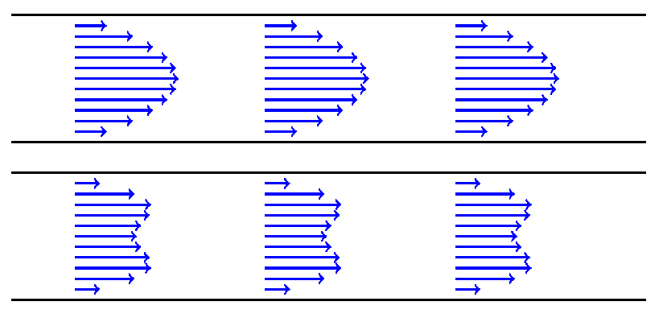
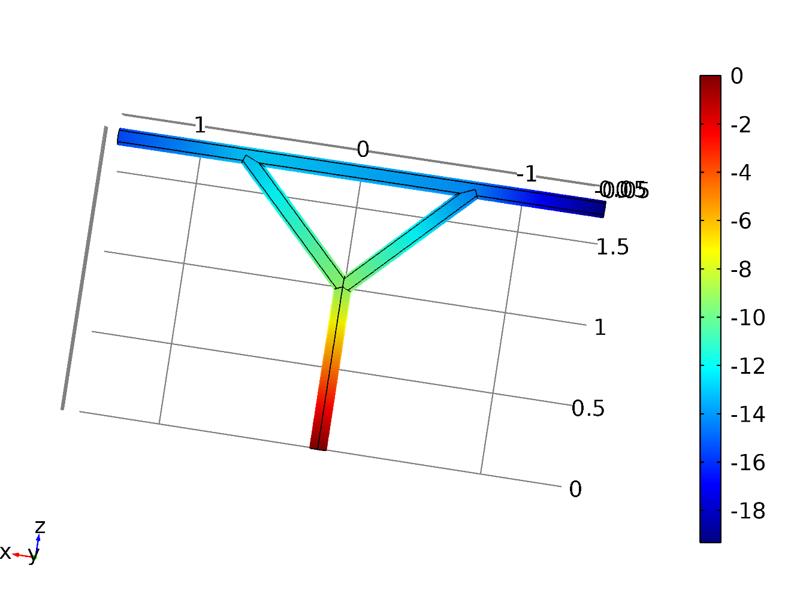
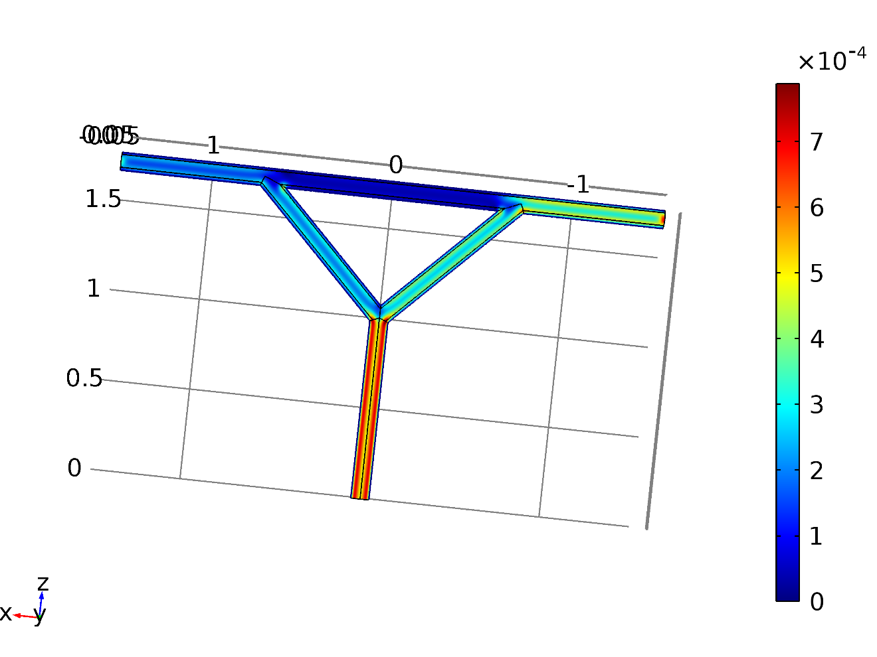
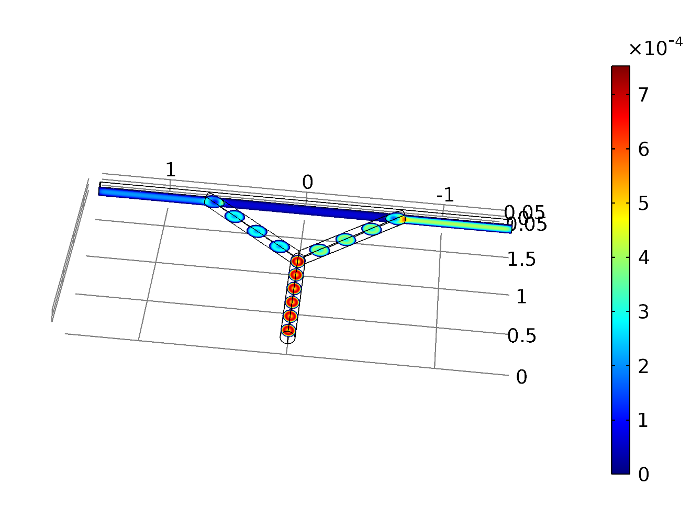
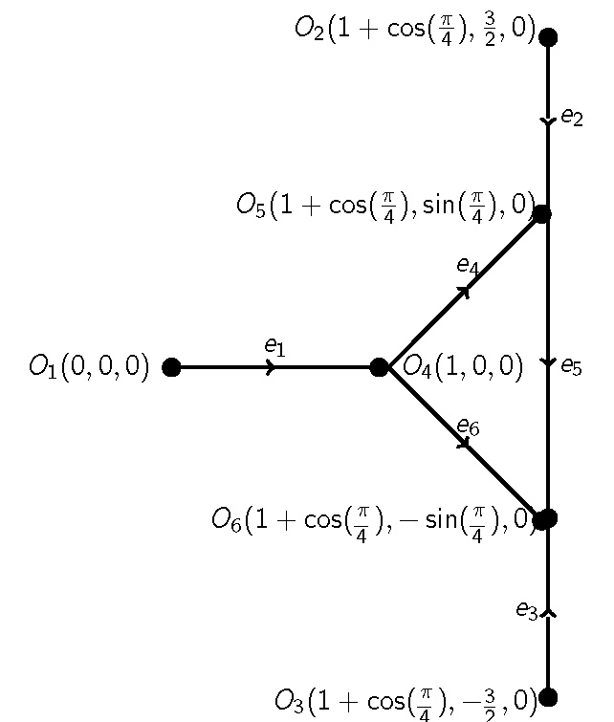
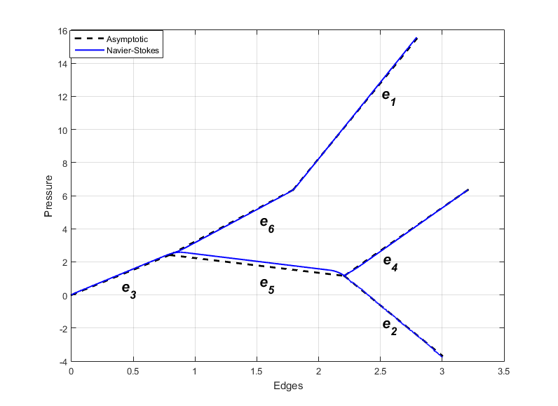
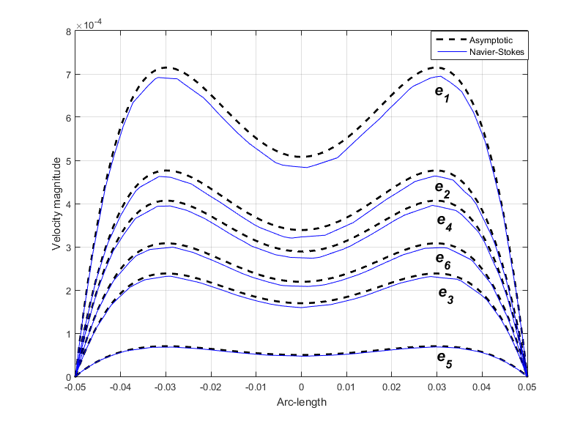
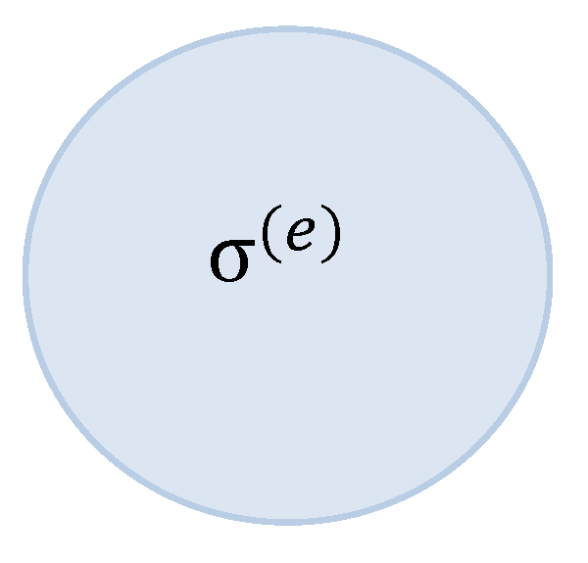
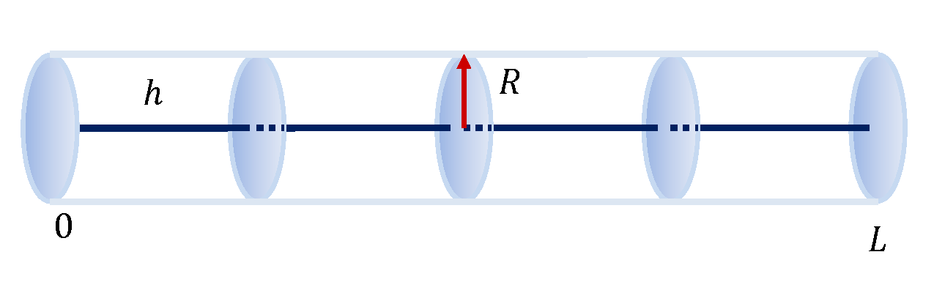
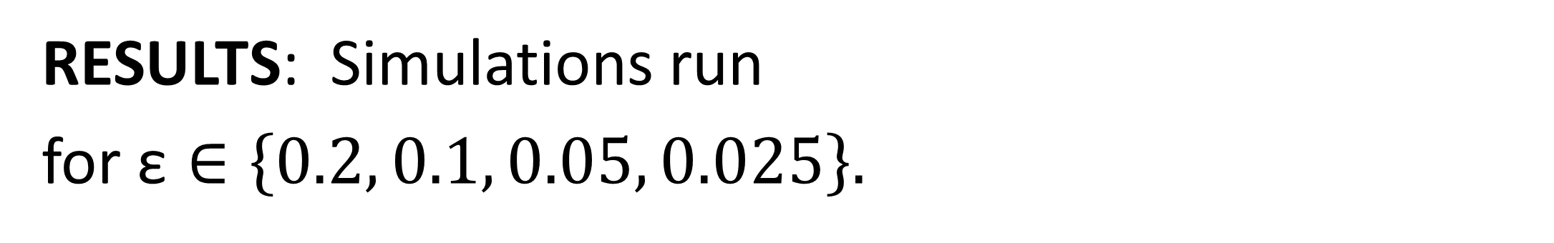
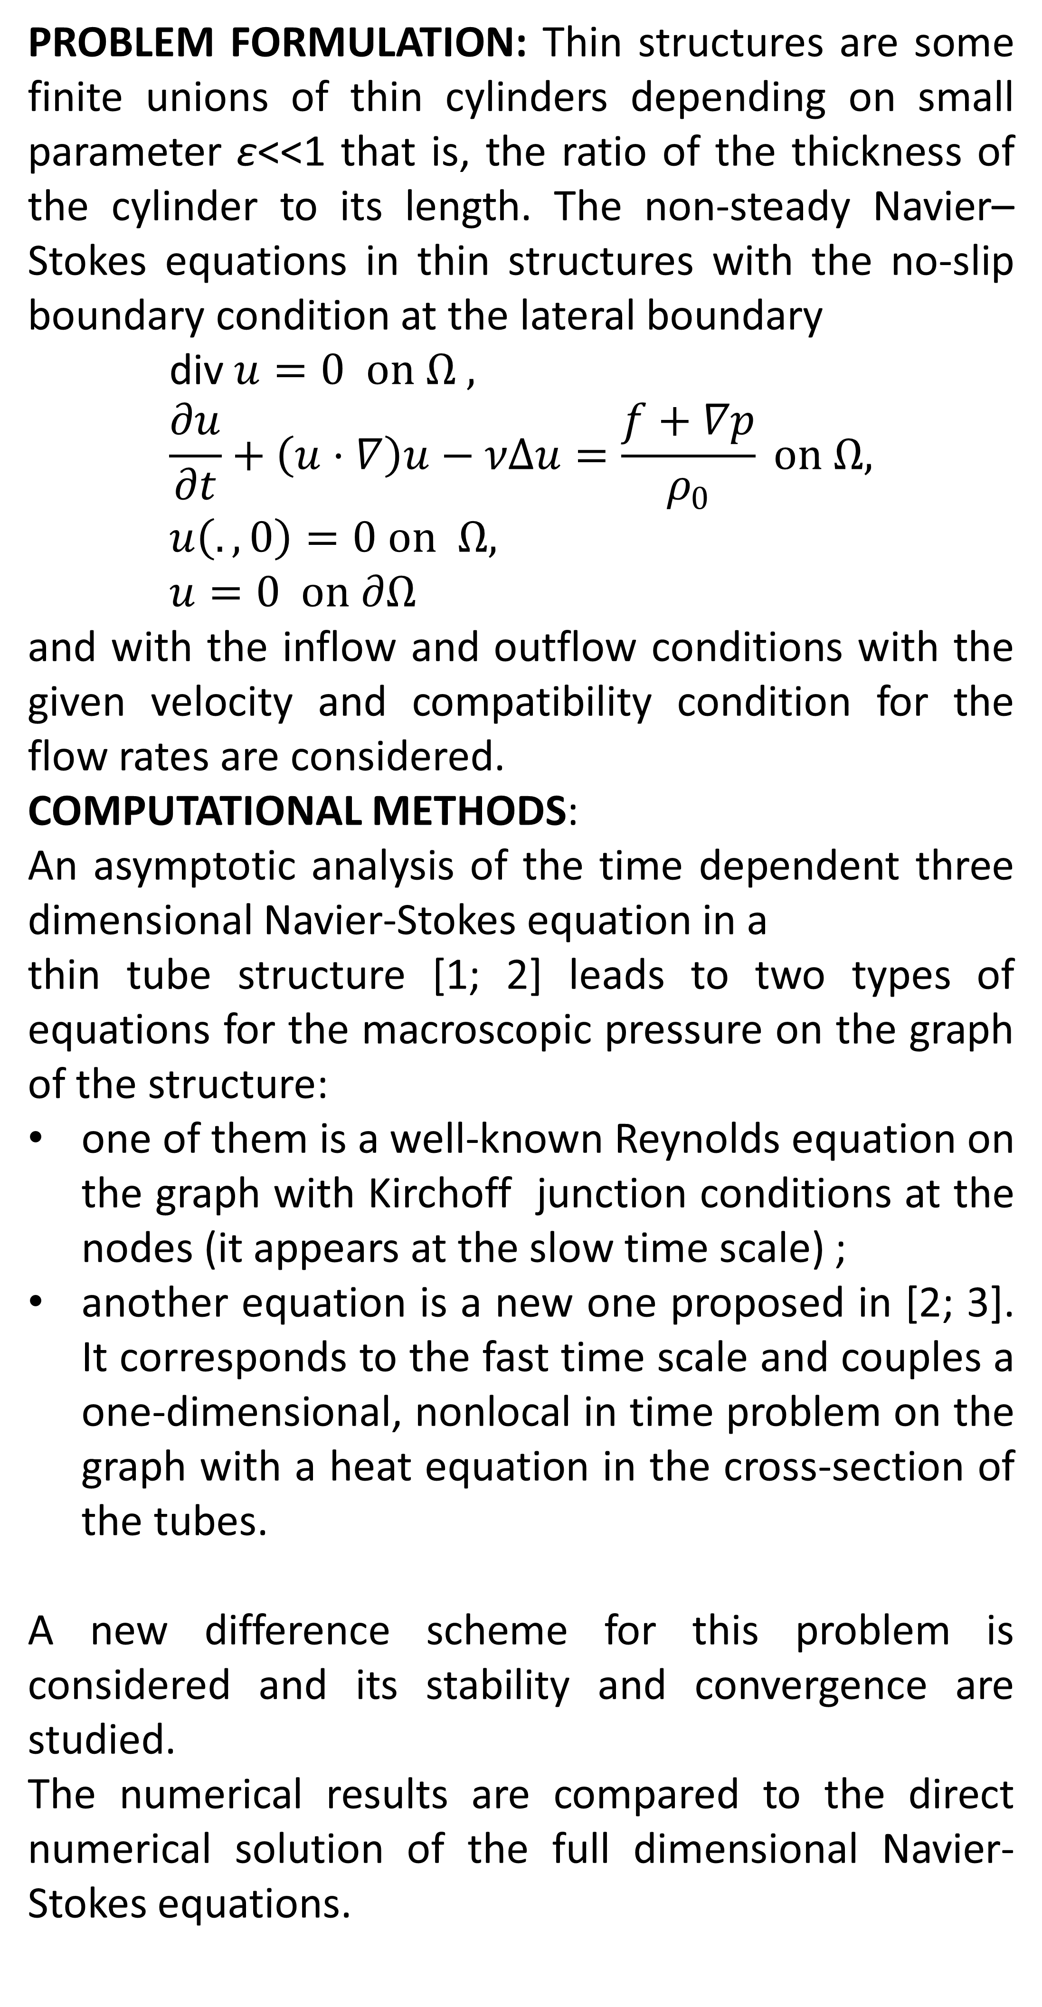
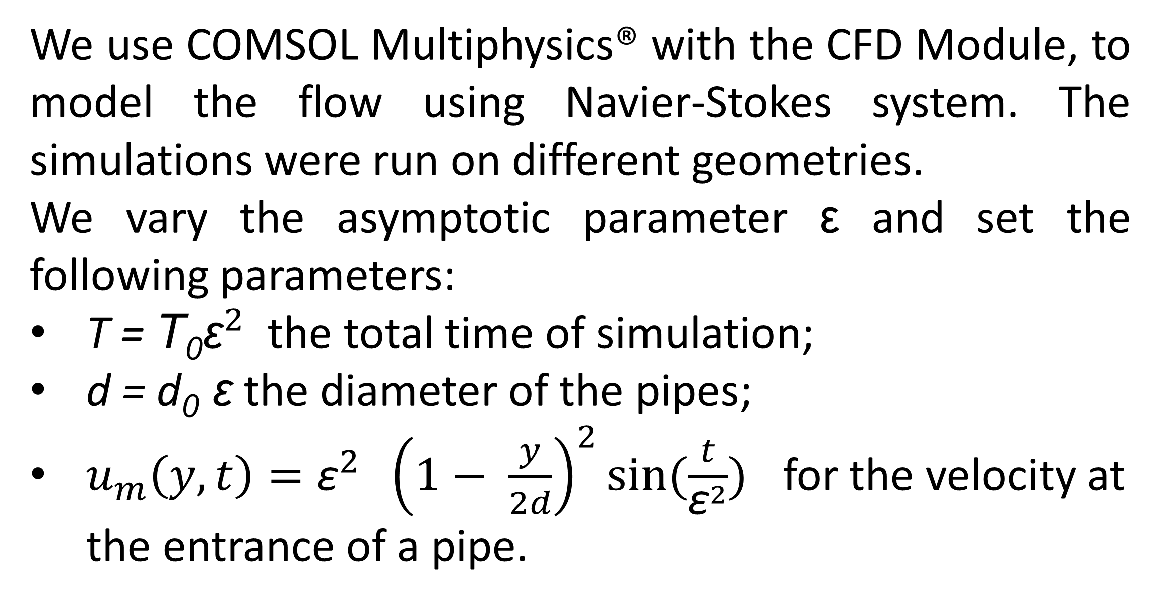
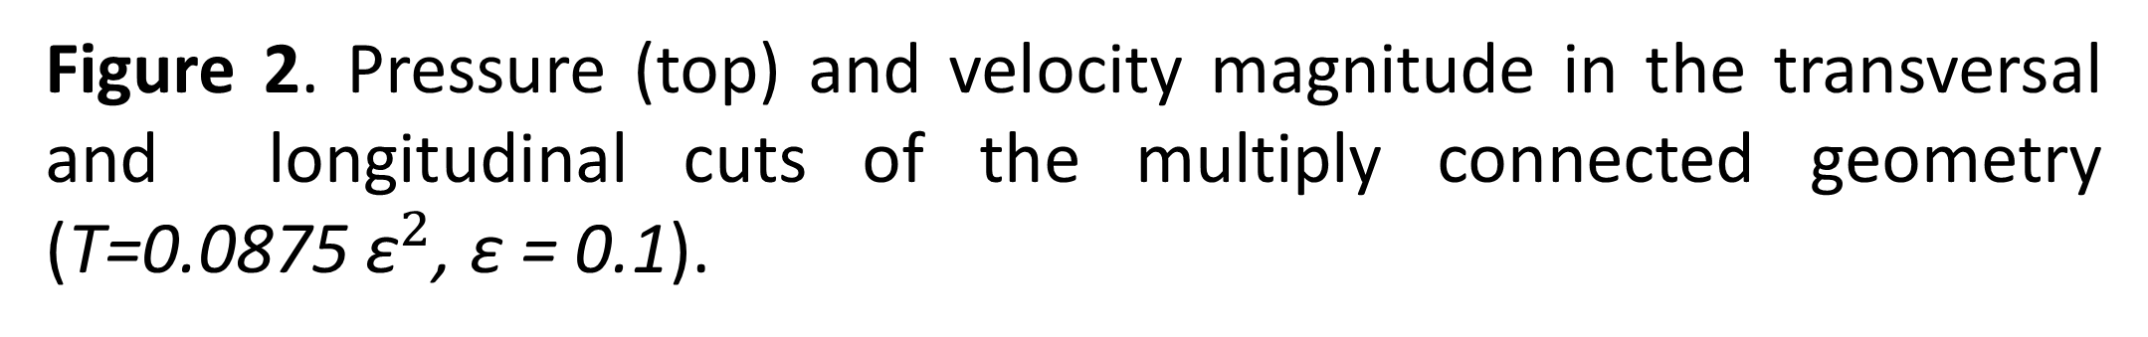
Modeling of the viscous flows in a network of thin tubes
Éric Canon ¹, Frédéric Chardard ¹, Grigory Panasenko ^{1,2}, Olga Štikonienė ²
1. Institute Camille Jordan UMR CNRS 5208 and SFR MODMAD FED 4169, Univ. Lyon, UJM, F-42023, Saint-Étienne, France
2. Institute of Applied Mathematics, Vilnius University, Vilnius, Lithuania
INRODUCTION: Flows in thin tubes arise in a wide variety of contexts like microfluidics and flows in blood vessels. Stationary laminar incompressible viscous flows in a thin tube are described by the stationary Poiseuille profile. However, the time scale of the phenomena may prevent stationary approximation to be valid as noticed by Womersley for blood flows. In that case, one needs to use a time-dependent Poiseuille profile.
We use COMSOL Multiphysics® with the CFD Module, to model the flow using Navier-Stokes system. The simulations were run on different geometries.
We vary the asymptotic parameter ε and set the following parameters:
T = T₀${\text{ε}}^{2}$ the total time of simulation;
d = d₀ $\text{ε}$the diameter of the pipes;
$u_{m}\left(y, t\right)={\text{ε}}^{2} {\left(1− \frac{y}{2d}\right)}^{2}sin(\frac{t}{{\text{ε}}^{2}})$ for the velocity at the entrance of a pipe.
Figure 1. Stationary (top) and time-dependent (bottom) Poiseuille profiles.
RESULTS: Simulations run
for $\text{ε}∈\left\{0.2, 0.1, 0.05, 0.025\right\}.$
PROBLEM FORMULATION: Thin structures are some finite unions of thin cylinders depending on small parameter ε<<1 that is, the ratio of the thickness of the cylinder to its length. The non-steady Navier–Stokes equations in thin structures with the no-slip boundary condition at the lateral boundary
$$\text{div} u=0 on Ω , \\ \frac{∂u}{∂t}+\left(u⋅∇\right)u−νΔu=\frac{f+∇p}{ρ_{0}} on Ω, \\ u\left(.,0\right)=0 on Ω, \\ u=0 on ∂Ω$$
and with the inflow and outflow conditions with the given velocity and compatibility condition for the flow rates are considered.
COMPUTATIONAL METHODS:
An asymptotic analysis of the time dependent three dimensional Navier-Stokes equation in a
thin tube structure [1; 2] leads to two types of equations for the macroscopic pressure on the graph of the structure:
one of them is a well-known Reynolds equation on the graph with Kirchoff junction conditions at the nodes (it appears at the slow time scale) ;
another equation is a new one proposed in [2; 3]. It corresponds to the fast time scale and couples a one-dimensional, nonlocal in time problem on the graph with a heat equation in the cross-section of the tubes.
A new difference scheme for this problem is considered and its stability and convergence are studied.
The numerical results are compared to the direct numerical solution of the full dimensional Navier-Stokes equations.
Figure 2. Pressure (top) and velocity magnitude in the transversal and longitudinal cuts of the multiply connected geometry (T=0.0875 ${\text{ε}}^{2}$, ε = 0.1).
(a) (b) (c)
Figure 3. Comparison between the asymptotic model and the Navier-Stokes numerical solution for ε = 0.1. (а) the multiply connected geometry; (b) the pressure along tubes; (c) the velocity magnitude across the middle of the six tubes with respect to the distance to the axis of the tube.
CONCLUSIONS:
We have developed a scheme for the asymptotic model, with proven convergence, valid for any smooth cross-sections. It shows good agreement with full Navier-Stokes equations.
Acknowledgments:
This work was partially supported by the European Social Fund according to the activity "Improvement of researchers qualification by implementing world-class R and D projects" No. 09.3.3-LMT-K-712.
REFERENCES:
Panasenko G., Pileckas K., Asymptotic analysis of the non-steady Navier-Stokes equations in a tube structure.I. The case without boundary layer-in-time. Nonlinear Analysis, Series A, Theory, Methods and Applications, 122, 125—68 (2015)
Panasenko G., Pileckas K., Asymptotic analysis of the non-steady Navier-Stokes equations in a tube structure. II. General case. Nonlinear Analysis, Series A, Theory, Methods and Applications, 125, 582—607 (2015)
Panasenko G., Pileckas K., Flows in a tube structure: equation on the graph, J. Math. Phys., 55(8):081505, 11, (2014)
Canon É., Chardard F., Panasenko G., Štikonienė O., Numerical solution of the viscous flows in a network of thin tubes. (Submitted 2019)
Excerpt from the Proceedings of the 2019 COMSOL Conference in Cambridge

