Slide 1
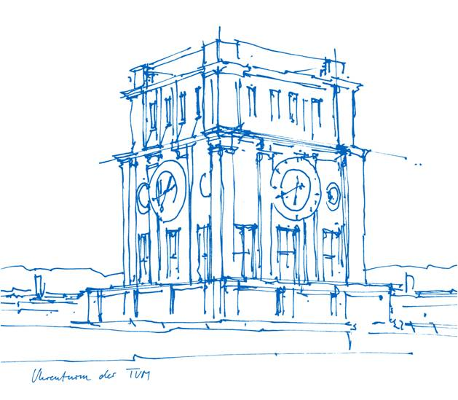

Numerical Simulation of the Time-Dependent Permeation Through Barrier Structures
Dr. Oliver Miesbauer
Jing Tang
Chair of Food Packaging Technology
Technical University of Munich

Slide 2
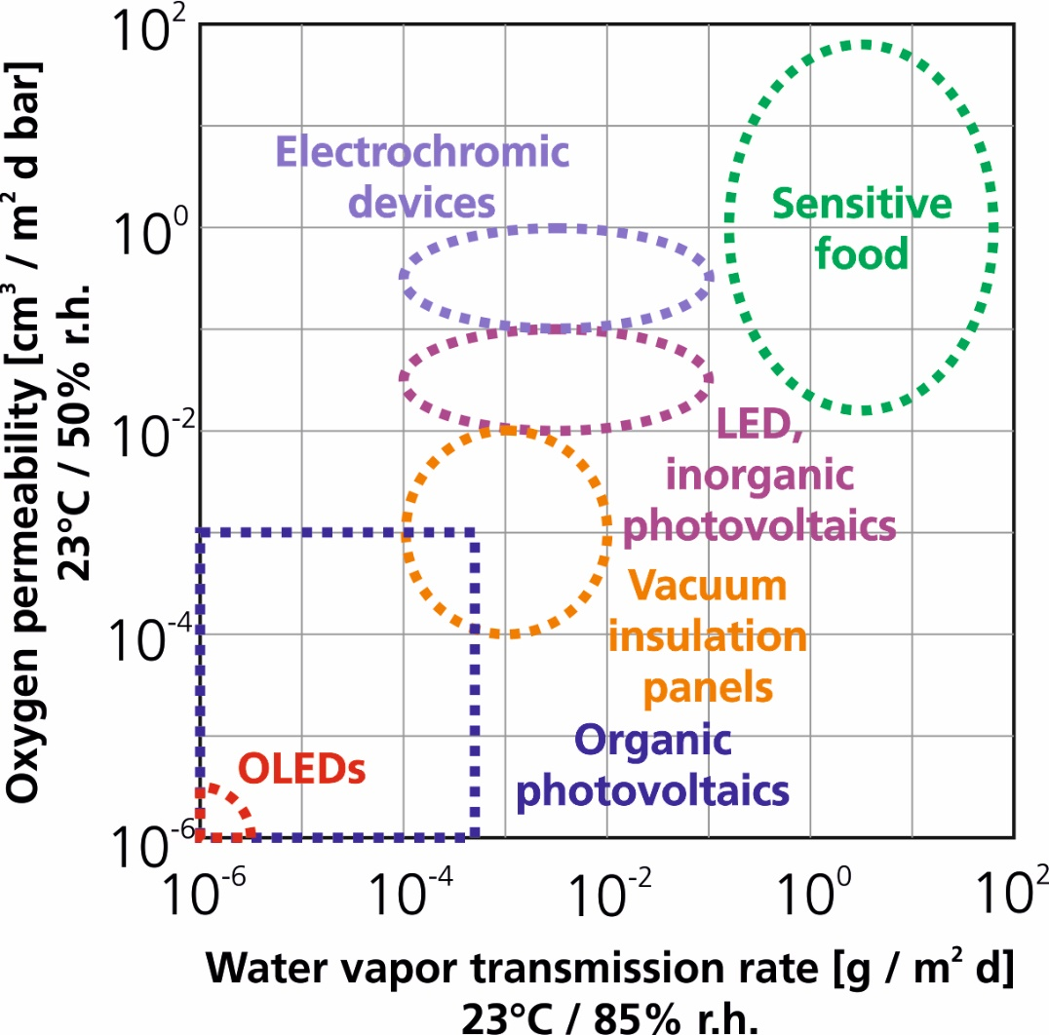
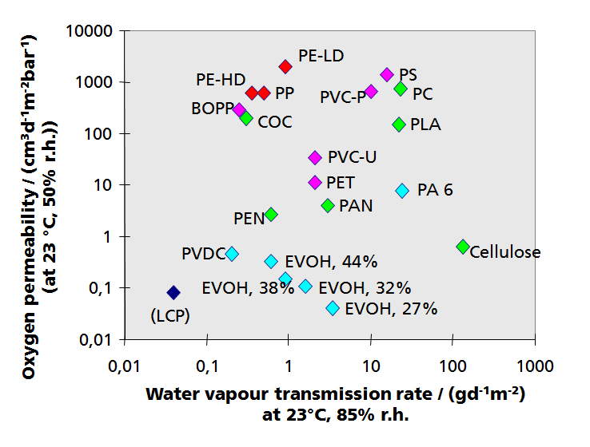
Barrier requirements of technical products
permeance
permeance
Barrier performance of polymer films of thickness 100 μm
Source: Fraunhofer IVV

Slide 3
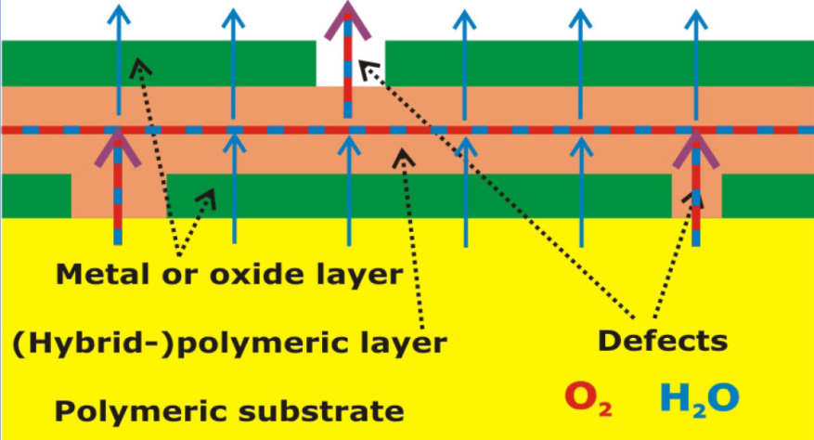
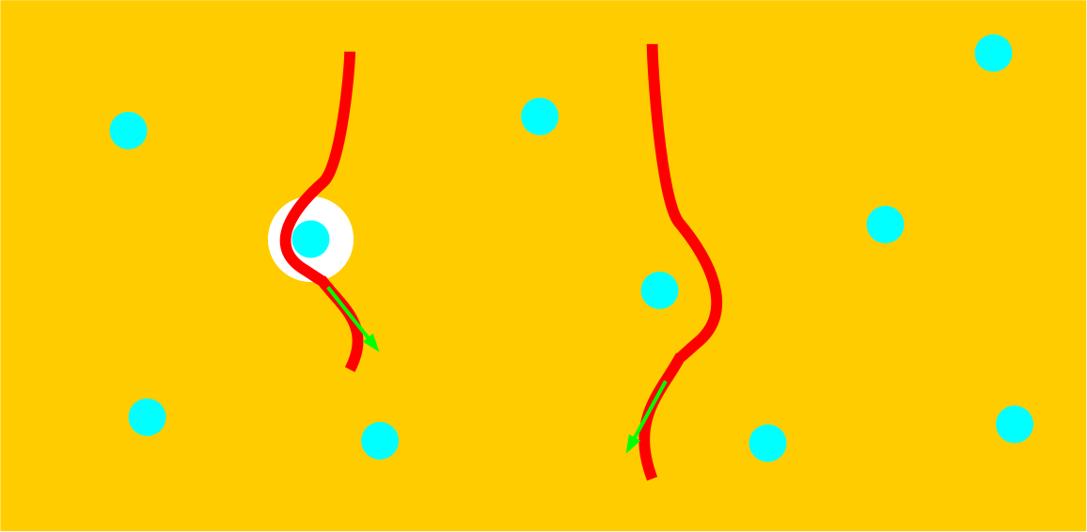
Concepts of barrier structures
Inorganic-polymeric multilayer structures
Deposition of metals or transparent oxides, nitrides from gas phase
Deposition of polymers from gas or liquid phase
Polymeric layers with dispersed particles
Inorganic particles: sheet silicates, graphene
Shape of particles: platelets, fibers
Oliver Miesbauer, Analytische und numerische Berechnungen zur Barrierewirkung von Mehrschichtstrukturen, Dissertation, 2017

Slide 4
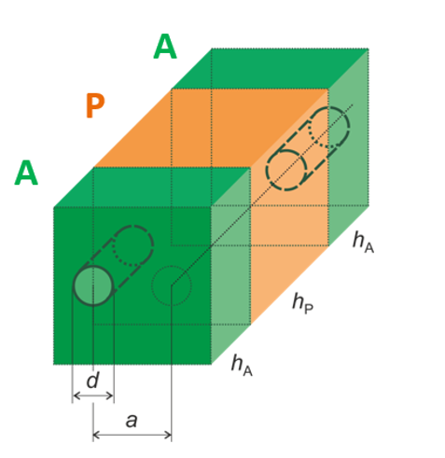
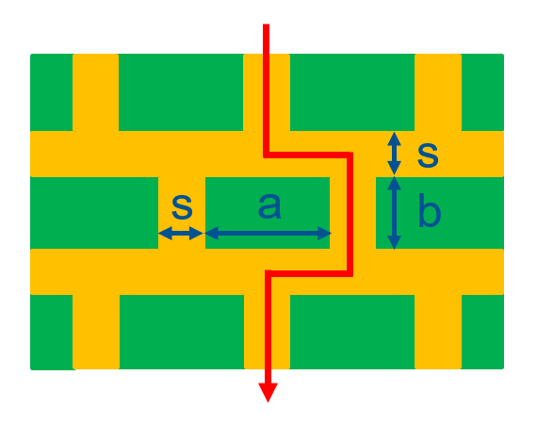
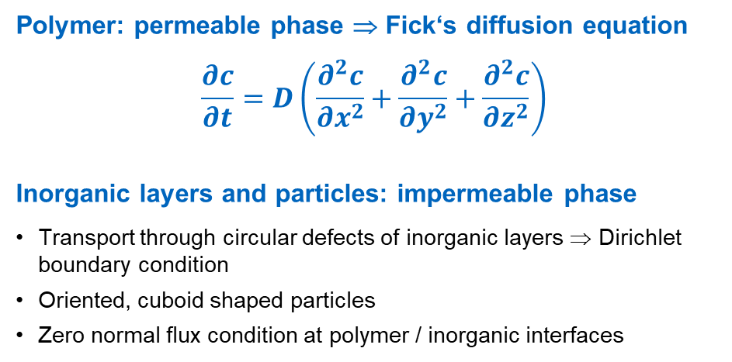
Models for barrier structures
Oliver Miesbauer, Analytische und numerische Berechnungen zur Barrierewirkung von Mehrschichtstrukturen, Dissertation, 2017
Polymer: permeable phase ⇒ Fick‘s diffusion equation
$$\frac{∂c}{∂t}=D\left(\frac{∂^{2}c}{∂x^{2}}+\frac{∂^{2}c}{∂y^{2}}+\frac{∂^{2}c}{∂z^{2}}\right)$$
Inorganic layers and particles: impermeable phase
Transport through circular defects of inorganic layers ⇒ Dirichlet boundary condition
Oriented, cuboid shaped particles
Zero normal flux condition at polymer / inorganic interfaces

Slide 5
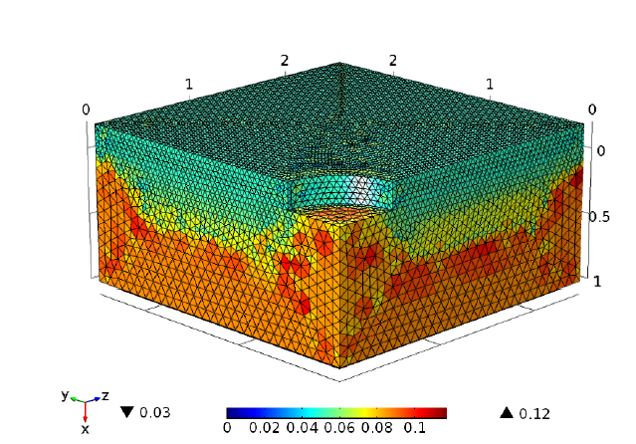
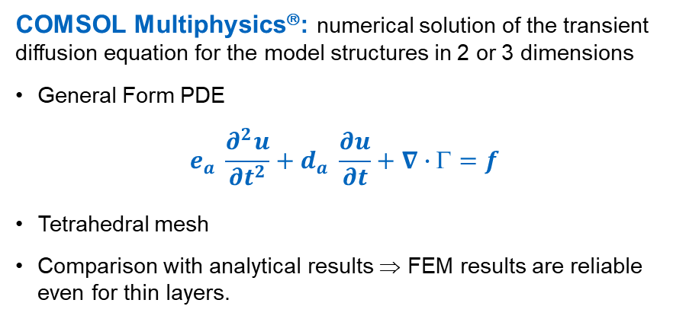
Finite element simulation
COMSOL Multiphysics®: numerical solution of the transient diffusion equation for the model structures in 2 or 3 dimensions
General Form PDE
$$e_{a} \frac{∂^{2}u}{∂t^{2}}+d_{a} \frac{∂u}{∂t}+∇∙Γ=f$$
Tetrahedral mesh
Comparison with analytical results ⇒ FEM results are reliable even for thin layers.
Tetrahedral mesh for permeable inorganic layer on top of polymeric substrate
Oliver Miesbauer, Analytische und numerische Berechnungen zur Barrierewirkung von Mehrschichtstrukturen, Dissertation, 2017

Slide 6
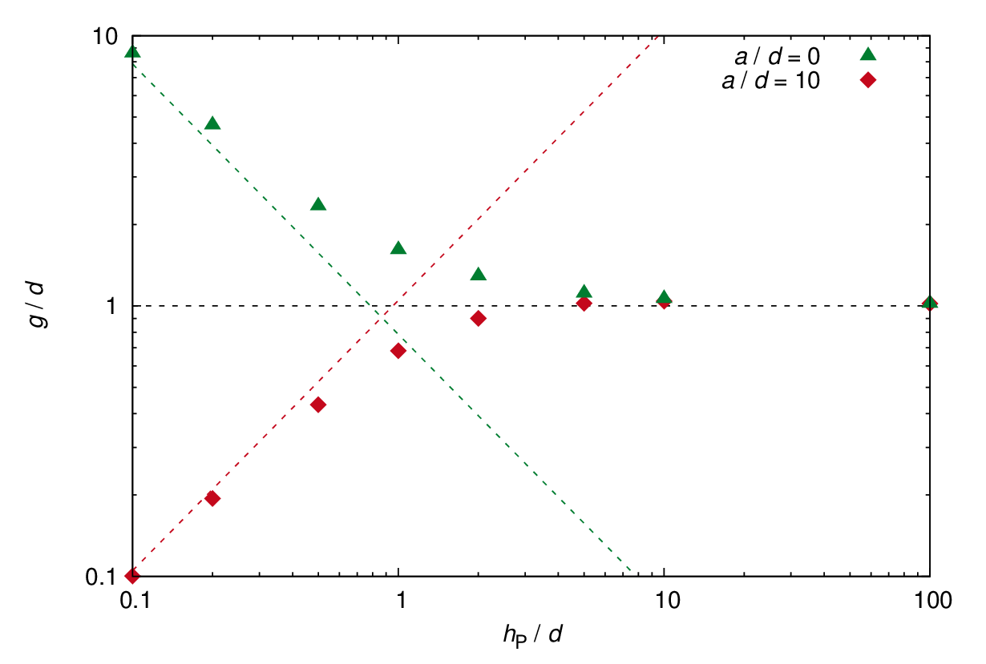
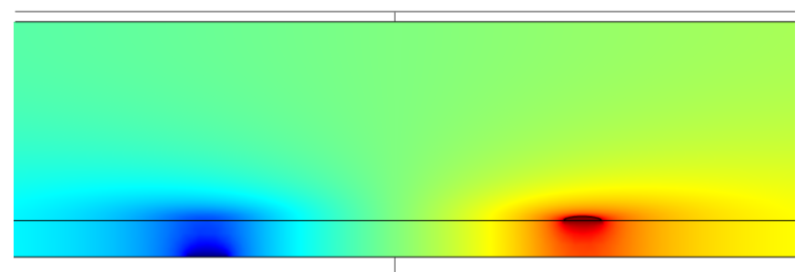
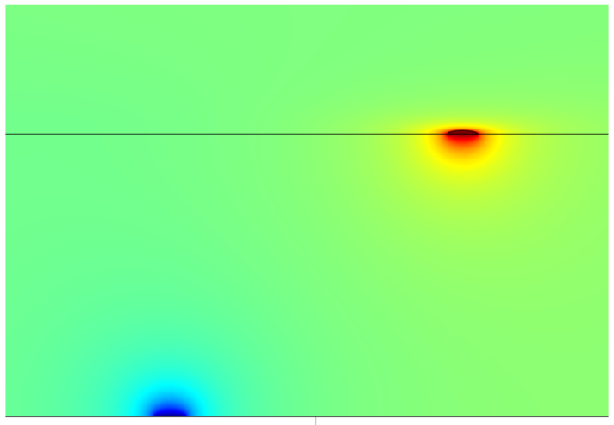
3-dim. steady-state permeation through inorganic layer / polymeric layer / inorganic layer
Defects of the inorganic layers are decoupled, if polymeric intermediate layer is sufficiently thick ⇒ Elongation of the diffusion path length (tortuous path).
Numerical simulation: Decreasing the thickness of the polymeric intermediate layer reduces permeance, if the layer is sufficiently thin.
norm. defect distance
0
10
norm. flux
Oliver Miesbauer, Analytische und numerische Berechnungen zur Barrierewirkung von Mehrschicht-strukturen, Dissertation, 2017
norm. polymer thickness

Slide 7
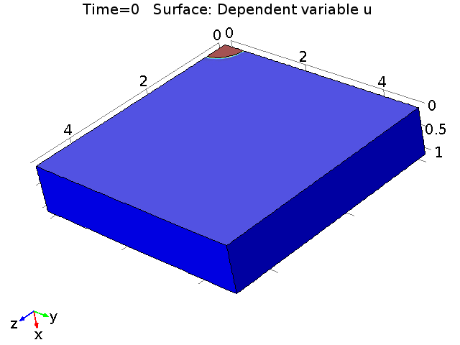
3-dim. transient permeation through inorganic layer / polymeric layer / inorganic layer
Inorganic
Polymer
Inorganic
Oliver Miesbauer, Analytische und numerische Berechnungen zur Barrierewirkung von Mehrschichtstrukturen, Dissertation, 2017

Slide 8
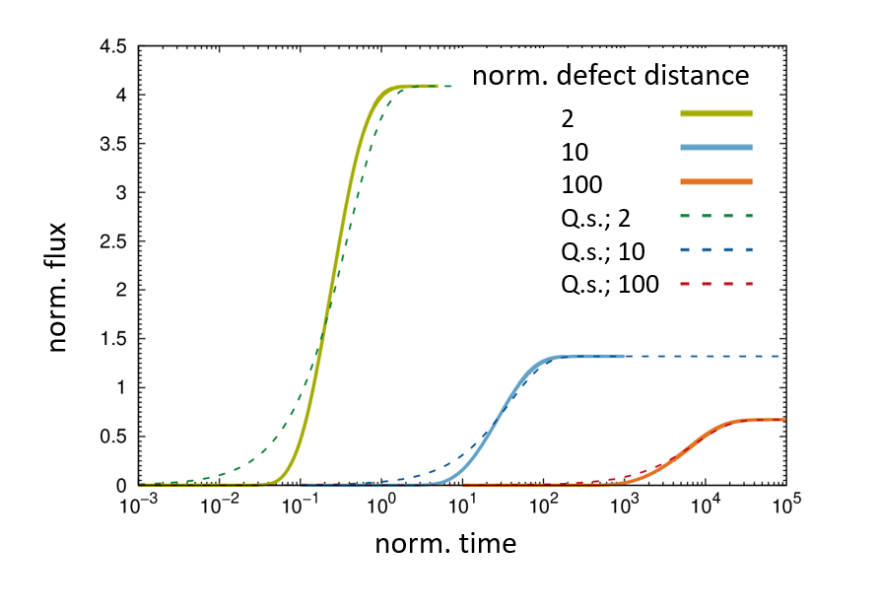
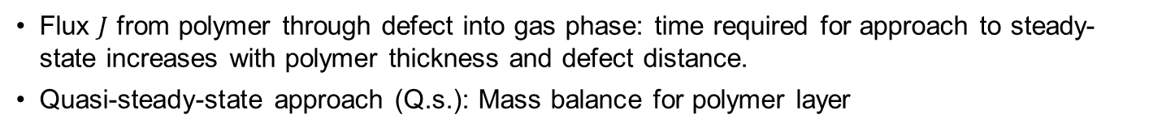

3-dim. transient permeation through inorganic layer / polymeric layer / inorganic layer
Flux $J$ from polymer through defect into gas phase: time required for approach to steady-state increases with polymer thickness and defect distance.
Quasi-steady-state approach (Q.s.): Mass balance for polymer layer
$$J\left(t\right)=α\left(1−\exp\left(−βt\right)\right)$$
Polymer thickness << defect diameter
Inorganic
Polymer
Inorganic
Oliver Miesbauer, Analytische und numerische Berechnungen zur Barrierewirkung von Mehrschichtstrukturen, Dissertation, 2017

Slide 9
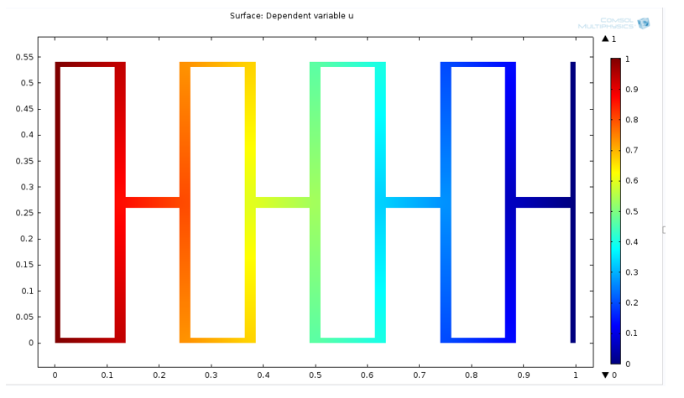
2-dim. steady-state permeation through a polymeric layer with dispersed nanoparticles
Permeable channels between impermeable particles
Concentration profile in channels is nearly 1-dimensional and linear.

Slide 10
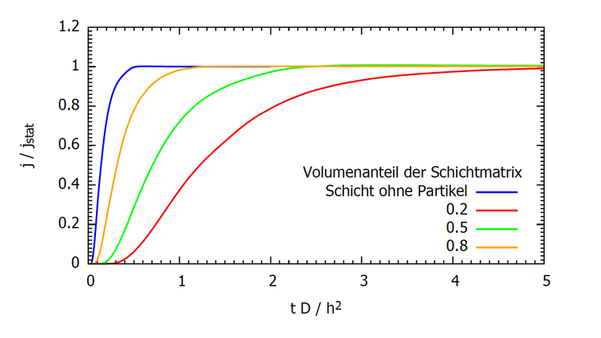
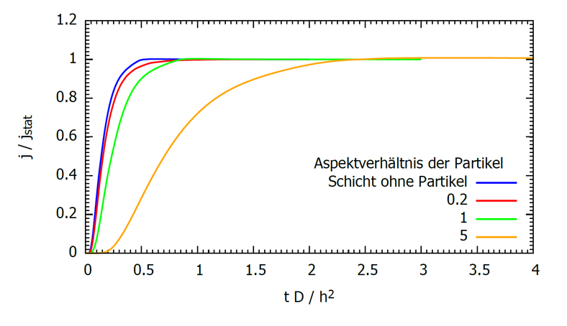
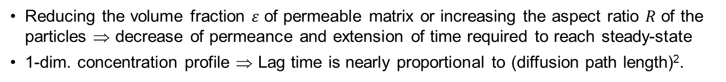


2-dim. transient permeation through a polymeric layer with dispersed nanoparticles
Reducing the volume fraction $ε$ of permeable matrix or increasing the aspect ratio $R$ of the particles ⇒ decrease of permeance and extension of time required to reach steady-state
1-dim. concentration profile ⇒ Lag time is nearly proportional to (diffusion path length)².
$$R=5$$
$$ε=0.5$$
Volume fraction of permeable matrix
Aspect ratio of particles
Layer without particles
Layer without particles

Slide 11
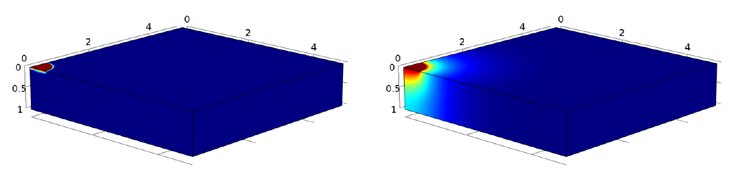
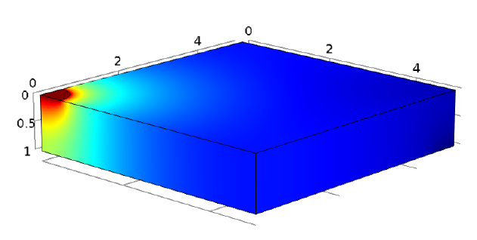
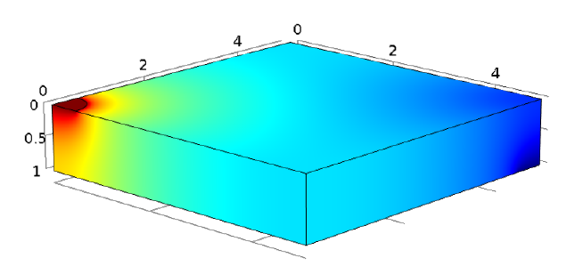
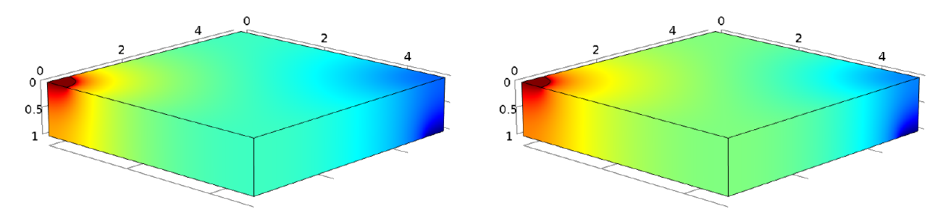
Thank you for your attention
Dr. Oliver Miesbauer, Chair of Food Packaging Technology, Technical University of Munich
Phone: +49.8161.71.3595, Email: oliver.miesbauer@tum.de

