Slide 1


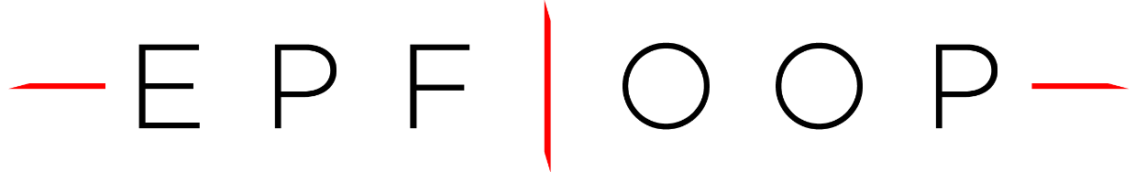
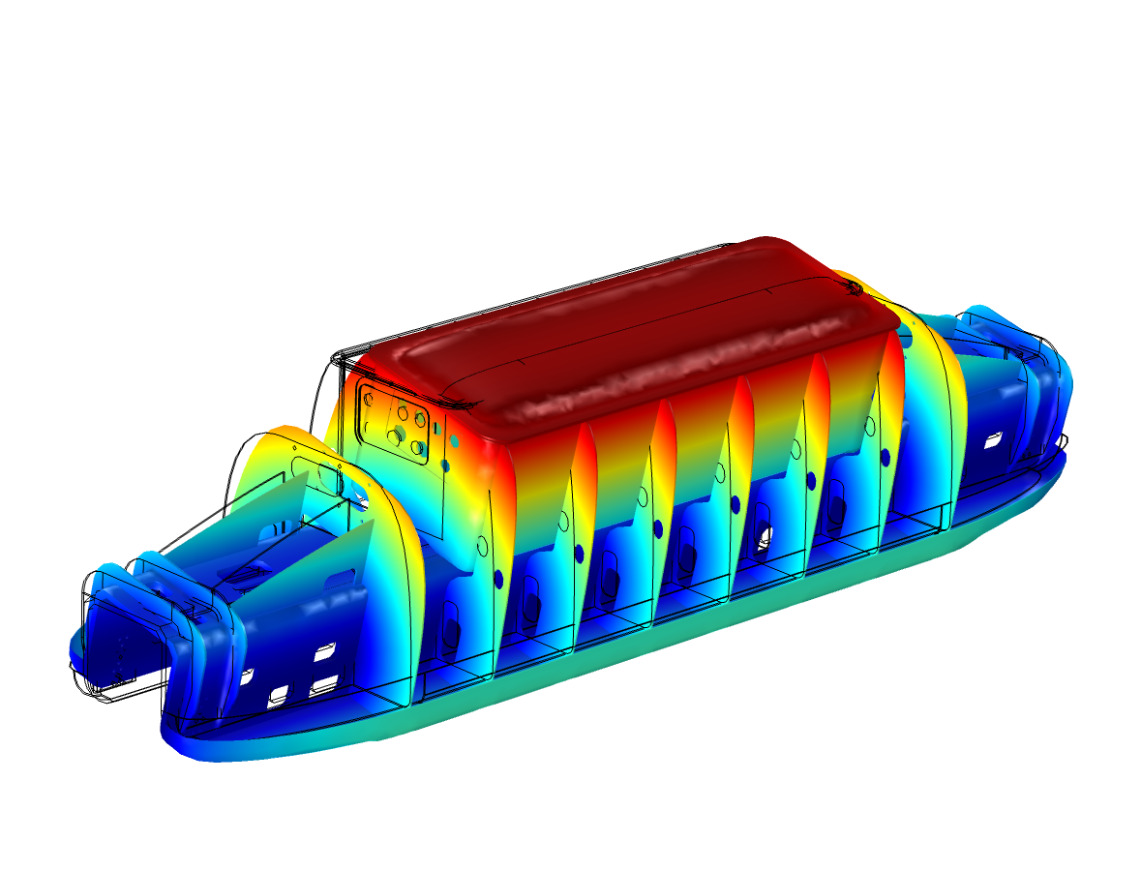
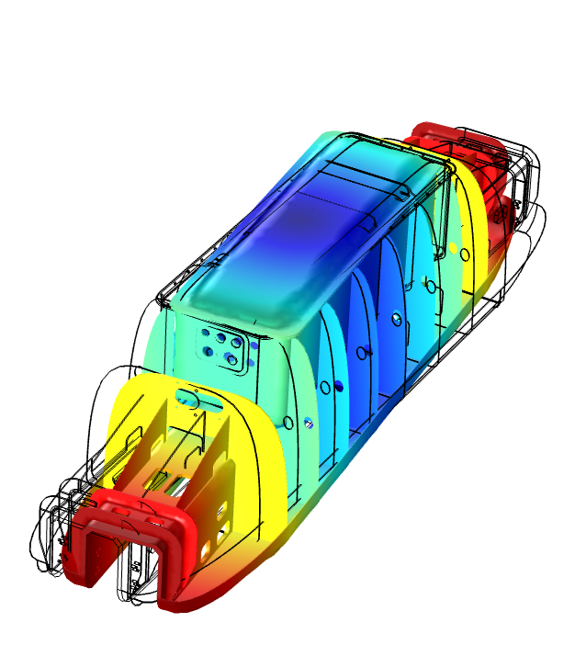
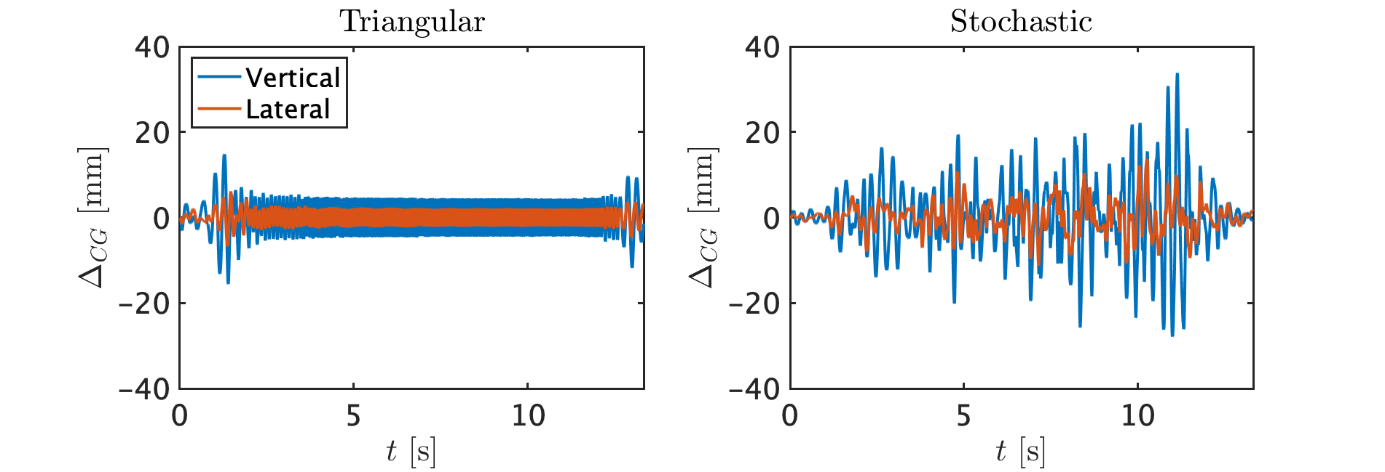
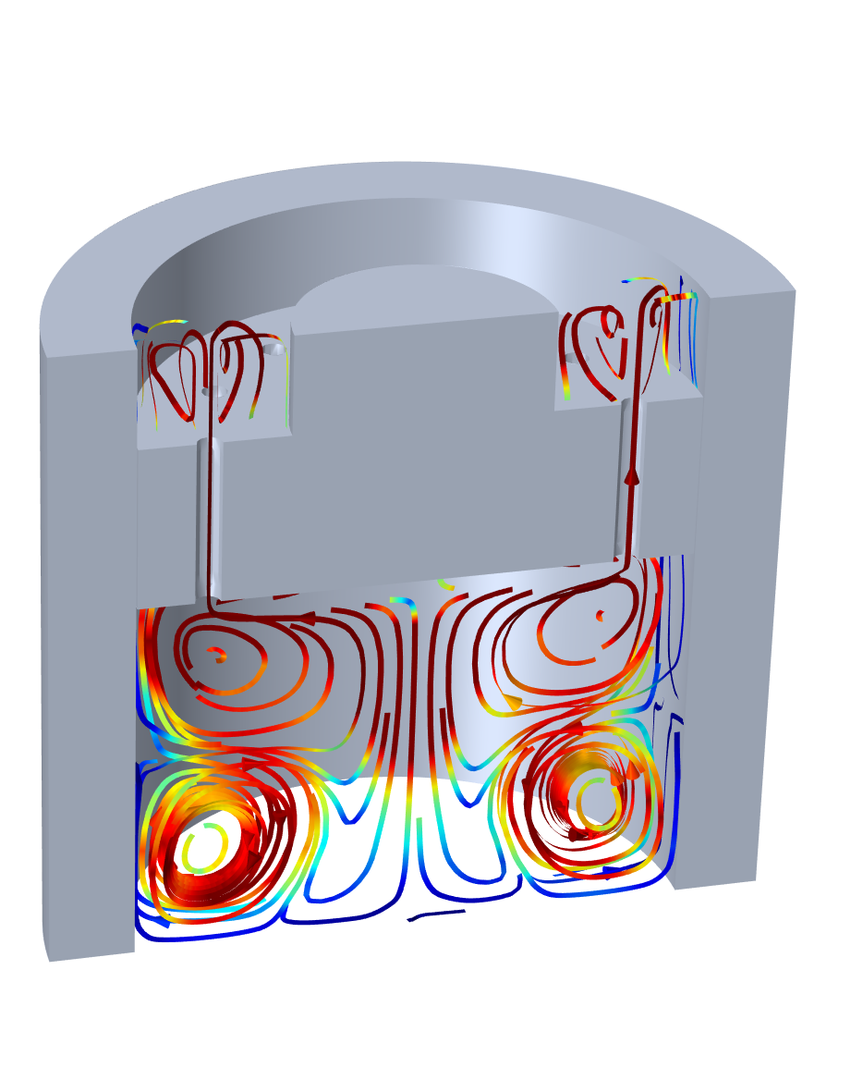
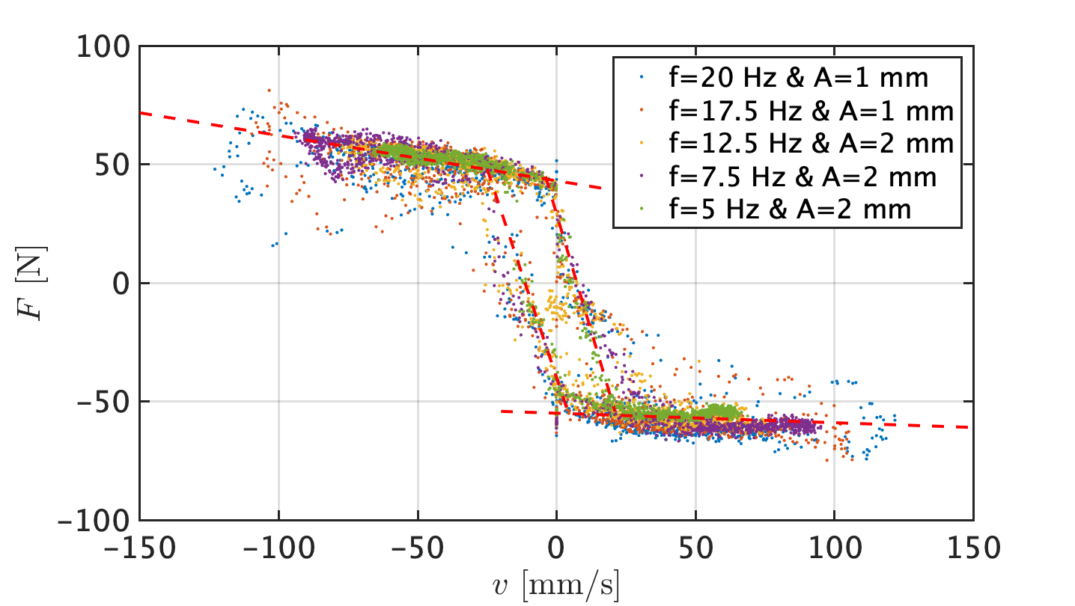
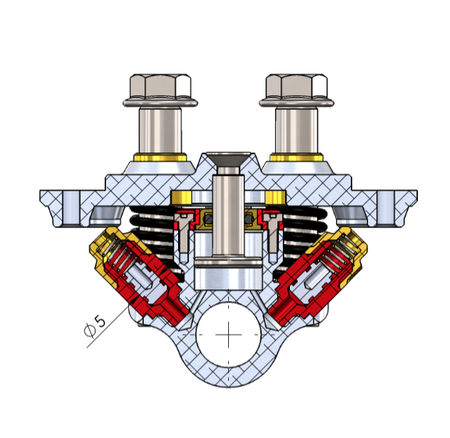
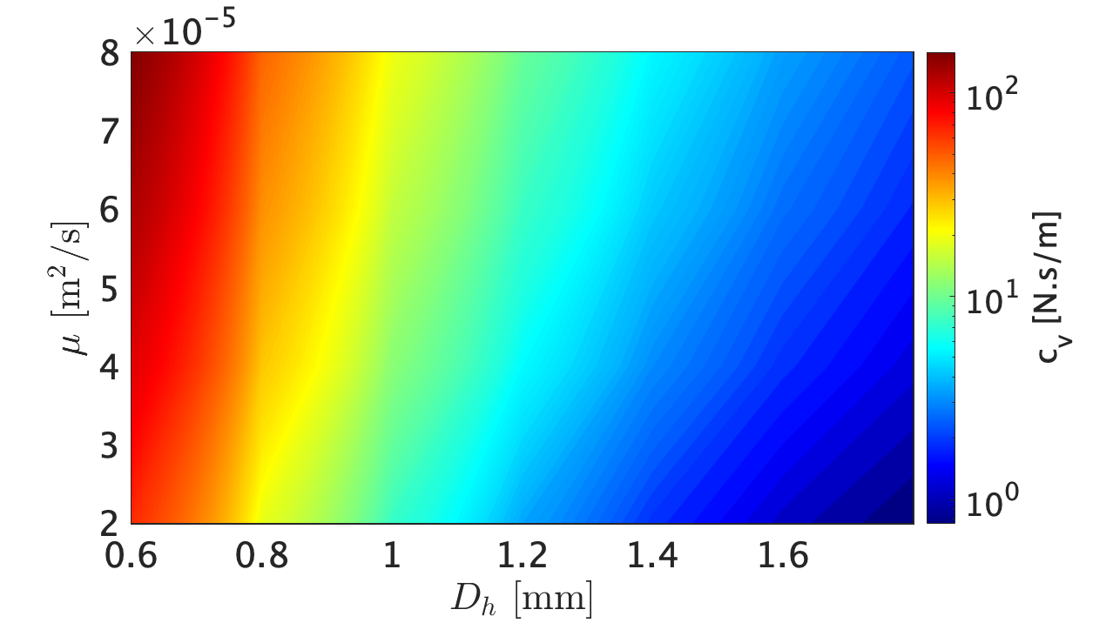
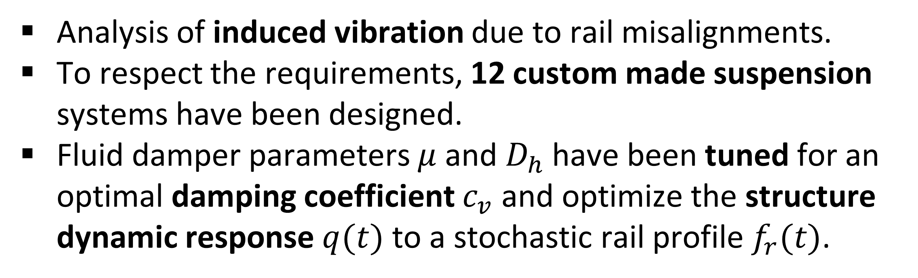


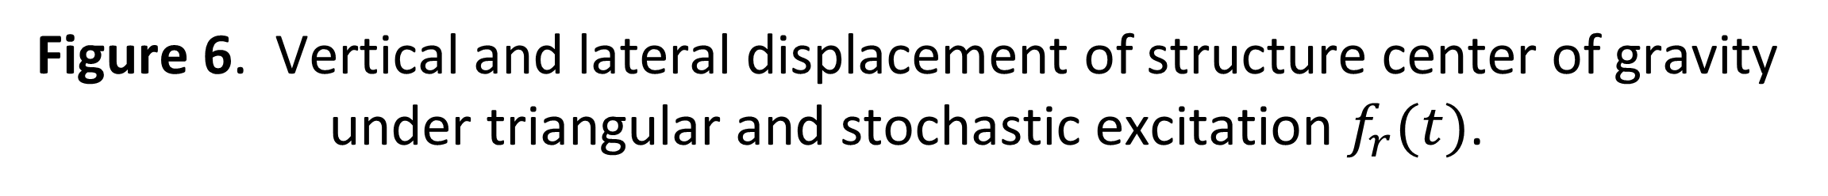

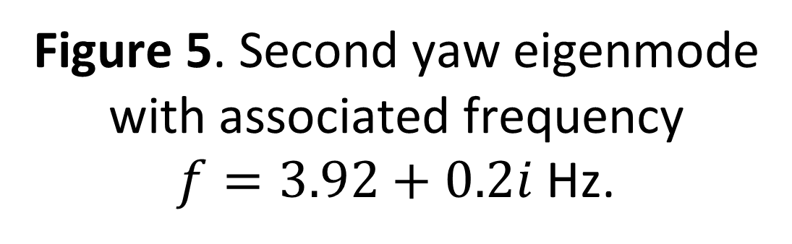


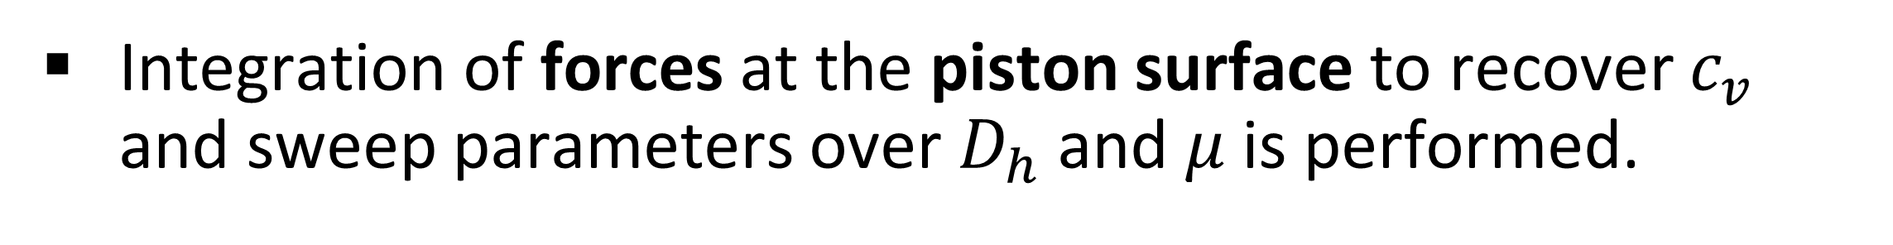
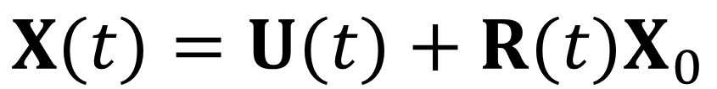
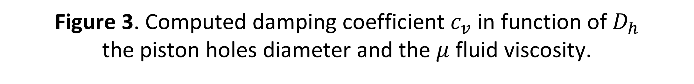

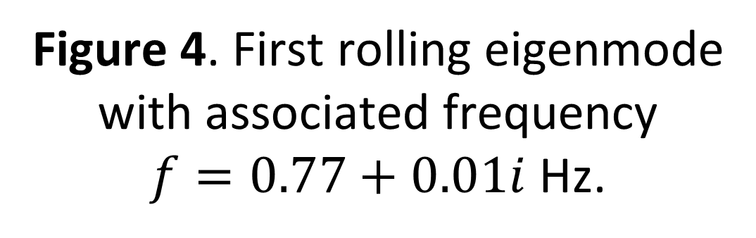


SpaceX Hyperloop Competition 2019:
Fluid damper optimization by CFD & Multi-body simulations of the EPFLoop prototype dynamic response to stochastic excitation
Jérôme Harray¹, Lorenzo Benedetti¹, Nicolò Riva¹
Introduction
1. École Polytechnique Fédérale de Lausanne, STI – IEL – DESL, CH-1015 Lausanne, Switzerland
Analysis of induced vibration due to rail misalignments.
To respect the requirements, 12 custom made suspension systems have been designed.
Fluid damper parameters $μ$ and $D_{h}$ have been tuned for an optimal damping coefficient $c_{v}$ and optimize the structure dynamic response $q(t)$ to a stochastic rail profile $f_{r}(t)$.
Eigenmodes and associated eigenfrequencies were inspected to track the critical dynamic body motions.
$$f_{r}(t)$$
$$μ,D_{h}$$
Fluid damper
$$c_{v}$$
Body
dynamics
$$q(t)$$
Figure 4. First rolling eigenmode with associated frequency
$f=0.77+0.01i$ Hz.
Figure 5. Second yaw eigenmode with associated frequency
$f=3.92+0.2i$ Hz.
Figure 1. Computation methodology flow chart.
Transient response computed to assess the maximum lateral and vertical pod deviation from the track.
Computational approach
Fluid damper analyzed with the modules Heat Transfer in Solid (ht) coupled with Laminar Flow (spf) .
We use a Segregated Steps approach with a Direct Solver.
Incompressible flow assumption.
Structure-rail interaction modeled with Multibody Dynamics (mbd) coupled with Lumped Mechanical System (lms)
We use Fully Coupled approach with an Iterative Solver.
Uniform distribution of rail beam inclination and junctions steps. Rigid body assumption.
MBD
CFD
Figure 6. Vertical and lateral displacement of structure center of gravity under triangular and stochastic excitation $f_{r}(t)$.
$$q(t)$$
The maximal displacement of critical components are computed, assuming the pod as rigid, to ensure avoiding contact with the rail and the integrity of the structure:
$$k$$
$$X(t)=U(t)+R(t)X_{0}$$
Experimental validation
Testing of the manufactured system in EPFL facilities.
Application of sine cycles for various frequencies and measurements of force response.
Experimental characterization of the variation in upstroke and downstroke damping coefficient.
$$f_{r}(t)$$
$$c_{v}$$
Figure 2. CFD and multi-body simulations interlinking.
Results
Integration of forces at the piston surface to recover $c_{v}$ and sweep parameters over $D_{h}$ and $μ$ is performed.
Figure 7. Experimental validation of fluid damper performance.
Conclusions
The simulations of the damping coefficient agrees with the experimental characterization.
The system has been extensively validated through tests performed at the 2019 SpaceX Hyperloop Competition.
Figure 3. Computed damping coefficient $c_{v}$ in function of $D_{h}$
the piston holes diameter and the $μ$ fluid viscosity.
Excerpt from the Proceedings of the 2019 COMSOL Conference in Cambridge

