Slide 1


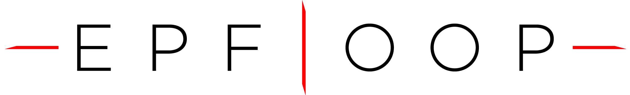
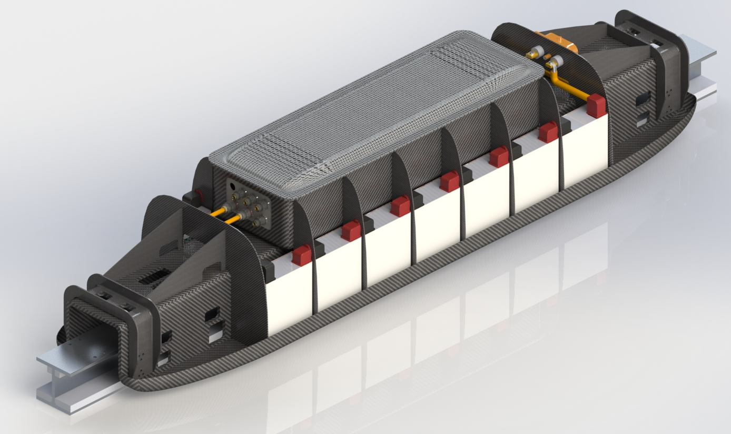
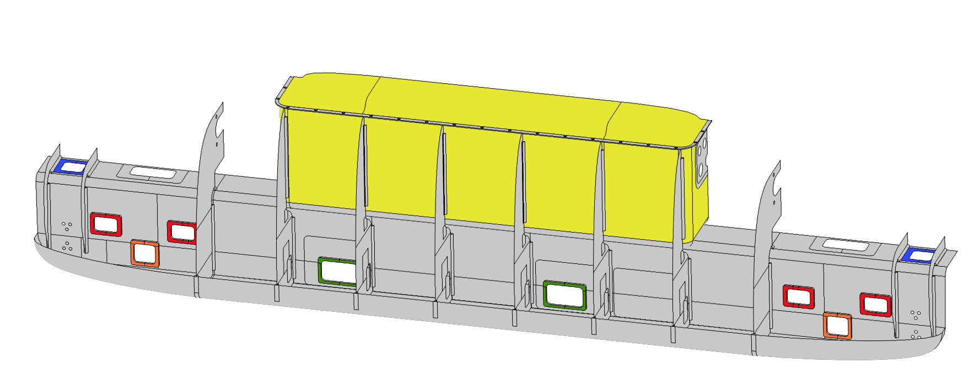
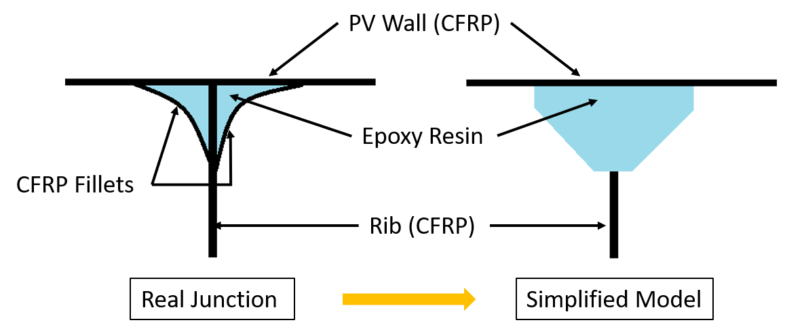
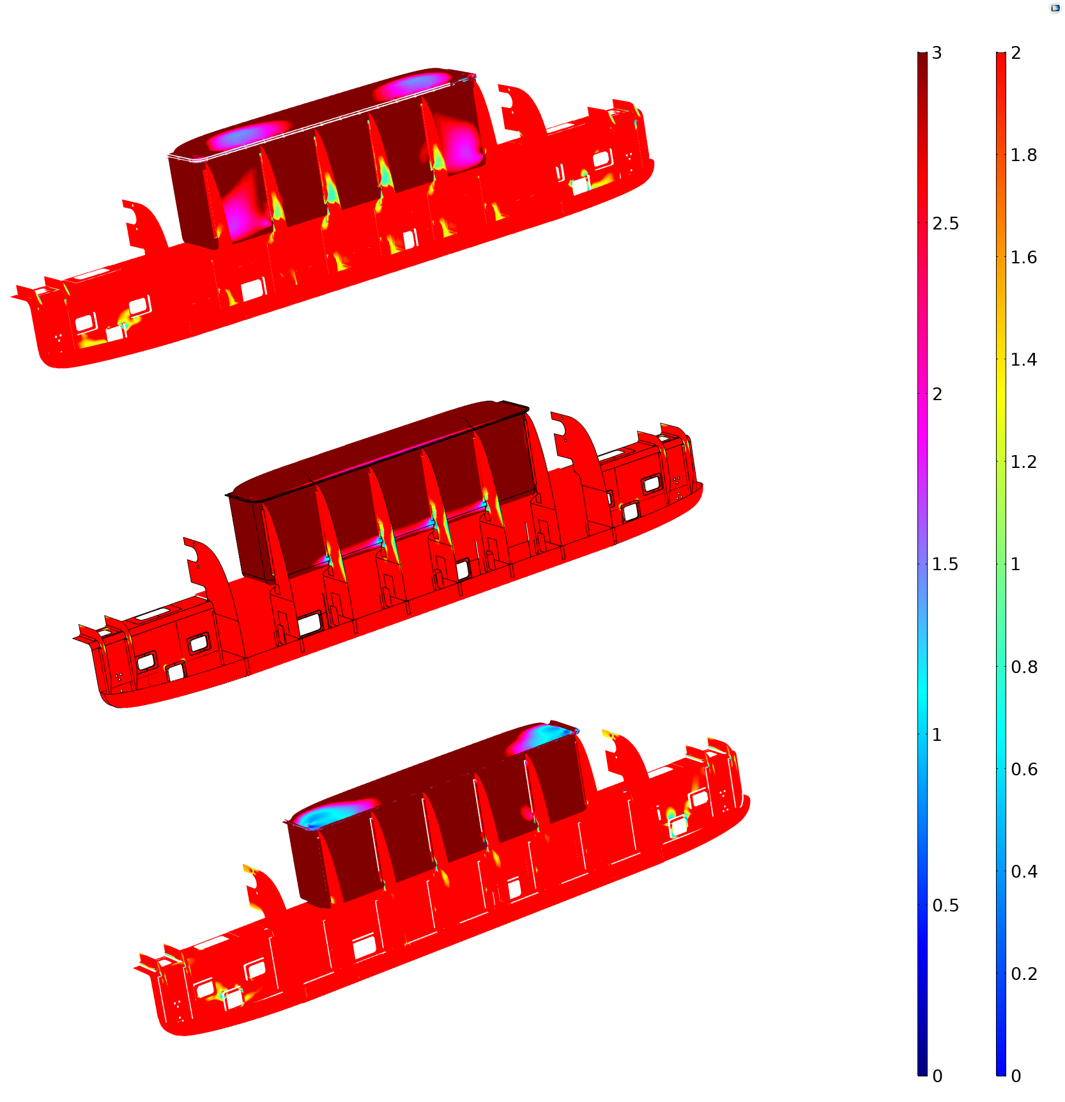
SpaceX Hyperloop Competition 2019:
Design of a carbon fiber composite chassis for the EPFLoop prototype using COMSOL Multiphysics composite materials module
Lorenzo Benedetti¹, Jérôme Harray¹, Nicolò Riva¹
1. École Polytechnique Fédérale de Lausanne, STI – IEL – DESL, CH-1015 Lausanne, Switzerland
Introduction
Design loads, safety criteria and results
Carbon fiber composite structure composed of 3 parts: main U-shaped chassis, pressure vessel and aeroshell.
Objective: support the structural loads such as the inertial ones and vibration and maintain a lightweight structure.
Inertial loads are computed during acceleration (1g) and deceleration (7g) for masses located in various positions in the prototype and directed against the motion.
The pressure vessel, containing the electronic to be protected against vacuum, is internally subjected to 1 bar.
The linear induction motor (LIM) produces a maximum thrust of 2.5 kN and a lateral force of 3.8 kN.
The brakes are capable of exerting a deceleration force of 5 kN per caliper, for a total of 10 kN braking force.
The vibration due to rail misalignment creates a lateral force of 2.5 kN and a vertical one of 3 kN on the suspension inserts.
y
x
z
Vertical stability inserts
Braking inserts
Computational approach
Pressure vessel
Extensive use of the new Composite Material module.
The Layered Shell module has been introduced to analyze the carbon fiber – foam sandwich structure.
The Solid Mechanics module has been used to correctly simulate the glued junctions between CFR panels.
Lateral stability inserts
LIM inserts
Iterative design ensures a Tsai-Wu safety factor of 2 on the entire structure and 3 on the pressure vessel. The following plot shows Tsai-Wu safety factors for:
Non-planar shell to shell connection presents a transfer of the load concentrated along an intersecting line.
Instead, the proposed approach allows to eliminate the stress concentrations at the connections between shells.
Further stress concentrations at sharp edges between solids and shells are avoided smoothing the geometry.
Aluminum inserts and connection plates are simulated with standard isotropic shell elements.
Taking advantage of symmetry, only half of the structure has been modeled.
The final mesh consists of 400k tetrahedral solid elements and 500k triangular shell elements.
A Fully Coupled approach with a Direct Solver is used.
Top fibers
Foam/middle fibers
Bottom fibers
Solid Mechanics (solid)
Shell (shell)
-
Layered Shell
Material Node
Solid-Shell
connection
The final design is a 22 kg CFR structure with a satisfactory safety factor during worst case loading (7g deceleration).
The structure has been successfully tested at EPFL and during the 2019 SpaceX Hyperloop competition final.
Excerpt from the Proceedings of the 2019 COMSOL Conference in Cambridge

