Slide 1
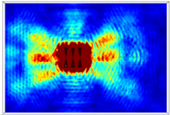
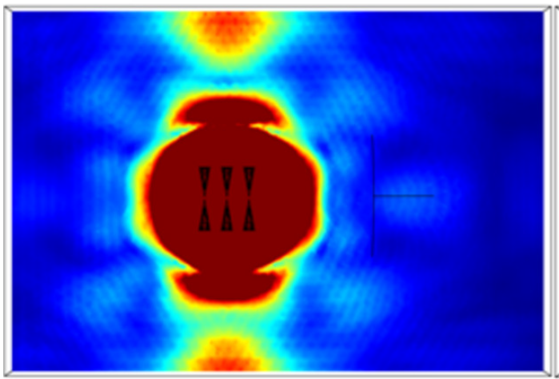
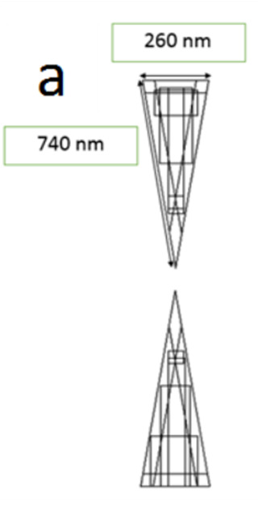
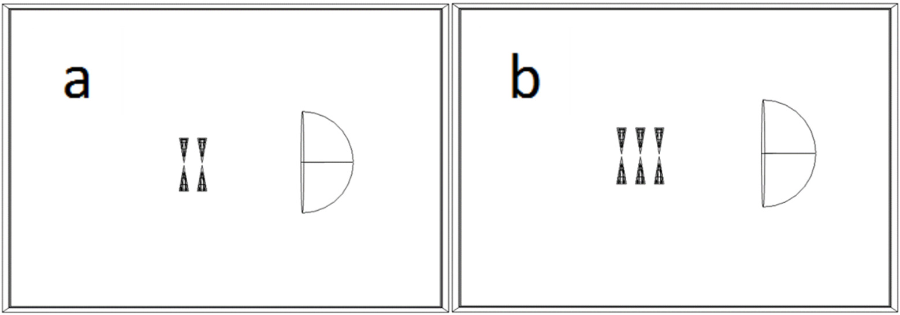
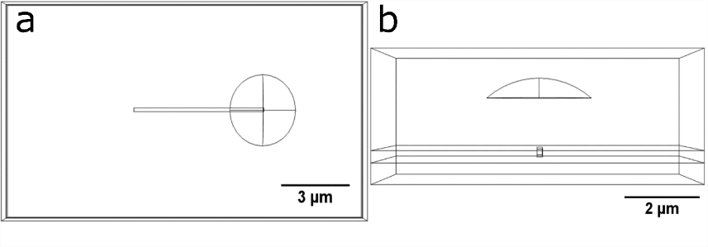
Light Enhancement and Direction Control Using Bowtie Antenna Arrays
I. Pita^{1,2}, N. Liu², B. Corbett¹
1. Photonics Centre, Tyndall National Institute, Lee Maltings, T12 R5CP, Cork, Ireland
2. Department of Physics and Bernal Institute, University of Limerick, Castletroy, V94 T9PX, Limerick, Ireland
INRODUCTION: The focus of this work is to determine the potential for arrays of nanoscale bowtie antennas for light enhancement and direction control in nano-optics devices. This is achieved by studying the effects of illumination on the backscattered and total fields, along with the intensity of propagated light for different arrays. Gold antennas on both glass and Si3N4 were used.
RESULTS: Increasing the wavelength past 1000 nm caused the propagation direction of the light to shift due to interference. These arrays showed strong potential enhancement over single antennas of different orientations.
a
b
E
E
Min
Max
Figure 3. The electric field propagation for a 3 bowtie antenna array at (a) 650 nm and (b) 1150 nm under the same polarization conditions.
Figure 1. The geometry of (a) the bowtie antenna used and (b) the simulation setup of a bowtie array with orientation ↑. The semicircle is used to integrate the propagating electric field.
 | Antenna ratio 3 ↑↑↑/1↑
Polarization | 0 degrees | 90 degrees
↔ | 3.51 | 1.41
↕ | 2.15 | 8.50
 | Antenna ratio 3 ↑↑↑/1→
Polarization | 0 degrees | 90 degrees
↔ | 0.15 | 2.12
↕ | 1.78 | 2.54
COMPUTATIONAL METHODS: The Wave Optics Module in COMSOL Multiphysics® was used to simulate the bowtie nanoantenna arrays and semiconductor materials using material parameter values. A 3D model was used to properly model the polarization effect of the reflected/backscattered fields. A 3D Gaussian beam was applied to simulate the excitation beam and the Frequency Domain stationary solutions were obtained for a series of simulation parameter sets. A range of wavelengths between 650 nm and 1500 nm were used to illuminate the antennas and the polarization was altered to observe how propagation would change.
The intensity output was measured by integrating the electric field over the surface area of a partial circle placed a set distance from the array. In addition gold strips were added and a partial semicircle was used to replicate a lens of suitable NA to study propagation effects.
Table 1. The enhancement obtained for an array of 3 bowtie antennas when compared to one antenna of the same orientation.
Table 2. The enhancement obtained for an array of 3 bowtie antennas when compared to one antenna of perpendicular orientation.
CONCLUSIONS: The arrays were capable of producing strong enhancement in light polarized parallel to the long axis of the antenna providing directed light which an enhancement of between 3.5 and 8.2 than that produced by a single antenna in the same orientation. Enhancement of a factor of 2 was also obtainable for a bowtie of the opposite orientation. Further increases in the enhancement could be obtained by increasing the number of antennas in the array regardless of substrate changes carried out in the simulations. These results could prove useful both for light direction or more efficient semiconductor quantum dot excitation in nano-optics devices.
*This work was funded by the Irish Research Council: (GOIPG/2018/10)
Figure 2. The geometry of (a) the gold strips and (b) the lens added to the bowtie arrays. The strips were placed both next to, and above the arrays to study propagation.
REFERENCES:
L. Novotny et al, Antennas for Light, Nat. Photonics, 5, 83-90 (2011)
Z. Fang et al, Plasmonic Coupling of Bow Tie Antennas with Ag Nanowire, Nano Lett., 11, 1676-1680, (2011)
Excerpt from the Proceedings of the 2019 COMSOL Conference in Cambridge

