Slide 1


Light Enhancement and Direction Control Using Bowtie Antenna Arrays
Isabel Pita, Ning Liu, and Brian Corbett

Slide 2
Presentation Outline
Bowtie Antenna Applications and Array Potential
Bowtie Antenna Array Design in COMSOL
Methods for Optical mode measurement
Gaussian Beam Design
Propagation along Substrate
Comparison to Single Antenna
Conclusions and Applications

Slide 3
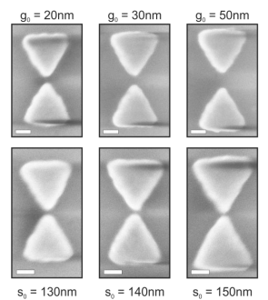
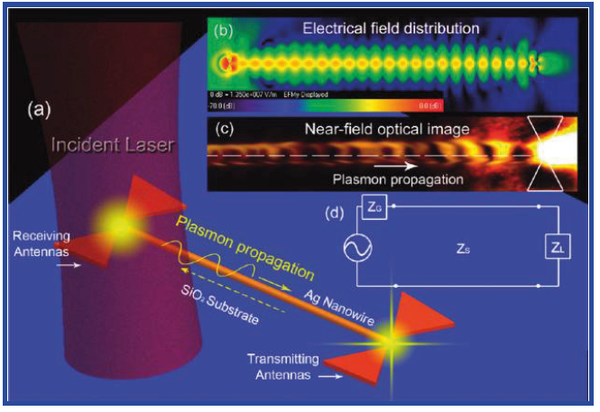
Uses of Bowtie Antenna
Strong and Confined Near Field Enhancement
High Scattering Resonance Between Tips
Enhanced Surface Plasmon Propagation
M. Kaniber et al, Sci. Rep., 6, 23203, 2016
Z. Fang et al, Nano Lett., 11, 1676, 2011

Slide 4
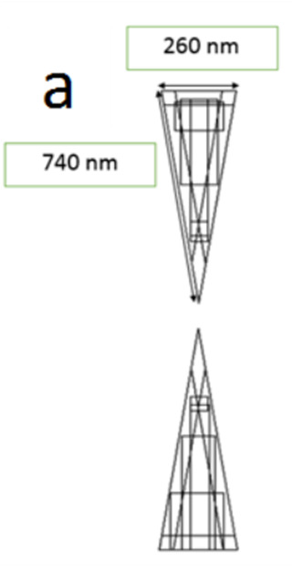
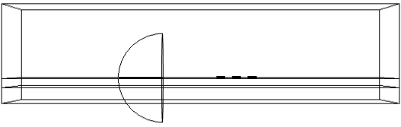
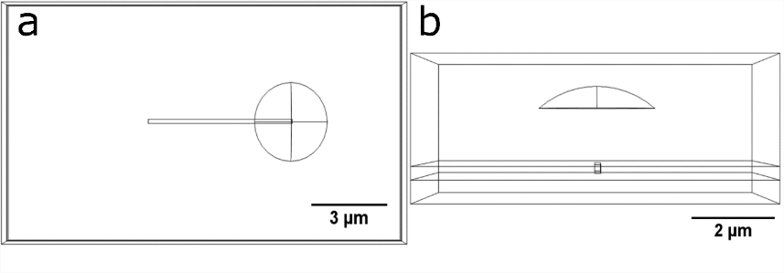
Antenna Array Geometry
260 nm
740 nm
Y
X
Z
X
Gold Antenna
Air-Glass Interface

Slide 5
Geometry Featuring Gold Strips
Z
Y
X
X
Gold Trench Addition
Lens Configuration

Slide 6
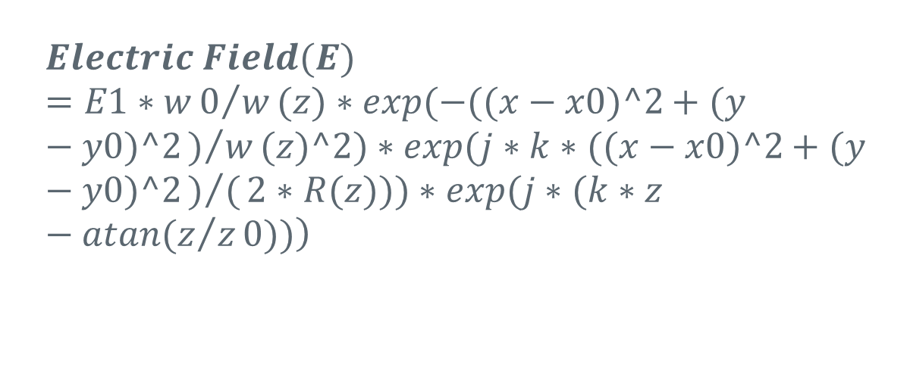
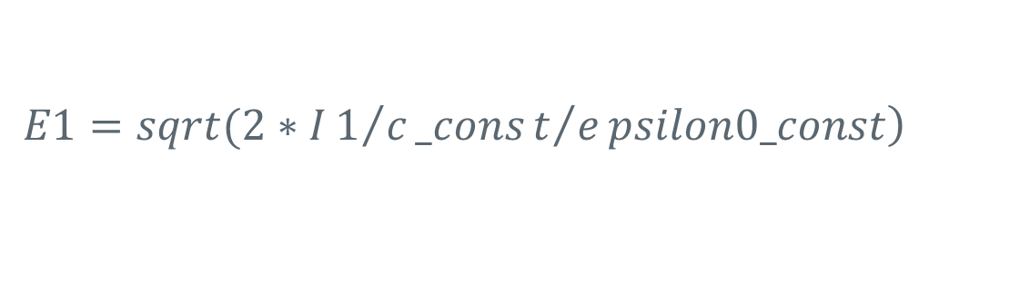
Gaussian Beam Shaping
$$\left.Electric Field(E)=E1∗w0/w(z)∗exp(−((x−x0)^2+(y−y0)^2)/w(z)^2)∗exp(j∗k∗((x−x0)^2+(y−y0)^2)/(2∗R(z)))∗exp(j∗(k∗z−atan(z/z0))\right)$$
$$\left.E1=sqrt(2∗I1/c_const/epsilon0_const\right)$$

Slide 7
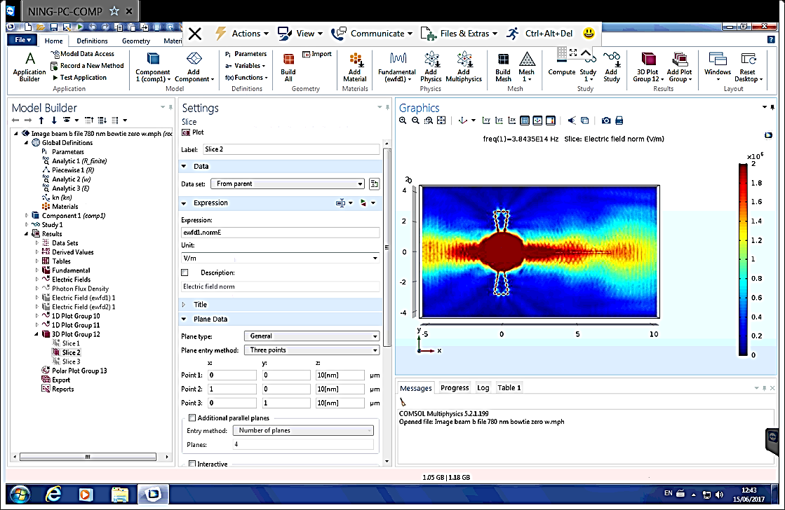
Change in Direction With Wavelength
Higher Wavelength Changes Direction
E
E
650 nm
1150 nm
High
Low

Slide 8
Propagation with Change in Polarization
In both the optical mode propagates perpendicular
E
E
Better Control of Surface Plasmons
High
Low

Slide 9
Measured Mode Propagation
 | Antenna ratio 3 ↑↑↑/1↑
Polarization | 0⁰ | 90⁰
↔ | 3.51 | 1.41
↕ | 2.15 | 8.50
 | Antenna ratio 3 ↑↑↑/1↔
Polarization | 0⁰ | 90⁰
↔ | 0.15 | 2.12
↕ | 1.78 | 2.54

Slide 10
Propagation With Gold Trenches
Strong SPP Direction Control
E
E
1 Au Antenna
3 x Au Antenna
High
Low

Slide 11
Propagation With Gold Trenches
Strong SPP Direction Control
E
E
1 Au Antenna
3 x Au Antenna
High
Low

Slide 12
Trench Cut Enhancement (100 nm)
 | Antenna ratio 3 ↑↑↑/1↑
Polarization | 0⁰ | 90⁰
↔ | 0.04 | 0.22
↕ | 3.60 | 8.07
 | Antenna ratio 4 ↑↑↑↑/1↑
Polarization | 0⁰ | 90⁰
↔ | 0.01 | 0.76
↕ | 4.93 | 15.06

Slide 13

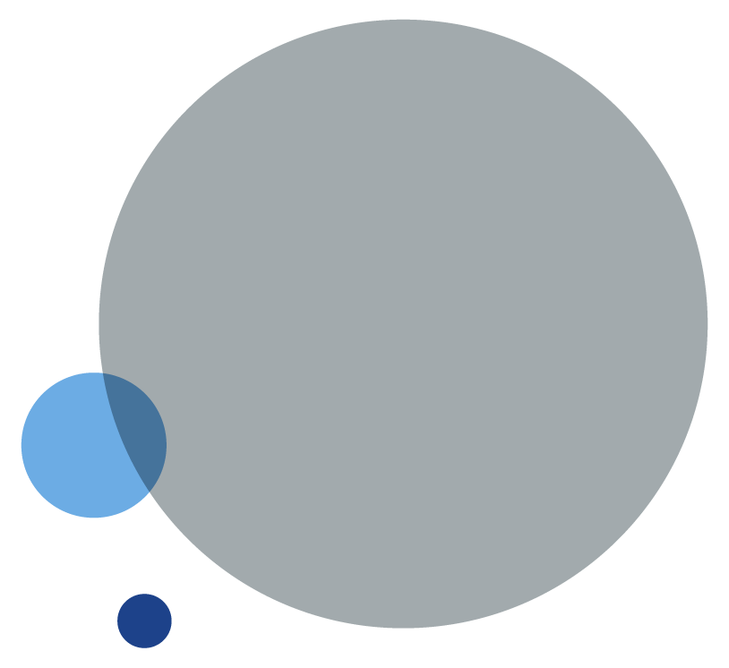
Conclusions and Applications
Arrays of bowtie antennas allow for direction control at higher wavelengths
Allow improved SPP control
Provides better enhancement than a single bowtie antenna
Potential uses in nano-optics devices
Nano-dot excitation
Switch behaviour
If a picture needs a caption it can look like this.

Slide 14
Dr. Ning Liu and Dr. Brian Corbett.
III-V Materials and Devices Group, Photonics Centre, Tyndall National Institute
Nanophotonics and Nanoplasmonics Group, Department of Physics, University of Limerick.
This work was funded by the Irish Research Council Postdoctoral Fellowship Fund GOIPD/2018/10

Slide 15



Tyndall National Institute,
Lee Maltings,
Dyke Parade,
Cork,
Ireland.
T12 R5CP
t: +353 21 490 4177
e: info@tyndall.ie
tyndall.ie

