Slide 1
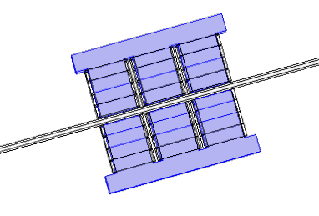
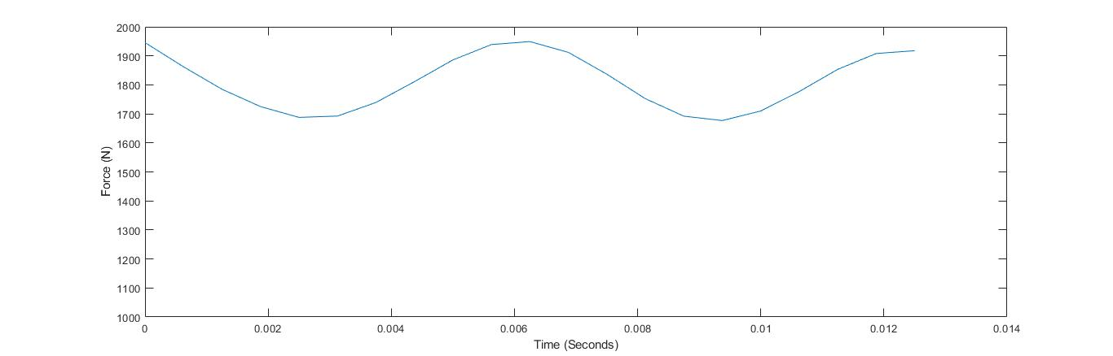
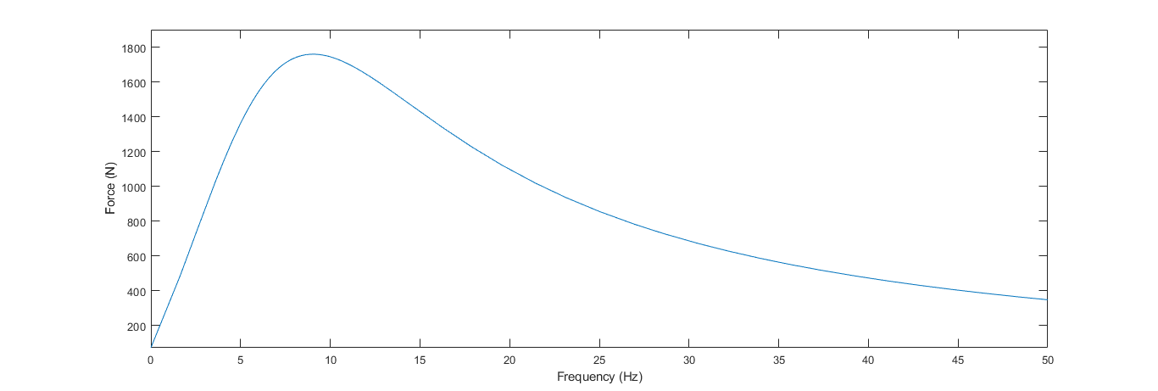
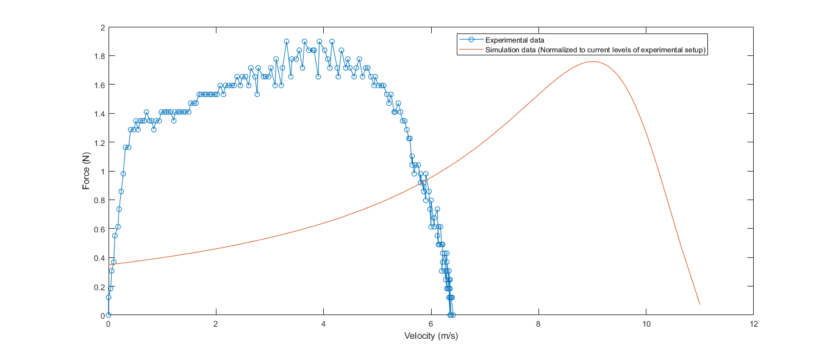
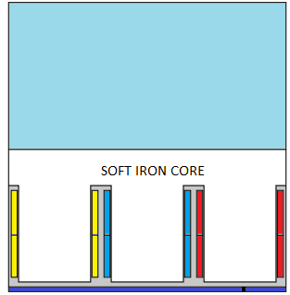

Design and Analysis of Double Sided Linear Induction Motor(DSLIM) for a Scaled Hyperloop Pod
Jay Prakash¹, Aswini Manoharan¹ , Gandharva Appagere¹ , Aravind S Kumar¹ , Vivek Anand¹
1. KTH Royal Institute of Technology, Stockholm, 11428, Sweden
INRODUCTION: The goal is to design a Double Sided Linear Induction Motor (DSLIM) to propel a scaled Hyperloop pod up to 100 m/s. It comprises of modeling the stator core, coils and the secondary I-beam.
RESULTS: The net force on I-beam is evaluated at different combination of frequencies and velocities. The results are illustrated in the figures [3] and [4]. The force of attraction between the primary cores on each side is calculated. Further to be able to employ control algorithms, lumped impedances were deduced under locked rotor and no-load conditions.
Figure 1. Single pole of Double Sided LIM along with the I-beam
Figure 3. Transient analysis of 3D model demonstrating the force ripple
COMPUTATIONAL METHODS: The Rotating Machinery Magnetic (rmm) interface from AC/DC module is used to model the 2D equivalent of the DSLIM. Further a 3D model was built in Magnetic fields interface to accurately represent the problem. The following equations were solved for:
Vector potential formulation
∇×𝐻=𝐽
𝐵=∇×𝐴
𝐸=−𝜕𝐴/𝜕𝑡
Scalar potential formulation
∇.𝐵=0
Further, the performance was evaluated under the non-linear constitutive relation for Magnetic field as follows:
Figure 4. Average force at different frequency at a zero velocity
CONCLUSIONS: The goal was to validate the characteristic curve of DSLIM and use the simulation setup to deduce design parameters satisfying performance requirements. Further the profile from simulation is validated against experimental data on a prototype. The comparison is presented in figure [5].
$$B=f(\left|H\right|)\frac{H}{|H|}$$
Anti-periodic BC
Figure 2. Comparison of simulation and experimental data
Coils
Future work comprises of further optimization over several design parameters utilizing cluster computing feature. To integrate MATLAB® LiveLinkTM to supply modulated signals and study the effect of harmonics on the performance.
PMC
Figure 2. Elements in the simulation setup and the boundary conditions
REFERENCES:
I. Boldea, S. A. Nasar, The Induction Machine Design Handbook
MATLAB is a registered trademark of Mathworks Inc.
LiveLink is a trademark of COMSOL AB.

