Slide 1


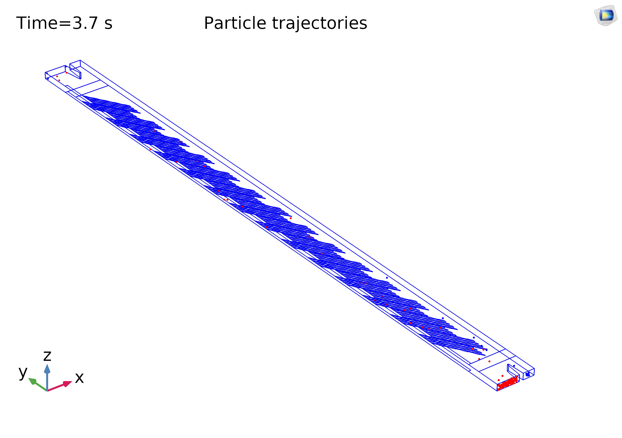
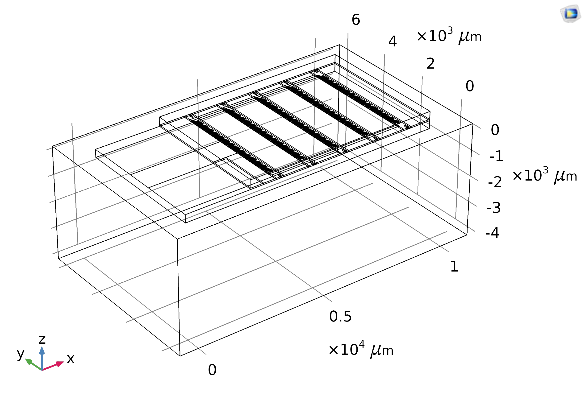
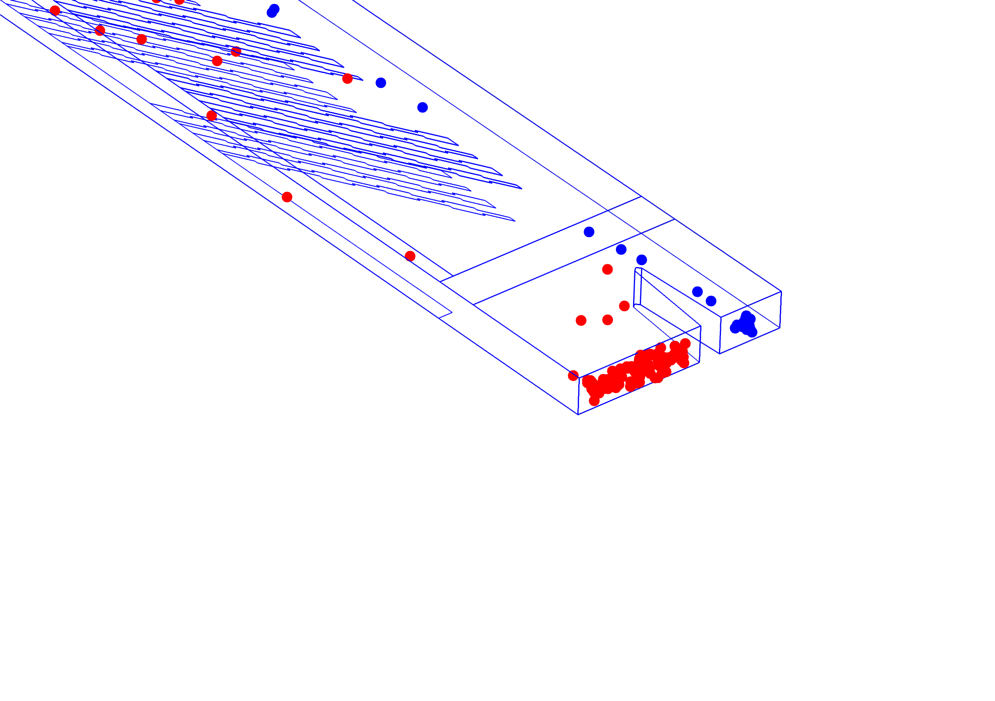
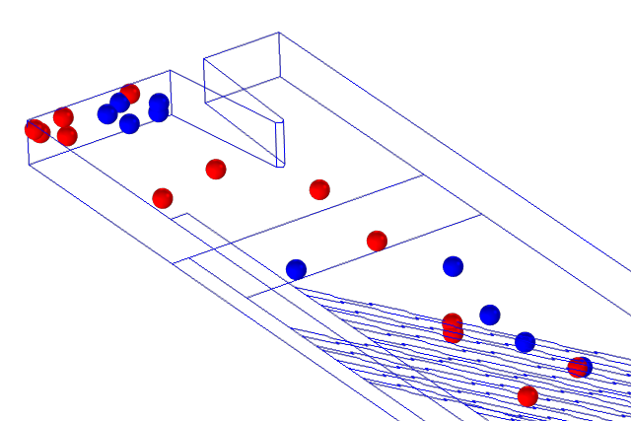
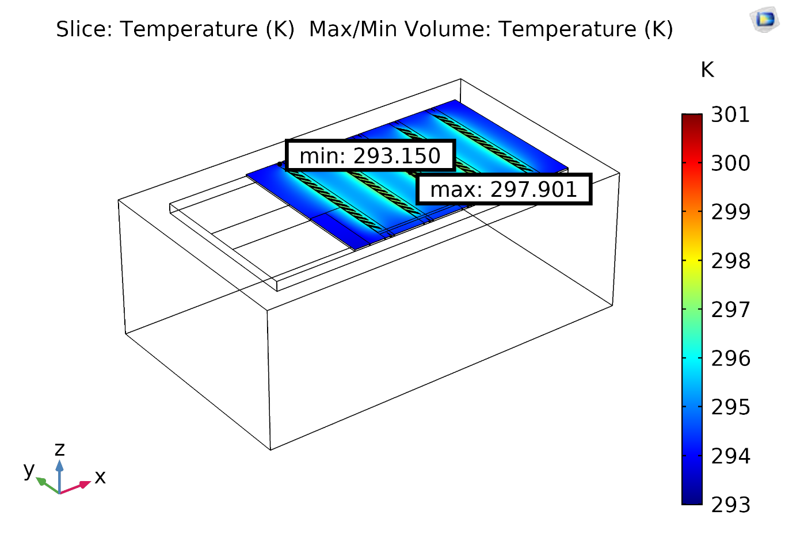
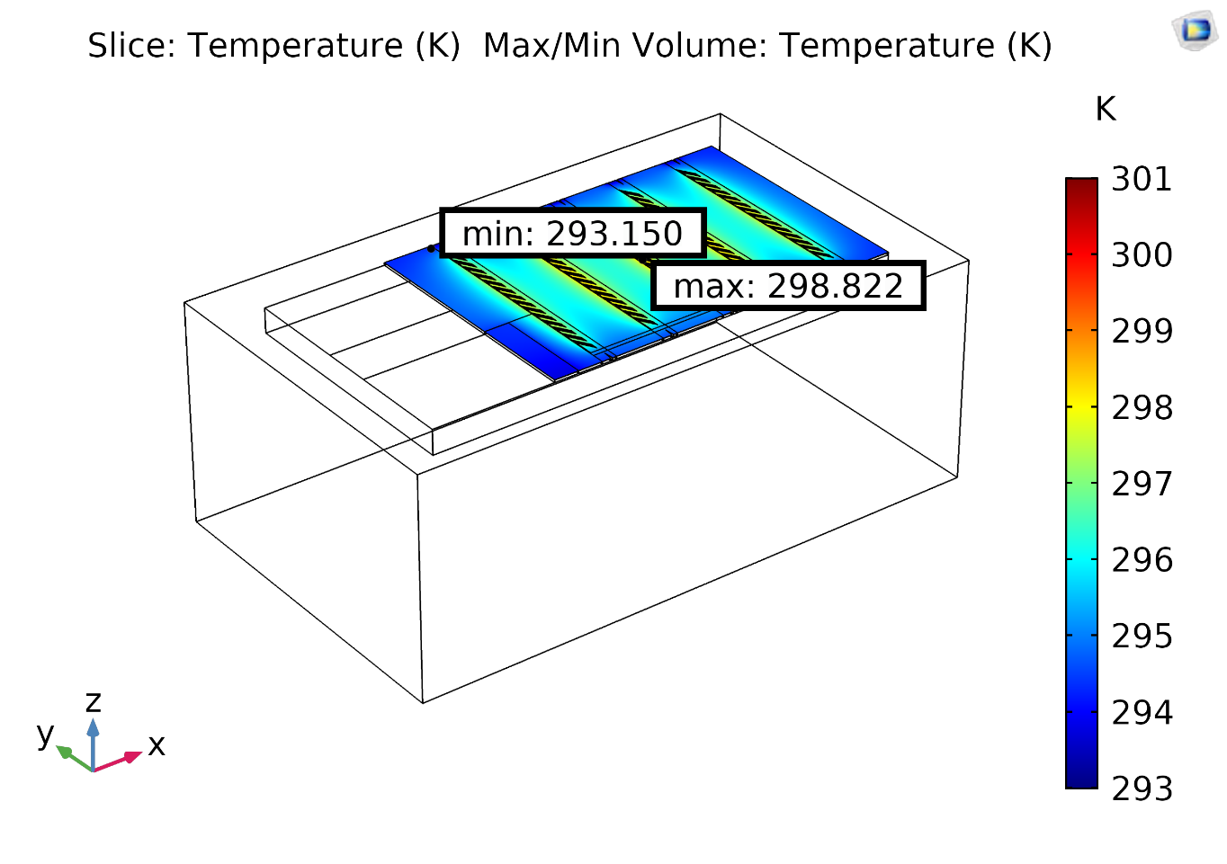
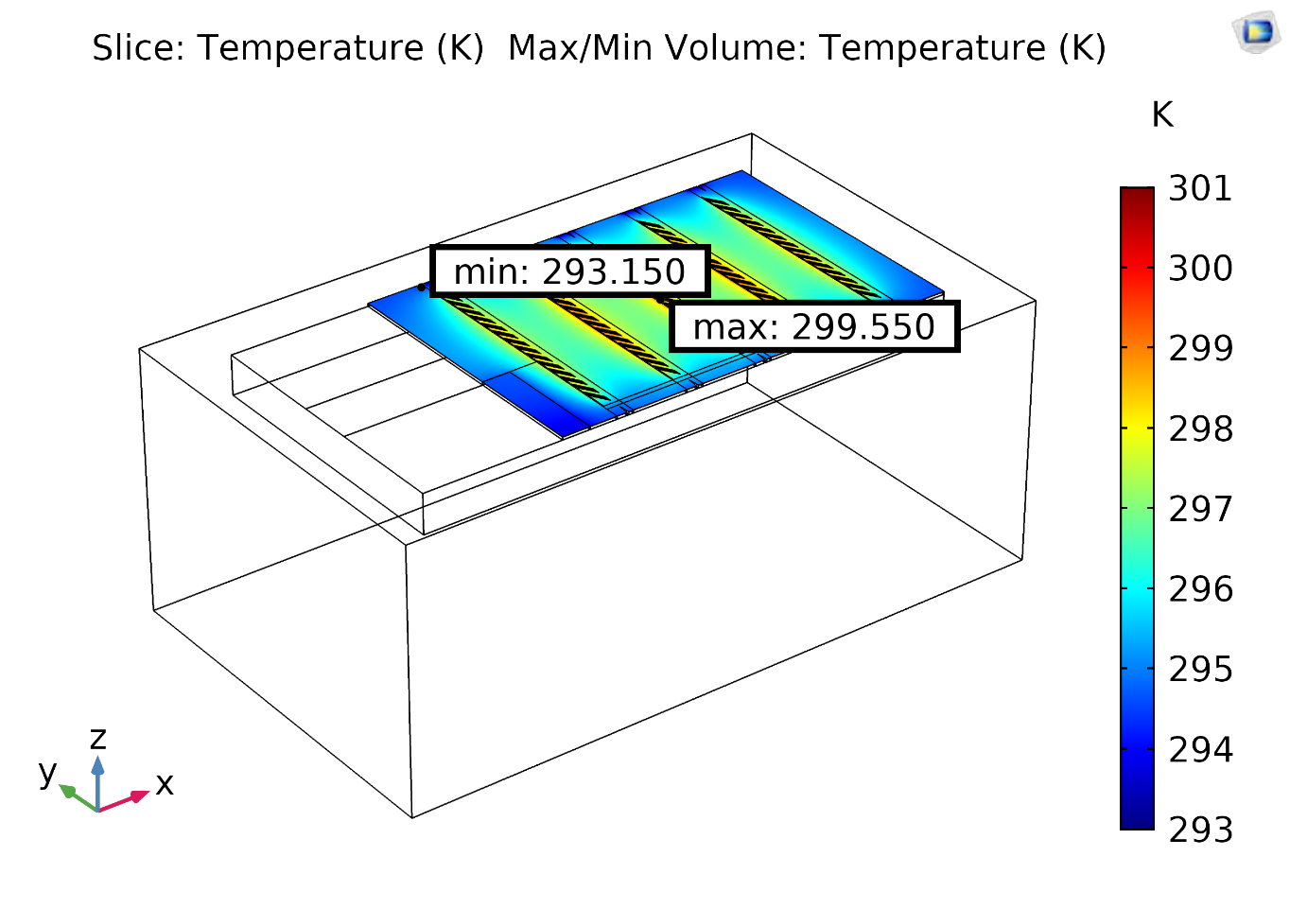
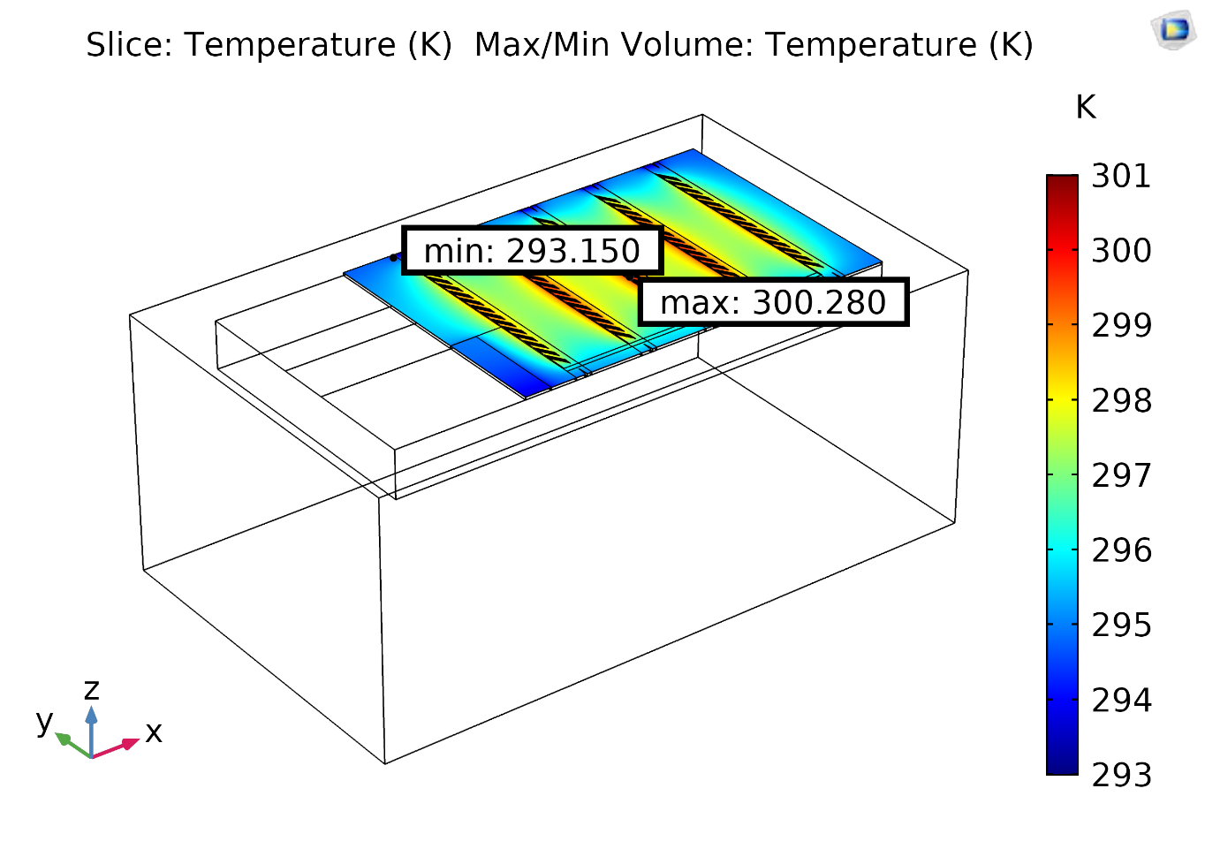
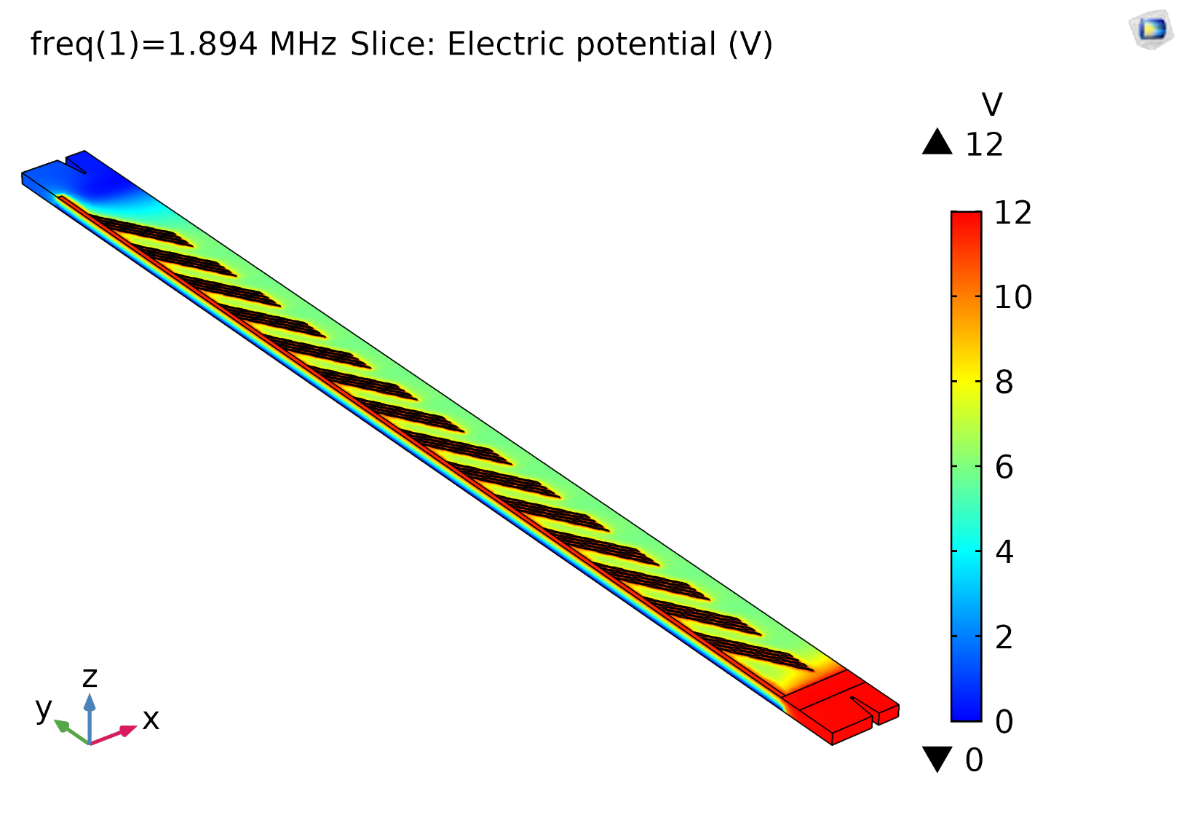
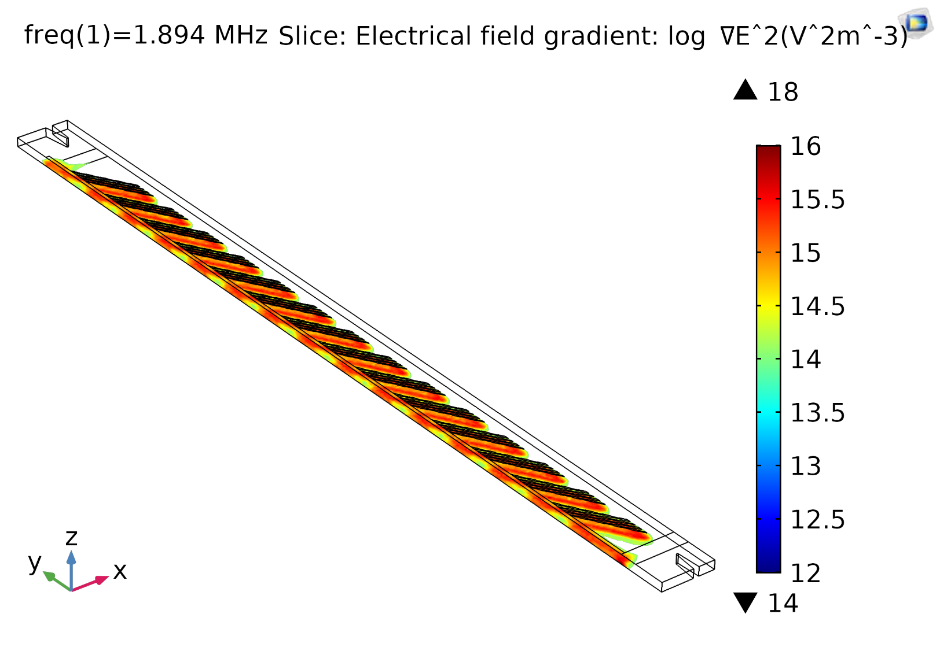
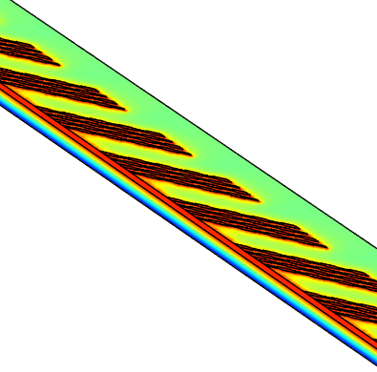


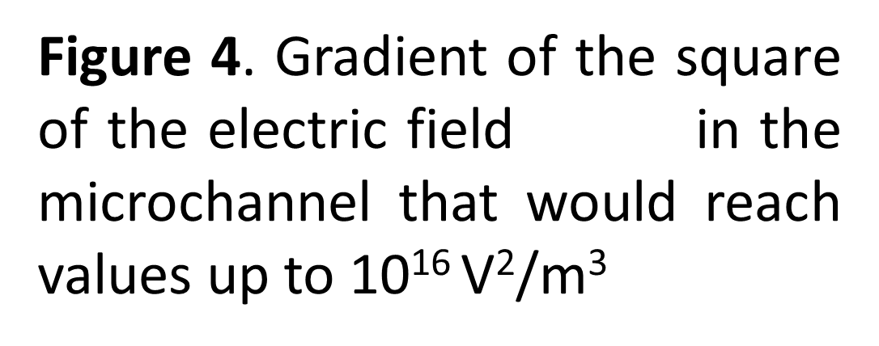
Microalgae Cell Separation and Concentration in a
Microfluidic Channel under Dielectrophoresis (DEP) Effect
A.Barai¹, N. Boldt², M. Birkholz¹
¹IHP – Leibniz-Institut für innovative Mikroelektronik, 15236 Frankfurt (Oder), Germany
²Fachgebit Sensorik und Aktorik, Technische Universität Berlin, Germany
INRODUCTION: Dielectrophoresis (DEP) is a promising technology for cell separation and sorting of microalgae. In this work, DEP is used in the cell separation of Chlamydomonas reinhardtii (a microalga that is useful in the production of biofuel) based on their lipid content inside a microfluidic setup. COMSOL Multiphysics is used to determine the correct process parameters and the temperature & elec. current distribution inside a microfluidic setup.
RESULTS: Successful cell separation of C.reinhardtii at 12 Vpp AC-DEP voltage (fig. 3), 1.894 MHz freq. and 3 µL/min mass flow rate (fig. 5). Moreover, a strong gradient of the square of the electric field led to an impactful DEP force strength up to 10¹⁶ V²/m³ (fig.4).
To achieve high throughput, parallel microchannel were designed as a gap structure between PDMS sheets with electrode arrays on top and bottom by silica glass substrate and copper heat sink on the bottom (fig.1-2). The temperature difference was simulated using parametric sweep (i.e. 0.3-0.2-0.9 mm and 4.3-0.2-4.9 mm thickness (th) for substrate and heat sink correspondingly) which is shown in fig. 6-9.
Figure 5. The Relation in between increasing Mass flow rate (µL/min) and efficiency of the particle Separation (in percentage)
Inlets
Outlets
Figure 1. Cell separation of C. Reinhardtii in a microchannel using DEP technology. Red and blue cells represent C. Reinhardtii with low and high lipid content respectively.
Figure 2. A microfluidic setup (11.8 mm wide, 5mm long, 4.3 mm high) with 5 parallel microchannel with 56 pairs of electrodes on top and bottom substrate (300 µm thick).
COMPUTATIONAL METHODS:
Microfluidic particle simulation (MPS): To find the right set of process parameters (AC-DEP voltage, frequency, mass flow rate).
Electro-thermal simulation (ETS): To observe the thermal distribution inside the setup.
Physics modules used: Electric current (ec), laminar flow (spf), particle tracing for fluid flow (fpt) (with drag and DEP force), heat transfer in liquid (ht)
Governing equation for DEP force (FDEP):
Figure 6. Substrates: 0.3 mm th
Heat sink: 4.3 mm th
Temp. difference: 4.7 K
Figure 7. Substrates: 0.5 mm th
Heat sink: 4.5 mm th
Temp. difference: 5.7 K
Figure 8. Substrates: 0.7 mm th
Heat sink: 4.7 mm th
Temp. difference: 6.4 K
Figure 9. Substrates: 0.9 mm th
Heat sink: 4.9 mm th
Temp. difference: 7.1 K
CONCLUSIONS: Physical parameters of microalgae cell body, Clausius-Mossotti function, thermally stable electrode geometry (shape, size, position), AC-DEP voltage amplitude, frequency, and mass flow rate leads to strong and DEP effect in cell separation.
Figure 4. Gradient of the square of the electric field in the microchannel that would reach values up to 10¹⁶ V²/m³
REFERENCES:
R. R. Pethig, Dielectrophoresis: Theory, methodology and biological applications. John Wiley & Sons, 2017.
H. A. Pohl und K. Kaler, „Continuous dielectrophoretic separation of cell mixtures“, Cell Biophys., Bd. 1, Nr. 1, S. 15–28, 1979.
F. Gringel, V. Abt, P. Neubauer, und M. Birkholz, „Numerical analysis of dielectrophoresis for separation of microalgae“, DPG-Frühjahrstagung, Berlin 2018.
Figure 3. Electric potential between the top and bottom electrodes at 12 Vpp and 1.894 MHz frequency
ACKNOWLEDGEMENT: This work was supported by the German Federal Ministry for Education and Research (BMBF) within the funding program „Neue Produkte für die Bioökonomie“ as part of the „National research strategy bio-economy 2030“ administered by ptj Projektträger Jülich, funding number 031B0381.

