Slide 1
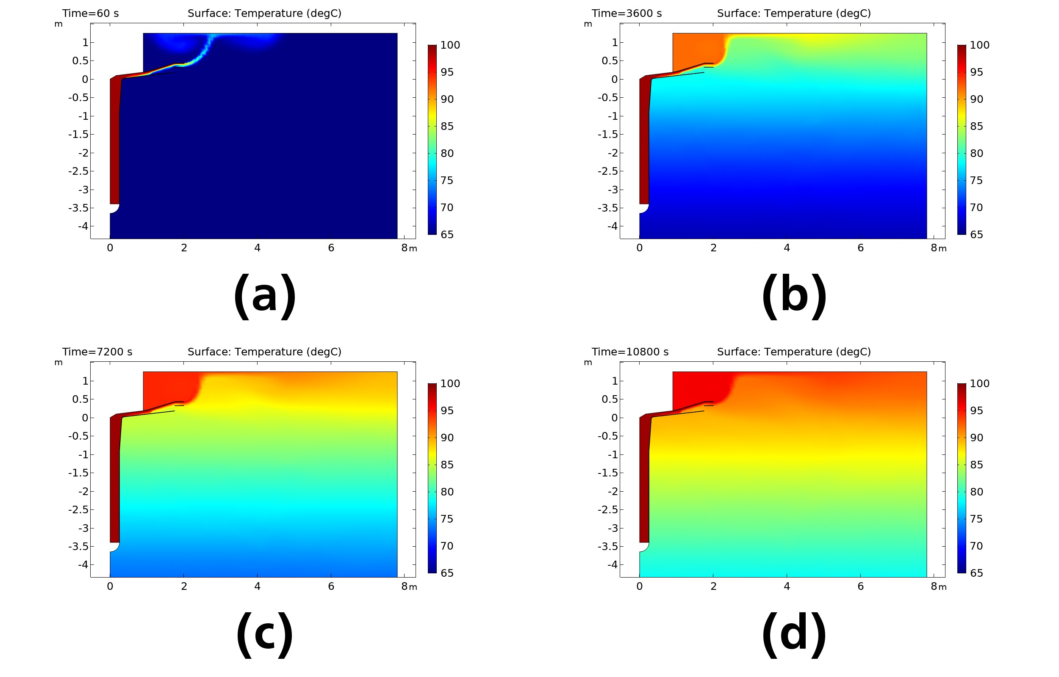
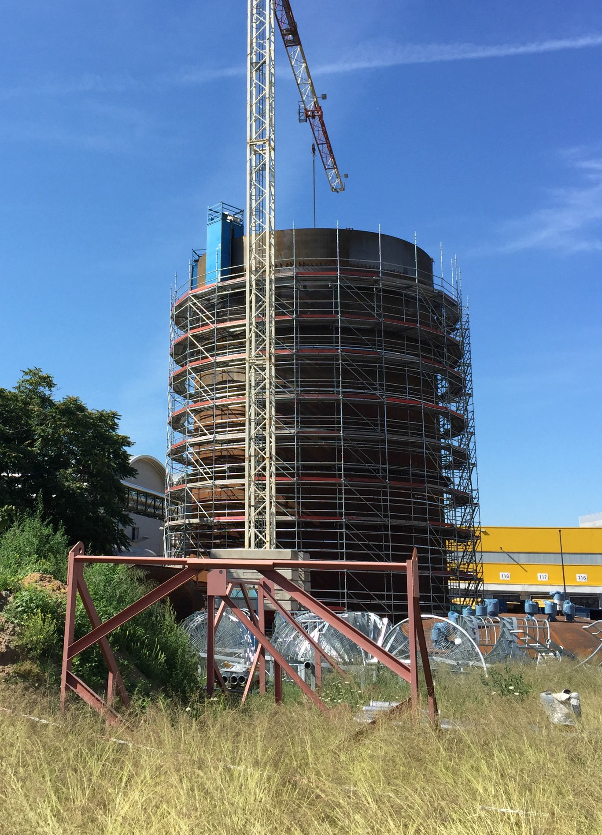
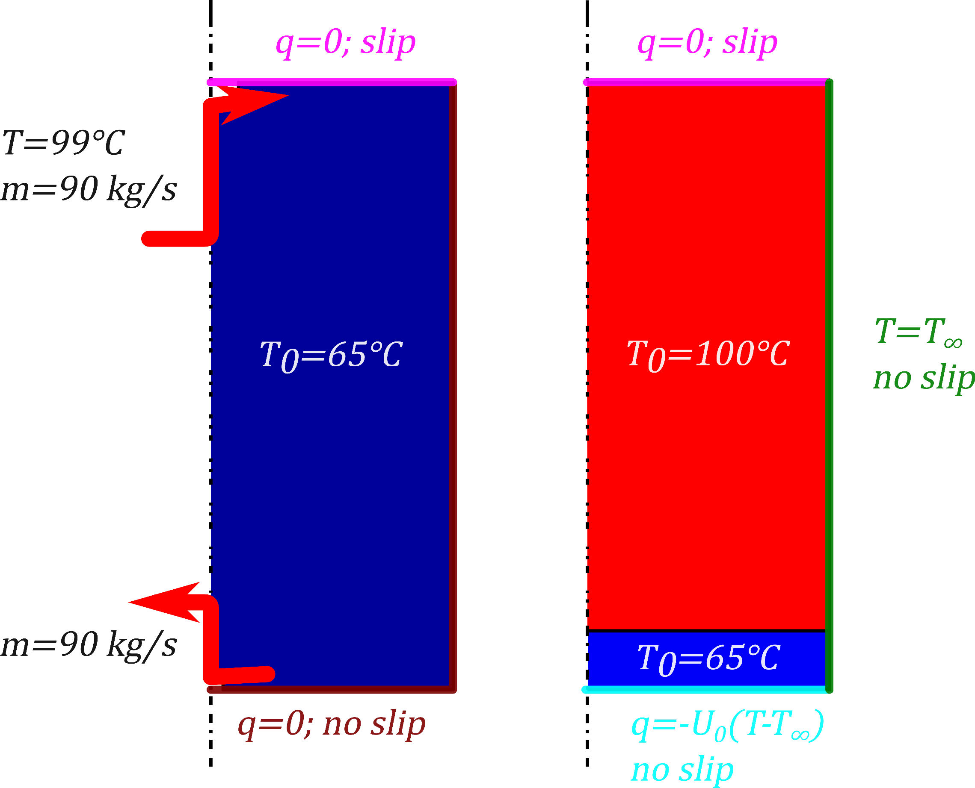



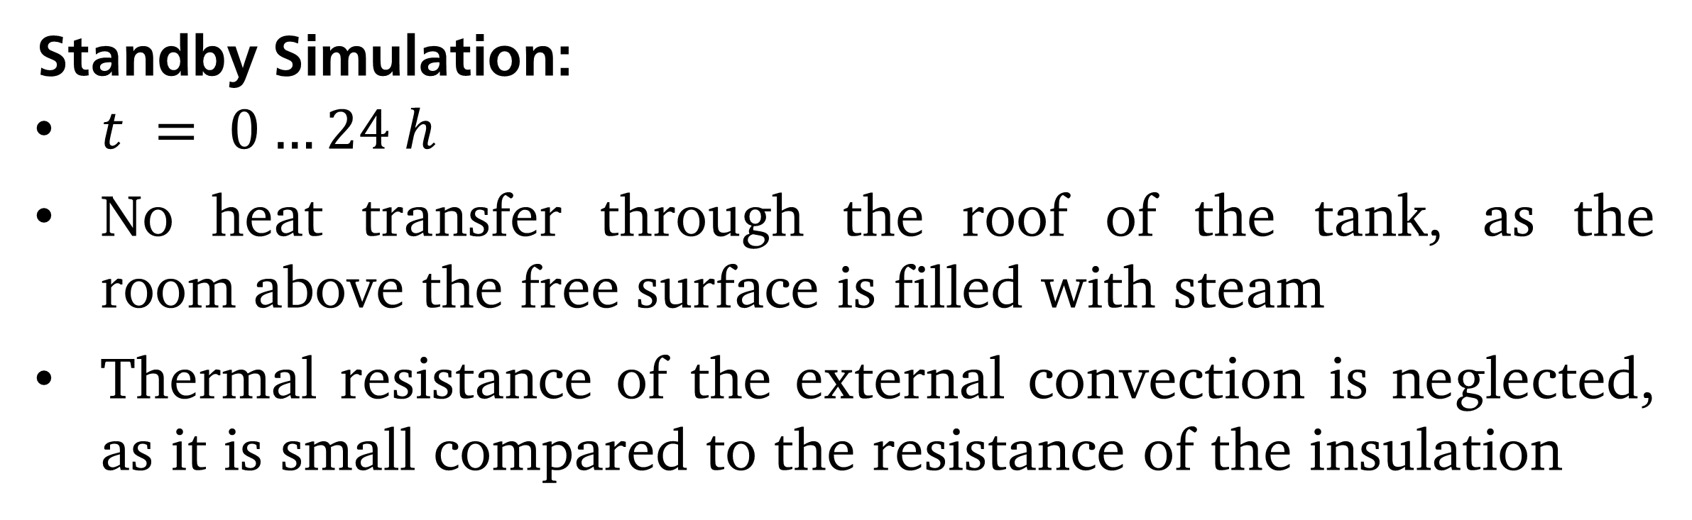
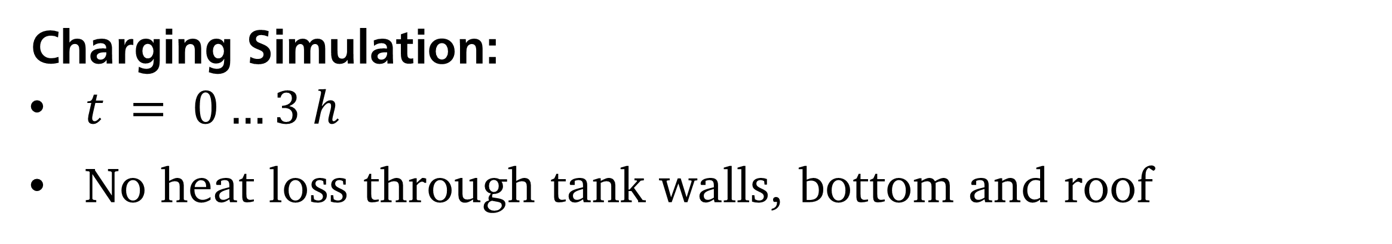

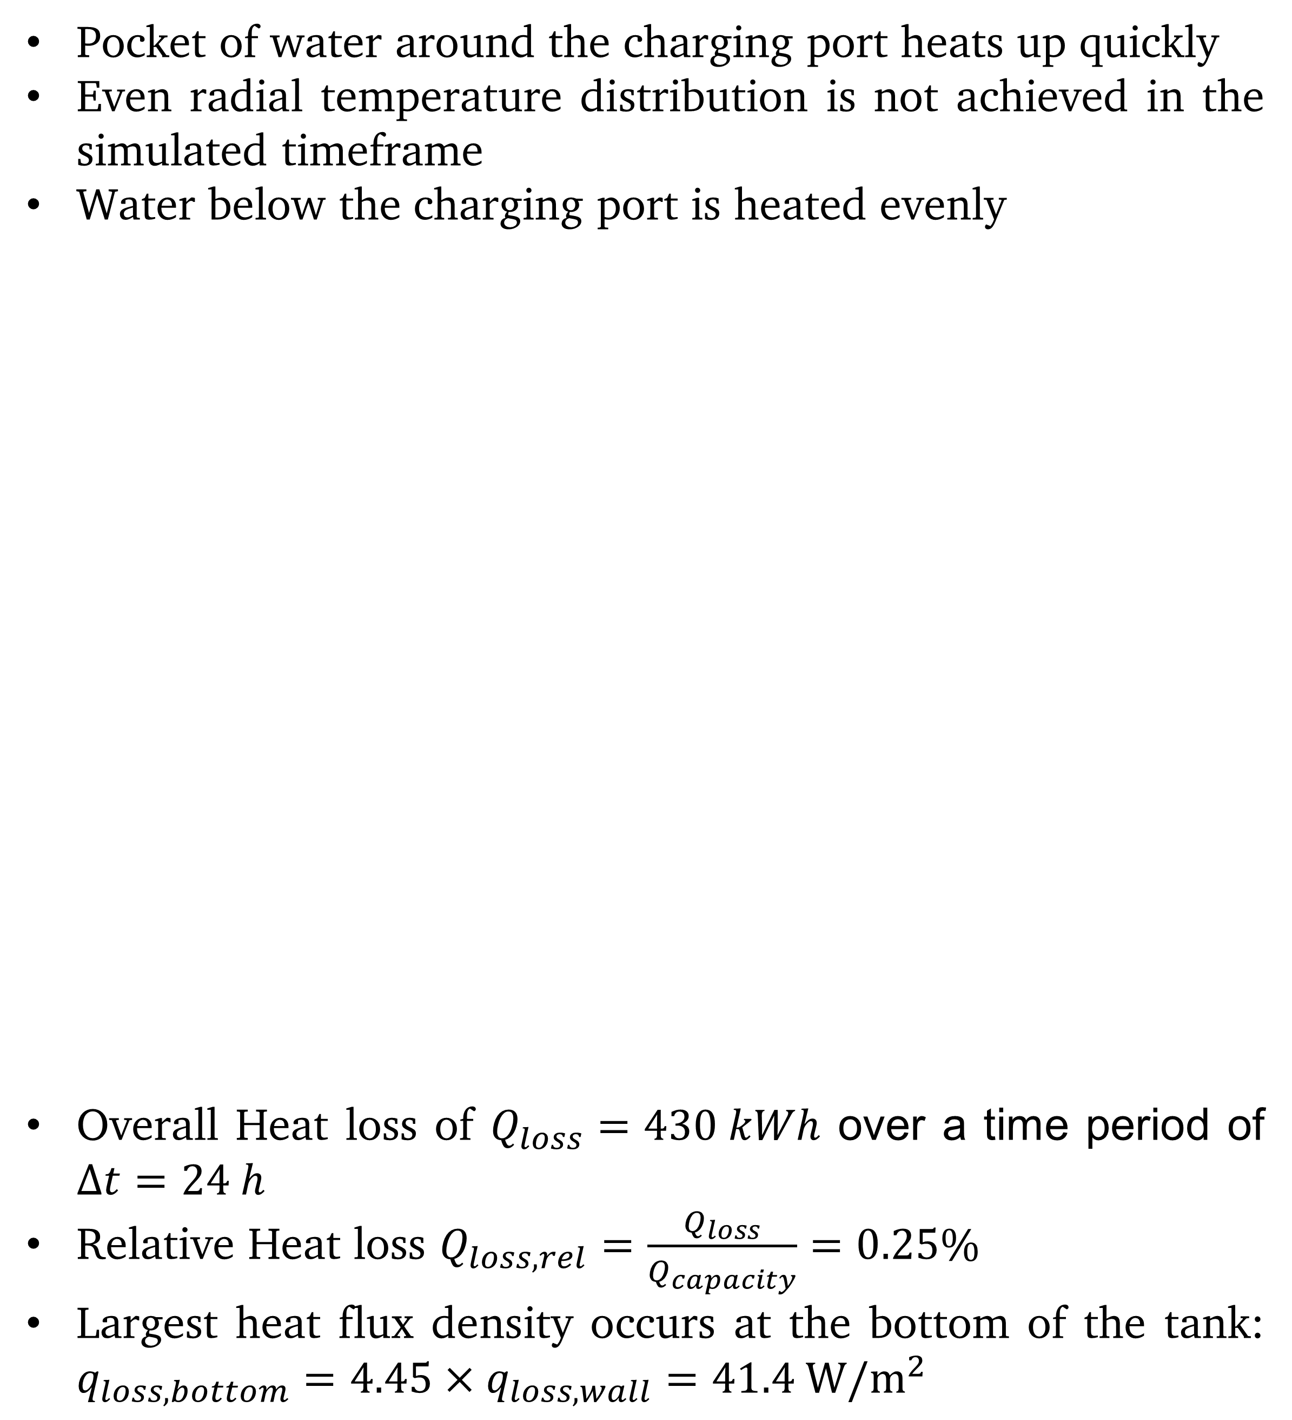
B. Krüger, F. Dammel, P. Stephan
High-Resolution CFD Modeling of a Large-Scale Short-Term Thermal Energy Storage Unit
Introduction
Results
Short-term thermal storage systems reduce the primary energy use and CO2 emissions^{[1]}
Small scale thermal storage systems have been the subject of many research endeavours^{[2]}
This work focuses on the following aspects during the charging and standby phases of a large scale short-term thermal storage system:
Turbulent mixing during charging (charging)
Heat loss through the walls of the tank (standby)
Pocket of water around the charging port heats up quickly
Even radial temperature distribution is not achieved in the simulated timeframe
Water below the charging port is heated evenly
Overall Heat loss of $Q_{loss}=430 kWh$ over a time period of $∆t=24 h$
Relative Heat loss $Q_{loss,rel}=\frac{Q_{loss}}{Q_{capacity}}=0.25\%$
Largest heat flux density occurs at the bottom of the tank: $q_{loss,bottom}=4.45×q_{loss,wall}=41.4 W/m^{2}$
Fig. 3: Temperature distribution around the charging port at
$t = 60 s$(a), $t = 1 h$(b), $t = 2 h$(c) and $t = 3 h$(d).
Fig. 1: Storage unit under construction.
Computational Methods
Charging and Standby phases studied independently
Storage design corresponding to storage system under con- struction by ENTEGA AG (Figure 1)
Nonisothermal Flow using v2f turbulence model
Conclusions
Charging Simulation:
$t = 0…3 h$
No heat loss through tank walls, bottom and roof
Significant mixing at the beginning of the charging process
Exergy losses
Much less mixing later on
Small impact on overall storage efficiency over charge- discharge cycle
In the future, the overall storage efficiency over a charge- discharge cycle will be examined and these results will be vali- dated using data obtained through temperature measurements of the storage unit constructed by ENTEGA AG.
Standby Simulation:
$t = 0…24 h$
No heat transfer through the roof of the tank, as the room above the free surface is filled with steam
Thermal resistance of the external convection is neglected, as it is small compared to the resistance of the insulation
References
[1] Verda, Vittorio; Colella Francesco, Primary energy savings through thermal storage in district heating networks, Energy, 36, 4278- 4286 (2011)
[2] Fertahi, Saïf ed-Din; Jamil, A.; Benbassou, A., Review on Solar Thermal Stratified Storage Tanks (STSST): Insight on stratifica- tion studies and efficiency indicators, Solar Energy, 176, 126-145, (2018)
Fig. 2: Computational Domain and Boundary Conditions.
krueger@ttd.tu-darmstadt.de
Institut für Technische Thermodynamik Technische Universität Darmstadt
Excerpt from the Proceedings of the 2019 COMSOL Conference in Cambridge

