Slide 1

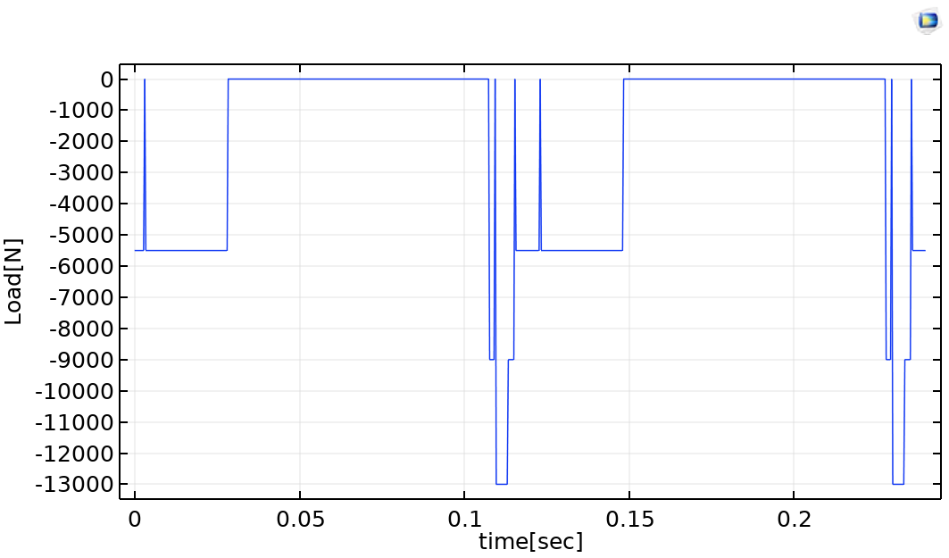
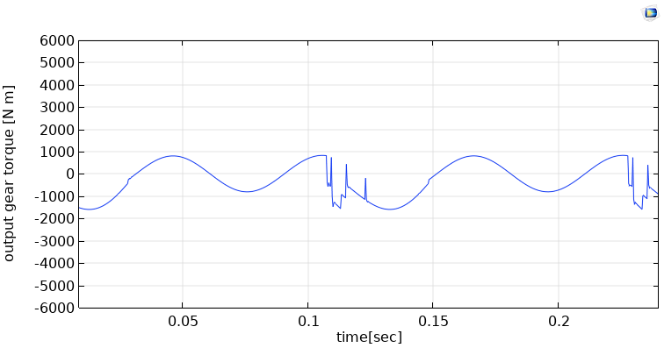
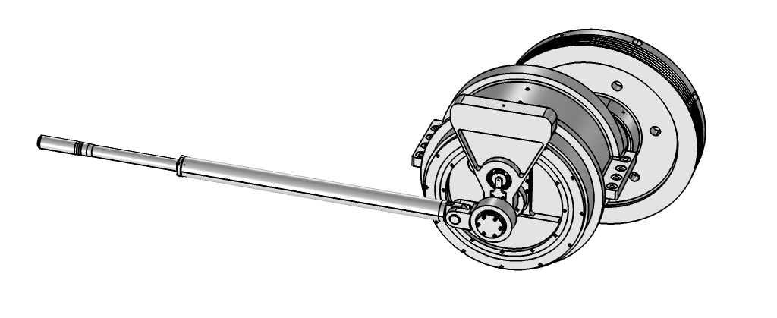
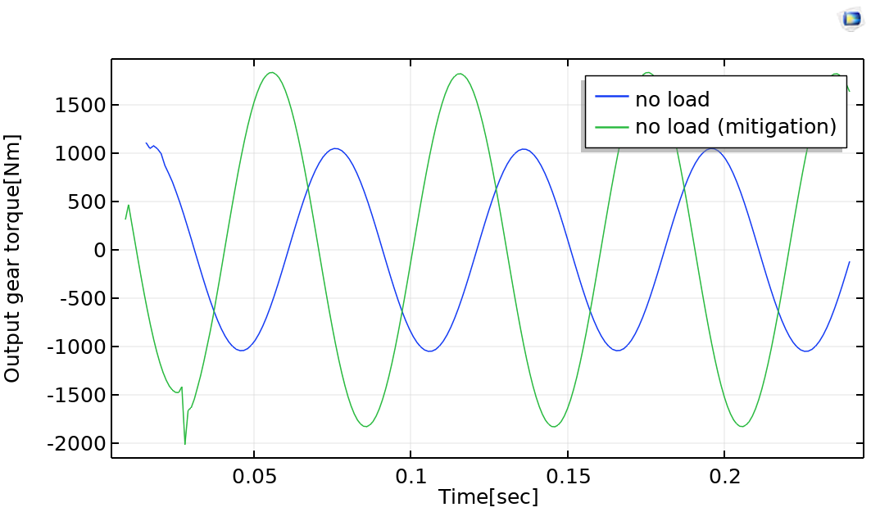
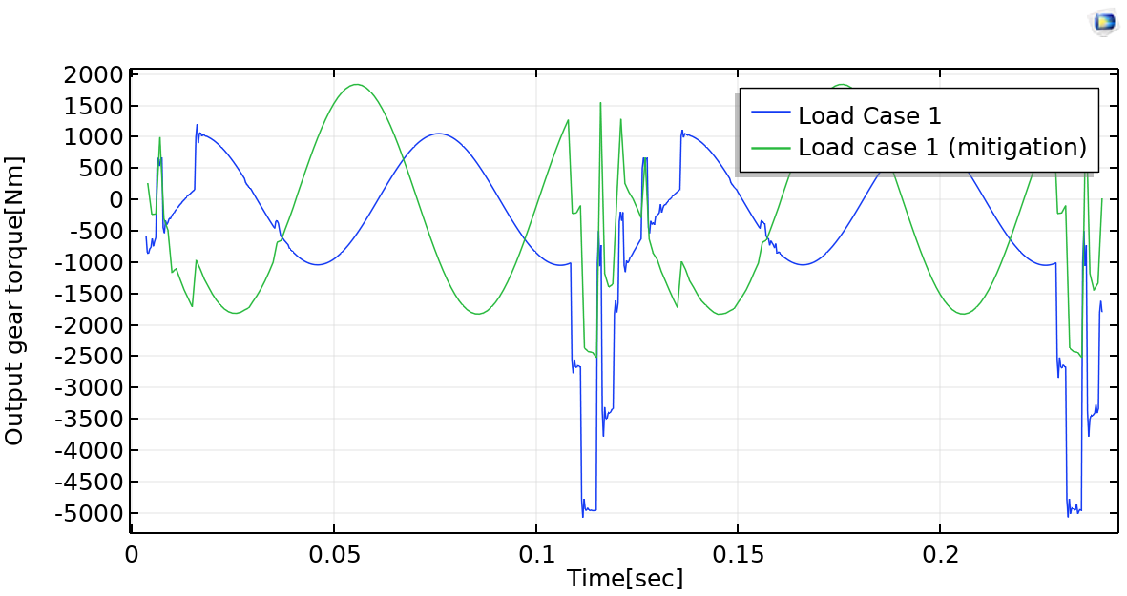
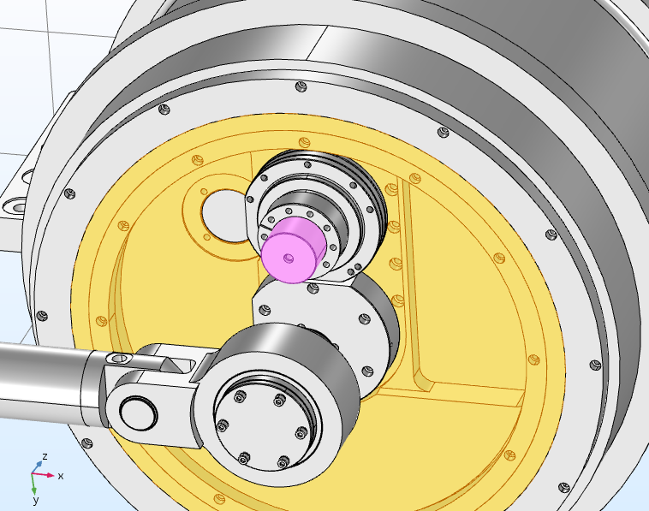
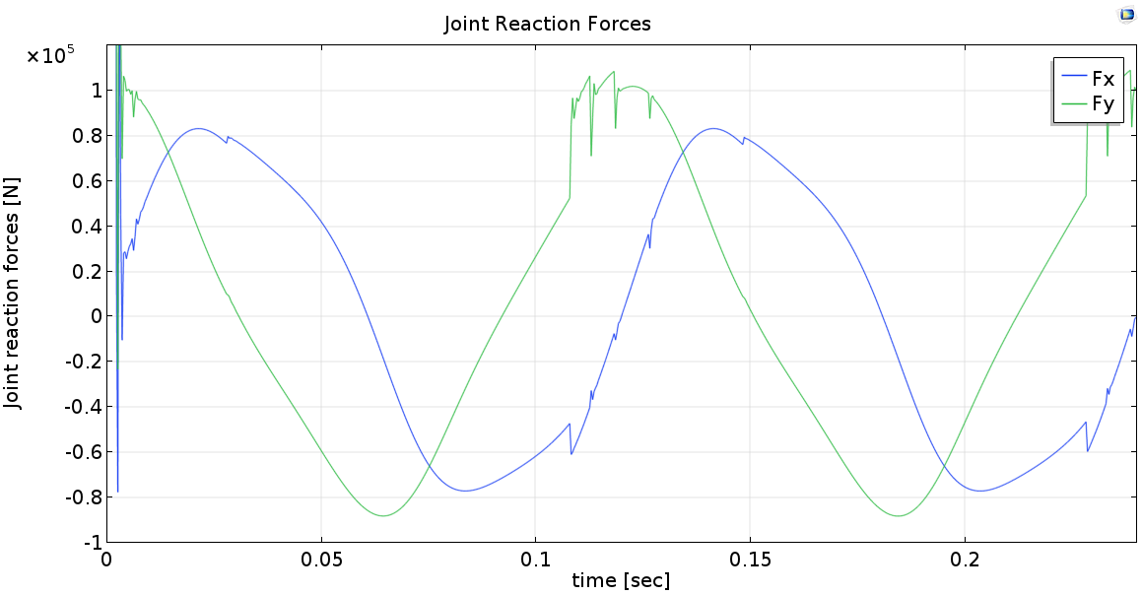
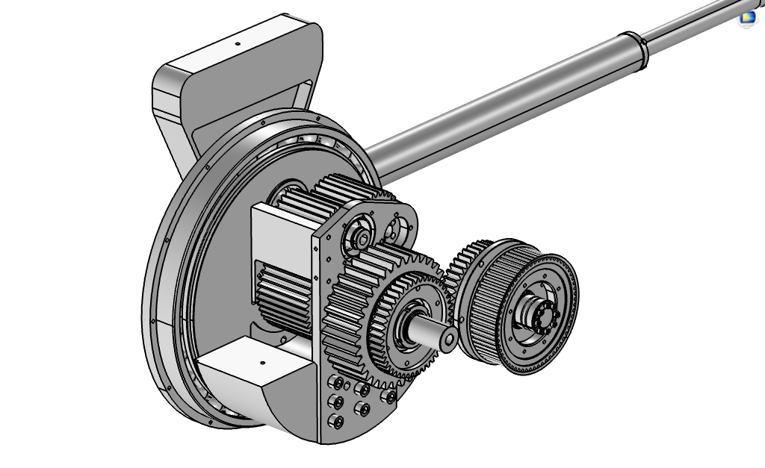


Multibody Dynamics Analysis of a High Speed Metal Forming Press
G. Michailidis¹, S. Afazov², A. Matamoros³
The Manufacturing Technology Centre, Physics Modelling, Coventry, West Midlands, CV7 9JU, UK
The Manufacturing Technology Centre, Physics Modelling, Coventry, West Midlands, CV7 9JU, UK
The Manufacturing Technology Centre, Controls and Connectivity, Coventry, West Midlands, CV7 9JU, UK
INTRODUCTION
RESULTS
COMSOL Multiphysics® Multibody Dynamics Module was used to analyze the performance of a high-speed metal forming press consisting of multiple processes for preform of aluminum blanks. The objective was to redesign the drive mechanism of the press, changing from a 4 bar linkage mechanism to a hypocycloidal gear system. The MBD analysis aimed to extract the torques generated on the machine gears in order to use them for detailed stress and fatigue analyses.
Different load cases required for the forming of the aluminum blanks were investigated in order to establish the levels of the generated gear torques.
Figure 3. Typical process load case
Figure 4. Generated torque in the output gear
MBD analysis was also used in order to understand whether it is feasible to reduce gear torques. A sensitivity analyses on critical parts of the machine was performed in order to establish the effect of the centre of gravity and weight on the levels of torques.
Figure 1. High Speed Metal Forming Press geometry
COMPUTATIONAL METHODS
Figure 5. No load output gear torque
Figure 6. Load case 1 output gear torque
COMSOL Multiphysics® Multibody Dynamics Module was used to describe the physics of the problem. Gears were modeled as rigid bodies using the spur gear domain and assigning number of teeth, pitch diameter and pressure angle.
The connections between the different mechanism parts were established through the use of Joints from the Multibody dynamics interface. The connections between the gears were defined through the use of Gear Pairs.
An investigation on the joint reaction forces of the output gear shaft was also conducted in order to understand the magnitude of the forces that the output shaft bearings will experience.
Figure 7. Output gear joint
Figure 8. Output gear joint reaction forces
CONCLUSIONS
The MBD model predicted gear torques for different load case scenarios which were used for detailed stress and fatigue calculations.
Through the use of the MBD model a design change in a critical component was recommended in order to reduce the magnitude of the generated gear torques.
Output gear shaft experienced high loads, it was recommended special consideration during the bearing selection to account for the high loads.
Figure 2. Hypocycloidal gear system
REFERENCES:
T. Lisle, D4.1-Review of Gearbox design, 2019
Excerpt from the Proceedings of the 2019 COMSOL Conference in Cambridge

